Slide 1
MARC Holdings Format
Webinar
presented by
Lynnette Fields
Director of Technical Services
Southern Illinois University Edwardsville
lfields@siue.edu

Slide 2
Notes:
Good morning! Just in case you’re curious, this in me in my office, preparing for this webinar.

Slide 3
Goals
Webinar is…
A basic introduction to MARC 21 Format for Holdings Data
structure of the MARC holdings record
description of fields (data elements)
A brief review of display of records in online library systems
Webinar is not…
An introduction to MARC format for authority or bibliographic data
An introduction to cataloging or descriptive cataloging standards (RDA: Resource Description and Access, etc.)
A detailed step-by-step procedure on how to create MARC holdings records

Slide 4
Why use standards?
Enables libraries to use commercially available or open source library automation data to manage library operations
Allow libraries to replace one system with another knowing that the data will be compatible
Notes:
Most libraries will migrate to a new system every 5-10 years. Having standardized holdings data makes the migrations much easier.

Slide 5
Definition
A MARC record is a MAchine-Readable Cataloging record.
Machine-readable means that one particular type of machine, a computer can read and interpret the data in the record.
Notes:
It’s always good to start with a definition.

Slide 6
Types of MARC records
Cataloging records come in three types:
Bibliographic
Authority
Holdings
Notes:
Bibliographic records contain information describing a book, serial, sound recording, etc .
Authority records contain standardized forms for names, titles and subjects that are used in bibliographic records and provide cross references in catalogs
Holdings records contain the holdings information – what copies are owned and where they are held – for physical and electronic forms
We’ll be focusing on holdings records today

Slide 7
MARC Holdings Records (MFHD)
Holdings records are dependent on the associated bibliographic record, and must be linked to it or the holdings information must be embedded in the bibliographic record.
Notes:
You will sometimes see the abbreviation MFHD for MARC holdings records
Read the screen
Holdings records can not live on their own – they must be linked to a bib record

Slide 8
MARC Holdings records
Carrier for holdings information for three types of bibliographic items:
Single part item
Multipart item
Serial item
Notes:
Single-part item – item which is complete in a single physical part – a one volume book, a single map
Multipart item – item which is complete, or intended to be complete, in a finite number of separate physical parts, for example a three-volume book, a set of maps
Serial item – an items which is issued in successive parts at regular or irregular intervals and is intended to be continued indefinitely
We’re now going to take a quick look at an example of each of these types
All of the examples I’ll be using are from SIUE’s Voyager catalog

Slide 9
Single part item
From bib record
From holdings record
Notes:
This is the public display for a single part item in SIUE’s VuFind public interface
The information in the red box comes from the bibliographic record and the information in the blue box comes from the MARC holdings record.
We have one copy of this book in our regular book collection (stacks) and it is currently checked out.

Slide 10
Single part item
MARC Holdings record
Public display that results from MARC Holdings record
Notes:
This is the Voyager holdings record that produces the holdings in the public display.
Don’t worry about the MARC record too much right now. After we look at the three types, we’re going to going over in detail all the components of the MARC record for each of the three types

Slide 11
Multipart item
Notes:
This is the public display of a multi-part item
Note that this is a 2 volume set in the Reference collection and both volumes are currently on the shelf.

Slide 12
Multipart item
Notes:
This is the Voyager holdings record that results in the holdings in the public display.

Slide 13
Serial item
Notes:
This is the public display of a serial item
From the summary note you can see that we have vol. 33 and 35-39 in the journal collection and from the note you see that vol. 34 is housed in the Regional collection.

Slide 14
Serial item
Notes:
This is the Voyager holding record that results in the public display

Slide 15
MARC Holdings records
Can contain four basic pieces of information:
Location
Items held
Publication pattern
Notes
Notes:
Location – the institution that holds the item and the location within the institution where the item can be found, such as the call number or shelf location
Items held – For a single-part monograph, this is the number of copies; for a multipart monograph or a serial it is the number of copies and volumes and issues held
Publication pattern – For serials, the holdings record can indicate the expected publication dates and numbering for issues. This information enables a system to assist with check-in and to automatically claim missing issues
Notes – this part of the holdings record contains information about special attributes of a copy or conditions for its use

Slide 16
Components of the MARC Holdings Record
Leader and directory
Variable control fields
Variable data fields
Notes:
We’re going to take a look at each of these components for each of our three types of holdings records

Slide 17
Components of the MARC Holdings Record (MFHD)
Leader and directory
Provides information required for the processing of a record – identifies the type of holding record
Data elements contain numbers or coded values and are identified by relative character position
24 characters long and is the first field in the MARC holdings record
Notes:
The leader and directory is information for the computer.
The most important leader value is the type of record – single part, multipart or serial

Slide 18
Single part item - Leader
Character position 05
Character position 06
Character position 17
Character position counting begins with 0
Notes:
These are the 3 important leader values – record status, type of record and encoding level
Notice that when you look at the MARC record, the leader is a string of characters. The character positions are defined for the different values. An important thing to remember is that character position counting starts with 0 and not 1.
Record status could be – c for corrected or revised
d for deleted
n for new
For this record we have c for corrected or revised
Type of record could be – u for unknown
v for multipart item holdings
x for single-part item holdings
y for serial item holdings
For this record we have x for single part holdings
We’ll see an example of v and y next
Encoding level could be 1 – holding level 1
2 – holding level 2
3 – holding level 3
4 – holding level 4
5 – holding level 5 with piece designations
m – mixed level
u – unknown
z – other level
For this record we have 4 for Holding level 4 – Holding level 4 means the holdings statement is formulated according to level 4 of the applicable standard. See MARC standards for a detailed description of these.

Slide 19
Multipart item
Character position 05
Character position 06
Character position 17
Notes:
The only value that is different for the multipart item leader is Type of record – we have v for multipart item

Slide 20
Serial item - Leader
Character position 06
Character position 05
Character position 17
Notes:
For the serial item leader we have a y for serial item holdings in the Type of record

Slide 21
Components of the MARC Holdings Record (MFHD)
Variable control fields – 00X fields
Do not contain indicator positions or subfield codes
001 – Control number
003 – Control number identifier
004 – Control number for related bibliographic record
005 – Date and time of latest transaction
007 – Physical description fixed field
008 – Fixed-length data elements
Notes:
The next part of the holdings record I want to talk about is the variable control fields – the 00X fields
Read the slide

Slide 22
Single part item – Variable control fields
Voyager doesn’t display the: 001 (Control number),
003 (Control number identifier)
004 (control number for related bibliographic record
005 – Date and time of latest transaction – September 20, 2014, 09:39:21 a.m. (093921)
007 is blank because this is a print item

Slide 23
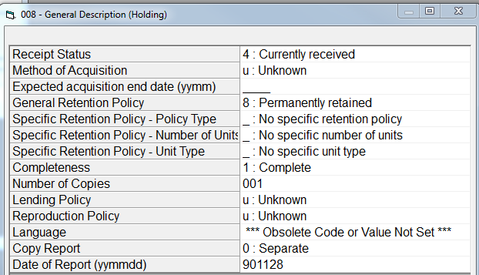
Single part item – Variable control fields - 008
Notes:
The 008 field is also referred to as Fixed-Length Data Elements.
It has 32 characters and all the information is in an abbreviated form.
This data is often used to identify and retrieve records matching specific criteria.

Slide 24
Multipart item - Variable control fields
007 not coded because this is a print item
Notes:
005 is the date and time of last transaction and the 007 is blank because this is a print item.

Slide 25
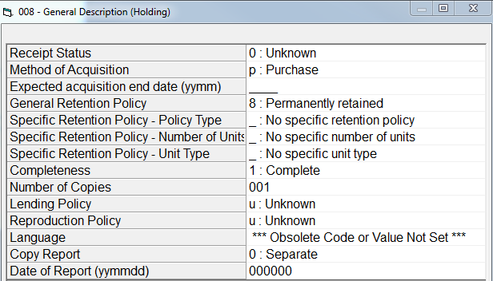
Multipart item - Variable control fields - 008

Slide 26
Serial item – Variable control fields
Notes:
As with the other two types of holdings records, the 005 is the date and time of last transaction and the 007 is blank because this is a print item.

Slide 27
Serial item – Variable control fields - 008

Slide 28
Components of the MARC Holdings Record
Variable data fields
Contain two indicator positions at the beginning of each field and subfield codes preceding each data element within the field
852 - Location
853 – Captions and Pattern – Basic Bibliographic Unit
856 – Electronic Location and Access
863 – Enumeration and Chronology – Basic Bibliographic Unit
866 – Textual Holdings – Basic Bibliographic Unit
Notes:
We’re only going to take a look at the most common variable fields, and we’ll do that by taking another look at our sample records
We will be looking field by field at just these selected fields
And, as with all variable fields in all MARC records, not all records with have all the variable fields –

Slide 29
852 – Location - Single part item
1st indicator – shelving scheme – 0 = Library of Congress classification
2nd indicator – shelving order - # = No information provided
$b – Sublocation or collection
$h – Classification part
$i – Item part
Notes:
For the 1st indicator there are values for the other classification schemes – 1=Dewey, 2=NLM, 3=SuDocs, etc.
2nd indicator has to do with serial and multipart items only
$h is for the main classification number
$i for the Cutter
Note that aastx translates to Book Collection in the OPAC

Slide 30
852 – Location - Multipart item
1st indicator – shelving scheme – 0 = Library of Congress classification
2nd indicator – shelving order - # = No information provided
$b – Sublocation or collection
$h – Classification part
$i – Item part
Notes:
Note that aref translates to Reference Book Collection in the OPAC

Slide 31
852 – Location -Serial item
1st indicator – shelving scheme – 5 = Title
2nd indicator – shelving order - # = No information provided
$b – Sublocation or collection
$l – Shelving form of title
$z – Public note
Notes:
We do not classify journals, so the location in the 852 does not have a class number.
The first indicator tells us that we are arranging these by title and not a classification se
The $b jour translates to Journal Collection
The $l – shelving form of title is the title we are using to alphabetize the journals – occasionally this it different than the title proper – this translates in the OPAC to Shelved by Title:
The $z are public notes that we want to display in the OPAC

Slide 32
856 – Electronic Location and Access – Single item
1st indicator – Access method – 4 = HTTP
2nd indicator – Relationship - 0 = Resource
$z – Public note
$u – Uniform Resource Identifier
Notes:
This is a new example because I wanted to show you a holdings record with an 856.
The 856 allows access to an electronic resource from the holdings record.

Slide 33
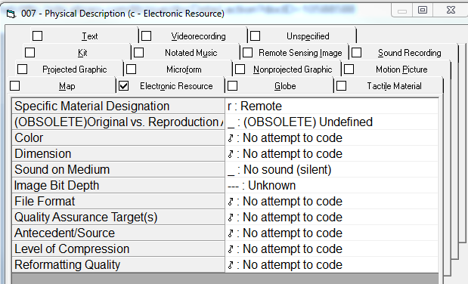
856 – Electronic Location and Access – Single item
Notes:
Note that because this is a non-print item, the 007 is filled out – even though most of it is “no attempt to code” – the important subfield is the smd.

Slide 34
853 – Captions and patterns - Multipart item
1st indicator – Compressibility and expandability – 2 = Can compress or expand
2nd indicator – Caption evaluation - 0 = Captions verified; all levels present
$8 – Field link and sequence number
$a – First level of enumeration
$t – copy
Notes:
The 853 describes the language and pattern that will display in the OPAC.
It works in conjunction with the 863 field
Read the box
The 853 does not display itself in the OPAC, but the $a and $t are responsible for the v. and c. showing up in the OPAC

Slide 35
863 – Enumeration and chronology - Multipart item
1st indicator – Field encoding level – 4=Holdings level 4
2nd indicator – Form of holdings – 1=uncompressed
$8 – Field link and sequence number – [linking number].[sequence number]
$a – First level of enumeration
$t – copy
Notes:
1st indicator – Holdings level 4 means there is detailed enumeration and chronology information – that means you have a 853 field that tell you what the display will look like and the 863 has the enumeration information
2nd indicator – Form of holdings – compressed (in a summarized form) or uncompressed (expressed in itemized form) – 1 = uncompressed
$8 – first part of the number is the linking number – then the period – then the sequence number
The 1s link the two 863 fields together, and the 10 and 20 put them in order
In the display, the v. comes from the 853 field and the 1 and 2 come from the 863

Slide 36
866 – Textual Holdings – General Information
1st indicator – Field encoding level – 3 – Holdings level 3
2nd indicator – Type of notation – 0 – Non-standard
$8 – Field link and sequence number –
$a – First level of enumeration
Notes:
We use a summary holdings statement for our bound journals. The 866 field allows us to do that easily
1st indicator – Holdings level 3 means this field contains summary enumeration and chronology.
2nd indicator – type of notation – most libraries would use a 1 for holdings formulated according to Holdings Statements for Bibliographic Items. I think we are also conforming to that standard, but for some reason we went migrated we decided to use the 2nd indicator 0.

Slide 37
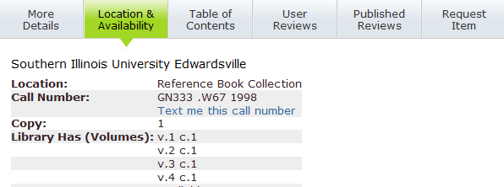
Multipart holding
853 field tells us the holdings will be volumes
863 $8 puts the fields in order for the display
Notes:
I have two more holdings records to take a look to finish up our discussion.
This is a multipart item and we want the volumes to be arranged in numeric order. We do that with the 863 $8.
Note that the $8 number gets larger as the volume numbers progress.
Even if you arranged the 863 fields in a different order, the $8 would arrange the fields in this order in the OPAC

Slide 38
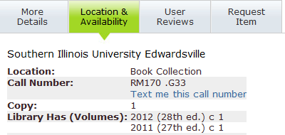
Serials holding
853 field tells us the holdings will be date and edition
863 $8 puts the fields in order for the display
Notes:
For serial holdings, we have decided that we want the most recent edition to display first in the OPAC.
We do that with the 863$8 – Note that the later date has a smaller $8 number – that makes the later date appear first in the OPAC.
Again, even if you arranged the 863 fields in a different order in the OPAC, the display would still be in this order due to the $8 values.
Even if you arranged the 863 fields in a different order, the $8 would arrange the fields in this order in the OPAC

Slide 39
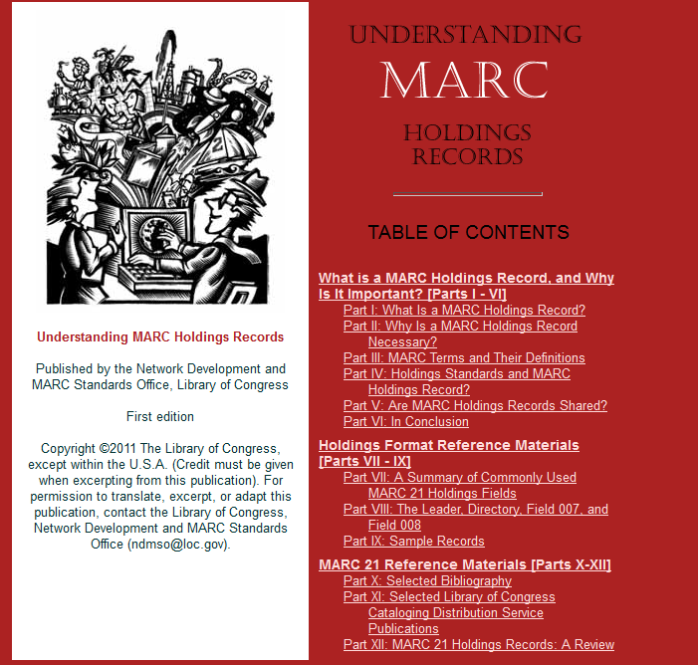
For more information
Understanding MARC Holdings Records
http://www.loc.gov/marc/umh/index.html
Notes:
I know this has been a really quick overview of MARC holdings records, and you may be more confused now that when we started, but there is more detailed information available.
This booklet developed by the Library of Congress is an excellent place to start if you really want to understand MARC holdings records.

Slide 40
For more information
MARC 21 Format for Holdings Data
http://www.loc.gov/marc/holdings/
Notes:
And, this website, maintained by the Library of Congress Network Development and MARC Standards Office is the place to look for an in depth guide to MARC holdings records.

Slide 41
Q&A Session
Questions?

Slide 42
Thank you!

