Slide 1
FRBR & DeDup
California State Library System
Jim LeFager

Slide 2
FRBR

Slide 3
Primo records are grouped using the principles in the Functional Requirements for Bibliographic Records published by the IFLA Study Group on the Functional Requirements for Bibliographic Records.
The grouping process is based on creating a vector for every record. The vector includes one or more keys that identify the group it represents. Records that have a matching key (Primo attempts to match all keys in the record) are added to a FRBR group and are assigned the ID of the group (the FrbrID). Each record can belong only to one group. Therefore, once a record is matched with an existing group, Primo terminates the grouping process for that record.

Slide 4
Display in the Front End
The Front End provides the following display options:
Display of a preferred record – Primo dynamically selects one of the records from the group for display in the brief results list. This is the preferred record. The preferred record is the highest ranked record from the results set. From the preferred record, the system displays a link to the additional records in the group.
Display of a generic record – Primo displays a generic record that contains work-level metadata. A link displays the records that are included in the group.

Slide 5
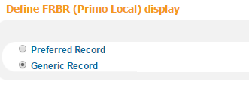
Preferred Record | Generic Record
In the Primo Back Office, under the Brief Results Tile in the Views Wizard, there is a setting to choose between showing the Preferred Record or a Generic Record

Slide 6
Example of Generic Record Option

Slide 7
Example of Preferred Record Option

Slide 8
FRBR Vector
The FRBR section in the PNX contains the FRBR vector. The vector has two parts:
Type (T)—The type can be used to FRBRize sets of records using different FRBR algorithms. Currently, there is a single type (1), which is based on creating and matching author-title keys.
If you would like to skip FRBRization for individual records, you can set this field to 99 in the normalization rules.– THIS WILL NEED TO GO TO DISCOVERY GROUP
Keys (Kn)—The key is created from specified fields of the source record that can be used to identify the group it represents. The keys are checked in order starting from K1. The data must be normalized.

Slide 9
Type 1 FRBR Vector and Algorithm
Field ID | Field Content
T | 1
K1 | Author part key
K2 | Title only key
K3 | Title part key

Slide 10
FRBR VECTOR FOR MARC21
Field ID | Source (value of $$K for K fields) | Key part type (value of $$A for K fields) | Note
T | Always 1
K1 | 100 or 110 or 111 OR 700, 710, 711 | A | Single occurrence of 100, 110, 111; multiple occurrences of 700, 710, 711 Take subfields a, b, c, d, q and n for 111
K2 | 130 | TO | Subfields a, d, m, n, p, r, s
K3 | 240 | T | Subfields a, d, m, n, p, r, s
 | And (if 240 exists and format is not SE) 245 |  | Subfields a, b, e, f, g, n, p
 | OR (if 240 does not exist and format is SE) 245 |  | Subfields a, b, e, f, g, n, p
 | OR 242 |  | Subfields a, b, f, g, n, p
 | OR 246, 247 |  | Subfields a, b, f, g, n, p
 | OR 740 |  | Subfield a, n, p

Slide 11
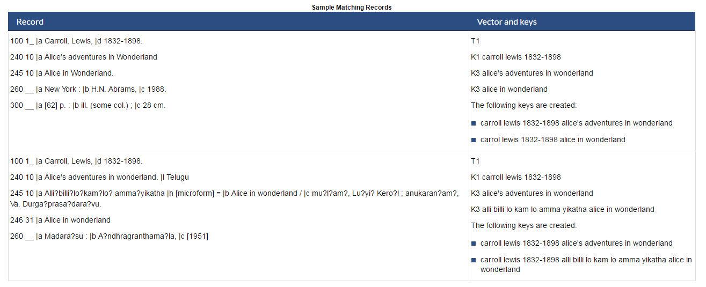
Example of Matching Records

Slide 12
Example of Non-Matching Records
Record | Vector and keys
100 1_ |a Chorpenning, Charlotte B. |q (Charlotte Barrows) 245 10 |a Alice in Wonderland, |c dramatized by Charlotte B. Chorpenning, a play from the library of the Association of the Junior Leagues of America, inc. 260 __ |a Chicago, |b The Dramatic Publishing Company |c [1946] 700 1_ |a Carroll, Lewis, |d 1832-1898. |t Alice's adventures in Wonderland | T1 K1 chorpenning charlotte b K3 alice in wonderland The following key is created: chorpenning charlotte b alice in wonderland
050 00 |a VXB 0196-0197 (viewing copy) 245 00 |a Alice in Wonderland. 260 __ |c 1999. 300 __ |a 2 videocassettes of 2 : |b sd., col. ; |c 1/2 in. viewing copy. 710 2_ |a Copyright Collection (Library of Congress) | T1 K1 copyright collection library of congress K3 alice in wonderland The following key is created: copyright collection library of congress alice in wonderland

Slide 13
Example of the PNX from a CALSTATE Record
<frbr>
<t>1</t>
<k1>$$Ktolstoy leo graf 1828 1910$$AA</k1>
<k3>$$Kvoina i mir maude$$AT</k3>
<k3>$$Kwar and peace$$AT</k3>
</frbr>

Slide 14
FRBR Vector and Algorithm
The FRBR vector includes part keys and the key type so they can be combined in the matching process. The keys are normalized. There can be several types of keys, each with multiple occurrences:
A—author part key – Author part keys are combined with title part keys to create a key that represents the work.
T—title part key – Title part keys are combined with author part keys to create a key that represents the work.
TO—title only key – This is a title key that is not combined with authors. This key should be created only from titles that are sufficient to identify the work by themselves. The MARC 130 (uniform title) tag is an example of such a field.

Slide 15
Preventing FRBR
FRBR can be prevented for Specific Records or groups of records, for example by Resource Type. This would require a Normalization Rule Change to the FRBR Section of the Alma Norm Rules

Slide 16
Preventing FRBR Links
Preventing FRBR Groups Based on Resource Type
https://knowledge.exlibrisgroup.com/Primo/Knowledge_Articles/Preventing_FRBR_Groups_Based_on_a_Resource_Type
How to Disable FRBR for new records in Primo
https://knowledge.exlibrisgroup.com/Primo/Knowledge_Articles/How_to_Disable_FRBR_for_new_records_in_Primo

Slide 17
FRBRization
Resources available in the Ex Libris Knowledge Center
https://knowledge.exlibrisgroup.com/Primo/Product_Documentation/Technical_Guide/040FRBRization#wwconnect_header

Slide 18
Dedup

Slide 19
Duplicate Detection Process
The duplication detection or matching process is based on creating a dedup vector for every PNX record in the Primo database. The vector includes all the data required by the Duplication Detection algorithm to determine if two records are equivalent.

Slide 20
Duplicate records are assigned the same matchID. For every group of duplicate records, the dedup process creates a merged record based on a preferred record (which is selected by the Preferred Record algorithm). In the current version, the preferred record is based on the delivery category and the record with the most fields in the Display section. The default priority is:
SFX resource
Online resource
Metalib resource
Physical item
Microform
In addition to the preferred record, fields from the Control, Links, Search, Facets, Additional Data, and Delivery sections are merged from all records and are included in the dedup merged record. All local fields are included. The availability and source fields from the Display section are also retained for every record.

Slide 21
Duplicate Detection Vector
The dedup vector includes the following:
Type (T). The type defines the matching rules that will be used. Currently Primo allows the following types:
Non-serials (T=1)—for all other records (refer to The Non-Serials Vector and Algorithm).
Serials (T=2)—for serial records (refer to The Serials Vector and Algorithm).
Articles (T=3)—for articles (refer to Deduplication Algorithm for Articles).
The Serials and Non-serials duplication detection algorithm has two phases: Candidate Selection and Record Matching. The Articles duplication detection algorithm has only a match phase.
Candidate Fields (C1-C10)—The Candidate Selection phase locates up to a set number of potential records for matching. This section in the vector is indexed in the persistence layer. The indexes are used to locate candidates.
Matching Fields (F1-F20)—During the record matching phase, fields from the Matching Fields section are compared. Fields that match are assigned weight points, as determined by the rules used. Records that cross the threshold are considered duplicates and are assigned the MatchID of the matching record.

Slide 22
The Serials Vector and Algorithm
Serials Candidate Vector
Field ID | Field Content | Note
C1 | UnivID, UnivID_invalid | This is a unique universal ID (for example, LCCN).
C2 | ISSN, ISSN_invalid, ISSN_cancelled
C3 | Short Title
C4 | Place of Publication | Only the first occurrence is used.
C5 | Single match ID | Intended for the Alma’s MMS ID or another ID that is reliable enough to serve as the sole basis for the match.

Slide 23
Serials Matching Vector
Field ID | Field Content | Note
F1 | UnivID
F2 | Univ_invalid | Multiple occurrences are delimited by a semicolon.
F3 | ISSN | Multiple occurrences are delimited by a semicolon.
F4 | ISSN_invalid | Multiple occurrences are delimited by a semicolon.
F5 | ISSN_cancelled | Multiple occurrences are delimited by a semicolon.
F6 | Start publication year
F7 | Full title
F8 | Brief title | Remove subtitle and any additional information.
F9 | Country of publication
F10 | Place of publication
F11 | Main entry (author, corporate body, meeting)

Slide 24
Quick Match
The quick match compares the following fields:
Single match ID
UnivID/UnivID_invalid
ISSN/ISSN_invalid/ISSN_cancelled
Full title
The full match compares all fields in the vector.
The table in the link below lists the default weights for quick and full matches for serials. If 800 points are reached in the quick-match stage, the records are considered a match. If not, the record proceeds to the full-match stage, which checks all fields. As in the quick-match stage, if 800 points are reached, the records are considered a match.
https://knowledge.exlibrisgroup.com/Primo/Product_Documentation/Technical_Guide/030Duplicate_Detection_Process/030Duplicate_Detection_Vector
In both the quick-match and full-match stages, the weight from the UnivID and ISSN matches is compared, and the higher of the two weights, not the sum, is assigned to the record.

Slide 25
Non-Serials Candidate Vector
Non-Serials Candidate Vector Fields
Field ID | Field Content | Note
C1 | UnivID and UnivID_invalid | A unique universal ID (for example, LCCN)
C2 | ISBN, ISBN_invalid | Multiple occurrences delimited by a semicolon.
C3 | Short title | The first 25 characters of the normalized title.
C4 | Year
C5 | Single match ID | Intended for the Alma’s MMS ID or another ID that is reliable enough to serve as the sole basis for the match.

Slide 26
Non-Serials Matching Vector
Field ID | Field Content | Note
F1 | UnivID
F2 | UnivID_invalid | Multiple occurrences are delimited by a semicolon.
F3 | ISBN | Multiple occurrences are delimited by a semicolon.
F4 | ISBN_invalid | Multiple occurrences are delimited by a semicolon.
F5 | Short title | The first 25 characters of the normalized title.
F6 | Year
F7 | Full title
F8 | Country of publication
F9 | Pagination | The highest number in the pagination field should be used.
F10 | Publisher
F11 | Main entry (author, corporate body, meeting)

Slide 27
Quick Match
The quick match stage compares the following fields:
Single match ID
UnivID/UnivID_invalid
ISBN/ISBN_invalid
Short title
Year
If 850 points are reached, the records are considered a match. If not, the record proceeds to full-match stage, which uses all fields except the full title is used instead of the short title. If 875 points are reached, the records are considered a match.
Full Weight Distribution: https://knowledge.exlibrisgroup.com/Primo/Product_Documentation/Technical_Guide/030Duplicate_Detection_Process/030Duplicate_Detection_Vector

Slide 28
Deduplication Algorithm for Articles
The Deduplication algorithm for articles matches a single key that is also used in the candidate and matching phases. Use C1 for the candidate key and F1 for the match. In addition to remote searches, the deduplication algorithm can be used for records that are harvested into the local Primo repository. In both cases, a single key is created from the following elements:
ISSN, DOI, or normalized journal title
Start page, author, or author last name
Publication year, issue, or part
Normalized article title

Slide 29
The Deduped-Merged Record
The system creates the merged record based on the preferred record, where the fields in the following sections are merged from all records in the dedup group:
Control—most fields are merged
Display—the source and availlibrary fields are merged. The availinstitution and availpnx fields are re-calculated
Links—all fields are merged and duplicate fields are removed
Search—all fields are merged and duplicate fields are removed
Sort—only fields from preferred are taken
Facets—all fields are merged and duplicate fields are removed
Dedup—not relevant
FRBR—all fields merged and duplicate fields are removed
Delivery—all fields are merged
Ranking—the highest value is taken from all records
Enrichment—not relevant
Additional data—all fields are merged and duplicate fields are removed

Slide 30
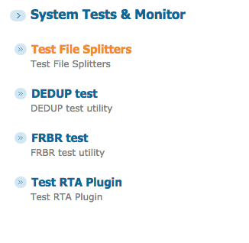
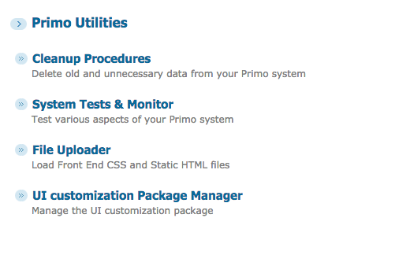
Primo Utilities – Using the Systems Tests
In the Primo Back Office, navigate to:
Primo Home > Primo Utilities > System Tests & Monitor

Slide 31
Through a window: my thirty years with the chimpanzees of Gombe
Dedupmrg4223527
01CALS_ALMA71181158630002901
01CALS_ALMA991000072979702920
01CALS_ALMA991000108489702921
01CALS_ALMA991000618409702919
01CALS_ALMA991001911519702906
01CALS_ALMA991001951179702915

Slide 32
Examples to Explore
War and Peace
Dedupmrg12165662
Dedupmrg5512077
01CALS_ALMA71169217470002901
01CALS_ALMA991002321509702921
01CALS_ALMA991007143449702906
01CALS_ALMA991007147579702915
01CALS_ALMA991012851679702910
FRBR
01CALS_ALMA991004915689702904
01CALS_ALMA71164013840002901
01CALS_ALMA71169930320002901
01CALS_ALMA71178091410002901
Dedupmrg5512077
dedupmrg3864265
01CALS_ALMA71148902520002901
01CALS_ALMA71150016440002901

Slide 33
Quartet in G-dur: für zwei Violinen, Viola und Violoncello
Dedupmrg7042570
01CALS_ALMA991008325179702910
01CALS_ALMA71185449660002901
FRBR – MATCH
dedupmrg7042570
dedupmrg13690101

Slide 34
Harry Potter and the Chamber of Secrets
01CALS_ALMA71169860580002901
01CALS_ALMA71141290880002901
01CALS_ALMA71146448820002901

Slide 35
Batman
01CALS_ALMA51197718830002901
Dedupmrg12151519

Slide 36
James.lefager@exlibrisgroup.com

