Slide 1
Authority Control in Alma
California State University | March 17, 2017
Megan Drake | Implementation Consultant
Emily Boss | Authority Control Task Force Chair

Slide 2
Agenda
Introduction
Manual linking between headings (F3)
Automatic linking between headings
Authority Control Task List

Slide 3
Introduction
Alma institutions may use either global authorities, local authorities, or both
By default Alma provides a set of global authority records that are updated and maintained regularly by Ex Libris in the Community Zone (CZ).
Local authorities will also be used for CalState – this will be covered in a later call for the interested institutions.

Slide 4
Introduction
There are several types of global authorities maintained by Ex Libris in the Community Zone. This is a selected list of the 18 available vocabularies:
LC Subject (LCSH): Library of Congress Subject Headings
LC Name (LCNAF): Library of Congress Name Authority File
LCGFT: Library of Congress Genre/Form Terms Thesaurus
LCMPT: Library of Congress Medium of Performance Thesaurus
NLM MeSH: United States National Library of Medicine Subject Headings
Integrated Authority File (GND): German National Library Gemeinsame Normdatei- Subjects and Names authorities
LACNAF: Library and Archives Canada name authority file
CSH: Canadian subject headings

Slide 5
Introduction
Vocabularies are updated regularly.
LC Subject (LCSH): Weekly
LC Name (LCNAF): Weekly
LCGFT: Weekly
LCMPT: When available
NLM MeSH: Annually
Integrated Authority File (GND): Daily
LACNAF: When available
CSH: When available
https://knowledge.exlibrisgroup.com/Alma/Product_Documentation/Alma_Online_Help_(English)/Resource_Management/040Metadata_Management/060Working_with_Authority_Records

Slide 6
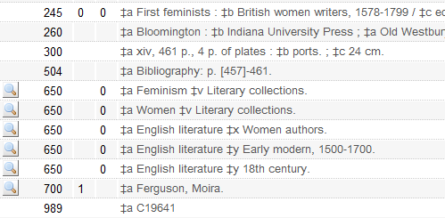
Introduction
From the editing mode of the metadata editor there is an indicator if the field is linked to an authority heading
The magnifying glass next to a field means that it is linked to an authority heading

Slide 7
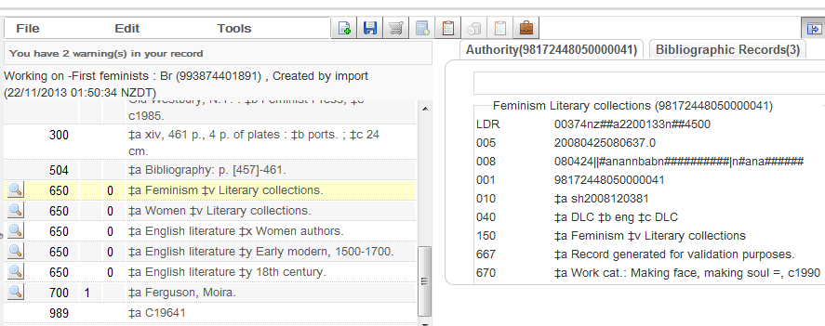
Introduction
After clicking the magnifying glass of a heading the linked authority record will open in the right pane. It will also include a separate tab with all related bibliographic records.
There are a total of three bibliographic records linked to this authority record
Clicked here
This opened with related authority record

Slide 8
Agenda
Introduction
Manual linking between headings (F3)
Automatic linking between headings
Authority Control Task List

Slide 9
Manual linking between headings - F3
The manual linking of authority headings is done while a record is being edited in the metadata editor
By clicking "F3" with cursor on a field a window will open with
  Authority records listed beginning in the alphabetically ordered place of the bibliographic heading
  A list of bibliographic headings which already exist in the institution
The list of authority records will be taken from the relevant authority record vocabulary (global or local) based on the field from which F3 is clicked

Slide 10
Manual linking between headings - F3
For example the following will occur after clicking F3:
If user has text in 650 2nd indicator 0 then the Library of Congress subject headings will appear
If user has text in 650 2nd indicator 2 then the MeSH medical subject headings will appear
If user has text in 650 2nd indicator 5 then the CSH Canadian subject headings will appear
If user has text in 650 2nd indicator 7 and subfield 2 GND then the GND subject headings will appear
If user has text in 650 2nd indicator 7 and subfield 2 NLI then the GND subject headings will appear

Slide 11
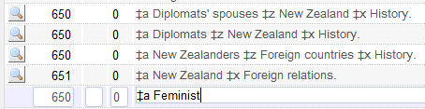
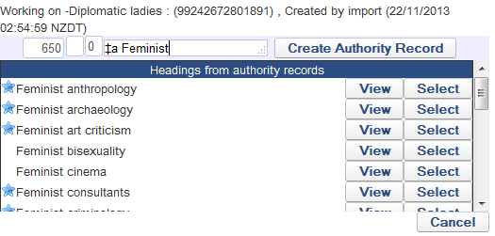
Manual linking between headings - F3
With cursor at the end of the 650 2nd indicator 0 field the user clicks F3
And gets this list
LCSH list

Slide 12
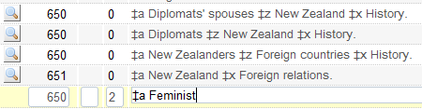
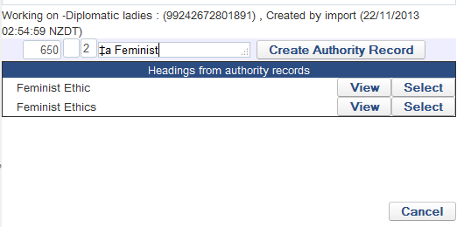
Manual linking between headings - F3
With cursor at the end of the 650 2nd indicator 2 field the user clicks F3
And gets this list
MeSH

Slide 13
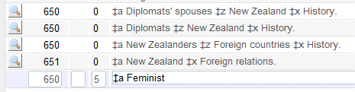
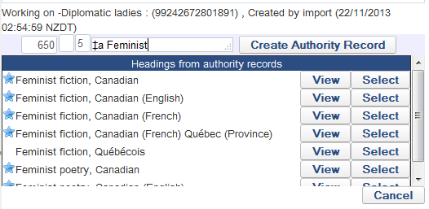
Manual linking between headings - F3
With cursor at the end of the 650 2nd indicator 5 field the user clicks F3
And gets this list
CSH

Slide 14
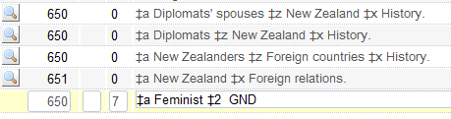
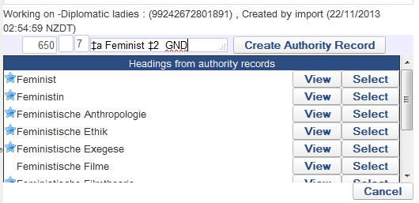
Manual linking between headings - F3
With cursor at the end of the 650 2nd indicator 7 field with subfield 2 "gnd" the user clicks F3
And gets this list
GND

Slide 15
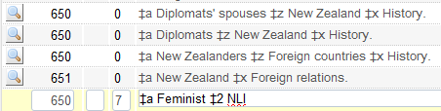
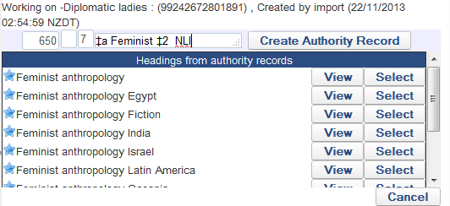
Manual linking between headings - F3
With cursor at the end of the 650 2nd indicator 7 field with subfield 2 "nli" the user clicks F3
And gets this list
NLI

Slide 16
Manual linking between headings - F3
The list which is received after clicking F3 is compromised of
Authority headings
Bibliographic headings
The list of authority headings contains
Preferred headings
Non preferred headings

Slide 17

Manual linking between headings - F3
The preferred terms have a star next to them
The non-preferred terms do not have a star next to them
Preferred
Non-Preferred

Slide 18
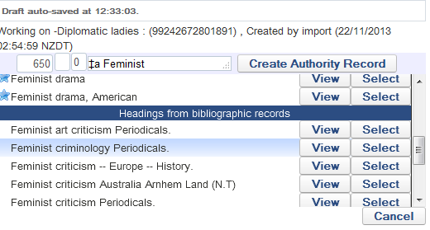
Manual linking between headings - F3
After the list of authority headings the list of bibliographic headings appear
Scrolled down to the "Headings from bibliographic records"

Slide 19
Manual linking between headings - F3
Options from the F3 list:
View:
  For authority headings it shows the authority record in the right pane of split editor mode with a tab for existing related bibliographic records.
  For bibliographic headings it shows the related bibliographic records in the right pane of split editor mode
Select:
  Selects the heading and uses it to replace the heading which already exists in the bibliographic record. If a non preferred term is selected then the preferred term will be used

Slide 20
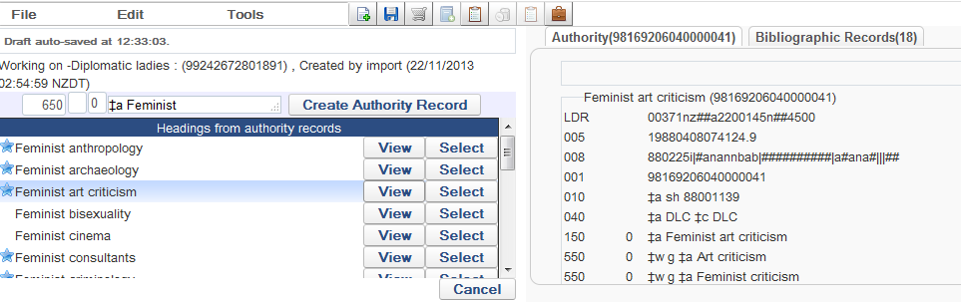
Manual linking between headings - F3
Clicked "View" on "Feminist art criticism". In right pane we see the authority record and a tab to view the 18 bibliographic records already linked to this heading
18 bibliographic records are already linked to this heading

Slide 21
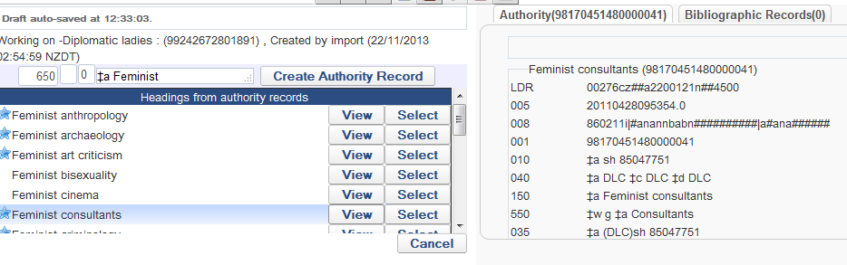
Manual linking between headings - F3
Clicked "View" on "Feminist consultants". In right pane we see the authority record and a tab showing that there are 0 bibliographic records already linked to this heading
0 bibliographic records are already linked to this heading

Slide 22
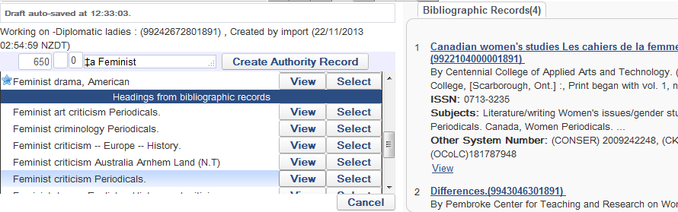
Manual linking between headings - F3
Clicked "View" on bibliographic heading "Feminist criticism Periodicals". In right pane we see 4 bibliographic records which have this heading.
4 bibliographic records have this heading

Slide 23
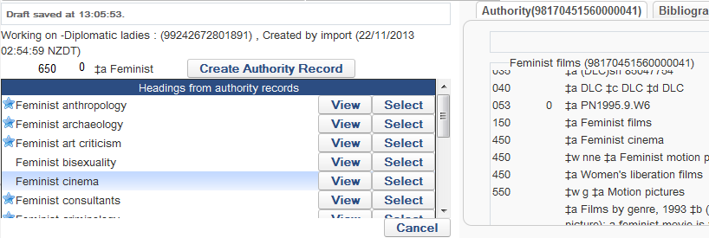
Manual linking between headings - F3
We will now click "select" on "Feminist cinema" which is a non-preferred term for "Feminist films"

Slide 24
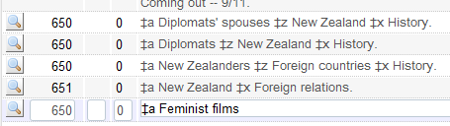
Manual linking between headings - F3
The preferred term heading is copied to the bibliographic record with a link to the authority heading

Slide 25
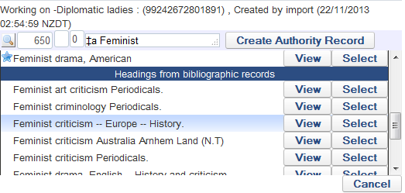
Manual linking between headings - F3
We will now click "select" on "Feminist criticism – Europe – History " which is from a bibliographic record.

Slide 26
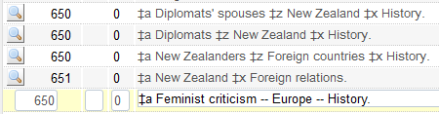
Manual linking between headings - F3
The heading is copied to the bibliographic record without a link to the authority heading

Slide 27
Questions?

Slide 28
Agenda
Introduction
Manual linking between headings (F3)
Automatic linking between headings
Authority Control Task List

