Slide 1
PRIMO NEW UI
CALIFORNIA STATE UNIVERSITY, OCTOBER 19, 2016
JIM LEFAGER, LYNN HIGGINS | IMPLEMENTATION CONSULTANTS

Slide 2
Primo Links
Production Front End (current UI):
http://calstate-primoprod.hosted.exlibrisgroup.com/primo_library/libweb/action/search.do?vid=<viewID>
Production Front End (new UI):
http://calstate-primoprod.hosted.exlibrisgroup.com/primo-explore/search?vid=<viewID>
Production Back Office:
http://calstate-primoprod.hosted.exlibrisgroup.com:1601/primo_publishing/admin/acegilogin.jsp Refer to “BE User” column on upcoming slides for your login
Sandbox Front End (new UI):
http://calstate-primosb.hosted.exlibrisgroup.com/primo-explore/search?vid=<viewID>

Slide 3
View IDs
Institution | View ID | BE User
California State University, Bakersfield | 01CALS_UBA | 01CALS_UBA / Bakersfield
California State University Channel Islands | 01CALS_UCI | 01CALS_UCI / ChannelIslands
California State University, Chico | 01CALS_CHI | 01CALS_CHI / Chico
California State University, Dominguez Hills | 01CALS_UDH | 01CALS_UDH / DominguezHills
California State University, East Bay | 01CALS_UHL | 01CALS_UHL / EastBay
California State University, Fresno | 01CALS_UFR | 01CALS_UFR / Fresno
California State University, Fullerton | 01CALS_FUL | 01CALS_FUL / Fullerton
Humboldt State University | 01CALS_HUL | 01CALS_HUL / Humboldt
California State University, Long Beach | 01CALS_ULB | 01CALS_ULB / LongBeach
California State University, Los Angeles | 01CALS_ULA | 01CALS_ULA / LosAngeles
California State University Maritime Academy | 01CALS_MAL | 01CALS_MAL / Maritime
California State University, Monterey Bay | 01CALS_UMB | 01CALS_UMB / MontereyBay

Slide 4
View IDs cont.
Institution | View ID | BE User
Moss Landing Marine Laboratories | 01CALS_MLM | 01CALS_MLM / MossLanding
California State University, Northridge | 01CALS_UNO | 01CALS_UNO / Northridge
California State Polytechnic University, Pomona | 01CALS_PUP | 01CALS_PUP / Pomona
California State University, San Bernardino | 01CALS_USB | 01CALS_USB / SanBernardino
San Diego State University | 01CALS_SDL | 01CALS_SDL / SanDiego
San Francisco State University | 01CALS_SFR | 01CALS_SFR / SanFrancisco
San Jose State University | 01CALS_SJO | 01CALS_SJO / SanJose
California Polytechnic State University, San Luis Obispo | 01CALS_PSU | 01CALS_PSU / SanLuisObispo
Sonoma State University | 01CALS_SOL | 01CALS_SOL / Sonoma
California State University, Stanislaus | 01CALS_UST | 01CALS_UST / Stanislaus
California State University, Sacramento | 01CALS_USL | 01CALS_USL / Sacramento
California State University San Marcos | 01CALS_USM | 01CALS_USM / SanMarcos

Slide 5
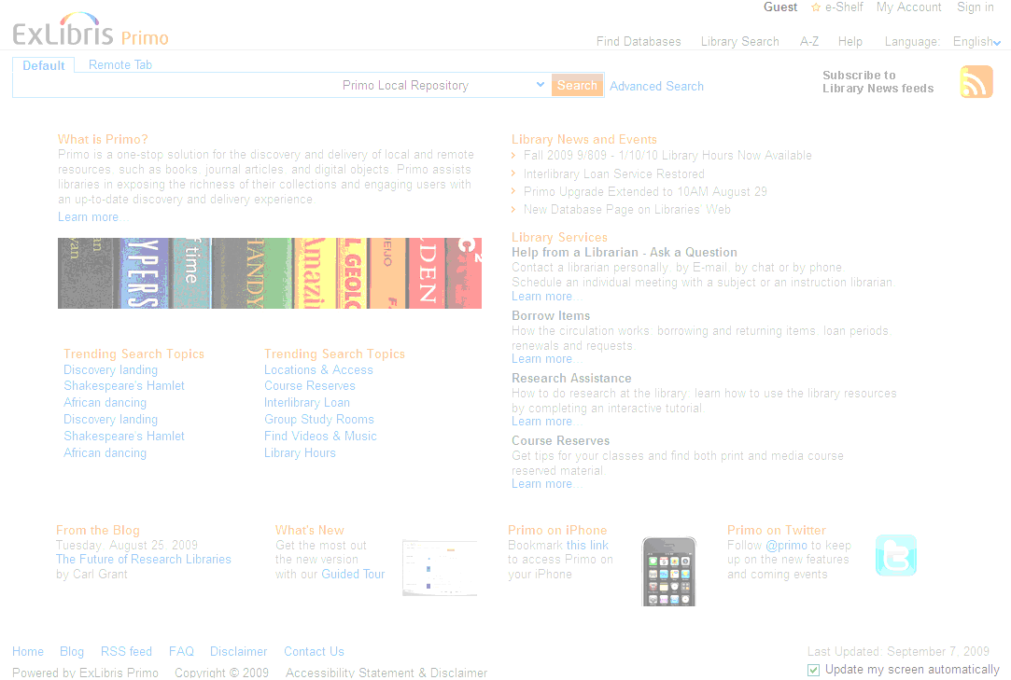
Page Structure – Current UI
header
featured
news
services
footer

Slide 6
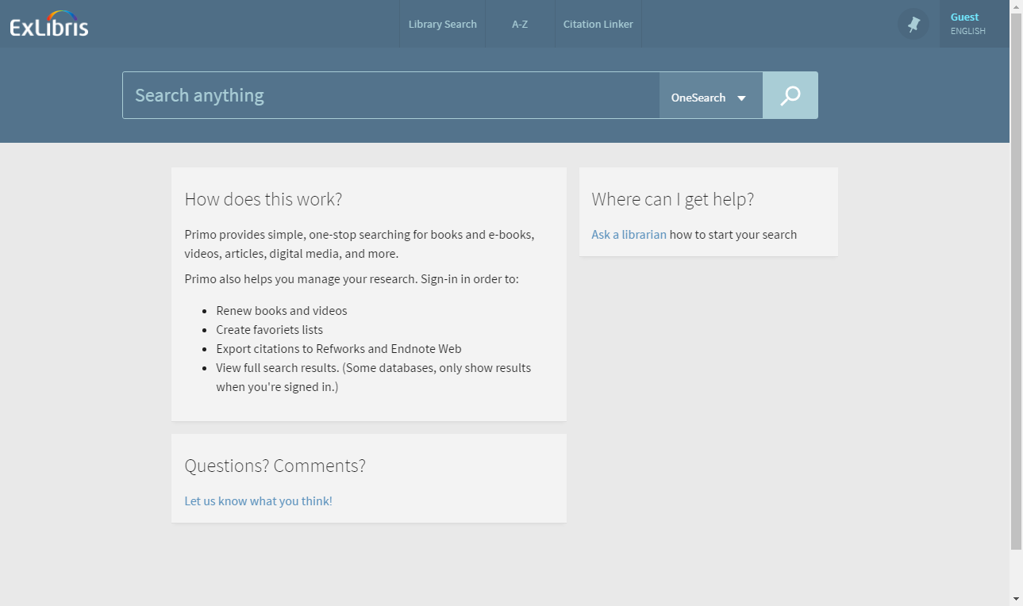
Page Structure – New UI
Logo
Layout Card
Layout Card
Layout Card

Slide 7
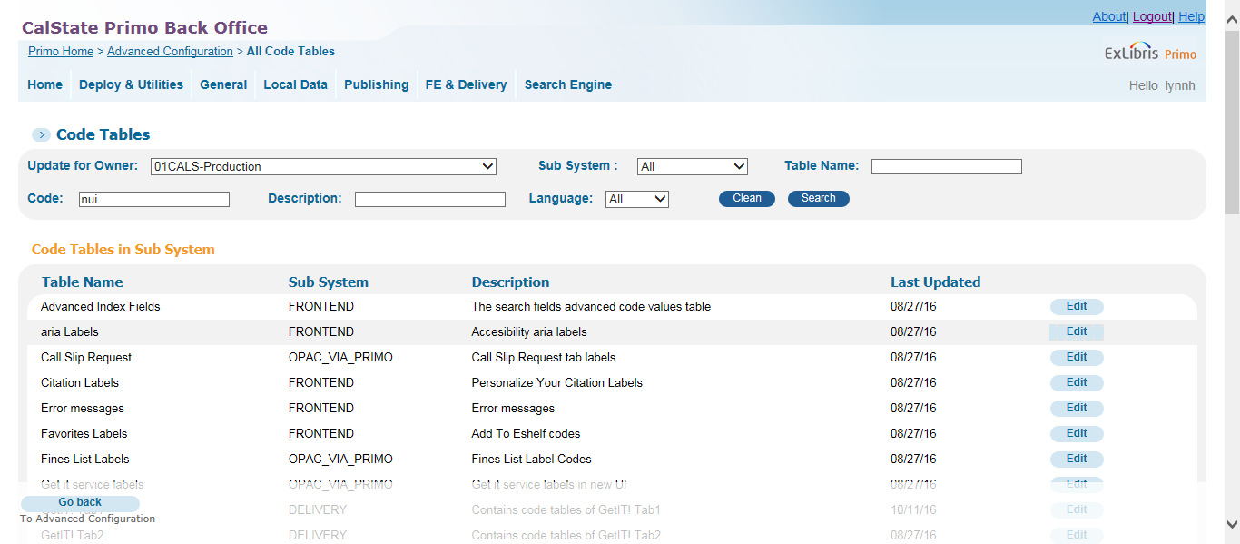
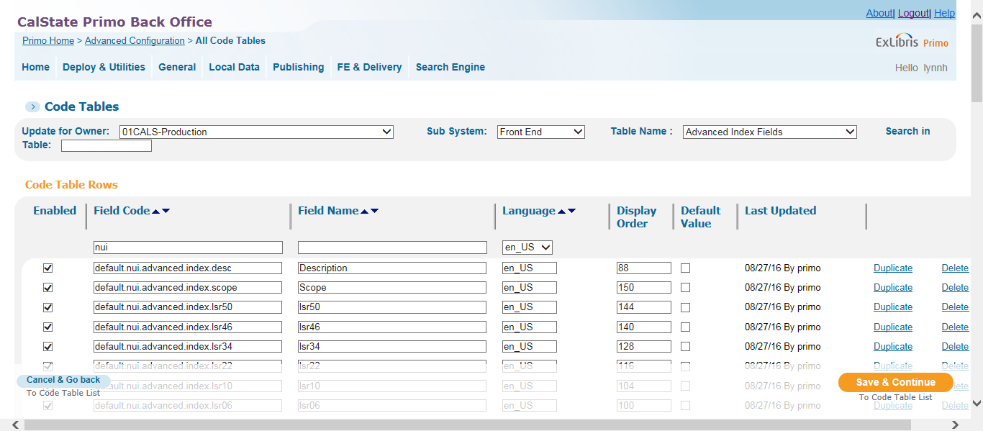
Code Table Values – New UI
Search “nui” to see all code tables with new UI entries

Slide 8
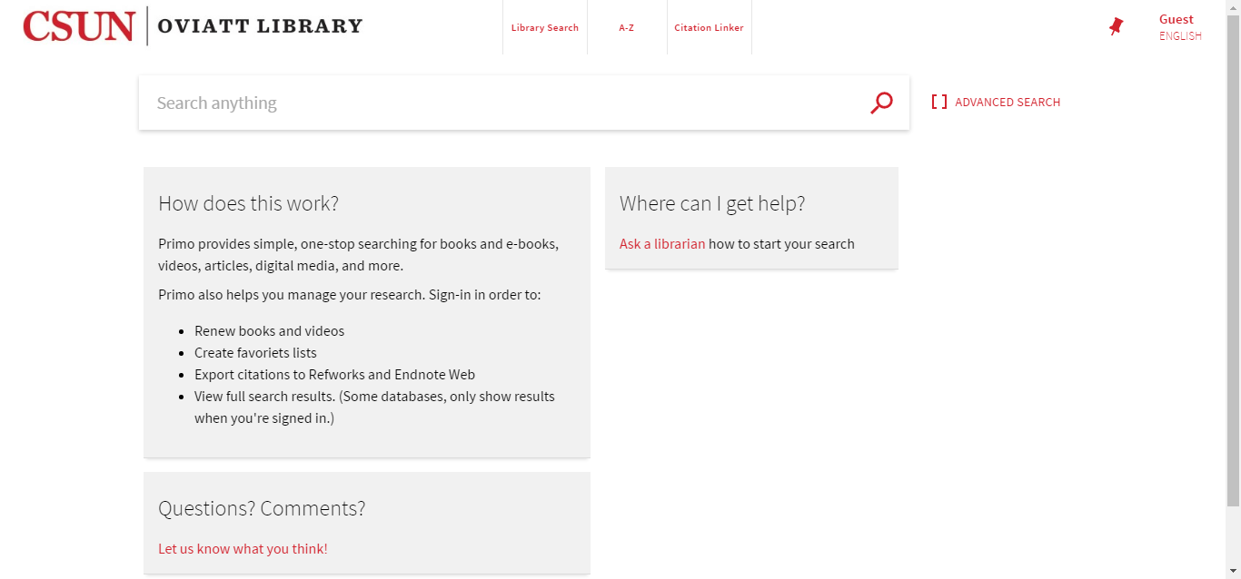
Basic Search

Slide 9
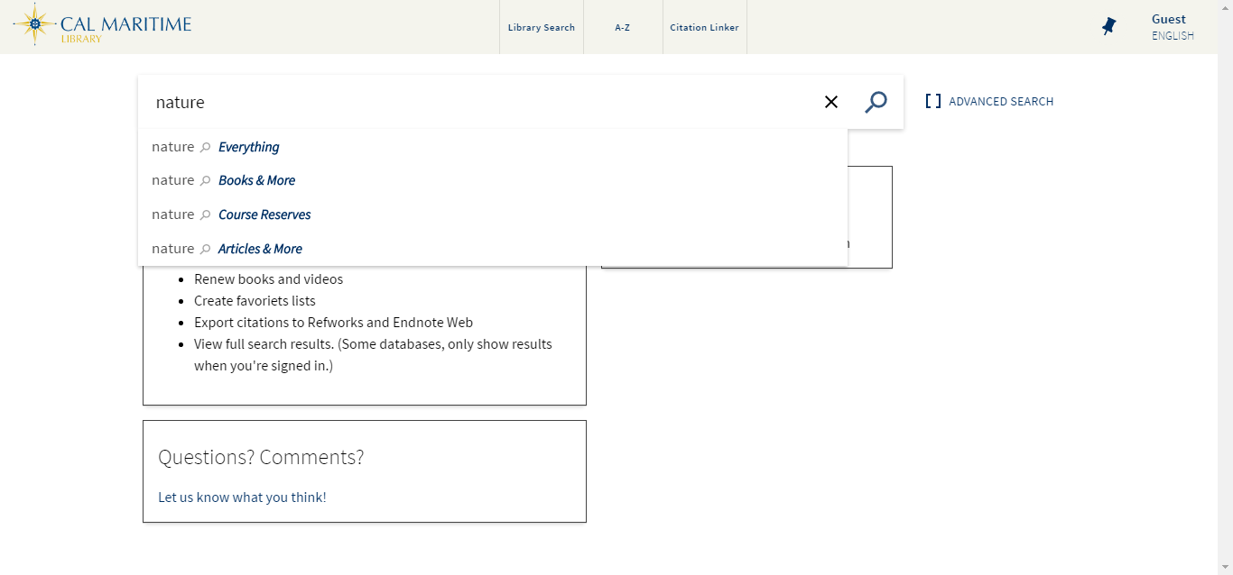
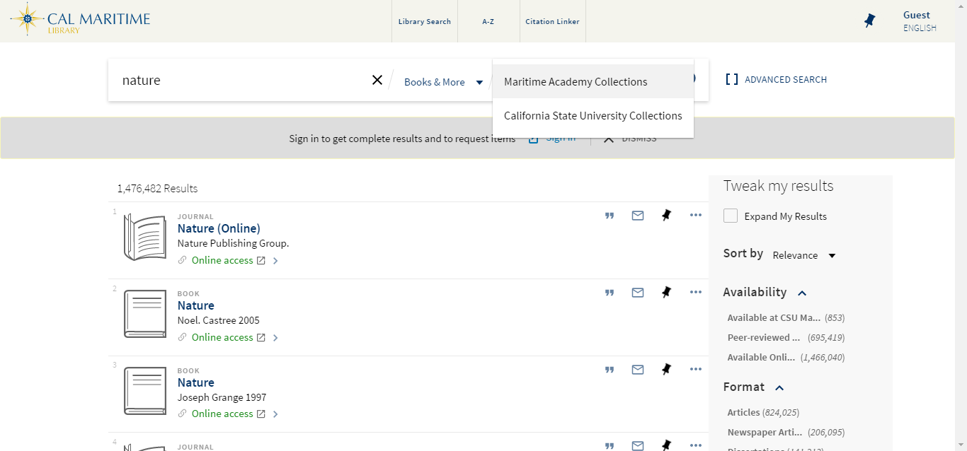
Basic Search – New UI Scopes and Tabs
Tabs:
Tabs and Scopes:

Slide 10
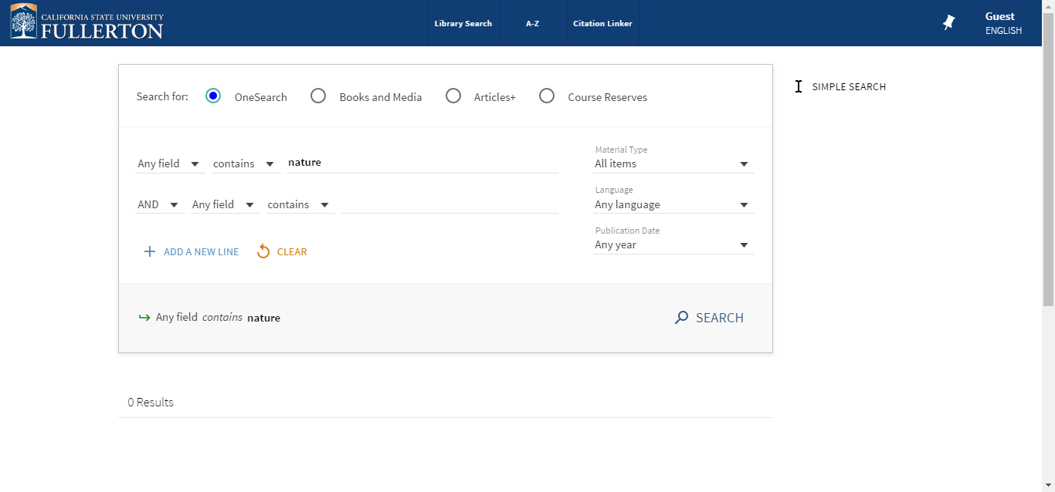
Advanced Search

Slide 11
New UI → Current UI Temporary Redirects
Browse, Citation Linker, A-Z components redirect to current UI until February release
Browse link in navigation bar added via main menu tile in BE – remove this after February release
Citation Linker and A-Z link changes TBD after February release

Slide 12
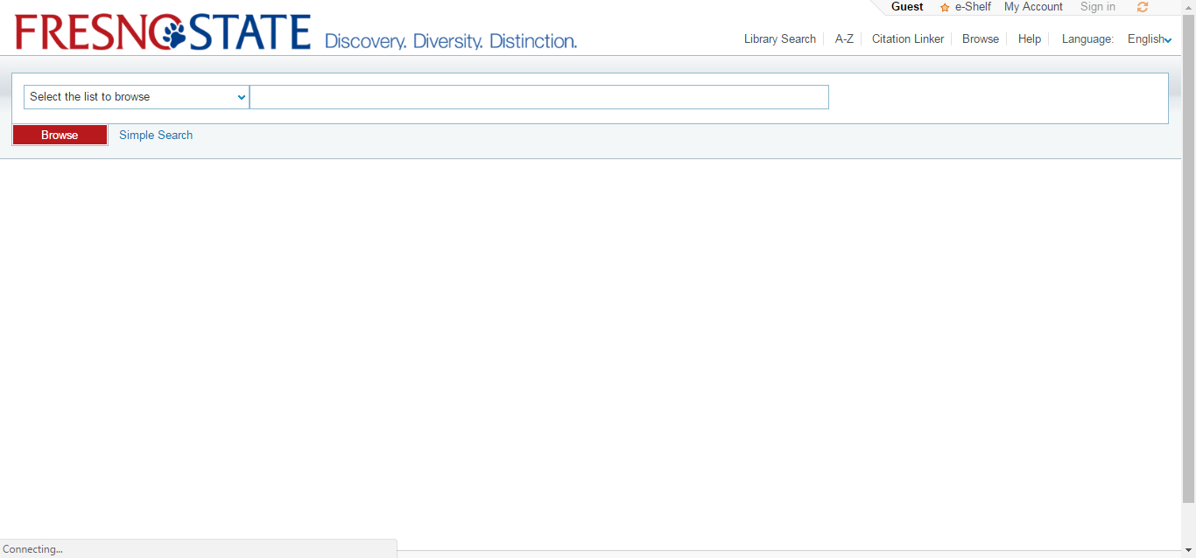
Browse Search

Slide 13
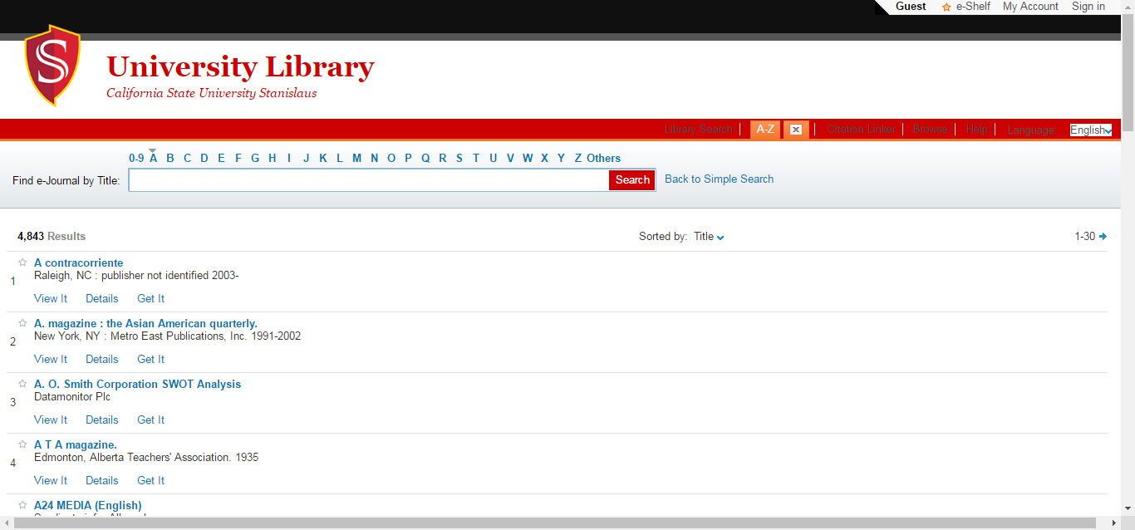
A-Z List

Slide 14
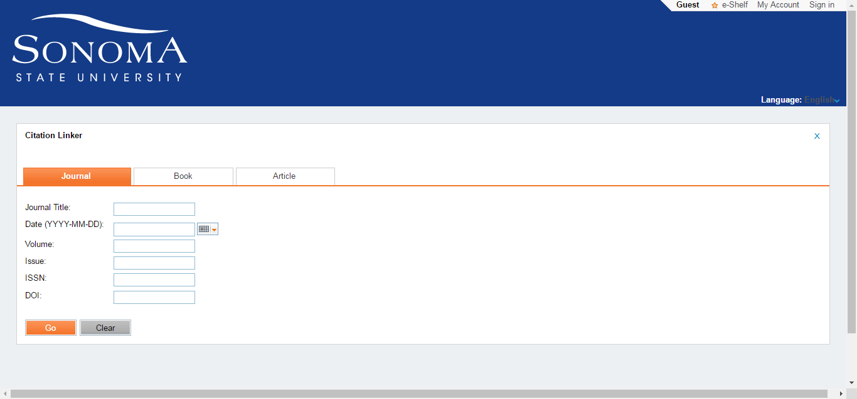
Citation Linker

Slide 15
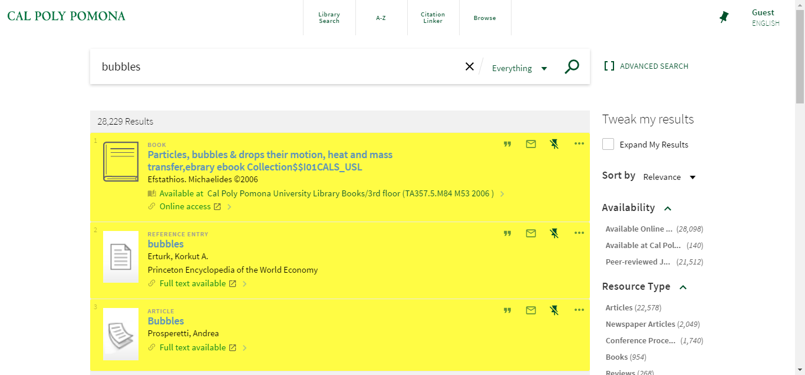
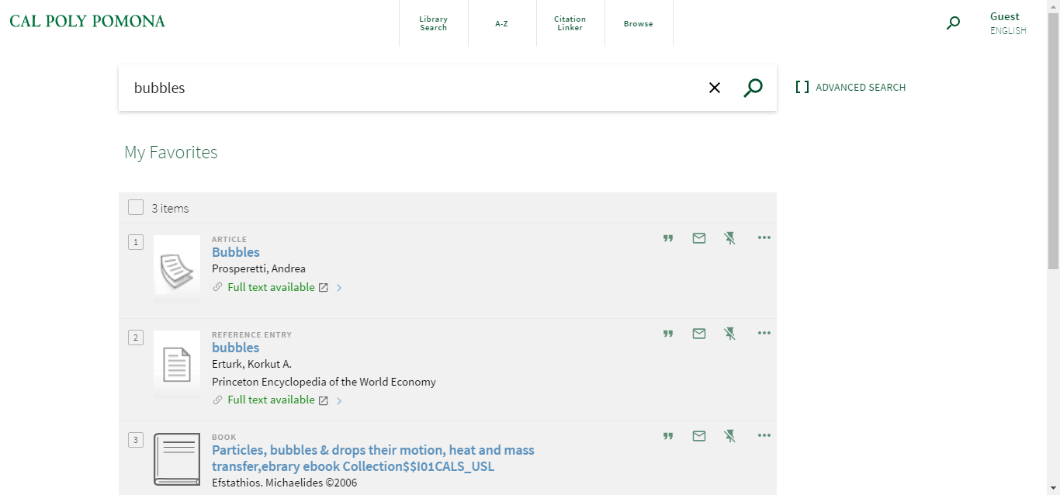
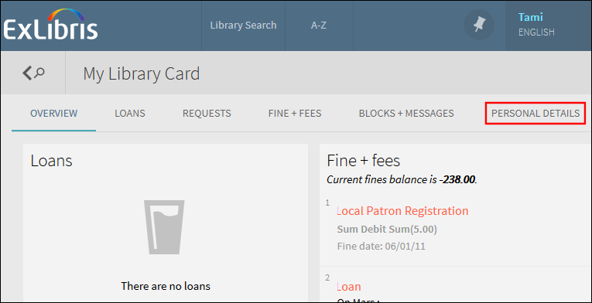
Favorites and My Library Card
Favorites
My Library Card

Slide 16
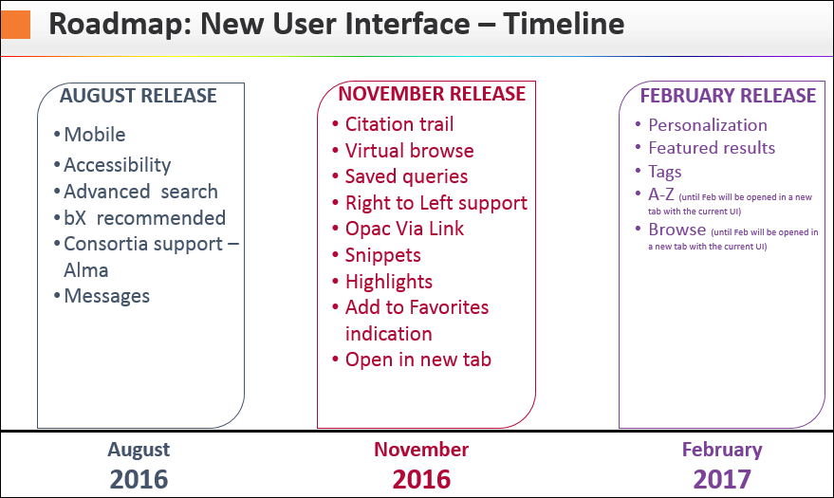
New UI Roadmap
https://knowledge.exlibrisgroup.com/Primo/Product_Documentation/New_Primo_Interface/010Frequently_Asked_Questions

Slide 17
New UI Resources
Documentation:
http://knowledge.exlibrisgroup.com/Primo/Product_Documentation/New_Primo_Interface
Training:
http://knowledge.exlibrisgroup.com/Primo/Training/New_Primo_Interface
August Release Notes:
http://knowledge.exlibrisgroup.com/Primo/Release_Notes/2016/02August_2016

Slide 18
Customization Package – New UI
Documentation:
https://knowledge.exlibrisgroup.com/Primo/Product_Documentation/Back_Office_Guide/090Primo_Utilities/The_UI_Customization_Package_Manager
Training:
https://knowledge.exlibrisgroup.com/Primo/Training/New_Primo_Interface/Configuring_the_Primo_New_UI/01_Download_and_Upload_the_Customization_Package
https://knowledge.exlibrisgroup.com/Primo/Training/New_Primo_Interface/Configuring_the_Primo_New_UI/02_Contents_of_Customization_Package
Known issue with zip:
https://knowledge.exlibrisgroup.com/Primo/Knowledge_Articles/What_might_be_the_issue_where_uploading_the_New_UI_Customization_package_doesn't_work

Slide 19
Development Environment (Optional) – New UI
https://github.com/ExLibrisGroup/primo-explore-devenv
Proxy address:
var PROXY_SERVER = 'https://calstate-primoprod.hosted.exlibrisgroup.com:443';

Slide 20
File Uploader Utility – Current UI
https://knowledge.exlibrisgroup.com/Primo/Product_Documentation/Back_Office_Guide/090Primo_Utilities/The_File_Uploader_Tool

Slide 21
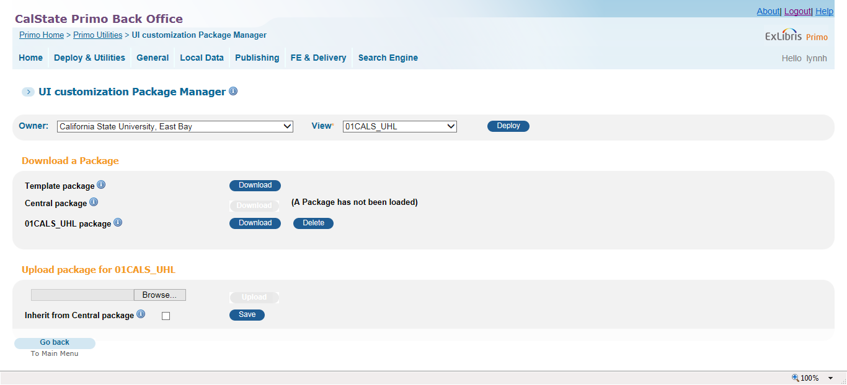
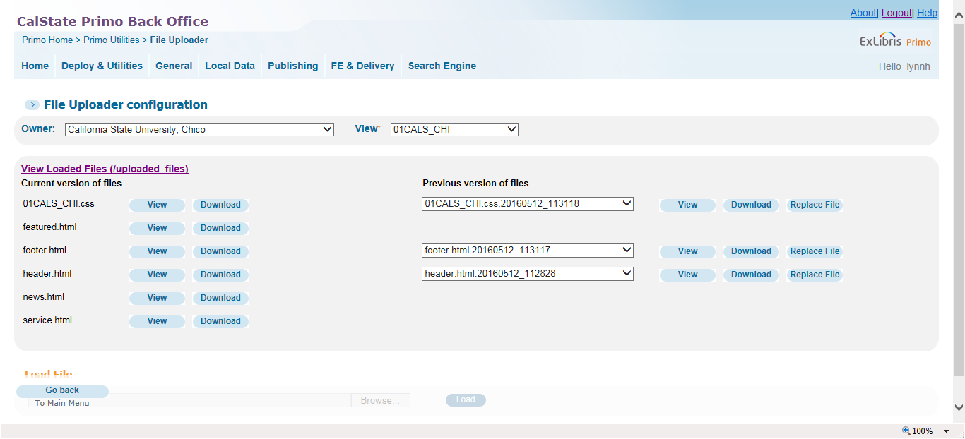
Download UI Files
Primo Utilities > UI Customization Package Manager
Primo Utilities > File Uploader

Slide 22
Questions?

Slide 23
THANK YOU
lynn.higgins@exlibrisgroup.com
james.lefager@exlibrisgroup.com

