Slide 1
Copy Cataloging in Alma
presented by
Marcus Jun & Luiz Mendes
CSU Alma Training
Resource Management
October 5, 2016
Notes:
Goal of our presentation:
To present a brief overview of copy cataloging in Alma, including
To serve as a roadmap for developing cataloging procedures

Slide 2
Acknowledgements
A special thanks to Mallory DeBartolo and Sarina Sinick for organizing the CSU Alma Training series.
Thanks also to Lauren Magnuson for configuring Alma and OCLC to ensure settings for importing records from OCLC Connexion would work for all of us (for this presentation!). And thanks to both Sarina and Lauren for their assistance troubleshooting problems with NZ configurations, passwords, etc.
Thanks to Brandon and David for coming to the rescue when we “screamed” for help.

Slide 3
Contents
Cataloging Methods
Configuration Setup (OCLC & Alma)
Cataloging Steps
  Searching Alma
  Exporting records from OCLC
  Overlaying NZ records, Adding local fields, Creating holdings and items
Cataloging Live Demo!
Cataloging Procedures: Future directions

Slide 4
Copy Cataloging Methods
In Alma, records can be imported via:
Exporting records from OCLC (Connexion)
Title-by-title
Batch processing
Search External Resources (WorldCat, Library of Congress)
Notes:
Briefly demonstrate search ext res and importing from network zone?
Can import network zone record into institution zone. (Appears in IZ repository search when holdings record is attached.)
Oclc Connexion export settings will be institution specific (For ex: login id, password)
For Example, San Marcos uses import of records in batch from OCLC.

Slide 5
OCLC & Alma (Configurations)
To set up Connexion and Alma to import records from OCLC Connexion, follow the procedures outlined in this document:
  OCLC Connexion-Alma Integration
Notes:
Show:
OCLC
Alma
Metadata Editor > File > Options
Set “Placement of New Bibliographic Records” to: Network Zone

Slide 6
Scenario
A new book was sent to Cataloging. Cataloger identifies a brief bibliographic record in the Network Zone.
Assumptions:
Brief order records input in NZ;
PO line created, the item has been received;
Adding the PO line automatically created holding and item records in Alma;
The resource was received in Acquisitions and forwarded to Cataloging.
Cataloging Procedure:
Cataloger must overlay the brief record in the NZ with the full record from OCLC and make any updates to the holdings and item records, as appropriate;
Cataloger must ensure record includes matching OCLC number input in 035 field;
NOTE: Records in Alma must be released!
Notes:
Add caveat about scope of presentation not including acquisitions? I added the PO line because it creates holdings and item records which impacts cataloging
(Release all Records!) or SAVE AND RELEASE RECORD

Slide 7

Example 1
Title: Girl on the train (Paula Hawkins)
ISBN: 9781594634024
OCLC: 953415919 (pcc, DLC)
First Riverhead trade
paperback edition
Notes:
Love warrior (dlc/pcc, oclc 950202463)
Woman in cabin 10 (dlc/pcc, fiction, oclc 945072389)
Handmade Christmas (I level, oclc 937454651)
The pub (I level, oclc 935196555)
Craft pizza (brief record, oclc 940934172)
Mikoyan mig (brief record, oclc 919860050)

Slide 8
Step 1: Search Alma
Search Alma for ALL TITLES
  Before importing a record catalogers must search (by TITLE, OCLC #, ISBN) for a title in both the Institution Zone and the Network Zone.
  Ensure record includes OCLC record number (035)
The objective is to avoid unintended overlay of records and duplicate records in the Network Zone!
Notes:
Demonstrate All Titles Alma repository search.

Slide 9
Step 2: Catalog in OCLC Connexion
Find record in Connexion
Ensure OCLC record number matches OCLC record number in Alma NZ record (035 field)
Export record

Slide 10
Step 3: Complete Cataloging in Alma
Check overlay of NZ record
Add Local fields (e.g., Cataloger’s initials, etc.)*
Edit holdings: Add call number
Edit item record: Add barcode
Notes:
*Explain that adding local fields can be done via Normalization Rules as well.
Overlay, update holdings call #, add barcode in item editor.

Slide 11
Putting the Pieces of the Puzzle Together:
Copy Cataloging Live Demo!
Notes:
After Live Demo! PAUSE For QUESTIONS!

Slide 12
Scenario
A new book was sent to Cataloging. Cataloger identifies a brief bibliographic record in the Network Zone input by another CSU library.
Assumptions:
Brief order record input in NZ CSU libraries.
Cataloging Procedure:
Cataloger must overlay the brief record in the NZ with the full record from OCLC and create holding and item records for the local library;
Cataloger must ensure record includes matching OCLC number input in 035 field;
NOTE: Records in Alma must be released!
Notes:
Add caveat about scope of presentation not including acquisitions? I added the PO line because it creates holdings and item records which impacts cataloging
(Release all Records!) or SAVE AND RELEASE RECORD

Slide 13

Example 2
Title: The Pub (Pete Brown)
ISBN: 9781910254523
OCLC: 935196555
Step.1. Search Alma
Check OCLC Record number
Step 2. Catalog in Connexion
Step 3. Complete cataloging in Alma
Local data
Holdings, items

Slide 14
Future Directions
ULMS TS Task Forces:
Development and refinement of cataloging procedures;
Development and testing procedures for cataloging using batch processing;
Creation of shared import profiles and normalization rules;
Creation of templates (bib and holdings);
… and more!

Slide 15
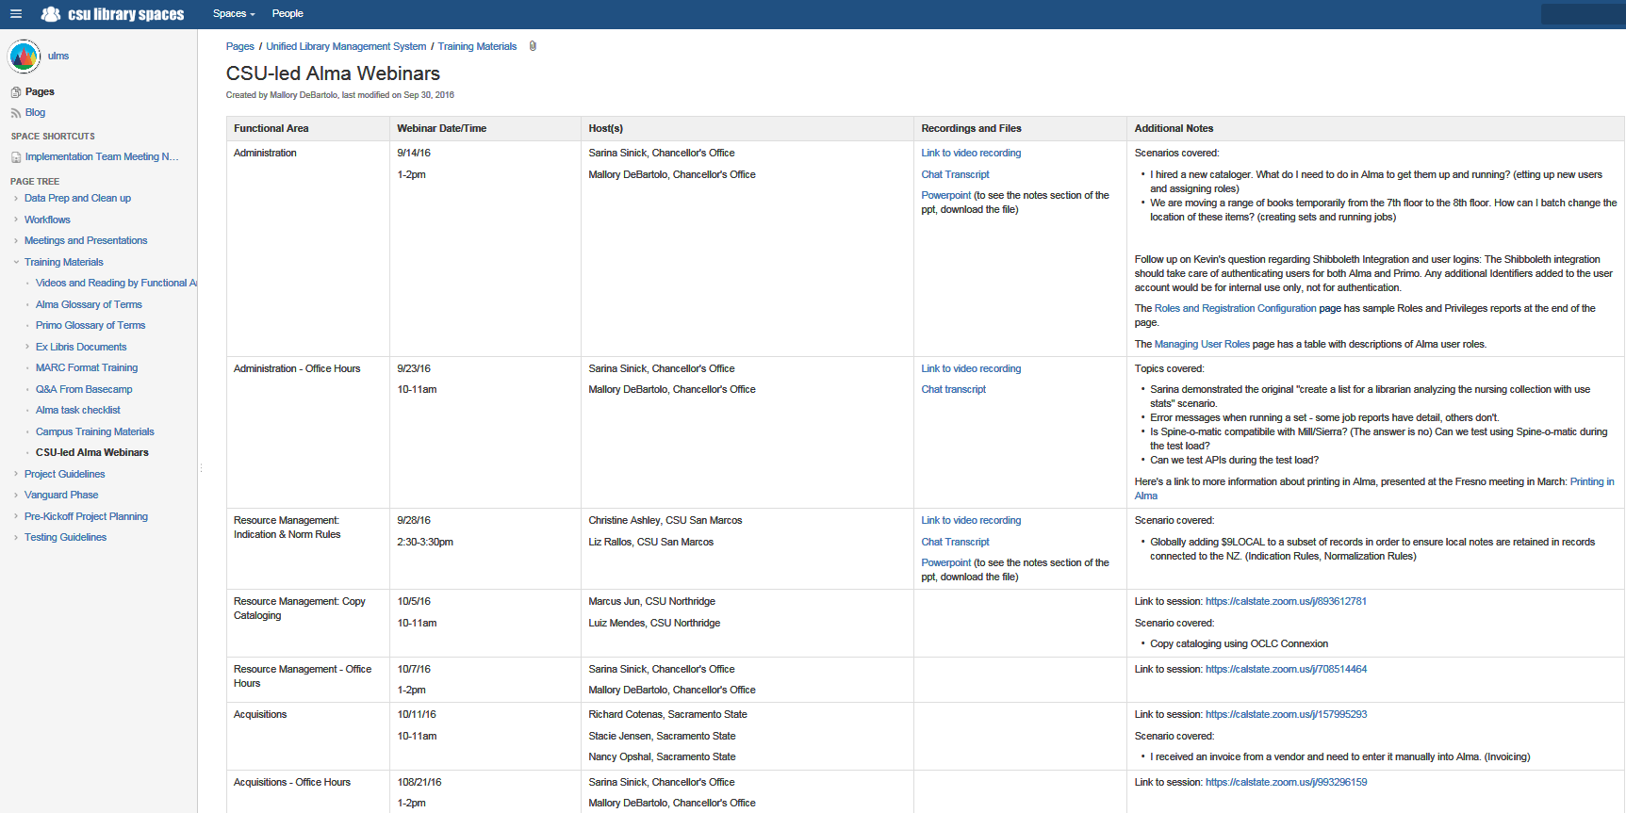
Upcoming CSU Alma Training

Slide 16
Thank You!
marcus.jun@csun.edu
luiz.mendes@csun.edu
Questions?

