Slide 1
949 field and Connexion export
Using the 949 field to populate call number, barcode
Preliminary info, subject to change

Slide 2
Current use in Connexion with Millennium
Use the 949 field to create item record with call number, location, item type, status and barcode
949
|z call number type
|a call number
|l location
|t item type
|s status
|I barcode

Slide 3
Alma: Import profiles (for batch records)
In Alma, an import profile is used to import batches of records from a Marc file or from an ftp server
In the Inventory settings you can indicate 949 subfields to populate barcode and location in Alma item/holdings records.
There is an option to update call number in the holdings record from the bibliographic record.

Slide 5
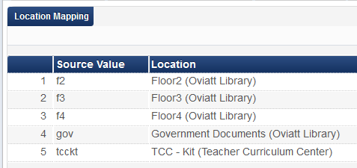
Alma: Import profiles (for batch records)
In the Mapping tab you can specify location codes (949 |l) that correspond to locations (852 |b and |c in holdings record)
For example, location code, f4 maps to 852 |b Oviatt |c f4

Slide 6
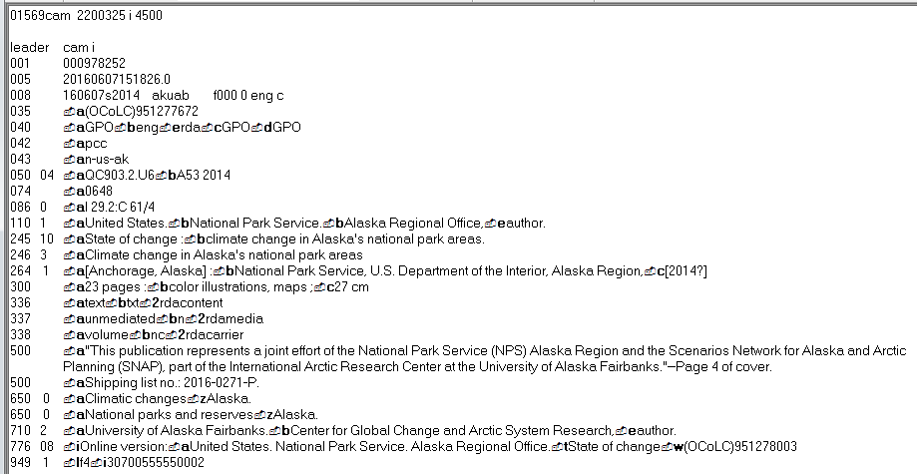
Sample record used with import profiles
949 _1 $l f4 $i 30700555550002

Slide 7
Export result in Alma
Holdings record
852 |b and |c populated with location code, f4
852 |h and |I populated with call number from bib record

Slide 8
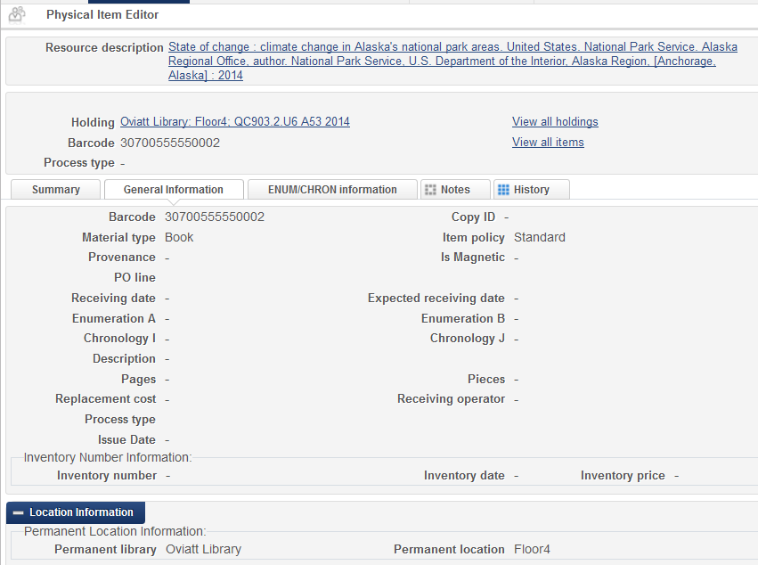
Export result in Alma
Item record

Slide 9
Alma: Connexion exported records
OCLC Connexion integration profile
Alma, Administration, General Configuration, Configuration Menu, External Systems, Integration Profiles
Does not have same 949 inventory-populating functionality as import profiles so cannot use 949 subfields to update call number, location and barcode.
If you would like to ask Exlibris to add this function please vote on the Idea Exchange website
http://ideas.exlibrisgroup.com/forums/308173-alma/suggestions/16336627-ability-to-use-import-profiles-on-oclc-connexion-e
To vote you just need an email address.

Slide 10
Oclc Connexion Integration profile
No Inventory or Mapping tabs

Slide 11
Issue: 949 remains in NZ record

Slide 12
Do we even need the 949 inventory-creating functionality for Connexion exported records?
If a resource we are cataloging has a PO line attached to the bib record at time of order, then Alma will automatically create inventory (holdings and item records).
So a cataloger would not need 949 field in Connexion to create inventory
Just need to verify/update call number in existing holdings record and update barcode in existing item record

