Slide 1
Activating
Local Collections
San Diego State University Library
ULMS Presentation
November 8th 2016
Tyler Rogers & Jennifer Rogers

Slide 2
Pre-Alma Workflow Overview
MONOGRAPHS
Harvest e-book packages based on URLs in OCLC.
Purchased records from vendors.
Added 793 (now 973) field for local collections (including single e-book orders).
856 field points directly to resource.
SERIALS
Use Serials Solutions MARC record service. MARC records point to the journal finder that have all iterations of a journal.
Portfolios are also selected in SFX to allow for “Find Full-Text” functions from databases.
856 field URL points to Serials Solutions journal finder.

Slide 3
STANDARDS
** Open URL (NISO): ANSI/NISO Z39.88-2004 (R2010) The OpenURL Framework for Context-Sensitive Services.
** KBART (Knowledge Bases And Related Tools) UK Serials Group: KBART standards have helped shape the format of package spreadsheets.
** Crossref (DOI service): standard to allow for full-text linking between library-subscribed resources.

Slide 4
Portfolio Loader Spreadsheets Used (Example from LOCKSS
Spreadsheet from LOCKSS Server
-Note “publication_title” and “print_identifier” instead of “TITLE and “ISSN”. These are KBART standard data fields. These fields must be copied over to the Portfolio Loader spreadsheet in order for the upload process to work.
-http://www.niso.org/apps/group_public/download.php/16900/RP-9-2014_KBART.pdf (page 18-19)
Portfolio Loader Format

Slide 5
PROBLEM: COMMUNITY ZONE RECORD METADATA IS NOT SO FULL (YET).
Example: Gale’s Eighteenth Century Collections
Title: Achilles in petticoats an opera. As it is performed at the Theatre-Royal, in Covent-Garden. Written by Mr. Gay, with alterations. The music entirely new by Dr. Arne
Community Zone Record: MMS ID 993360000000180801 (8 fields populated, lacks author and any subject heading)
Network Zone Record: MMS ID 991044743159702901 (contains 41 fields, including subjects and author)
Also can be a little awkward to select (requires a lot of prep work).

Slide 6
Community Zone Record

Slide 7
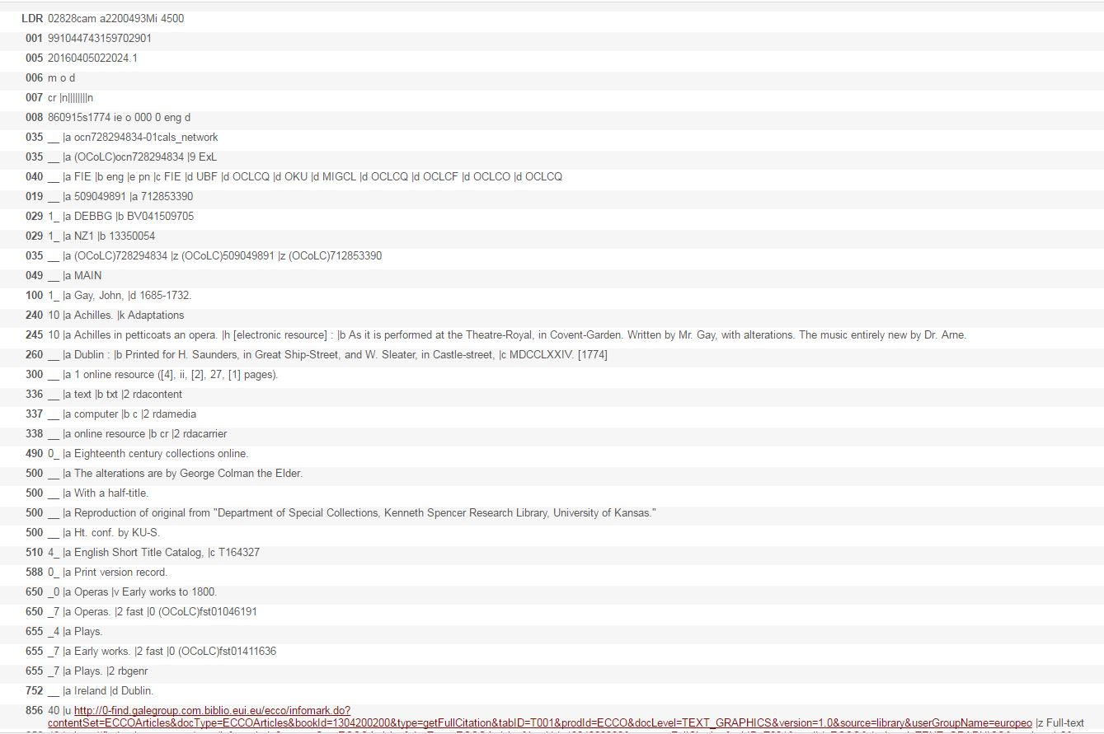
Network Zone (Formerly SDSU) Record

Slide 8
SFX to Alma Transition: Terminology
https://calstate.atlassian.net/wiki/display/ULMST/SFX+-+Alma+Glossary
Courtesy of Jessica Hartwigsen

Slide 9
New Workflows with Alma
-- Create local electronic collections.
-- We will probably still add 973 fields. (e.g. “Rittenhouse Nursing e-book collection” or “EBSCOhost/OCLC ebooks online”).
-- 856 fields aren’t used anymore but usually are still kept in bib records. Instead links from portfolios are used.
--Not sure if we’ll use electronic collections for e-books. Maybe Collection Manager.
-- SFX will not be used after migration.
--Note two systems now instead of four!

Slide 10
Alma Training Resources
Managing Electronic Collections Documentation: http://knowledge.exlibrisgroup.com/Alma/Product_Documentation/Alma_Online_Help_(English)/Resource_Management/050Inventory/020Managing_Electronic_Resources
Creating an Electronic Collection:
https://www.youtube.com/watch?v=ePNnwdARlmE&hd=1
Adding/Deleting/Updating Portfolios:
http://knowledge.exlibrisgroup.com/@api/deki/files/39140/Using_the_Alma_Portfolio_Loader_-_Examples.pdf
https://www.youtube.com/watch?v=jHbJ2IDLgYs&hd=1
http://knowledge.exlibrisgroup.com/Alma/Product_Documentation/Alma_Online_Help_(English)/Resource_Management/050Inventory/020Managing_Electronic_Resources#Adding.2C_Updating.2C_or_Removing_Portfolio_Information_in_Bulk_Using_an_Excel_File
SFX to Alma Configuration Guide:
http://knowledge.exlibrisgroup.com/@api/deki/files/26602/SFX_Target_and_Alma_E-Collection_Configuration.pdf

