Slide 1
Cataloging in Alma
Copy cataloging in Alma with records from Search External Resources

Slide 2
Copy cataloging methods
- In Alma import record through Search External Resources or from Network Zone
- In OCLC Connexion export record into Alma

Slide 3
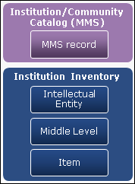
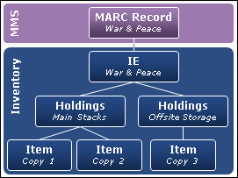
MMS (bib record), Holdings, Item
http://knowledge.exlibrisgroup.com/Alma/Product_Documentation/Alma_Online_Help_(English)/Resource_Management/050Inventory/010Introduction_to_Alma_Inventory

Slide 4
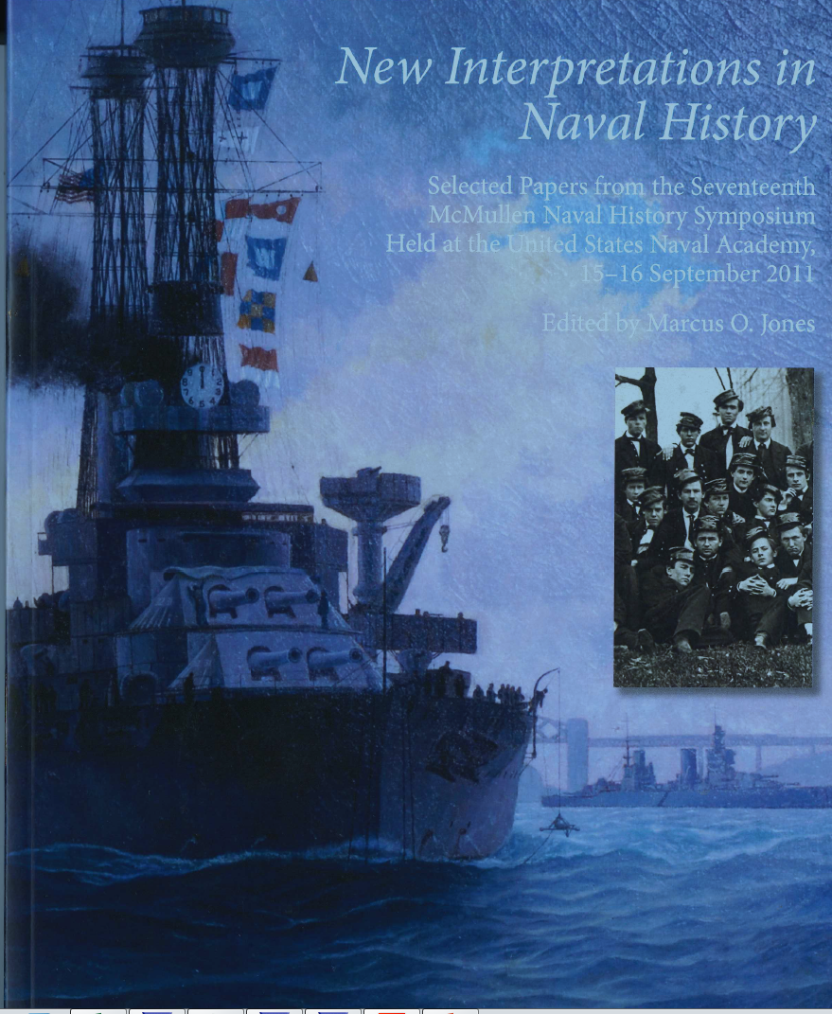
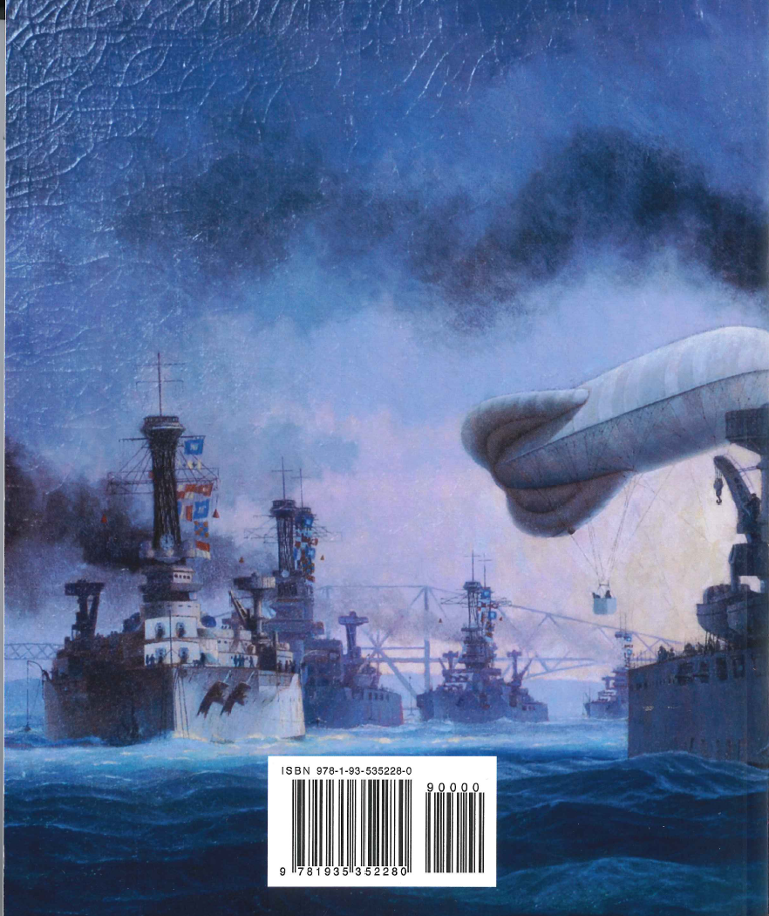
Monograph Example (isbn 9781935352280)
Notes:
Alternative example: isbn 9781598534733 title: war no more : three centuries of American antiwar and peace writing or oclc 947857970 White house garden tour. OCLC 839438312 Case management manual for United States bankruptcy judges.
Network zone: oclc 939920810 Treasured landscapes
Movie: Fat, sick & nearly dead (oclc 712068552)

Slide 5
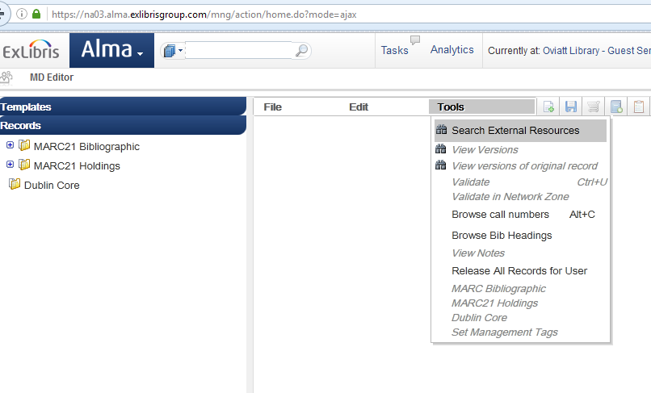
1. Metadata Editor
-Tools, Search External Resources

Slide 6
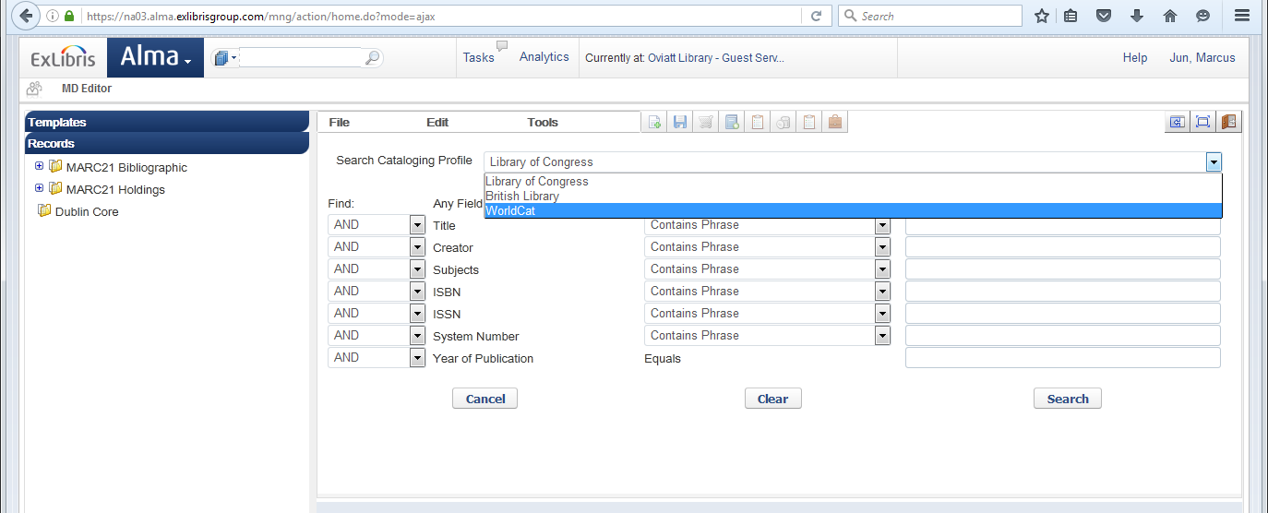
9781935352280

Slide 7
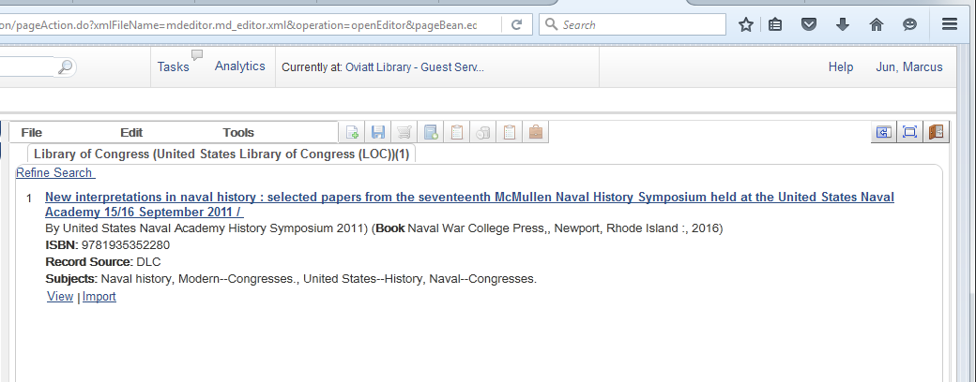

Slide 8
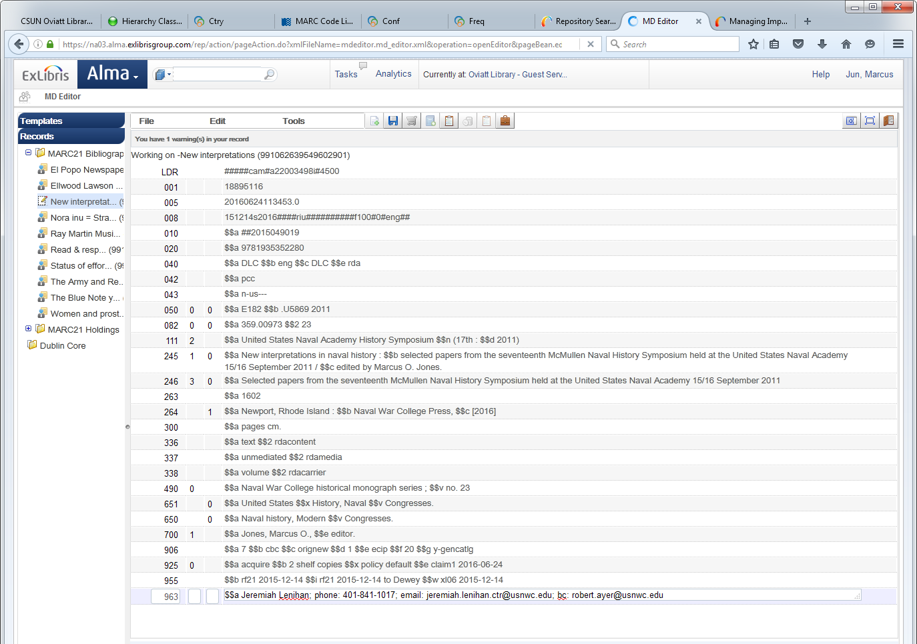

Slide 9
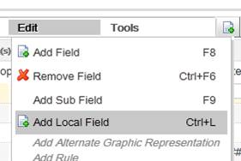
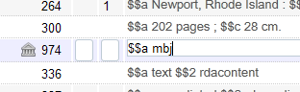
974: Add Local Field (Ctrl+L)
Notes:
If using Ctrl+L then don’t have to add $$9 LOCAL.

Slide 10
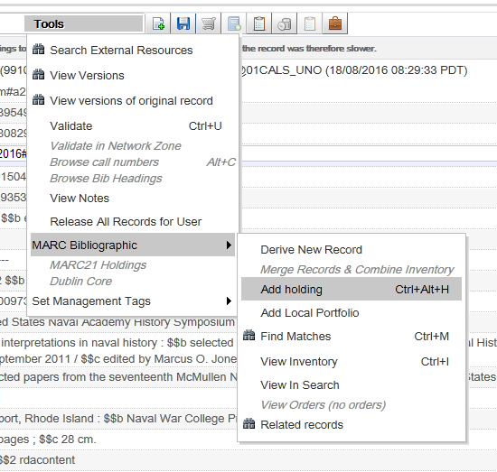
2. Add Holdings record
Tools, MARC Bibliographic, Add holding (Ctrl+Alt+H)

Slide 11
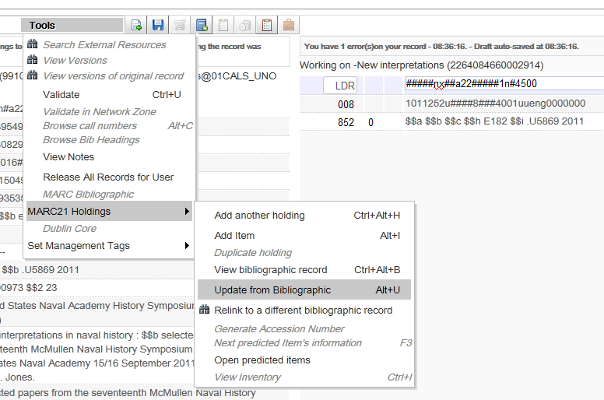
852 $$h, $$i from 090, 050 in bib record
Tools, Marc21 Holdings, Update from Bibliographic (Alt+U)
Notes:
By default Alt+U copies LC call number from 090 (if exists) or if 090 doesn’t exist then 050 field. (http://knowledge.exlibrisgroup.com/Alma/Knowledge_Articles/Holding_852_subfield_%24%24i_is_missing_-_how_to_update_in_batch%3F)
If you want to copy a different classification scheme, in the 852 field first indicator you enter the number. For example, entering 3 will copy 086 (sudoc call number) into $$h.

Slide 12
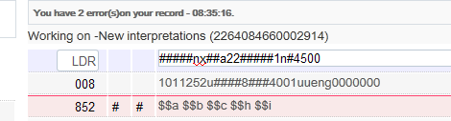
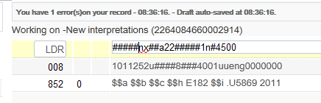
852: Before and After

Slide 13
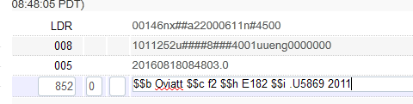
852 $$B $$C
-In 852 $$b add “library”
  Examples: TCC, Map, SCA, MM, RPM, Oviatt (case sensitive)
-In 852 $$c add shelving location within “library”
  Examples: tccmd, maprf, spc, mmi, RPMPRR, f2 (case sensitive)

Slide 14
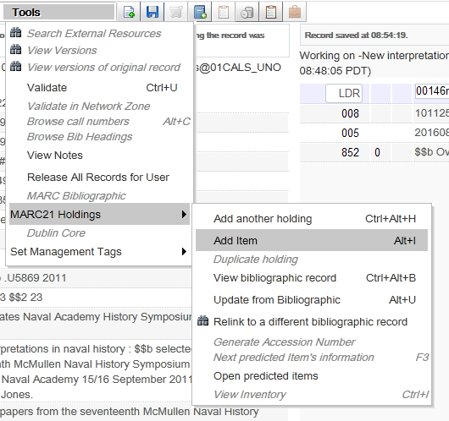
3. Add Item
Tools, MARC21 Holdings, Add Item (Alt+I)

Slide 15
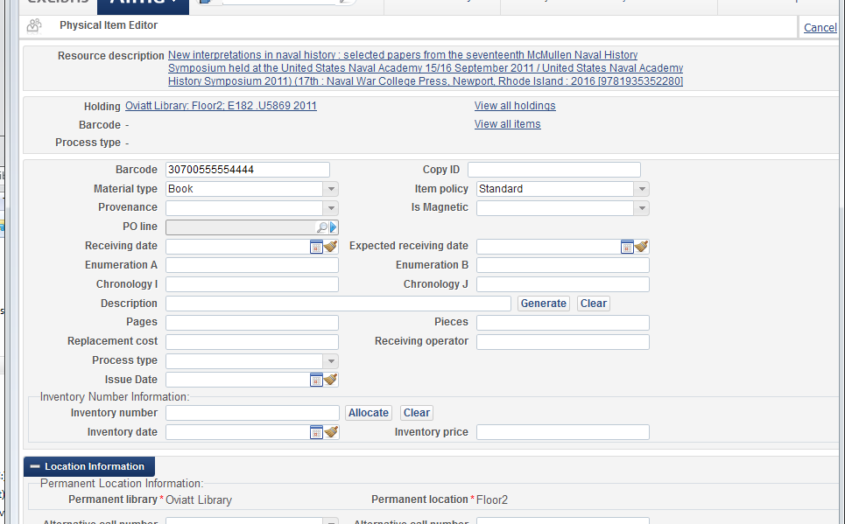
Physical item editor
Add barcode, material type, and item policy

Slide 16
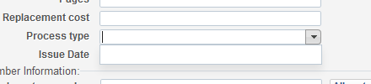
-System limitation: can’t change process type to “in processing” at item creation. Save, close physical item editor, re-open item editor, and then change the process type. (http://knowledge.exlibrisgroup.com/Alma/Knowledge_Articles/Cannot_edit_or_add_Process_Type_when_creating_an_item_-_why%3F)
-Lauren asked Exlibris if all new physical items could be set by default to “in processing”.
-Another option: Use Scan In Items under Acquisitions to Set Status to Cataloging to indicate that item is “not in place”

Slide 17
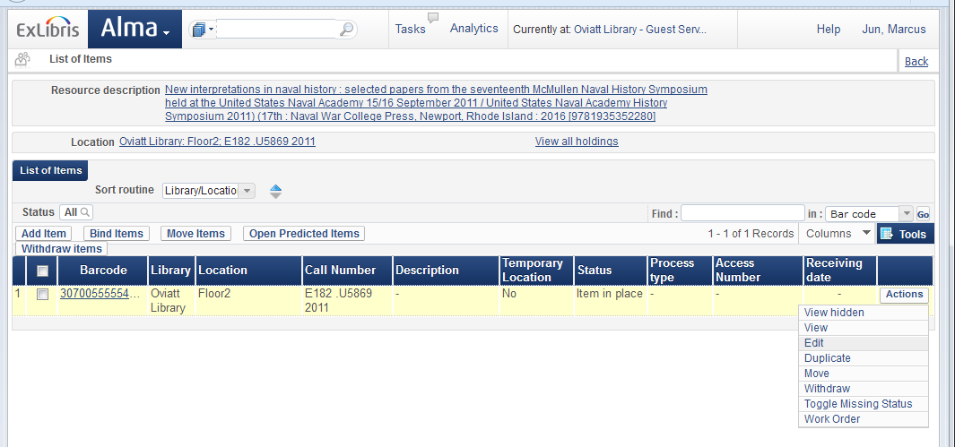

Slide 18
