Slide 1
Indication rules in alma
Filtering a set of records
by Marc field and subfield

Slide 2
Purpose
Exlibris definition: “Indication rules are used to filter sets. The result of the filtering process is a new set that is created that is a subset of the original set.”
In Alma you can create a set from search results and to narrow the results further you can use indication rules.
An Alma search index can include more than one MARC field. For example, the Local Notes search index includes all 59x fields. But if you want to search a specific field (ex: 590) you must use an indication rule.
So if you are searching for the phrase “Special collections copy has” in a 590 note you would conduct a repository search, save the set, and then run an indication rule for the phrase in the specific 590 field.
Notes:
In Millennium you could create a list by directly searching for specific fields but in Alma this is a two-step process.
You may not have to use indication rules especially if you are searching an index that includes only one field. For example: 965 internal note. 974 cataloger’s initials, 964 discipline fund code, 973 local collection title, 966 summary holdings, 963 vendor record number.

Slide 3
resources
Alma documentation:
http://knowledge.exlibrisgroup.com/Alma/Product_Documentation/Alma_Online_Help_(English)/Resource_Management/020Using_the_Repository_Search/030Managing_Search_Queries_and_Sets#Working_with_Indication_Rules
Exlibris presentation: http://knowledge.exlibrisgroup.com/@api/deki/files/42088/Rules_-_Indication_rules_and_set_filtering.pptx
Indication rules examples: http://knowledge.exlibrisgroup.com/@api/deki/files/42081/Rules_-_Indication_rule_examples.docx

Slide 4
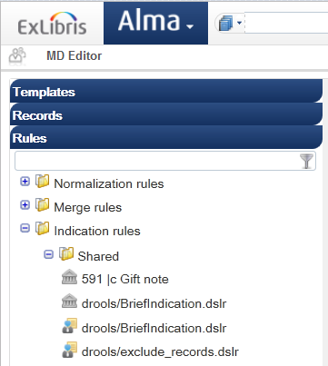
Metadata editor
Similar to normalization rules, indication rules are found in the Metadata Editor, under Rules, Indication rules.

Slide 5
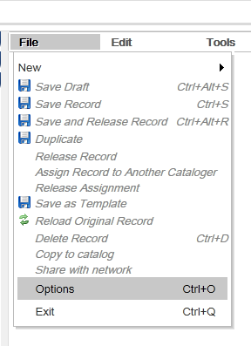
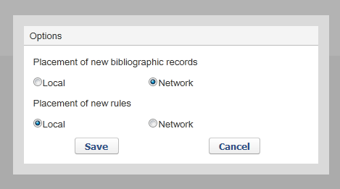
Save rules in local zone
Notes:
Although rules can be saved to the network zone, some rules may be institution specific or even cataloger specific. Additionally, rules must be saved locally if you wish to filter sets.

Slide 6
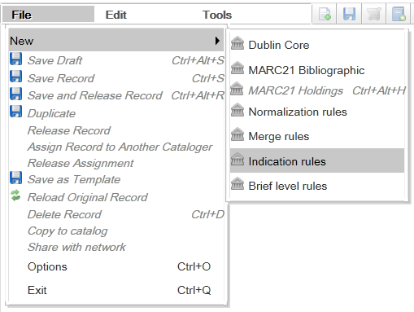
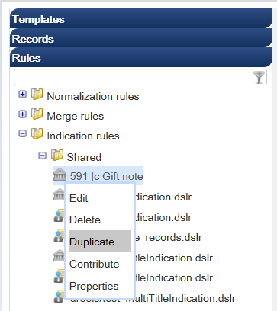
Creating a new rule
File, New, Indication rules
Or duplicate from existing rule

Slide 7
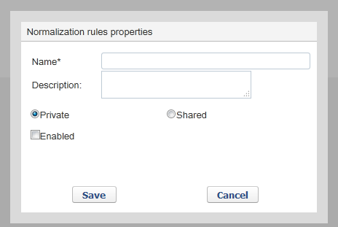
Indication rules properties
Notes:
Private: only you can work on the rule.
Shared: can be viewed and edited by all catalogers
Enabled: if an indication rule is not enabled it cannot be used on a record. You might want to “disable” an indication rule if it is undergoing testing.

Slide 8
Example
rule "590 Special Collections copy has"
when
exists "590.a.Special Collections copy has*"
then
set indication."true"
end
Notes:
Use “when” condition to filter the set. The second half of the indication rule from “then… …end” remains the same for all indication rules.

Slide 9
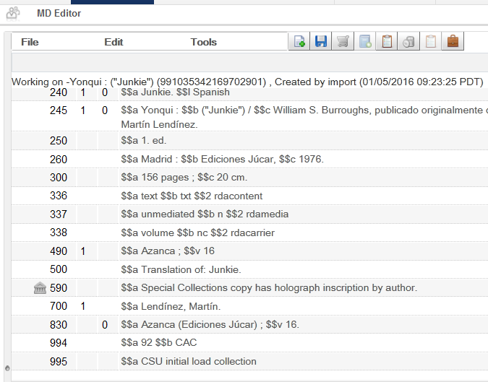
Testing the rule
You can test the indication rule by opening a bibliographic record in Metadata Editor.

Slide 10
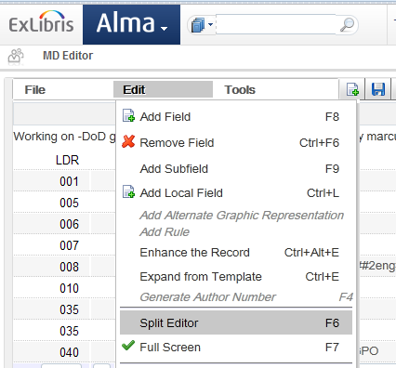
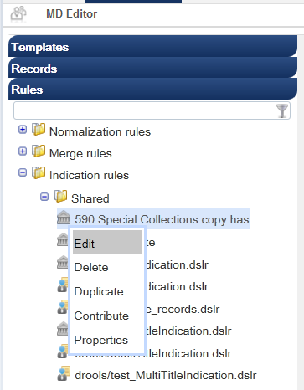
Edit, Split Editor (F6). Then Edit the indication rule you wish to test.

Slide 11
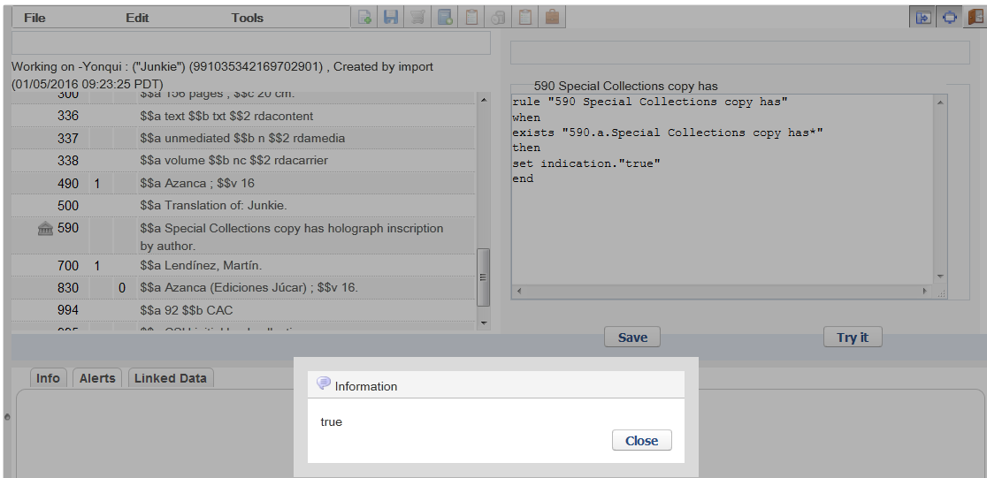
Try it
Notes:
When you click on “Try it” a pop-up window will display true or false depending on whether or not the record meets the conditions of the indication rule. In this example, the record has a 590 field with subfield a that begins with Special collections copy has… so the indication rule returns true.

Slide 12
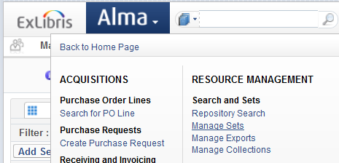
Filter a set
I have already saved a set with 50k records (SCA Library, Physical titles). To apply a filter to a set, go to Resource Management, Search and Sets, Manage Sets

Slide 13
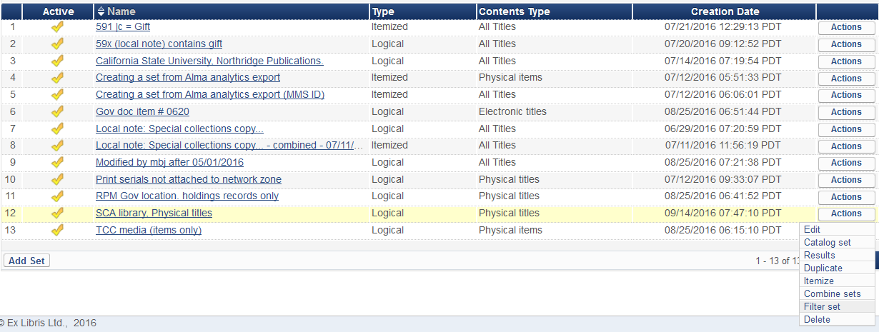
Find the set you wish to filter, then Actions, Filter set.

Slide 14
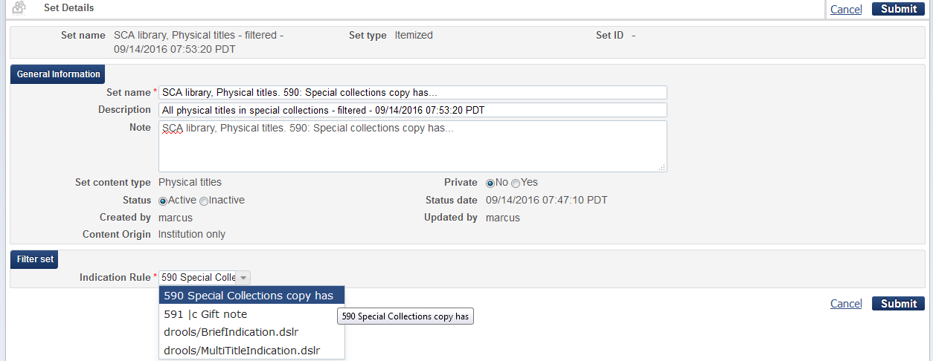
Name the new set, choose indication rule

Slide 15
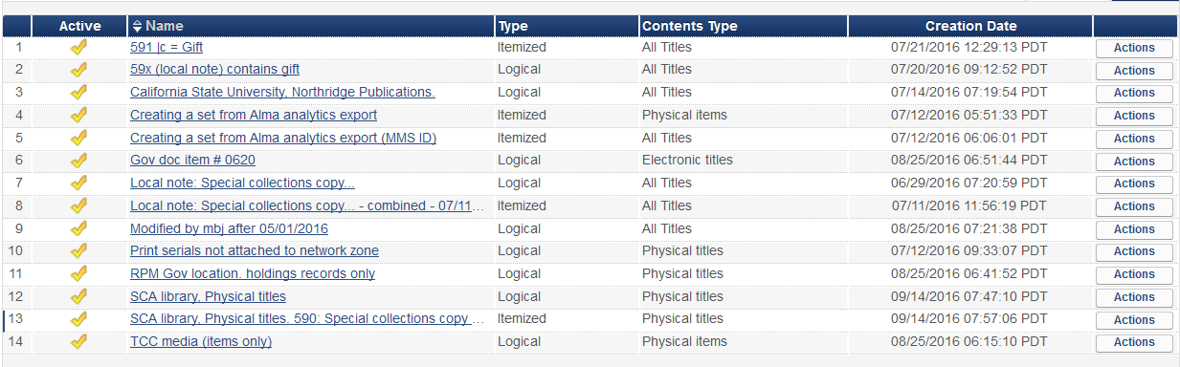
Result: set #13 with 63 records
(original set)
50,970 records
63 records
Notes:
Set 12 is the original set and set 13 is the filtered set.

