Slide 1
CalState
Data Migration Preparation
October 14, 2015

Slide 2
Copyright Statement
All of the information and material inclusive of text, images, logos, product names is either the property of, or used with permission by Ex Libris Ltd. The information may not be distributed, modified, displayed, reproduced – in whole or in part – without the prior written permission of Ex Libris Ltd.
TRADEMARKS
Ex Libris, the Ex Libris logo, Aleph, Alma, SFX, SFXIT, MetaLib, DigiTool, Verde, Primo, Voyager, MetaSearch, MetaIndex and other Ex Libris products and services referenced herein are trademarks of Ex Libris, and may be registered in certain jurisdictions. All other product names, company names, marks and logos referenced may be trademarks of their respective owners.
DISCLAIMER
The information contained in this document is compiled from various sources and provided on an "AS IS" basis for general information purposes only without any representations, conditions or warranties whether express or implied, including any implied warranties of satisfactory quality, completeness, accuracy or fitness for a particular purpose.
Ex Libris, its subsidiaries and related corporations ("Ex Libris Group") disclaim any and all liability for all use of this information, including losses, damages, claims or expenses any person may incur as a result of the use of this information, even if advised of the possibility of such loss or damage.
© Ex Libris Ltd., 2013

Slide 3
Agenda
Migration Scope
Documentation
Alma core components
Migration Form, Migration Mapping table
Physical to Electronic
Data Extract

Slide 4
Migration Scope
ILS (Millennium/Sierra (III), Voyager, Koha)
SFX link resolved
ERM (Verde, Non-Exlibris ERM)

Slide 5
Documentation
ILS - Millennium and Sierra (III)
Millennium and Sierra (III) Delivered Files List.xlsx
Millennium and Sierra (III) Field Mapping.xlsx
Millennium and Sierra (III) Migration Form.xlsx
Extracting Records from Millennium and Sierra (III) for Migration to Alma.pdf
Millennium and Sierra (III) to Alma Data Delivery Instructions.pdf
Millennium and Sierra (III) to Alma Migration Guide.pdf

Slide 6
Documentation
SFX
SFX to Alma AutoExtract Migration.pdf
SFX to Alma Migration Guide.pdf
Additional documentation (if required)
Link resolver (local) to Alma Activation.pdf

Slide 7
Documentation
E-resources migration
Electronic Resource Handling in Alma Migration.pdf

Slide 8
Documentation
ERM
Check documentation under
Migration > Electronic > ERM Non-Ex Libris
Migration > Electronic > Verde

Slide 9
Agenda
Migration Scope
Documentation
Alma core components
Migration Form, Migration Mapping table
Physical to Electronic

Slide 10
Areas to be Migrated Once
Remember: There are three areas of data migration that are deeply tied to the configuration processes of Alma and are only migrated from the source systems once - during the test load:
Libraries
Locations
Vendors

Slide 11
Core Components
Institution:
  Each Alma installation is composed of a single institution that includes one or more libraries
Library:
  Physical building/place where materials are stored
  Has its own open hours
Locations:
  Physical locations/collections in the library
  Fulfillment policies are driven by locations and user group

Slide 12
Alma Locations
Locations in Millennium are generally analogous to locations in Alma.
Libraries are groups of locations.
A location may belong to only one library.
Since Millennium has only one level of location, we must create a list of Alma library locations upon migration to Alma.
Generally, the Millennium location corresponds to the physical/shelving in Alma.

Slide 13
Alma Libraries
  Based on input in Alma Library tab
  See Millennium to Alma Migration Guide “Creating a List of Alma Libraries” section

Slide 14
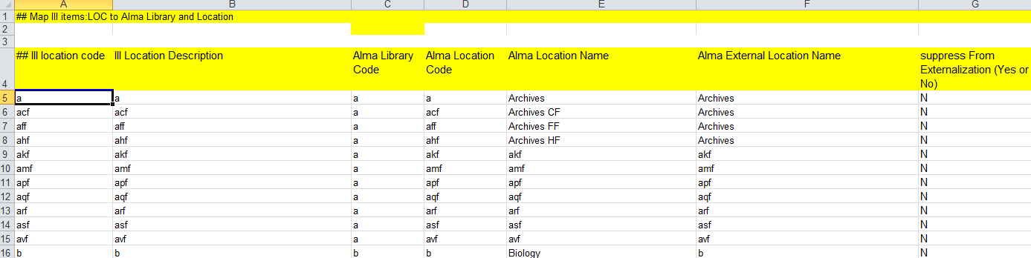
Alma Locations
After determining your Alma libraries, determine which Millennium locations belong to each library and how they map to libraries and locations in Alma
See Millennium to Alma Migration Guide “Location Mapping” section

Slide 15
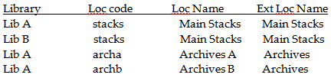
Alma Locations
Mapping table can collapse location codes – two location codes into one Alma Location code
Alma Location names are unique per library

Slide 16
Agenda
Migration Scope
Documentation
Alma core components
Migration Form, Migration Mapping table
Physical to Electronic

Slide 17
Resource Management and Inventory

Slide 18
Migration – Bibliographic data
Institution Zone
Bibliographic records
Inventory – physical (items, holdings records), electronic inventory (portfolios, electronic collections)
Patrons
Fulfillment – Loans (active), hold requests (on hold shelf), fine & fees (active)
If included:
Acquisition – vendors (migrate once in test load), purchase orders, funds
Course Reserves – Course information, Reading lists
Network Zone
The “Master” NZ record and group of de-duplicated bibliographic records from all institutions with linking between IZ (Institution Zone) and NZ (Network Zone) records.
Optional:
Shared electronic resources
Global Vendor file

Slide 19
NZ record
Each institution provides file of bibliographic records.
Each site ensures that there is a single standard shared identifier (such as OCLC ID) across the records in order to allow the Network Zone to be populated and de-duplicated based on this defined identifier. Typically, the largest members’ relevant records are contributed to the Network Zone first, and smaller sites either link to already contributed records or contribute their unique records.
Only records with relevant matching criteria are considered for contribution and linking. Records with no identifier selected for matching will remain in IZ and not contributed to NZ.

Slide 20
Local Extentions
Local fields - 09X, 59X, 69X and 9XX and
extension $$9 LOCAL
Consortia members may want to share bibliographic records but still maintain some local information in their IZ record. This can be accomplished through the use of local tags.
Tags in the 09x, 59x, 69x, and 9xx ranges that are marked with $9 LOCAL are saved in the IZ as local extensions to the master Bib record. Tags that are not in these ranges, as well as tags in these ranges that are not marked with $9 LOCAL are not saved in the IZ.
Notes:
If local extension fields are provided, it is recommended that local institutions use the range 950-999 for this. Network zone shared records can identify local fields that are not local extensions and are shared/used equally across the network. Leaving the 900-949 range open allows this option.
During the migration process, the contents of the NZ record are the contents of the first record of the group. When a record is added to the NZ and no match is found, the record (without local extensions) is added to the NZ and the local extensions are added to the linked IZ record.
When a subsequent record is matched to the NZ record, the subsequent record’s local extensions are saved to the linked IZ record, and all other tags from the subsequent record are discarded in favor of the first-in NZ record.

Slide 21
Suppressed records
Each institution provides file of suppressed bibliographic records. IZ suppressed records migrate with suppressed flag into IZ.
When building the NZ, it is typically recommended that all shared catalog records are not suppressed so that each IZ can decide on its own suppress behavior.
Suppression in Alma can also be done at the holdings administrative level (not part of migration).
Migration form enables to define location as suppressed.
Notes:
In this case, when records are exported to Primo, the bibliographic record is exported, but no services (holdings) are listed as being available.
Only when a shared catalog record is definitely to be suppressed for all members equally should Bib-level suppression be used in the central catalog.

Slide 22
OCLC Publishing
Each record with OCLC number (035 with official OCLC prefix) will migrate marked for OCLC publishing - (publishing of bibliographic record with embedded holdings data).
If LHR publishing is used another flag should be set in records after migration.

Slide 23
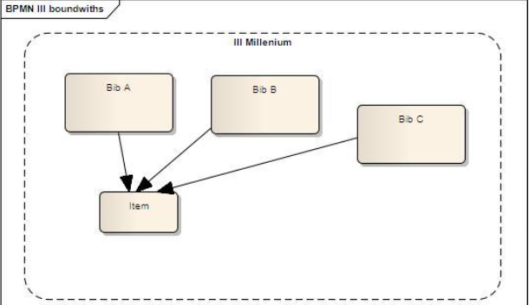
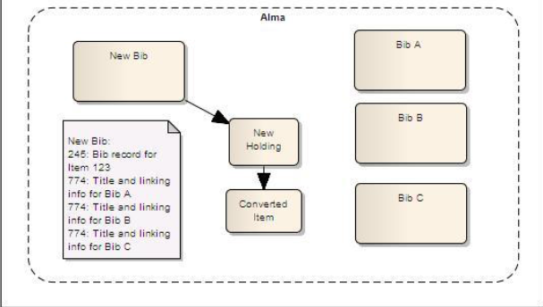
Bound Withs

Slide 24
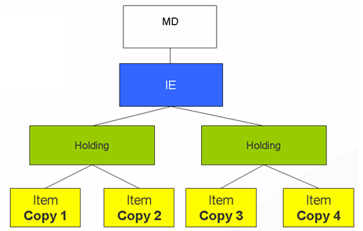
Inventory
    Alma Physical Inventory Structure:

Slide 25
Alma - Holdings Records
The modified MARC holdings record is imported for use in Alma using the multi-level hierarchy of 852‡b and ‡c.
The Alma library is placed in the 852‡b
The Alma location is placed in the 852‡c
Groups for Holding Records
The permanent location and call number in Alma are only stored in the holdings record. All items attached to the holdings record have the same permanent location and call number.

Slide 26
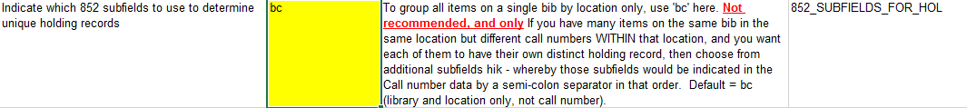
Alma - Holdings Records
MARC holdings records that are either migrated directly from existing MARC holding records or generated from information in the checkin and/or item records.
Indicate which 852 subfields will be used to determine the holdings record groups by answering the Indicate which 852 subfields to use to determine unique holding records question in the Questionnaire tab of the Millennium (III) Migration Form.
Notes:
It is possible to change the default grouping of location to use the location and call number, as described in the following section: Changing the Holding Record Grouping. However, be aware that if you use the location and call number, and your call numbers differ by even a little bit, you may have more holding records than you expected

Slide 27
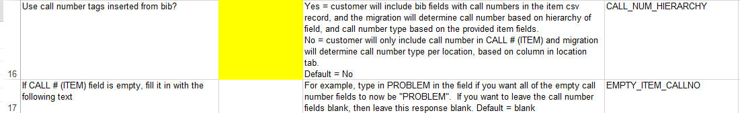
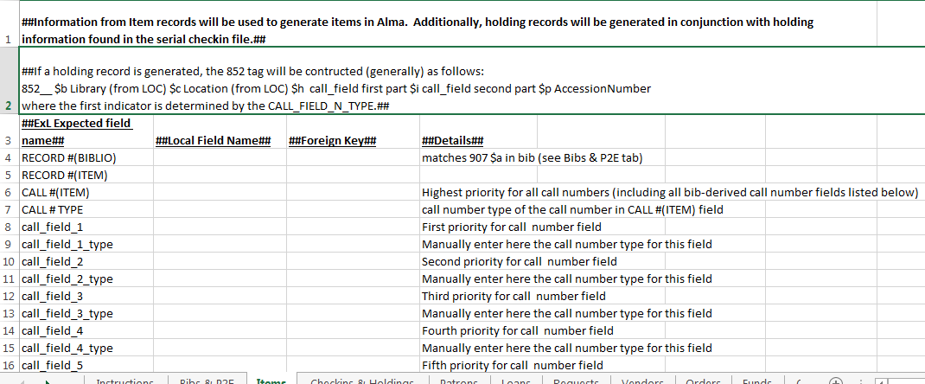
Alma - Holdings record - Call Number
Notes:
If there are any item call numbers that differ from the holdings record’s call number, the differing call number is stored in the item’s Alternative Call Number field

Slide 28
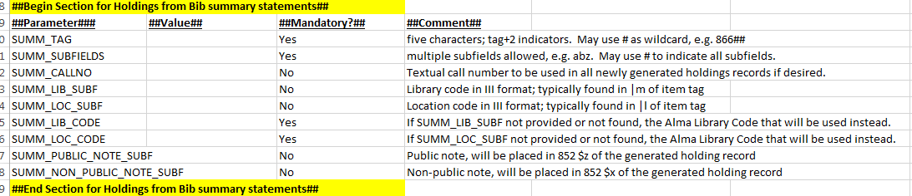
Alma – Holdings record statement
All library has statements (summary holdings statements) are added to the new holdings record in an 866 field. One 866 field is added for each summary holding statement.
Bibliographic record tag has statement infomation – fill in migration mapping form the following section:

Slide 29
Alma - Items
    Millennium Item Type Code migrates to Alma Item Policy field
Item barcode:
  If the barcode is empty, leave as empty.
  If the barcode exists but is not unique:
    First item barcode - migrate as is.
    Second and subsequent item barcodes encountered – migrate as <item barcode>-<item id>.
    Item Statuses in Alma there are two
        Base status (on shelf or not)
        Process type – technical statuses migrate as “TECHNICAL Migration” and internal note 3

Slide 30
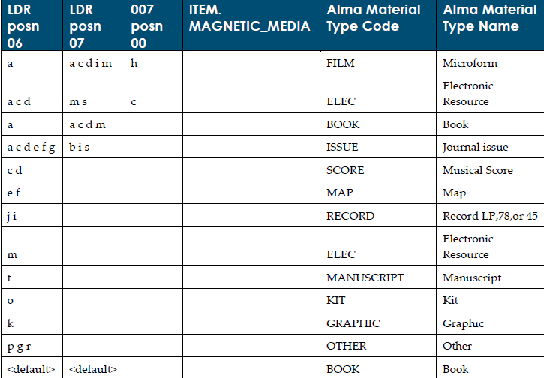
Item - Material type

Slide 31
Fulfillment

Slide 32
Patron Information
Millennium identification number for Alma User Name
Default language
Patron Group codes to migrate as Internal (Local borrowers)
Questionnaire tab

Slide 33
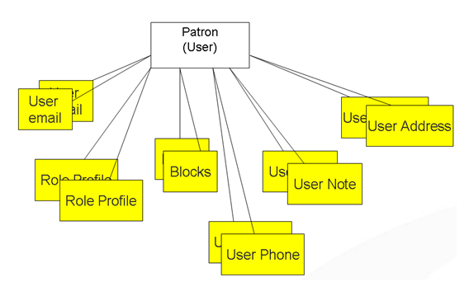
Alma Patron Structure

Slide 34
Patrons
Generally patron information maps from Millennium to Alma directly
  Notes – see Millennium to Alma Migration Guide
  Blocks – suspense date in note
  Internal Patrons
  Active Loans
  Active Requests (on hold shelf for pickup)
  Active Fines and Fees
Review Millennium to Alma Migration Guide for more specifics

Slide 35
Patrons
Patrons in consortium
It is very common for patrons to have duplicate patron records at various institutions in a consortium.
There are two kinds of patron records:
Master patron – the patron record of the patron at their home institution
Stub patron – a copy of the patron record for use at visited institutions
Do you have stub records? Will you migrate them?
Notes:
Post-migration, Alma customers are able to generate new stub patrons in visited intuitions when the workflow requires it. The migrated stub patron records can continue to be used in Alma, depending on customer desires.

Slide 36
Fulfillment
Use Course Reserve BRANCH to Course Unit Map?
Answer ‘Yes’ only in case you have multiple units to manage course reserves and map in Alma Course Unit tab.
Loans – only active loans migrate
Hold requests – only on shelf hold requests migrate
Campus Code – patron’s affiliation for ILL or cross-campus borrowing. If needed - map the HOME_LIBR value to the Alma Campus Code value with this map.
User Stat Categories – if exists map into Alma Statistical categories
Course Faculty – if exists map in table into Alma Academic Departments

Slide 37
Acquisitions
Options: Select Yes or No depending on whether or not you have contracted with Ex Libris to migrate any Acquisitions data.
Notes:
Depends on migration mode per institution. If selected Yes – will migrate

Slide 38
Central or Default Order Library
If you would like to use a Central Order Library for all of your purchase orders that are migrated to Alma, provide a valid Alma Library code in the Central Order Library question (Questionnaire tab)
If you do not define a Central Order Library for all purchase orders, provide a default order location for those orders in Millennium that do not have one defined (Questionnaire tab)
DO NOT FILL IN BOTH FIELDS.

Slide 39
Currency and Fiscal Period
Questionnaire tab
Default Currency= USD
Indicate the library’s Fiscal Period Cycle Pattern (DD-MM-C) (Day/Month/Cycle) (Questionnaire tab)
For example, a one year fiscal period starting on January 1 is indicated by: 01-01-1. A one year fiscal period starting on July 1 is indicated by: 01-07-1.
Alma currently supports one-year fiscal period cycles (therefore the Cycle can only be 1)
Notes:
Alma currently supports one-year fiscal period cycles.

Slide 40
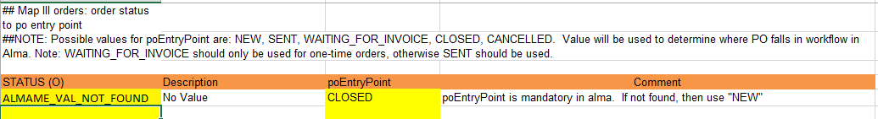
PO Entry point
Status(O) – used to identify POL workflow in Alma.
Mandatory
STATUS (O): The possible values for the order status in Millennium, found in the STATUS (O) field in your order extract.

Slide 41
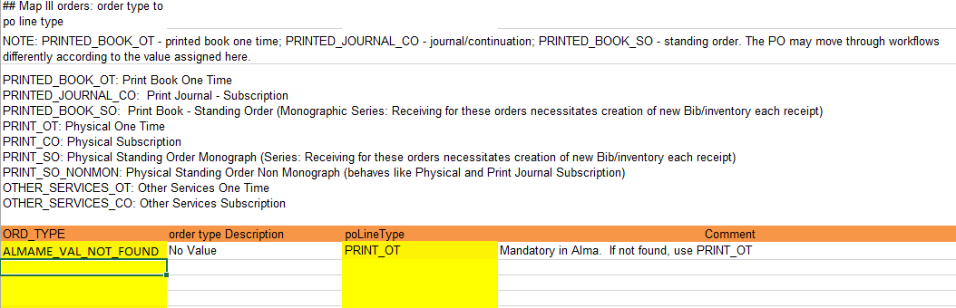
Acquisition
Purchase order line types

Slide 42
Acquisition
Funds
Generated for the current fiscal year based on a single list of funds
LEDGER CODE, LEDGER NAME, FUND CODE, FUND NAME, LIBRARY, EXT ID, ALLOCATION

Slide 43
Vendors
Alma Vendor code is unique
Alma Vendors are also Alma Users (Contacts)
Alma Vendors have list of allowed currencies
Alma Vendor accounts – one required; created if not in Millennium data (minimal information)
Millennium vendor status mapping
Millennium EDI migrated as-is
REMEMBER – One-time migration of Vendor records!

Slide 44
ACQ Method
The acquisition method is an indication of how the order is acquired.
Possible values: PURCHASE, APPROVAL, GIFT, VENDOR_SYSTEM, DEPOSITORY, EXCHANGE, TECHNICAL, and LEGAL_DEPOSIT
Mandatory in Alma
III ACQ_TYPE +/- ORD_TYPE => ACQ Method in Alma

Slide 45
Agenda
Migration Scope
Documentation
Alma core components
Migration Form, Migration mapping
Physical to Electronic
Data Extract

Slide 46
Electronic Inventory
ILS-managed electronic resources – identification and conversion to electronic inventory
SFX-managed electronic resources migration
Identification of potential duplication between SFX and ILS resources

Slide 47
Physical to Electronic
A process (called P2E) converts records identified as electronic to the electronic format indicated in the e-resources extract.
First, the records are migrated as physical; then the P2E process is run to convert them to electronic.

Slide 48
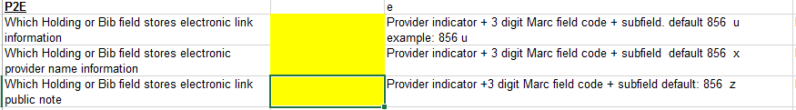
Physical to Electronic
Provide a list of bib keys that identify records that are electronic, in the following format:
b123475,portfolio
b12345,package
b12346,db
Set Location type as electronic in migration form
Fill in link field details
For more information on the electronic migration approach to Alma, refer to the Electronic Resource Handling in Alma Migration document as well as the Millennium to Alma Migration document.

Slide 49
Electronic Types
Portfolio - stand-alone title electronic inventory. Example, journal title
  Specify as portfolio in P2E file
Electronic Collection - subscription/ aggregator package. E-inventory (portfolios) where applicable are stored in Alma. Access provided to the whole package or specific portfolios. Examples, “ProQuest 5000” or “Gale Virtual reference Library”
  Specify as either of the following in P2E file to create as electronic collection in Alma
    package
    db

Slide 50
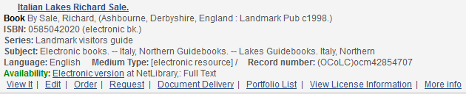
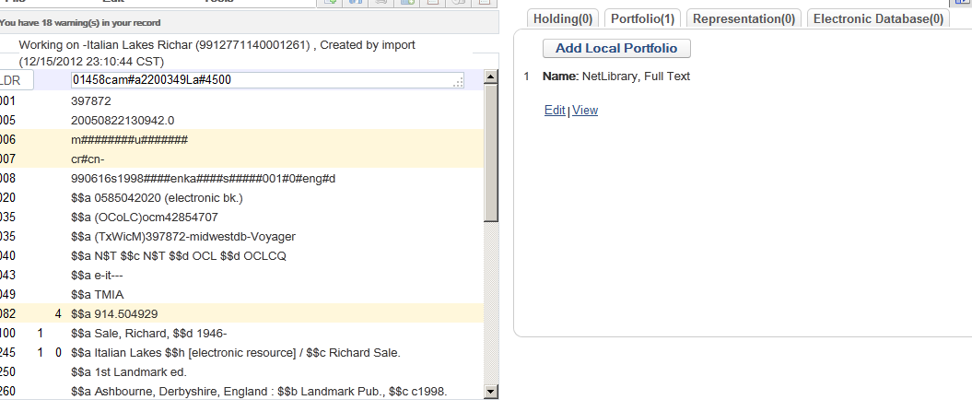
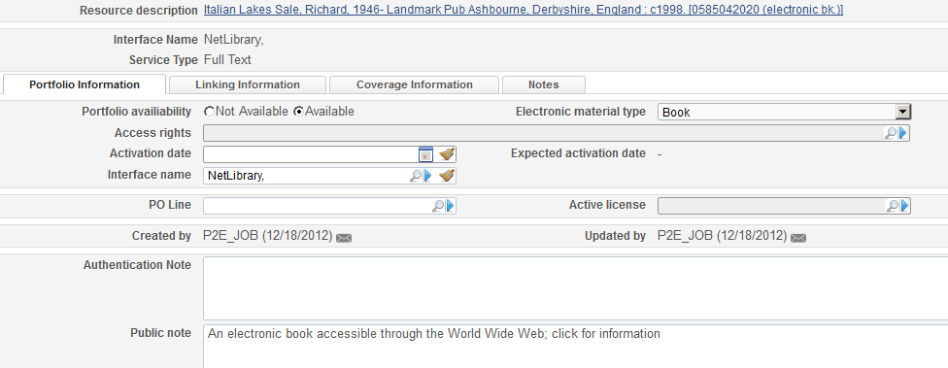
Example of a Portfolio in Alma
You can see the
Electronic version
In the MD Editor,
notice that there is
not a physical, but Portfolio
Details of the
Portfolio

Slide 51
ERM
    Licenses – (XML)
      License details (license code, start date )
      License Terms
      License attachments (optional),
      Notes
    Vendor Interfaces (link to vendor record in Alma) - (XML)
      Vendor / Vendor account details (core vendor/vendor account attributes such as codes and names)
      Contact information/Contact persons (optional)
      Interface list
      Admin fields
      Access fields
      Statistics fields
      Notes
    E-inventory fields and linking - (Excel)
      relevant linking and information
    “ERM (Local) to Alma Data Delivery Specification.pdf”

Slide 52
Agenda
Migration Scope
Documentation
Alma core components
Migration Form
Physical to Electronic
Data Extract

Slide 53
Data extract
III/Sierra – Customer provides data in supported format. Ex Libris transforms and loads the data.
SFX – Customer runs AutoExtract. Ex Libris loads the data.
ERM – Customer provides data in supported format. Ex Libris transforms and loads the data.

Slide 54
Test Load Data Retained at Cutover
Configuration
  All configuration
  Internal (Staff) and External Users (Public) roles (if ID matches on load)
Data elements:
  Internal Users type STAFF (manually added to Alma)
  Migrated Vendors
  Vendors manually added to Alma
The rest of the data will be reloaded.

Slide 55
Lessons Learned from previous migrations
Millennium Migration Form (tips from Ex Libris)
  External vs. Internal user
  PO Line Types (cannot be manually updated after load therefore need to be carefully mapped)
  Location and Library codes (limited to 10 chars + no spaces + no special chars)
  *ALL* location codes must be included even if they are obsolete. Location codes that are not in use can be mapped to ZZZ or any other code.

Slide 56
Lessons Learned from previous migrations
Millennium Migration Form
• Validate, but check
• Alma Location: Alma locations are probably simplest if you keep them to a single call number type. If folks have Millennium locations with combined call number types, they should consider splitting these into discrete Alma locations.
  • Item Type: Item Policy does NOT equal Millennium Item Type
  • PO AcqMethod: suggestion from other customers -- default your orders to "VENDOR_SYSTEM" instead of "PURCHASE"

Slide 57
Lessons Learned from previous migrations
Millennium Field Mapping form
  • Bib ID key source field should be changed to RECORD# (Millennium .b number) not 001.
  • Call number types and fields in the Items tab are confusing and mostly hopefully avoidable via "Use call number tags inserted from bib" value
  • Also in Items tab: "MESSAGE(ITEM)" if mapped to a fulfillment note - be aware that a F.N. pops up at every scan of the item. Be careful what you map to the fulfillment note!!

Slide 58

Questions

Slide 59
Thank You!

