Slide 1
SHARED ELECTRONIC RESOURCE MANAGEMENT MODELS
California State University | January 9, 2017
MEGAN DRAKE | IMPLEMENTATION CONSULTANT

Slide 2
Joint Acquisitions and Negotiation
Network Zone
Joint Electronic Resources
Privately Owned Electronic Resources
Privately Owned Electronic Resources

Slide 3
eResource Management Workflow Models
Model 1 – local acquisition, licensing and management
E-resources are licensed and managed by individual institutions due to their specific needs
Model 2 – centralized acquisition, licensing and e-resources management
E-resources are licensed and managed by consortium center for all institutions or selected institutions
Model 3 – centralized negotiation and management, local acquisition
License terms and fees are negotiated by the central office, purchasing and invoice processing is done by individual institutions

Slide 4
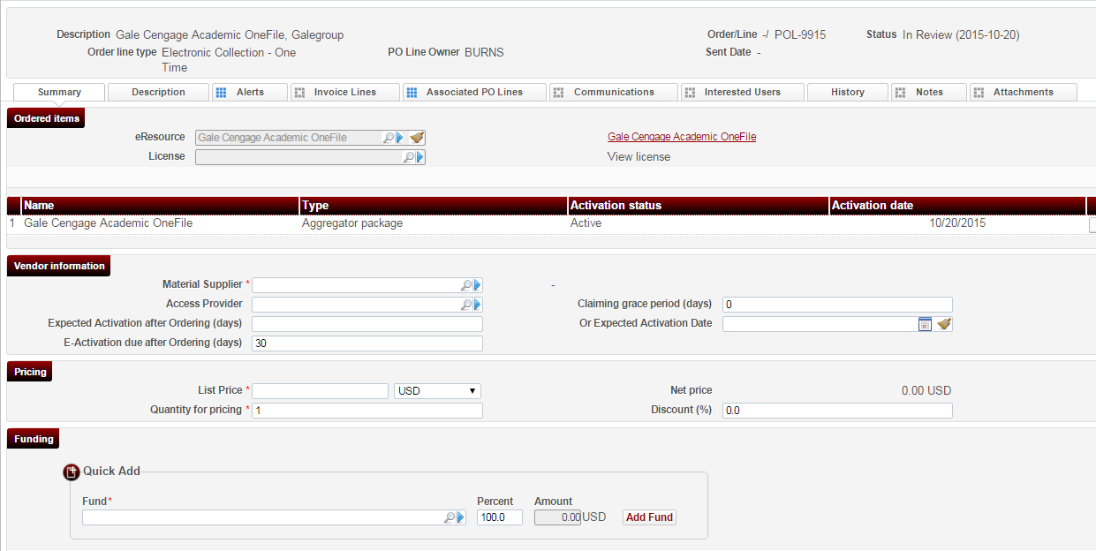
Model 1 – Local Acquisition, Licensing and Management
All steps of e-resource management cycle are performed by an individual institution in Alma Institutional Zone.
Institutional License
Institutional Vendor
Institutional Fund

Slide 5
Model 2: Full Centralized Management
The entire flow is managed by the central office in the Network Zone
Central office maintains:
Funds
Vendors
Licenses
E-products
Central office acquires, processes payment, negotiates license agreement and activates e-resources

Slide 6
Model 2: Full Centralized Management
How does it look in Alma?

Slide 7
Model 3: Centralized Management with Local Acquisitions
Central office negotiates electronic resources on behalf of consortium members
Electronic resources are managed centrally in the Network Zone
Members manage the acquisition and payment independently in IZ based on local funds

Slide 8
Model 3: Centralized Management with Local Acquisitions
How does it look in Alma?

Slide 9
Questions?

