Slide 1
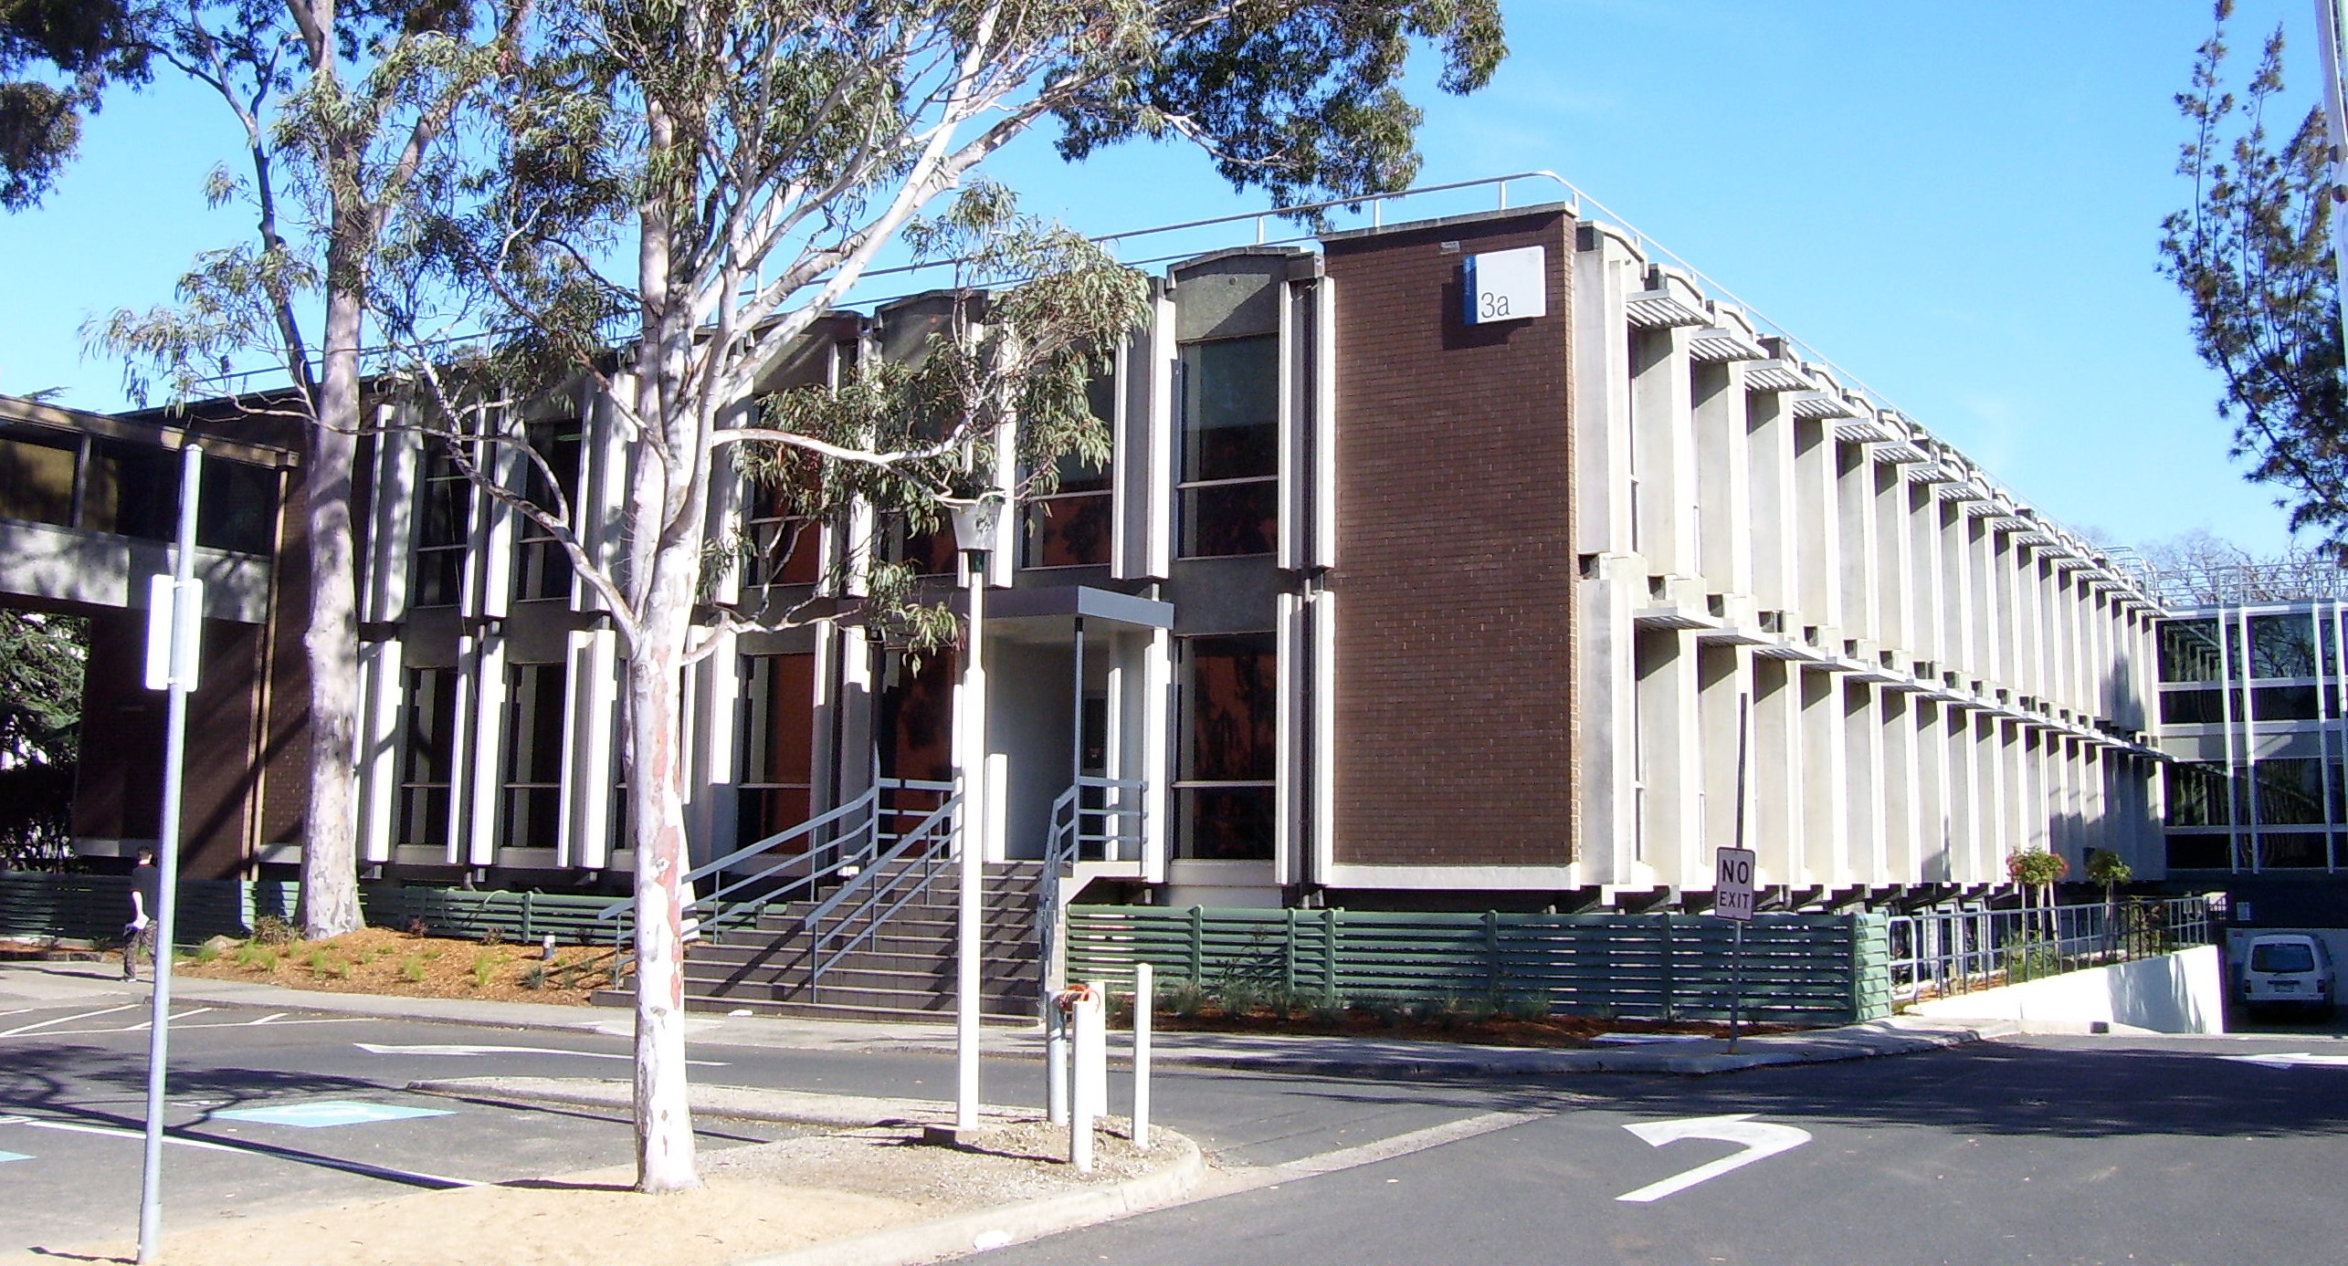
Alma Analytics calculation of the cost per use in the cost usage subject area with DB and JR1
Yoel Kortick Senior Librarian
https://en.wikipedia.org/wiki/Monash_University,_Clayton_campus

Slide 2
Introduction
Academic OneFile in the “Usage Data”
Academic OneFile in the “Cost Usage”
Example using Journal JR1
The ‘Usage” amount in the ‘Cost Usage’ subject area
https://slidemodel.com/templates/animated-rainbow-business-powerpoint-template/
http://image.shutterstock.com/z/stock-photo-business-hand-writing-blank-agenda-list-130255148.jpg

Slide 3
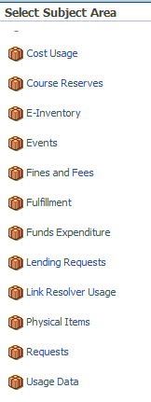
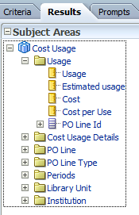
Introduction

Slide 4
Introduction
The “Cost Usage” subject area uses a combination of data from
The “Usage Data” subject area of Alma Analytics
The acquisitions data from Alma
For an in depth description and examples of the “Usage Data” subject area of Alma Analytics see
Separate detailed PowerPoint presentation which focuses on the “Usage Data” and contains examples
The On Line help
This current presentation will focus on the “Cost Usage” subject area, primarily on how the ‘Cost per use’ is calculated.

Slide 5
Introduction
The “Cost per use” measure in the “usage” dimension of the “Cost Usage” subject area is the result of the “cost” divided by the “estimated usage” Cost per use = Cost / Estimated Usage
We will look at an example for the database “Academic OneFile” for the previous two calendar years and see exactly how this is done.

Slide 6
Introduction
First we will look at and analyze “Academic OneFile” in the Usage Data subject area
Then we will look at “Academic OneFile” in the Cost Usage subject area
Lastly we will see the acquisitions data in Alma
By combining our findings we will see exactly how the cost per use is calculated.

Slide 7
Introduction
Academic OneFile in the “Usage Data”
Academic OneFile in the “Cost Usage”
Example using Journal JR1
The ‘Usage” amount in the ‘Cost Usage’ subject area
https://slidemodel.com/templates/animated-rainbow-business-powerpoint-template/
http://image.shutterstock.com/z/stock-photo-business-hand-writing-blank-agenda-list-130255148.jpg

Slide 8
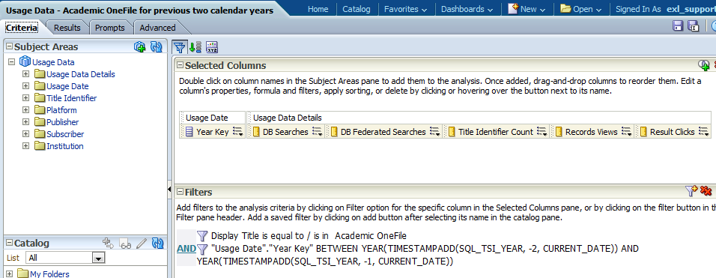
Academic OneFile in the “Usage Data”
Here is the criteria tab of a report for “Academic OneFile” in the “Usage Data” subject area
The relevant measures will be displayed
Will retrieve only for Academic OneFile
Will include the past two calendar years

Slide 9
Academic OneFile in the “Usage Data”
Here are the results of the report for “Academic OneFile” in the “Usage Data” subject area
The total usage for 2014 is 966,408. This is the sum of ‘DB Searches’ + ‘DB Federated Searches’ + ‘Records Views’ + Result Clicks’
The total usage for 2015 is 770,306. This is the sum of ‘DB Searches’ + ‘DB Federated Searches’ + ‘Records Views’ + Result Clicks’

Slide 10
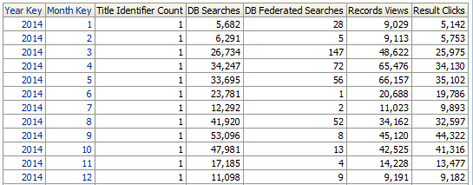
Academic OneFile in the “Usage Data”
If we include also the “Month Key” in the report then we see that all of 2014 is included
All months of 2014 are included

Slide 11
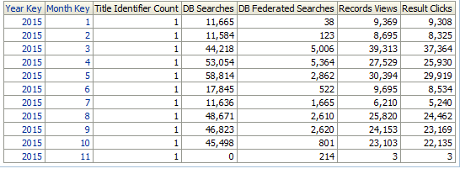
Academic OneFile in the “Usage Data”
If we include also the “Month Key” in the report then we see that all of 2015 is not included. This means that the latest loaded COUNTER report did not include December 2015.
Missing December 2015

Slide 12
Academic OneFile in the “Usage Data”
Because we have all of the data for 2014 for Academic OneFile the “estimated usage” and “usage” will be the same.
For 2015 Alma Analytics will need to estimate the usage for all of 2015 based on the 11 months which are already there.

Slide 13
Introduction
Academic OneFile in the “Usage Data”
Academic OneFile in the “Cost Usage”
Example using Journal JR1
The ‘Usage” amount in the ‘Cost Usage’ subject area
https://slidemodel.com/templates/animated-rainbow-business-powerpoint-template/
http://image.shutterstock.com/z/stock-photo-business-hand-writing-blank-agenda-list-130255148.jpg

Slide 14
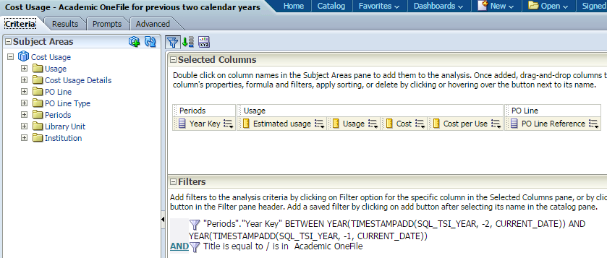
Academic OneFile in the “Cost Usage”
Here is the criteria tab of a report for “Academic OneFile” in the “Cost Usage” subject area
The relevant measures and related POL will be displayed
Will include the past two calendar years
Will retrieve only for Academic OneFile

Slide 15
Academic OneFile in the “Cost Usage”
Here are the results of the report for “Academic OneFile” in the “Usage Data” subject area
First let’s discuss the ‘Estimated Usage’

Slide 16
Academic OneFile in the “Cost Usage”
For 2014 the ‘Estimated Usage’ and ‘Usage’ are the same because have data for all of 2014.
For 2015 the ‘Estimated Usage’ is higher than the ‘Usage’ because for the ‘Usage’ we have the first 11 months and are missing December.
The 770,306 is for 11 months (as we saw in the “Usage Data” subject area). That means each month is about 70,027 usage (770,306/11).
If we take the 770,306 and add the remaining estimated month of 70,027 we get 840,333

Slide 17
Academic OneFile in the “Cost Usage”
Now we will use the “estimated usage” to get the ‘Cost Per Use’
The formula will be: Cost per use = Cost/Estimated Usage
So … now we need to get the cost
The related POL is 595499.
The cost for 2014 is 44,290
The cost for 2015 is 90,560

Slide 18
Academic OneFile in the “Cost Usage”
If we look at POL 595499 (next slide) we can see that the total transactions of invoice lines
For 2014 was 44,290 (as appears in analytics)
For 2015 was 90,560 (as appears in analytics)

Slide 19
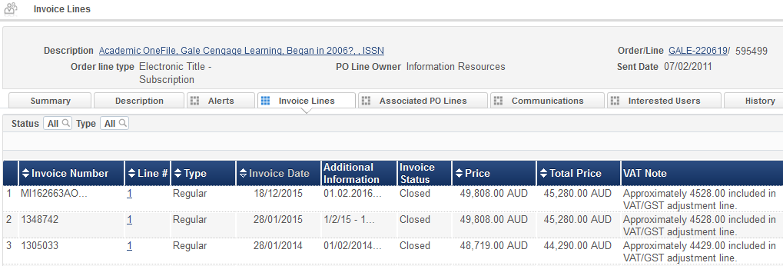
Academic OneFile in the “Cost Usage”
2015 total is 45,280.00 + 45,280.00 = 90,560.00
POL 595499
2014 total is 44,290.00
Note: above the date used by the cost usage is taken from the invoice date. From the March 2016 release and onwards the date will be taken from the period of the fiscal year of the fund used for payment.

Slide 20
Academic OneFile in the “Cost Usage”
Now we have everything we need to figure the ‘Cost per use’
Cost per use = Cost/Estimated Usage
The ‘Cost per use’ for Academic OneFile for
2014 = 0.05 (which is 44,290/966,408)
2015 = 0.11 (which is 90,560/840,333)

Slide 21
Introduction
Academic OneFile in the “Usage Data”
Academic OneFile in the “Cost Usage”
Example using Journal JR1
The ‘Usage” amount in the ‘Cost Usage’ subject area
https://slidemodel.com/templates/animated-rainbow-business-powerpoint-template/
http://image.shutterstock.com/z/stock-photo-business-hand-writing-blank-agenda-list-130255148.jpg

Slide 22
Example with JR1
We can see in the “Usage Data” subject area that title “Citizenship Studies” is JR1 (Journal)

Slide 23
Example with JR1
Here is the same title in the “Cost Usage” subject area with Cost Per Use data for 2015
This is the usage we saw in previous slide from “Usage Data” subject area in column “Journal Usage Counter”

Slide 24
Example with JR1
Now we show the cost for the same title in the “Cost Usage” subject area for 2015
Here is the price from the POL
the POL

Slide 25
Example with JR1
We see below from the Usage Data subject area that the estimated usage is 997 and the usage is 914.
The estimated usage is 83 more than the usage.

Slide 26
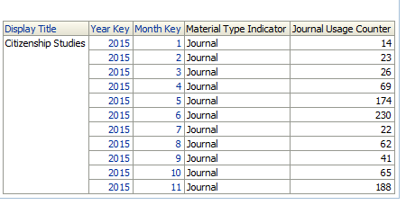
Example with JR1
In the Usage Data subject area we see that we have information for 2015 up to and including November but we do not have December.

Slide 27
Example with JR1
To get the “extra month” Analytics takes the total usage of 914, divides it by 11 months, and states the average month is 83, and then uses that to get the “estimated Usage”
914 + 83 = 997

Slide 28
Example with JR1
The cost per use is 1.25 which is cost 1,244 divided by Estimated usage 997

Slide 29
Introduction
Academic OneFile in the “Usage Data”
Academic OneFile in the “Cost Usage”
Example using Journal JR1
The ‘Usage” amount in the ‘Cost Usage’ subject area
https://slidemodel.com/templates/animated-rainbow-business-powerpoint-template/
http://image.shutterstock.com/z/stock-photo-business-hand-writing-blank-agenda-list-130255148.jpg

Slide 30
The ‘Usage” amount in the ‘Cost Usage’ subject area
For Electronic Collection (Material Type Indicator DB)
The ‘Usage” amount which appears in the ‘Cost Usage’ subject area is calculated as follows:
In the case of an electronic collection it is the sum total of these four measures which appear in the "Usage Data Details" folder of the 'Usage Data' subject area:
"Usage Data Details"."DB Federated Searches"
"Usage Data Details"."DB Searches"
"Usage Data Details"."Result Clicks"
"Usage Data Details"."Records Views"

Slide 31
The ‘Usage” amount in the ‘Cost Usage’ subject area
For Electronic Collection (Material Type Indicator DB)
For example ‘Academic OneFile’ is a collection (Material Type Indicator DB) and appears as follows in the Usage Data subject area for 2015:
The sum total of the “DB Federated Searches“ + "DB Searches" + "Result Clicks" + "Records Views“ =
349808 + 21825 + 204284 + 194389 = 770306

Slide 32
The ‘Usage” amount in the ‘Cost Usage’ subject area
For Electronic Collection (Material Type Indicator DB)
The sum of the four measures in the ‘Usage Data’ subject area, which is 770306, appears as the ‘usage’ measure in the ‘Cost Usage’ subject area

Slide 33
The ‘Usage” amount in the ‘Cost Usage’ subject area
For Electronic Journal (Material Type Indicator Journal)
The ‘Usage” amount which appears in ‘Usage’ folder of the ‘Cost Usage’ subject area is calculated as follows:
In the case of an electronic journal it is equal to the following measure which appears in the ‘Usage Data Details’ folder of the 'Usage Data' subject:
"Journal Usage Counter"

Slide 34
The ‘Usage” amount in the ‘Cost Usage’ subject area
For Electronic Journal (Material Type Indicator Journal)
For example ‘American Journal of Physics’ is an Electronic Journal (Material Type Indicator Journal) and appears as follows in the Usage Data subject area for 2015:
The "Usage Data Details"."Journal Usage Counter" = 735

Slide 35
The ‘Usage” amount in the ‘Cost Usage’ subject area
For Electronic Journal (Material Type Indicator Journal)
The value of the "Usage Data Details"."Journal Usage Counter" measures from the ‘Usage Data’ subject area, which is 735, appears as the ‘usage’ measure in the ‘Cost Usage’ subject area

Slide 36
Thank you
Yoel Kortick Senior Librarian
https://en.wikipedia.org/wiki/Monash_University,_Clayton_campus

