Slide 1
Alma Link Resolver Usage
A new Alma Analytics subject area
Yoel Kortick | Senior Librarian

Slide 2
Agenda
1
Introduction
2
The measurements
3
Examples

Slide 3
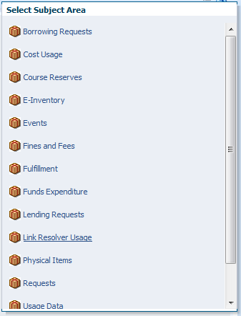
Introduction

Slide 4
Introduction
A new Link Resolver Usage subject area was added to Alma Analytics.
The fields of this subject area can be used to create reports that provide both specific details of link resolver usage as well as a broad perspective of how the Alma link resolver is used.
This provides libraries with a useful means of determining proper electronic collection development.

Slide 5
Introduction
This new subject area supplements the existing Usage Data subject area.
The existing Usage Data subject area includes data from vendors and is loaded by way of UStat, while the Link Resolver Usage subject area takes data directly from the Alma link resolver.

Slide 6
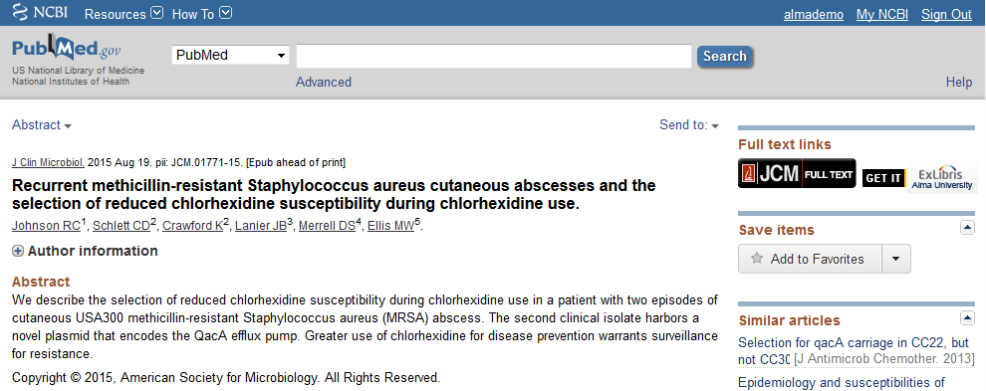
Introduction
The Alma Link Resolver includes not only Primo searches but also searches from an external source such as PubMed or a native vendor interface
Link to the article at Alma University

Slide 7
Agenda
1
Introduction
2
The measurements
3
Examples

Slide 8
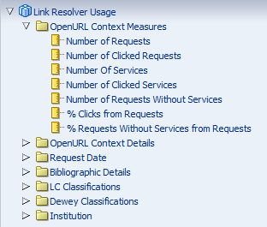
The measurements
The fact “OpenURL Context Measures” contains seven measurements

Slide 9
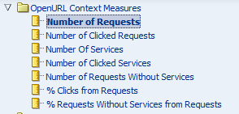
Number of Requests
A “Number of Requests” entry will be created any time an open URL request is sent to the Alma Link resolver
Examples of when this “Request” entry will be created are
If a user clicks a link to the Alma Link resolver from an external source such as PubMed or a vendor native interface
If a user clicks “View It” from the Primo search results for an electronic resource

Slide 10
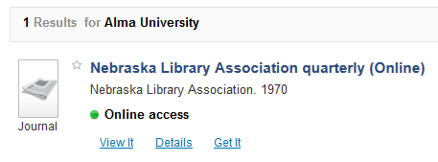
Number of Requests
Example 1
From PubMed Click Link to the article at Alma University
Example 2
From Primo results click “View It”
10

Slide 11
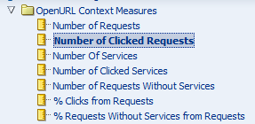
Number of Clicked Requests
The “Number of Clicked Requests” states whether or not at least one of the services was clicked.
The value will be 0 or 1.
‘0’ means no services were clicked
‘1’ means that at least 1 service was clicked.

Slide 12
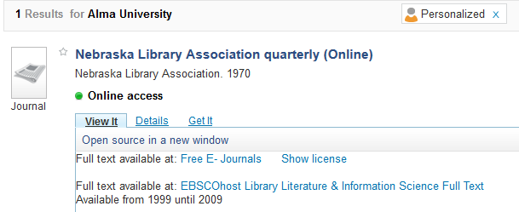
Number of Clicked Requests
If someone clicks 1 or more of these services then the ““Number of Clicked Requests” ” will be “1”

Slide 13
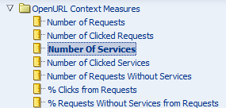
Number of Services
The “Number of services” is the number of services offered per incoming open URL request.
The incoming URL request may come from
The “View It” tab within Primo
The electronic services page after clicking from another source

Slide 14
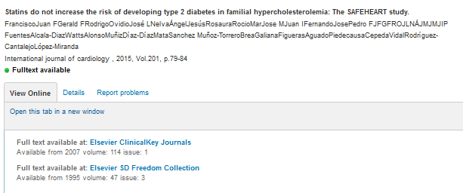
Number of Services
Two services
Two services

Slide 15
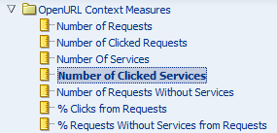
Number of Clicked Services
The “Number of Clicked Services” is the number of services used by (clicked by) the end user.

Slide 16
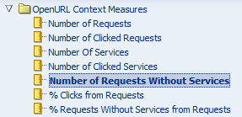
Number of Requests Without Services
A “Number of requests without services” will be created for each incoming open URL which does not result in any services.
The “Request without services” will exist if the Alma Link resolver returns no results

Slide 17
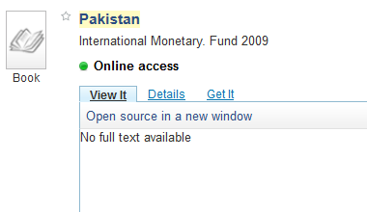
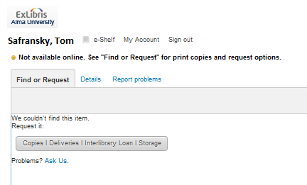
Number of Requests Without Services

Slide 18
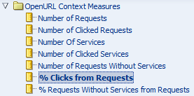
% Clicks from Requests
The “% Clicks from Requests” is the “Number of clicked Requests” divided by the “Number of Requests”
In other words, “of all the total requests how many were actually clicked”

Slide 19
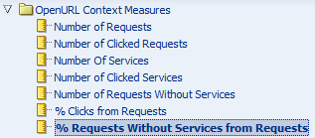
% Requests Without Services from Requests
The “% Requests Without Services from Requests” is the “Number of Requests Without Services” divided by the “Number of Requests”
In other words “of all the incoming open URL requests how many did not have services”

Slide 20
Agenda
1
Introduction
2
The measurements
3
Examples

Slide 21
Example 1
This report is called “Number of clicked requests in the last year for sources 'Feminist Studies' and 'Women's Studies Collection'”
It lists the ‘Number of clicked requests’ for each month for each of these sources
This means that an easy comparison can be made.
For various reasons (perhaps overlap analysis) the library is considering cancelling one of these sources
This means that the library can now identify which of the two sources is most used and therefore cancel the most appropriate one

Slide 22
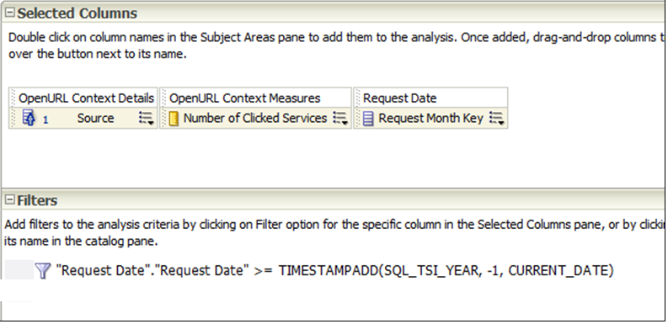
Example 1

Slide 23
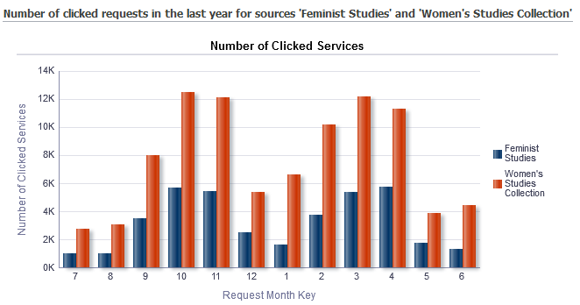
Example 1
It is clear from the results that if one of these sources needs to be canceled then it should be ‘Feminist Studies’ because it is used much less than ‘Women’s Studies Collection’

Slide 24
Example 2
This report is called “Top Dewey Classifications for Alma Resolver Requests without services in the last year”
It lists the and the top ten ‘Number of requests without services” and then the corresponding ‘Dewey Classification Group’
This means searches have been made by patrons but there have not been full text services.
This means that the library might want to consider changing the collection development policy and purchasing more resources in these areas.

Slide 25
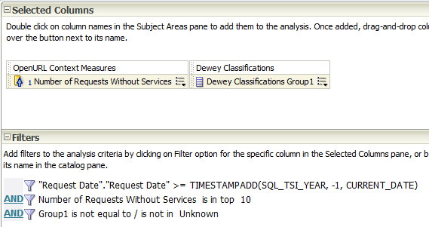
Example 2

Slide 26
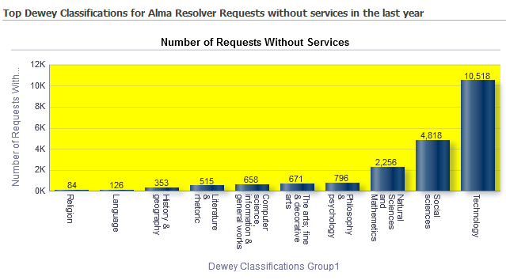
Example 2
There were over 10,000 searches in the area of ‘Technology’ in the last year with no full text services available

Slide 27
Example 3
This report is called “Top Ten Dewey Classifications for Alma Resolver Clicked requests in the last year”
It lists the and the top ten ‘Number of clicked requests’ and then the corresponding ‘Dewey Classification Group’
This means searches have been made by patrons and they have clicked a request for services
This means that the library might want to consider continuing to purchase resources in these areas because they are being used.

Slide 28
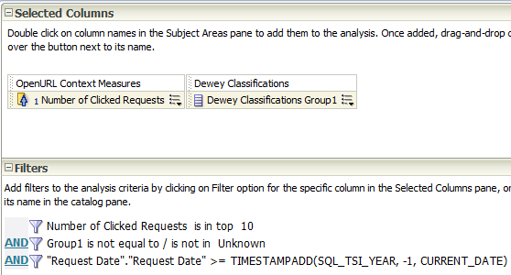
Example 3

Slide 29
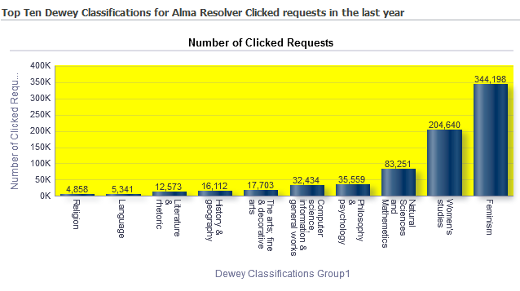
Example 3
There were over 344,000 searches in the area of ‘Feminism’ over 200,000 in ‘Women’s studies’ in the last year for which patrons accessed services

Slide 30
Example 4
This report is called “Top Ten Sources for Alma Resolver Clicked requests in the last month”
It lists the and the top ten ‘Number of clicked requests’ and then the corresponding ‘Source’
This means searches have been made by patrons and they have clicked a request for services when coming from the specific source
This means that the library can identify where the users are coming from and customize / prepare accordingly

Slide 31
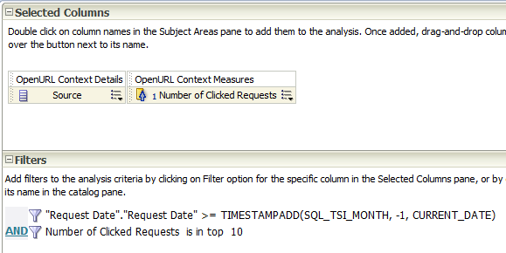
Example 4

Slide 32
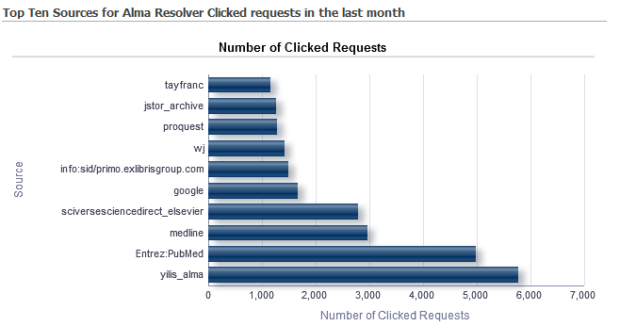
Example 4
The top 5 are
Primo (yilis_alma) with almost 6,000 clicked requests
Pubmed with almost 5,000 clicked requests
Medline with almost 3,000 clicked requests
Science direct Elsevier with almost 3,000 clicked requests
Google with almost 2,000 clicked requests
There were more searches in Pubmed and Medline combined than in Primo.

Slide 33
THANK YOU
Yoel.Kortick@exlibrisgroup.com

