Slide 1
Go VE – Consortia Self Switch CSU -Early Access
Jan 2021

Slide 2
Self-Switch Process for Consortium
Getting Started for an institution level
Authentication
Documentation
Timeline
Self Configuration Tasks
Communication

Slide 3
Self-Switch Process for Consortium
Enablement
Consortium (NZ)
Start the process
Create unified index
Copy Central package
Institution (IZ)
Create views from Primo
Copy Customization and translations from Primo
Copy PC key from Primo
Authentication
Institution only (IZ)
Configure User Authentication
Configuration
Consortium (NZ)
Plan the central management
Configure the central configuration
Institution (IZ)
Configure the features in institution level (consortia related and other features)
Go Live!
DNS switch
Redirection to primo VE
Live enablement
Copy Favorites and Analytics
Notes:
Documentation – getting started

Slide 4
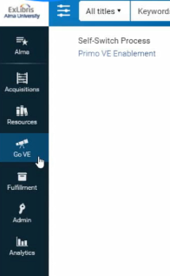
Getting Started for an institution level
Enablement for consortium documentation

Slide 5
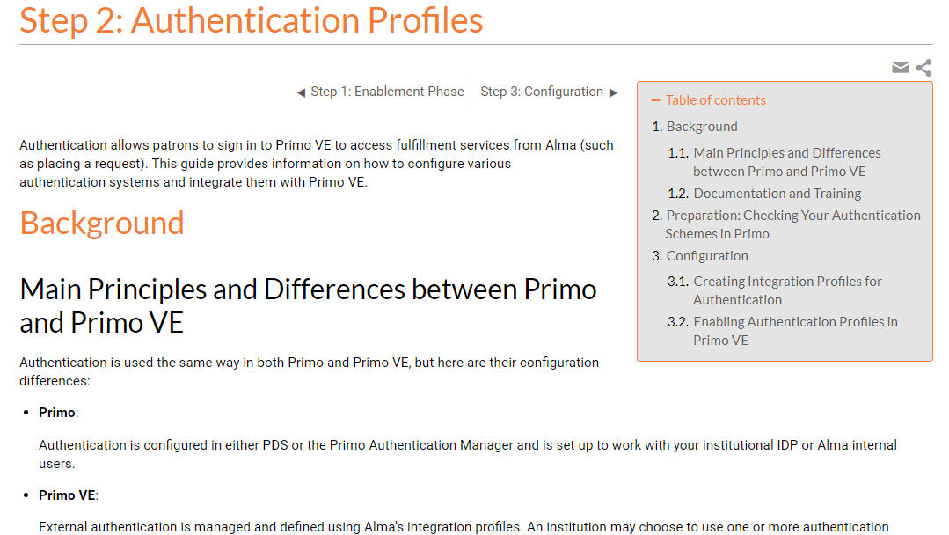
Authentication
Authentication documentation
Setup in parallel to Configuration Phase
May require involvement of institutional IT department

Slide 6
Documentation
Consortia related features documents:
Getting Started with Collaborative Networks
Converting Collaborative Network Features to Primo VE
Go VE documentation
Primo VE documentation

Slide 7
Timeline
Bi-weekly topics and tasks
Bi-weekly meetings during Jan-April
Feedback on previous topic self configuration
Technical Q&A
Assignments for coming week
Goals for April 2021;
Enablement completed
Authentication completed
Configuration in progress

Slide 8
Self Configuration Tasks
Consortium level configuration (By Feb 2nd)
Analyzing central management configuration in Primo
Planning the setup in NZ and IZ levels
The areas are: local fields, default display fields and local resource types
Institution Level configuration
Enablement of the institutions (By Jan 19th)
Configuring authentication (By Feb 16th)
Configuring a view (By Feb 2nd)
Configuring search scope + profile + slot (By Feb 16th)
Configuring Display field & local field (By March 2nd)
Adding a local resource type (By March 2nd)
Setting up an external DS import profile (By March 16th)

Slide 9
Communication
Basecamp - technical questions
Bi - Weekly meetings – self-switch feedback
Conclusion meeting – April 6th
April 6th – Go Live( End of May);
Basecamp discussions
Go_VE@exlibrisgroup.com
Periodic meetings – if needed

Slide 10
Thank you!

