Slide 1
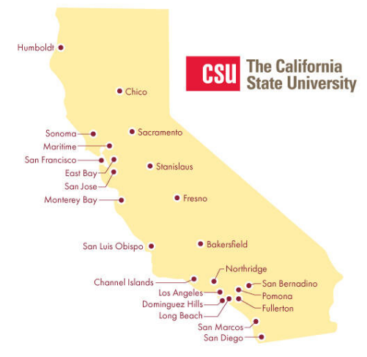
October 19, 2023 Technical Services Open Forum

Slide 2
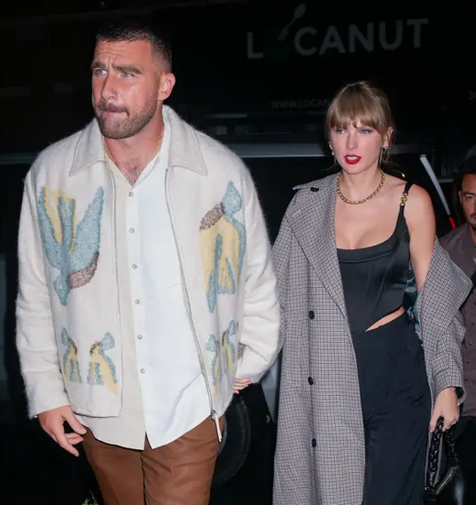
Today’s agenda
What is this meeting?
Announcements
Who am I
What can I do for you in this position?
General ULMS announcements
Wikidata Building Project announcement
ERM general; reporting Salesforce cases
Resource Management group
Primo VE testing team (VETT) report
NZ Mgt Group
What else?
Hang out
Notes:
Here’s the agenda for today.
*We haven’t had any version of this meeting since June 2023, so maybe this is your first time, welcome! So I wanted to share a little bit about this meeting and what you might find here and what you can bring here.
* Announcements! Quite a few groups reached out to me ahead of time as they had things they wanted to talk about here, you will see them listed on the agenda.
But maybe you have something to share that isn’t here, that would be the time.
If you don’t know me, I am Christina Hennessey, the new director of the ULMS, perhaps you know me as the “new Brandon”, I wanted to explain a little bit about me
And my role in the CSU, mainly so you know what I can do for you to make your jobs easier
As a regular feature in this meeting, I want to announce a few recent and upcoming webinars you might be interested in relation to the ULMS, the CSU, upcoming deadlines, some rah-rah CSU things
Then we’ll have updates from a few different groups: Wikidata Building Project, ERM, Resource Management, Primo VE testing team, and the NZ Management Group.
Anything else if we have time
Then I’ll turn off the recording and you are welcome to hang out and be social, talk about the weather, we can talk about Taylor Swift and Travis Kelce, etc.

Slide 3
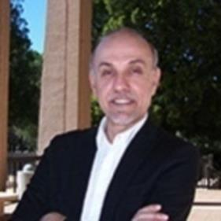
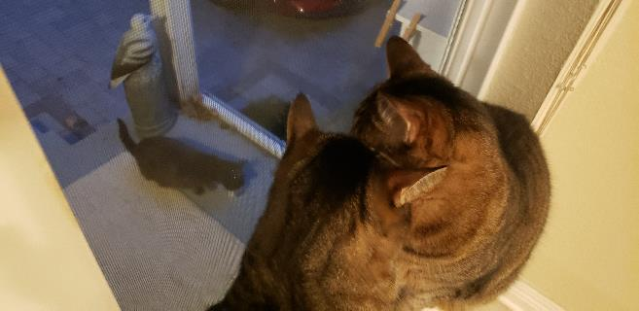
What is this meeting?
Short history of the Technical Services Open Forum
Luiz!
Weekly meetings online across the CSU
Great place to present, meet others
You don’t have to schedule a 10-minute demo or discussion
Notes:
So what is this meeting?
** So a very short version of the history – There was a time when all CSU libraries were in different library systems! There was an agreement in 2013 (yes! 10 years ago) to have the CSUs join in a unified library management system, or the ULMS. As we started merging our library systems and setting policies for the group at large, there was a great need for an open forum for CSU folks to discuss technical services issues in great depth, do presentations, solve common problems together, and sometimes just blow off steam or hear what is going on at other campuses.
** Luiz Mendes is our patron saint, as it were, he would probably say he is not a saint at all, but he started running meetings like these in 2015 across the CSU along with many of our other current and former CSU colleagues. The “Technical Services Open Forum” (TS Open Forum) was created as the channel of communication for discussions and decisions related to policies, as well as a platform for training, at a time when online training was really not the norm like it is today.
** After going live with the ULMS in 2017, the meetings continued weekly through the rest of 2017 and all of 2018, and eventually they went to monthly. Topics focused on exchange of ideas, best practices, policy decisions and discussions, examination of workflows, and any concerns technical services personnel had about the migration to and implementation of the new system.
You can look at this page that I put in the chat to see the history of the meeting, all the recordings are topics are there. https://calstate.atlassian.net/wiki/spaces/URM/pages/144572459/Technical+Services+Open+Forum+Recordings
** My personal take: I started in my job at the Chancellor’s Office less than a month ago, and I thought this was a good time to bring the meeting back. It’s really important to have a general place like this for technical services discussions, everyone is welcome, old and new. When I started at Northridge in 2018, I found this a really useful place to meet colleagues at other CSUs, hear about their similar issues, and within a few months I was doing a short presentation at this very meeting, my first online and Zoom presentation before we were all on Zoom so it was great experience with a group of library folks that are “on your side”. Many of you need this presentation experience for tenure, promotion, annual reviews, etc. and I want you to have this option.
Here’s a picture of my cats visiting with the neighborhood cats, much like we meet each other in the CSU, sometimes they just observe, see what’s going on, and sometimes they talk to each other a lot!
** I also recognize it is also a pain to schedule a meeting for something you want to present that is 10 minutes long but very important and awkward to share in an email, and this is a great place to do it! So welcome back and let’s continue to make the new TS Open Forum a success! Thanks to Luiz for his guidance on getting this restarted and for all the others that gave input.
Luiz or anyone else – do you have anything to add that people should know?

Slide 4
Announcements
Notes:
So now I want to open this up to any announcements that folks have that might not be on the agenda, this is your time to speak and share!

Slide 5
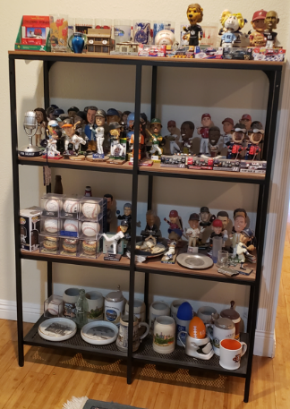
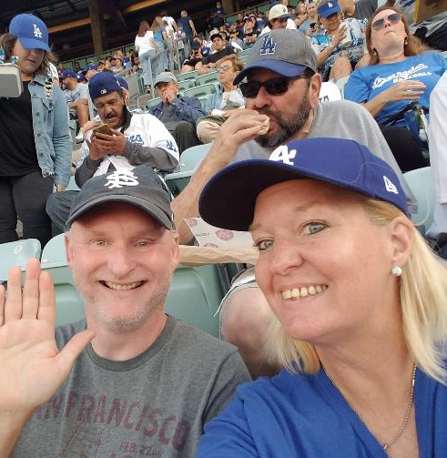
Who is Christina Hennessey?
New Director of the ULMS (Unified Library Management System)
“new Brandon” or “Brandon 2.0”
From Northridge - systems, former cataloger
Sports!
Notes:
I am not going to talk about myself at every TS Open Forum, I promise, but I have been visiting a lot of meetings this month across the CSU to explain my role so I wanted to do it here as well.
So this is my 4th week as the new Director of the ULMS, I work in the Chancellors Office in Long Beach, so you can either say that I work on ‘no campus’ or all of them!
I have been explaining myself to a lot of folks as “the new Brandon Dudley” or I have heard, Brandon 2.0, that is shorthand that I have hired into Brandon’s role at the Chancellor’s Office as he left for a similar position at Yale earlier this year. Here is a picture of me and Brandon at a Dodger game, even though he is a San Francisco Giants fan. Brandon is on the left.
Many of you know me from my previous role as the Systems Librarian at Cal State Northridge, I had been a faculty librarian there since 2018. Before that, I was in various roles at other libraries, including 15 years in systems and cataloging at Loyola Marymount University in Los Angeles, and before that I was a computer programmer not in libraries.
That’s all you really need to know about me for now, except that I am really, really into sports, here is one part of my bobblehead collection and I went to a live sporting event for every one of these, I go to a few live sporting events each week. If you are travelling somewhere in the United States, and looking for information on a sporting event, I can probably tell you what minor league baseball or hockey team plays there and where to park for free.

Slide 6
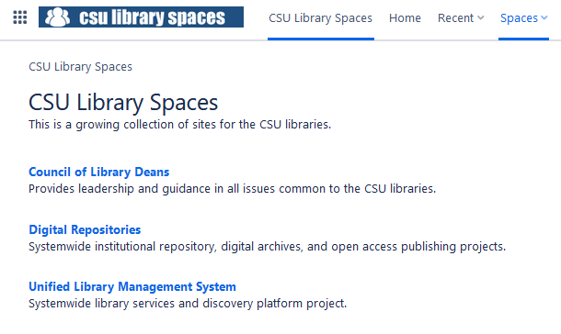
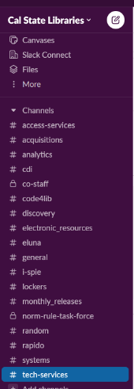
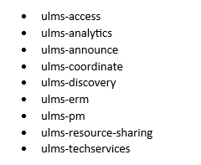
What can I do for you? Administrative
ULMS listserv admin
Slack admin
Confluence admin
Network Zone account
Notes:
The more important question that I want to answer for you is what I can do for you in this role.
The first thing is I can do a lot of administrative things for you, just like some of my other colleagues in the Chancellor’s Office, or CO.
We have a lot of managed listservs for the ULMS where we can communicate things about new features, problems, webinars, etc. Listservs are kind of an old-timey technology but they still work great for a lot of things. So if you need to subscribe to one or all of these, access this page (put in chat: https://calstate.atlassian.net/wiki/spaces/ULMSA/pages/1179739/Listserv+Information) and we’ll get you going.
We also have a very active Slack workspace for the CSU libraries. If you need an account here, let me know. This is a great place to start discussions, check your sanity on an issue you are having in the ULMS. Everyone in here is very helpful and working towards a common goal to keep our ULMS working. If you want to start your own Slack channel in the CSU libraries, no need to ask us, just do it!
Another administrative thing I can do for you is give you access on the CSU or ULMS wiki in Confluence, usually in a functional area. We do have a limited number of users on Confluence but if you can make even a minor case to me, you can probably have access. The ULMS wiki is here (put in chat: https://calstate.atlassian.net/). This is a great place for more permanent decisions, policy decisions, instructions, final documentation, links to videos, anything that you want to share with the world (and the Ex Libris customer world does look at these pages, we hear about it at conferences all the time!)
And if you have a project that requires Network Zone logon access, I can get you that as well. An example last week was that the ULMS Assessment & Analytics group is doing work with Network Zone Analytics, and many folks in the group needed that access.

Slide 7
Ex Libris Salesforce cases
We can see all your Salesforce cases
I might cc: myself on your case
We can enter them on your behalf at your site (emergency)
We can help escalate your cases
We have a monthly meeting with Ex Libris support
Yearly satisfaction survey
What I cannot do: set up a Salesforce account for you
Coming soon: an ‘write a good case’ refresher
Notes:
So one thing that has been really frustrating in recent years is we can no longer see each other’s Salesforce cases anymore in the CSU (when we used to be able to) and that makes it very difficult to know if an issue is local to your system or something CSU-wide, or Alma/Primo-wide.
I am pleased to announce that as of this week, not only can I see all your Salesforce cases, but so can Chris Lee and Jessica Hartwigsen. And much like Brandon, I will check these every morning in general to see if there is a larger issue we need to be aware of, so you don’t waste time thinking it is a local issue.
I wanted to warn you that I might cc: myself on your case if I am particularly interested in it or if it is part of a larger problem…this isn’t me checking up on you, hopefully it is so I can help and/or keep informed. You are also welcome to cc: on your case anytime so I get all the email updates.
The three of us can also enter cases on your behalf in your system so you can see them at your site. We still want you to enter your own cases for the most part as you know the problem best, but we understand that sometimes you need to teach a class, or go to daycare pickup, or it’s the weekend and you are away from home but your site is having issues and it’s important to get Ex Libris support working on this as soon as possible, please reach out.
Another thing you can always do is escalate your own case so it gets attention sooner but you can always reach out to us to escalate it as well or to ask if this should be escalated. We understand that a system emergency can be rather stressful and want to help you through it.
Chris, Jessica, and I will have a monthly meeting with Ex Libris support going forward. I want you to know this as you might have something that is not an emergency but is really annoying and being ignored, please reach out to us if that is the case and we have a in-your-face meeting where we can hopefully get results. You might also see comments by me on your case if nothing has been done on it for a month nudging Ex Libris to work on it.
It’s almost time for our yearly satisfaction surveys by functional area that lead into a report that we give to Ex Libris each year of ‘how are you doing’ so they can improve, look for those soon.
One thing I am sad that I cannot help you with if that I cannot create a Salesforce account for you and neither can the admin at your site. If you think you ever might need an account on there to open a case (e.g. you’re the only person working in your library that month as a backup), please request the account ahead of time as it takes a day or so for Ex Libris to add it to your campus.
Jessica will be talking about opening cases later this morning but I wanted to say that we’ll have a general ‘best practices in opening a case’ webinar coming up, in the meantime, you can also look at this ‘best practices’ page on our own CSU wiki (put in chat: https://calstate.atlassian.net/wiki/spaces/ULMS/pages/390594561/Best+Practices+for+SalesForce)

Slide 8
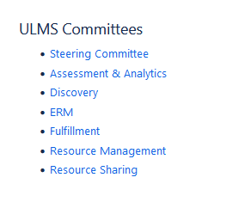
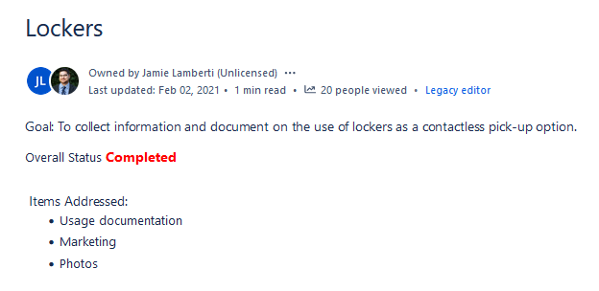
ULMS functional committees
https://calstate.atlassian.net/wiki/spaces/ULMS/overview
Notes:
For those of you not familiar with the ULMS structure, I want to introduce you to that.
I have this link on the slide and in the chat: https://calstate.atlassian.net/wiki/spaces/ULMS/overview, that’s the center of everything ULMS.
We have six different functional committees across the CSU for the different…functions! They all have their own goals and communications and meetings and some have open forums and office hours and webinars! There are 5-6 members on each group from different CSU campuses. The committees meet throughout the academic year and all committees have had their first meeting for 2023-2024 by now.
I’ll be sending a report each month of what all the committees are up to, each functional committee has a chair and they are part of the ULMS Steering Committee with me and a few members of the CO and we talk about issues of interest across the CSU and the functional areas.
Being part of the functional committees is a great way to get more involved in Ex Libris products in the CSU. If you want to be part of one of these, in the spring, we will ask your library deans who they would like on the groups, we try to balance them with experience and amongst campuses. But in the meantime, let me know, let your dean know that you would like to be nominated the next time these positions become open. We always want both new and experienced members.
** Also keep an eye out for calls for task forces! There are sometimes temporary projects that need a short-term group across the CSU, like when many of us implemented lockers in 2020 and 2021. Or maybe you have an idea for a task force, Chris Lee and I were talking about possibly an Alma letters task force, anything like that, let me know and I can help you organize & publicize it.

Slide 9
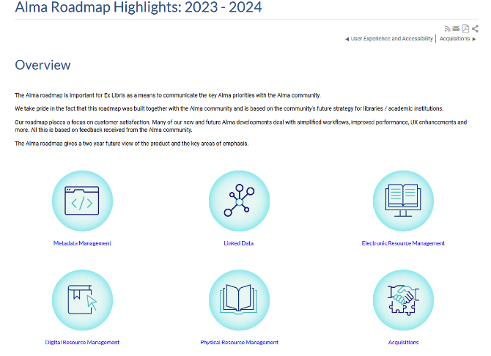
Other things I can do for you
New Ex Libris features
Roadmap updates
NERS/enhancement voting and proposals
On-boarding suggestions for learning Ex Libris products
General questions about Ex Libris products
In general: how can I help in something ULMS-related that is keeping you from doing your job or doing it well?
Notes:
A few more things I can do for you in this job:
I want to keep you updated on new features coming in Ex Libris products that might impact your work in the very near-term
Ex Libris also published a roadmap of things coming up in the next year or two by function, I want to keep you informed on that
We just finished NERS or enhancement voting for Rapido round 1, Alma and Primo will be in the Spring. Do you have an enhancement idea you want to propose? Are you not sure how to vote at your site? How is this different than Idea Exchange? Please reach out with questions about what can be a complicated process.
If you have new staff that will be working in Ex Libris products and not sure where to get them started, please reach out and I can put together a good list for them.
If you have general questions about Ex Libris products, please reach out. Right now I am working on a matrix of who has what products, features, integrations, mainly so I know but also so I can share it with all of you.
And in general – if something in an Ex Libris product is keeping you from doing your job or doing it well, please reach out with questions, no question is too small. Email, Slack, Zoom, whatever works.

Slide 10
Upcoming ULMS things
Resource sharing office hours: every Tuesday 11am-noon
ERM office hours: monthly, third Friday of the month 10am-noon
Analytics open forum
I-SPIE TV at 2pm today
New November 2023 release on Sunday, November 5
Notes:
Some upcoming ULMS-related things:
** Some groups are starting or have started office hours for your general ULMS questions. Chris Lee in the CO has been doing office hours every week on Tuesdays for resource sharing from 11am-noon. Feel free to come by.
** ERM will be giving us lots of updates shortly but I wanted to note that they are starting monthly office hours tomorrow!
** Analytics is working on an open forum coming soon, with a short Analytics presentation and then open questions/discussion, so look for that
** For those of you that have never been to I-SPIE TV, our resource sharing monthly meeting of presentations and discussions, you should come by! Exciting things are continuing to happen in Resource Sharing. The meeting is open to all and informative but also a lot of fun.
** A reminder that a big Alma/Primo release is coming on Sunday, November 5. I’ll send some updates in email once I know what it is in it but the big thing is that you no longer will be able to use the old Analytics interface out of Alma (Analytics itself is the same), Ex Libris has sent out a (19 question!) survey about it that they would like you to fill out, I will forward it with the recording
https://www.surveymonkey.com/r/GWNVBP7

Slide 11
Words Matter for the CSU: Inclusive Description Task Force October 17, 2023
Julie Moore (Fresno)
Luiz Mendes (Northridge)
Allison Bailund (San Diego)
Notes:
Two more rah-rah CSU things I want to tell you about and then someone else can talk!
Our very own Julie, Luiz, and Alison did a presentation earlier this week on the work by the Inclusive Description Task Force
I think the attendance was super-high, the presenters can share more but they said 500-600 people signed up nationwide? Maybe world-wide?
Really great presentation, great slides, a spirited Q&A afterwards. People really care about this subject and the CSU is a leader on this topic.
I’ll send out a copy of the recording available in chat and transcript
This was a great example showing “what catalogers do”, I used to be a cataloger and it was so hard to explain what we did and why it matters and this presentation did such a great job of that.
https://drive.google.com/file/d/1hlHRhNRXrGKBBhjGOx2BHaP4nGbU3M0p/view?usp=share_link

Slide 12
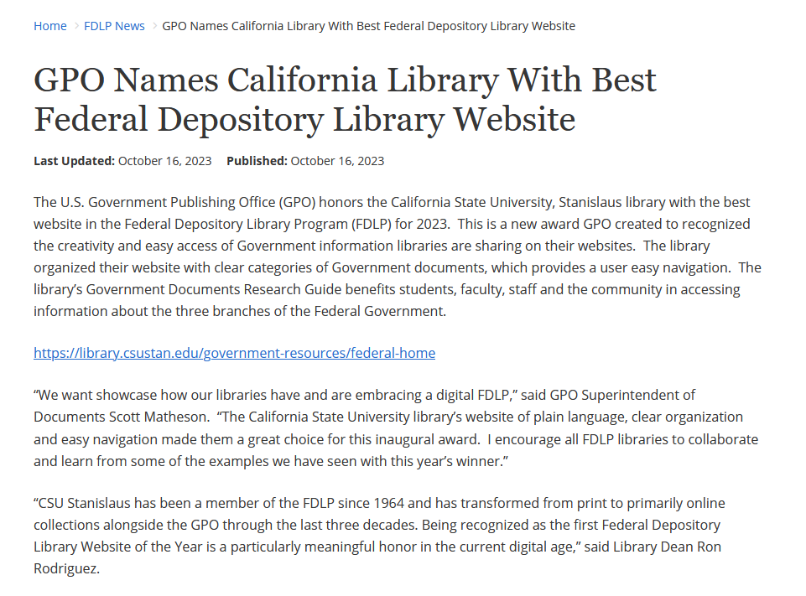
CSU Stanislaus –best website in the Federal Depository Library Program (FDLP) for 2023
https://library.csustan.edu/government-resources/federal-home
Notes:
Thanks to Jill for bringing this to our attention, this is a big deal that CSU Stanislaus library was awarded the ‘best federal depository library website’ for this year. Hurrah!
These are just the CSU rah-rahs and things that came off the top of my head this week, please send things along from your areas that I can include in here in the future.
Now I am going to stop talking and let’s hear from some other folks.
First - Greta with an update on the Wikidata Building Project
Kirstie & Jessica: ERM general; reporting Salesforce cases
Nerissa or Jill: Resource Management group (you have a printout if you need it)
Hannah: Primo VE testing team (VETT) report
Luiz: NZ Mgt Group
Next two slides then bye!

Slide 13
Next time!
Thursday, November 16, 11am-noon
Anthony Davis Jr. of Fullerton (Copyright and Policy Librarian) presenting about his unique process with Alma License Management
Notes:
Coming up next month!
Thursday, November 16, 11am-noon
Anthony Davis Jr. of Fullerton (Copyright and Policy Librarian) presenting about his unique process with Alma License Management
And whatever else comes up between now and then

Slide 14
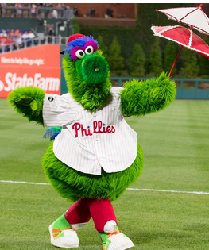
Thanks for attending!
Recording will be available & posted later this week
You are welcome to hang out until 1pm (recording off)
Go Phillies
Notes:
Thanks for attending
Recording will be available & posted later this week
You are welcome to hang out until 1pm (recording off)
Go Phillies, game 3 vs. the Diamondbacks is at 2pm today, the Phillies are up 2 games to none in a best of 7 series.

