Slide 1
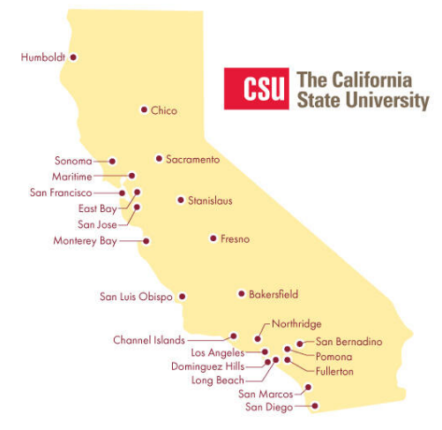
November 16, 2023 Technical Services Open Forum
Notes:
Welcome to the November 16, 2023 edition of the Technical Services Open Forum: Turkey edition

Slide 2
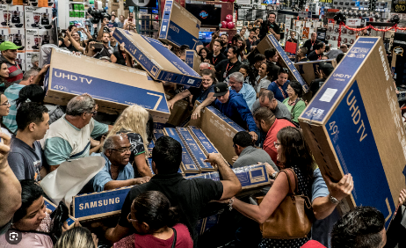
Today’s agenda
Announcements
Lending Physical Item Policies reminder (Chris Lee/CO)
Alma License Management @ CSU Fullerton (Anthony Davis, Jr.)
License update note (Jessica Hartwigsen/CO)
Update on SDSU’s Wikidata Building Project (Tyler Rogers)
What else?
Hang out
Notes:
Here’s the agenda for today.
Any announcements not on the agenda
Quick update reminding folks about the Lending Physical Item Policies from the CO’s Chris Lee
Alma License Management @ CSU Fullerton (Anthony Davis, Jr.)
After Anthony speaks, Jessica will give a short note on license updates
Update on SDSU’s Wikidata Building Project (Tyler Rogers), we’ve had some updates in past TS Open Forums on Wikidata projects, so here’s an update on the Building one
Anything else if we have time
Then at noon we’ll turn the recording off, we can hang out and talk about library work or your Black Friday shopping plans.

Slide 3
Announcements
Notes:
So now I want to open this up to any announcements that folks have that might not be on the agenda, this is your time to speak and share!
I have two myself:
Reminder that proposals for ELUNA in Minneapolis in May 2024 are due at the end of this month! I sent an email about this on Tuesday, we want lots of CSU folks sharing their knowledge and we want to support you too, let us know in the Chancellor’s Office if you want us to review anything, help with an idea, or a presentation. November 30 is only 13 days away and we are not in the office for most of those so it will happen quickly.
If you are in the various ULMS functional groups, you’ve heard that we are putting together a task force on data issues covering several topics. Jill Strykowski of SJSU will be putting together this group and we’ll be hosting a forum on Thursday, November 30 at 11am to discuss the various issues. You can let Jill know now or then if you are interested in being a part of this. This will be covering some of the issues that go across several of the groups: FRBR/DEDUP, fuzzy title search, secondary resource types, open access indicators, and things like the impact on user experience in finding things.
Not sure of the name of the group yet – maybe Data Excellence Task Force to mirror the terms Ex Libris is using, but the group can figure out a name they like, maybe something with Tiger Team in it, maybe Data mapping and interoperability task force…who knows.
Who else has an announcement?

Slide 4
Next time!
Thursday, December 21, 11am-noon
TJ Kao, Head of Metadata Creation, UC Davis
Will share how UC Davis takes advantage of the functionalities WMS Record Manager offers for various initiatives
Marcus Jun from SFSU – update on MARCIVE -> CRDP
And whatever else comes up between now and then
Notes:
Coming up next month! Yes, we are still meeting…and this will be recorded so you can watch it in January.
Thursday, December 21, 11am-noon
Thanks to Nerissa Lindsey at SDSU, we have a guest speaker from outside the CSU. TJ Kao, Head of Metadata Creation at UC Davis will be speaking on
how UC Davis takes advantage of the functionalities World Management System (WMS) Record Manager offers for various shared cataloging initiatives.
Also, Marcus Jun at SFSU will give an update on the transition from MARCIVE to CRDP, which will be happening in December.
After Marcus & TJ , we will have some time to discuss whatever else comes up between now and then, let me know if you have topics or something you want to present on.

Slide 5
Thanks for attending!
Recording will be available & posted later this week
You are welcome to hang out until 1pm (recording off)
Happy Thanksgiving!
Notes:
Thanks for attending
Recording will be available & posted later this week
You are welcome to hang out until 1pm (recording off)
Happy Thanksgiving, I hope you get to enjoy your turkey as much as Richard Sherman did in this picture.

