Slide 1
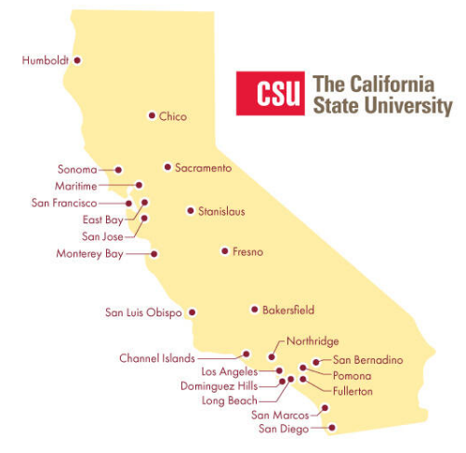
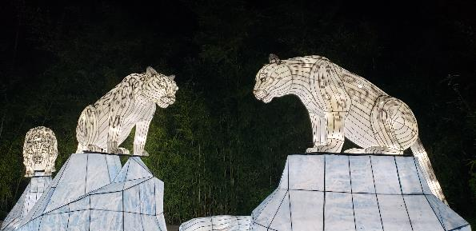
December 21, 2023
Technical Services Open Forum
Notes:
Welcome to the December 21, 2023 edition of the Technical Services Open Forum: Winter holiday edition
Happy Winter Solstice for those that celebrate, it is today at 7:27pm. If you don’t celebrate, we can at least look forward to longer days after today.

Slide 2

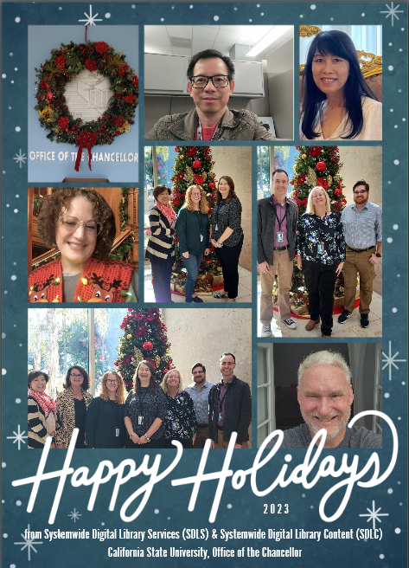
Happy holidays from the CO!
Notes:
First, I wanted to wish you all a happy holidays from the CO, many of you work with at least one of us in the Chancellor’s Office so we wanted to put a face to the folks in the CO for you this year, particularly the folks that are in library services.
Next year, I’ll actually put our names on here but feel free me to ask who someone is if you are not sure: going across here, we have: Bryan Tu, Lisa Tran, Jessica Hartwigsen, then some of SDLC: Ying Liu, Kirstie Genzel, and Ann Roll, and some of SDLS: David Walker, me (Christina Hennessey), and Christopher Lee. Then we have a picture with many of us including Leslie Kennedy, my grand-boss and the Assistant Vice Chancellor of Academic Technology Services. And of course, Brandon Dudley, he is still consulting with us from Yale and was certainly a part of this department and the CO for several months in 2023.
We sent cards to all your deans and asked them to post them somewhere you could all see it so maybe you have seen this already
Also! We printed way too many so if you are a person that likes holiday cards to display in your office or house, please reach out to me directly and I will be happy to mail one to you, I have a lot of holiday stamps to use up as well so you are helping me out!

Slide 3

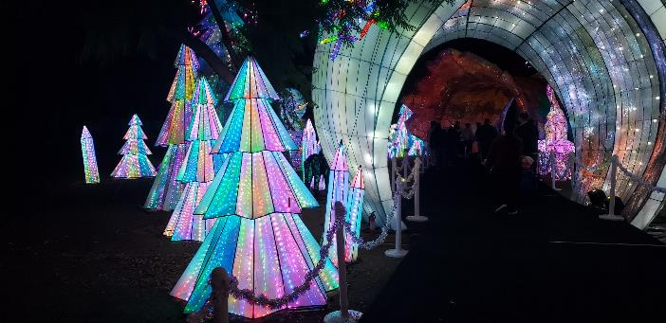
Today’s agenda
I have a few updates
Announcements
TJ Kao from UC Davis – WMS Record Manager and cataloging initiatives
Marcus Jun/SFSU update on MARCIVE DWS -> CRDP transition
What else?
Hang out
Notes:
Here’s the agenda for today.
I have a few updates on things
Then any of your announcements not on the agenda
We have a guest speaker from UC Davis, TJ Kao, their Head of Metadata Creation, who will be presenting on how UC Davis takes advantage of the functionalities WMS Record Manager offers for various cataloging initiatives. Thanks to Nerissa Lindsey, the head of the Resource Management Functional Committee for setting us up with TJ. We are hoping to have more guest speakers in TS Open Forum in the future so please reach out if you have seen a good speaker or presentation at a recent conference or meeting that you would like to share with your CSU colleagues.
One of our own, Marcus Jun of SFSU, will be presenting on the MARCIVE Documents Without Shelves (DWS) to the Cataloging Record Distribution Program (CRDP) transition for the CSU, the import profile changes he made and how he keep SFSU’s selection profile up to date. He is ready to answer your questions on what has been done so far in the NZ and what you will see in the coming year with these changes
Anything else if we have time
Then at noon we’ll turn the recording off (or whenever we are done), we can hang out and talk about library work or your holiday plans.

Slide 4
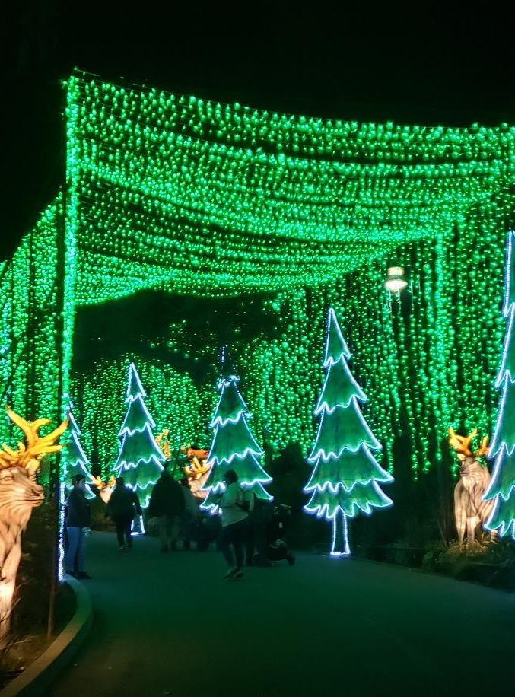
Updates from me
ELUNA conference proposal deadline now January 10, 2024
Data issues task force open forums complete
Next Ex Libris release update is Sunday, January 7, 2024
New eCAUG officers:
  Greta Heng, SDSU, Vice-Chair
  Jill Strykowski, SJSU, Secretary/Treasurer
ELUNA Learns 2024 sessions are free (not 2023)
I am still catching up
Notes:
Before we get into announcements from everyone else, I have a few:
Reminder that proposals for the ELUNA conference in Minneapolis in May 2024, the deadline was extended to Wednesday, January 10. As I mentioned last month, we want lots of CSU folks sharing their knowledge and we want to support you too, let us know in the Chancellor’s Office if you want us to review anything, help with an idea, or a presentation. January 10 is only 20days away but including holidays and vacations, that’s like 3 days so keep this is mind.
Our new Data issues task force has had a few open forums in November and December, we’ll be sending out more information about that in the new year, and next steps, thanks for your attendance and ideas!
Ex Libris release updates do not stop even though we are all on break, at least this one is not while we are closed but be ready for the next release update on Sunday, January 7, 2024. That will also come up fast.
We are keeping an eye on the California ELUNA user group, eCAUG, they have just elected a new board and our own Greta Heng at SDSU is the Vice-Chair and our own Jill Strykowski, of SJSU is the new Treasurer. I still want to have an in-person conference of some sort in 2024 for the ULMS, we are still waiting to see if that will be with eCAUG (we hope) or a CSU-focused one.
I sent some confusing emails earlier this week about ELUNA Learns sessions – just to clarify, only the 2024 sessions are free for all CSU folks since you are in the CSU consortium…you still have to pay $25 for the ones that already happened in 2024, even if you purchase them in 2024. Sorry for the confusion in my excitement to share free things!
Finally, I have been out of the office for the last two weeks and am still catching up on things, so you might get updates/emails from me during the break but no need to respond to anything until the new year

Slide 5
Announcements
Notes:
So now I want to open this up to any announcements that folks have that might not be on the agenda, this is your time to speak and share!
Who else has an announcement?

Slide 6
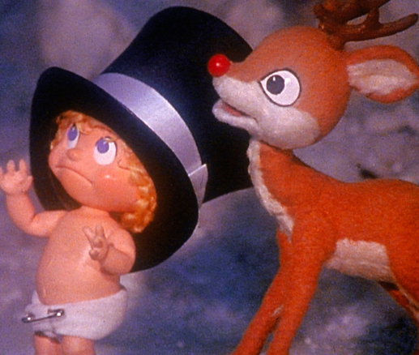
Next time!
Thursday, January 18, 11am-noon
Still working on topics, a few things in the works
Whatever else comes up between now and then
Notes:
Coming up next month! Most folks should be back in the office by this time…and these will always be recorded so you can watch it later in January.
Thursday, January 18, 11am-noon
I have a few topics that I’m working on for January but please reach out with more ideas anytime!
After that, we will have some time to discuss whatever else comes up between now and then, let me know if you have topics or something you want to present on.

Slide 7

Thanks for attending!
Recording will be available & posted later this week
You are welcome to hang out until 1pm (recording off)
Happy Holidays! I triple-dog-dare-ya
Notes:
Thanks for attending
Recording will be available & posted later this week
You are welcome to hang out until 1pm (recording off)
Happy holidays, I triple-dog-dare-ya to have a good one
https://www.youtube.com/watch?v=uIsgSQvsRj8

