Slide 1
Use Record Manager for local initiative at UC Davis
TJ Kao
Head of Metadata Creation
UC Davis
tjkao@ucdavis.edu

Slide 2
What is WorldShare Record Manager?
OCLC’s browser-based cataloging utility
Equivalent to OCLC Connexion (more or less)
Equipped with functionalities not available in Connexion*, e.g.
Transliteration for 8 Cyrillic languages
Management of local holdings records
Controlling non-LCSH 65Xs
Accessing non-LCSH authority files
*OCLC. OCLC cataloging application comparison. Accessed December 19, 2023. https://www.oclc.org/go/en/oclc-cataloging-application-comparison.html
**About Record Manager. OCLC Support. Accessed December 19, 2023. https://help.oclc.org/Metadata_Services/WorldShare_Record_Manager/Get_started/About_Record_Manager

Slide 3
Use case #1. Diversity/Equity/Inclusion Cataloging
Mandate:
UC Davis Library 2022-2027 Strategic Plan Priority 1. Object 1.2.1: Identify and address representation issues throughout the library’s website, social media and catalog
Actions (related to Record Manager):
Add non-English language subject headings, e.g.
Biblioteca Nacional de España Autoridades (BNE)
Répertoire de vedettes-matière de l'Université Laval (RVM)
Keep current of these subject headings
Notes:
UC Davis Library 2022-2027 Strategic Plan Priority 1: create welcoming physical and virtual spaces for our increasingly diverse campus community
Goal 1.2: Ensure website and virtual communications are accessible, use inclusive language and reflect the diversity of the campus.
Object 1.2.1: Identify and address representation issues throughout the library’s website, social media and catalog

Slide 4
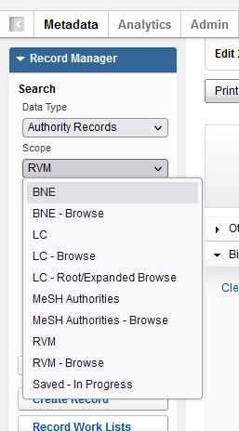
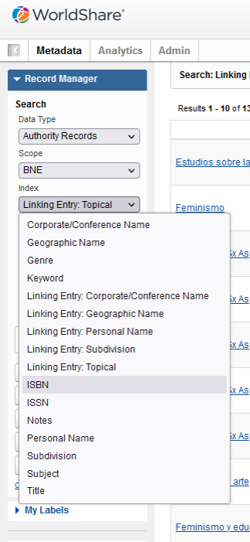
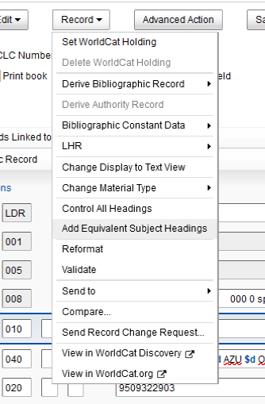
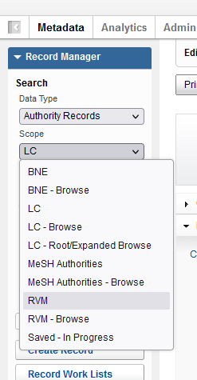
Adding non-LCSH subject headings
BNE (manual)
RVM (partially automatic)

Slide 5
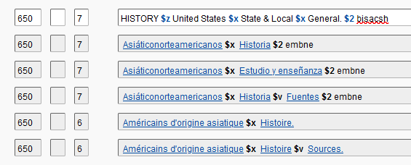
Keep current of non-LCSH subject headings
Controllable non-LCSH 65X in Record Manager:
AAT (Getty Art and Architecture Thesaurus)
BNE (Biblioteca Nacional de España)
Canadiana (French Names and Canadian Subjects)
FAST (Faceted Application of Subject Terminology)
GND Authorities (German Integrated Authority file)
Māori Subject Headings
MeSH Authorities (Medical Subject Headings)
NTA Names (Dutch Names)
RVM (Répertoire de vedettes-matière)

Slide 6
Use case #2. Linked Data Implementation
UC Davis’s continuously commitment to LD development, e.g. BIBFLOW, OCLC’s Project Passage, Share-VDE, PCC’s Wikidata Pilot, Sinopia BIBFRAME editor development, Ex Libris Linked Data Focus Group
A common false belief: “I am not doing anything related to linked data because I only do MARC cataloging”
Goal: operationalizing linked data workflow while continuously engaging cataloging staff in LD development, e.g. reinforcing the importance of verifying and controlling access points, creating LCNARs when not available

Slide 7
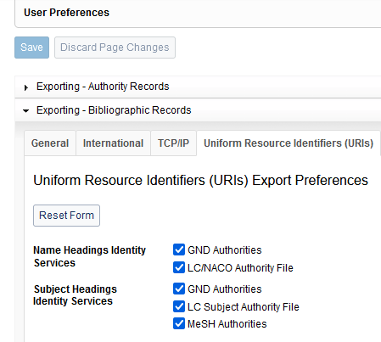
“Linky”-MARC records
Record Manager allows export WorldCat records embedded with select URIs

Slide 8
Impacts
Exporting with URIs embedded is configured for UC systemwide Daily WorldCat Updates
Prepared for Ex Libris’s upcoming Alma Info Card feature (triggered by the presence of URIs) (demo)
Notes:
The plan is to implement the card and page as part of the new all titles staff search that will be released in H2 2024 and into the MDE to assist with MARC cataloging.
The results display for the all titles search will have two additional sections that will be able to support info cards and person pages: Contributors and Subjects.
The first phase will have info cards and person pages available for personal names, for both sections.
The info card will display basic information about the person: name, picture (if available), short description, born, died, field of work and occupation. and will also display a link to the relevant Wikidata page.
The full person page will display three sections:
About section: The section will display the same information displayed in the info card with an expansion including the first few rows about the person from Wikipedia with a link to the full Wikipedia page.
Relations sections:
Titles contributed to by {Person Name}: This section will display additional titles that the person has contributed to.
Titles written about {Person Name}: This section will display titles that the person is a subject of those titles.

Slide 9
Select resources
OCLC cataloging application comparison
https://www.oclc.org/go/en/oclc-cataloging-application-comparison.html
OCLC’s documentation on WorldShare Record Manager
https://help.oclc.org/Metadata_Services/WorldShare_Record_Manager
UC Davis’s Record Manager training plan (April-June 2023)
https://docs.google.com/document/d/1VA6M_hi5DUb9WPpOF1xhW_84clwwfELqxmY1n0cKh_0/edit?usp=sharing

