Slide 1
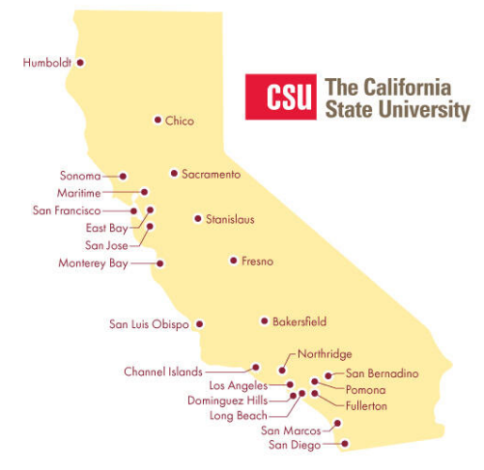
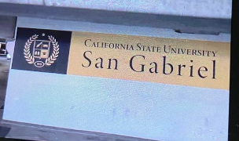
January 18, 2024 Technical Services Open Forum
Notes:
Welcome to the January 18, 2024 edition of the Technical Services Open Forum.
Thanks to Peggy Lau from Cal State East Bay for sharing this screenshot from the new Netflix TV show The Brothers Sun, there is apparently a 24th CSU campus now named California State University, San Gabriel!
I am not familiar with the show but I did read that the shots of this 24th CSU campus were filmed at Woodbury University in Burbank, not at a real CSU.

Slide 2
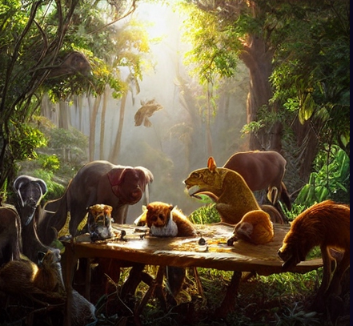
Today’s agenda
Announcements
Ex Libris system down - where to check status?
Catalog time tracking from University of California
What else?
Hang out
Notes:
Here’s the agenda for today.
Any announcements not on the agenda
The CSU libraries had an hour-long outage of all Ex Libris products on Wednesday, January 3, 2024 so I wanted to give a quick refresher on where to check for status updates if you suddenly cannot access Ex Libris products, those being: Alma/Rapido/Primo/Leganto/Rialto/Esploro.
* We have a trio of guest speakers from the University of California (UC) libraries, thanks to our ULMS Resource Management Functional Committee.
The UCs are doing very interesting work with tracking how much time is spent on aspects of cataloging in a way that makes it easy to run reports on how much time is spent on cataloging overall and where and how. This helps with cataloging project management, deciding when to outsource or do work in-house, and figuring out resources and budgets for grant proposals. They will tell us where they track the data in the records (and what they track), getting catalogers and administrators on board with the process, the types of reports they run, and what the benefits have been. The campuses differ in their implementation so they will tell us some about that as well.
So those presentations will be the bulk of our time today.
Anything else if we have time
Then at noon we’ll turn the recording off, we can hang out and talk about library work or if anything interesting will be going at your campuses next week, perhaps

Slide 3
Announcements
Notes:
So now I want to open this up to any announcements that folks have that might not be on the agenda, this is your time to speak and share!
I put the word ‘announcement’ in an AI generator with ‘cute creature’ option and got this, it’s cute but sort of scary!

Slide 4
Reminder of things to check/do for an Ex Libris system down
Wednesday, January 3, 2024 – All Ex Libris products were down for about an hour
Check in CSU Slack for current messages: https://calstatelibraries.slack.com/
Post a message to @here if you are comfortable
Notes:
* So I know January 3 seems like about a month ago but just to remind you, about 2 weeks ago, we had an outage on all our Ex Libris products for about an hour. Many of you were still on break, it was my first day back at work myself. We did our best to get the word out, but we missed some of you in our communications so I wanted to give a quick rundown of what you should check or do in the case of one of the Ex Libris products not working.
We won’t be going into opening a SalesForce case, that’s a webinar we have planned for another time. This is just in the case of an Ex Libris system down and it might be more than just your campus.
* This is a great time to join CSU Slack but you have your preferences…at least try to ask someone at your site that does use Slack if they know about a system problem.
* So for the Jan 3 outage, Hannah Lee of CSUDH wins the prize as she was the first person to alert any of us in Slack.
* For those of you that don’t use Slack, or aren’t as familiar with it, you can do an “at sign: here in any channel and it will send a push notification to everyone in the channel that has notifications on.
Hannah did this in the #systems channel but you can ask in any of the channels you feel comfortable with.

Slide 5
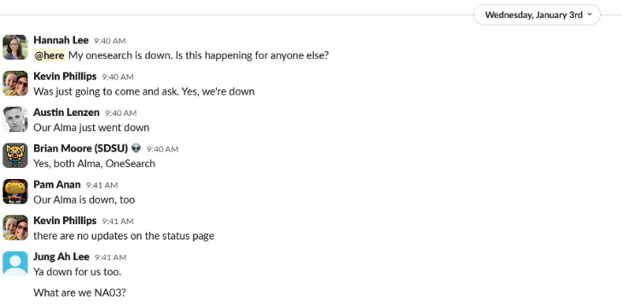
Add what you can!
If you have more to add, chime in
Notes:
You can see very quickly in this case that folks from many other CSUs chimed in Slack that it was not limited to CSUDH and not to Primo, Alma was down as well. Eventually we learned all the Ex Libris products were down but this helped us know this was not just a Primo problem,
Don’t assume that someone has reported that you are down as well, please add anything you can!

Slide 6
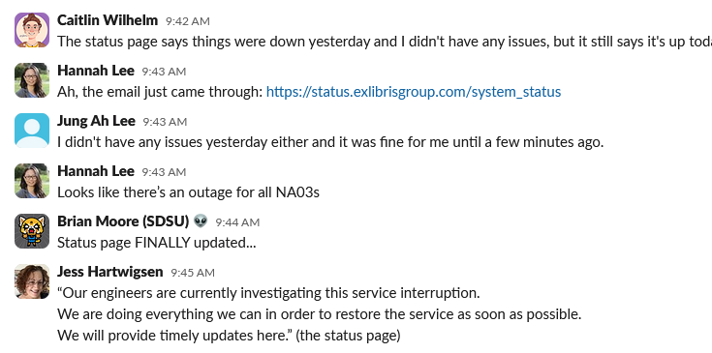
Check the Ex Libris status page
Look for all Ex Libris status updates on this page: https://status.exlibrisgroup.com/system_status
All the CSU is on ‘NA03’ server
CSU Slack will always have this information before Ex Libris
Notes:
*The next thing to do is to check the Ex Libris status page. I’ll show you the site in a minute but here is the URL, and I’ll send that with the recording as well.
*What you might need to know before you go to the page, is that all the CSU campuses are on the NA03 server.
*And the CSU Slack will ALWAYS have updated information before Ex Libris…imagine that they really have to confirm the nature of the problem before updating us
*You can see that discussion here in Slack as well, we knew there was a problem but Ex Libris had not said anything official yet, then they did.

Slide 7
A clear status page looks like this
Just look at NA03
Notes:
Here’s an example of what the status page looks like when everything is good, all green with checkmarks.
When you go to the status page, just look at what is being reported for the NA03 server.
Sometimes the outage is across Ex Libris products and servers but often it is server-specific

Slide 8
Look for a red dash for issues
Notes:
*I didn’t get a screenshot of our particular problem and you can only see back a week on the status page but here’s one from earlier this week on the NA07 server
I can see something happened on January 15, if I can’t see red, then look for the dash or minus.
*And if I float over the red dash circle, this box will appear to tell you what happened and when it was resolved. It might be in Israel time so you might need to use a time zone convertor to determine exactly when the outage happened.

Slide 9
Subscribe to status updates
Follow the instructions on this page: https://calstate.atlassian.net/wiki/spaces/UEC/pages/2855632914/Ex+Libris+System+Status
Notes:
We realize you might be deep in cataloging or working with a patron so you might need to get an email when there is a problem like this, here’s how to do that so you are ready in the future
Follow the instructions on this page to subscribe to one or all the Ex Libris product status updates, the URL is here and I’ll send it out with the recording as well.
Thanks to Jessica for creating this page, the subscription is not the easiest thing to set up but once you have it set up, you are good for life.
You can see here I got an email for all the products but you can get some or all

Slide 10
Status update emails look like this
Notes:
The emails from Ex Libris look like this…it says service disruption, then they link to the status page. You can see the tiny people are working on the problem in the image.

Slide 11
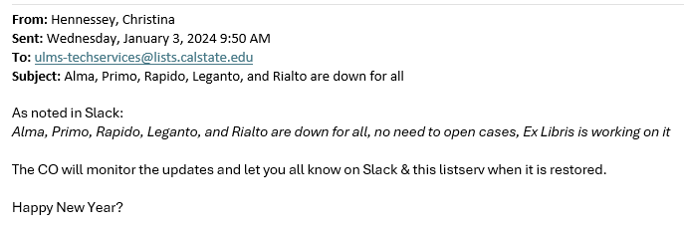
Check the ULMS listservs
ULMS-techservices, ULMS-accesservices in particular
We will make an announcement on those if we know something
Please email library@calstate.edu if you don’t see this anywhere, that gets all of us and we can make a local email
Notes:
*Next, we encourage you to check our CSU ULMS listservs for updates, especially tech services and access services
*We will make an announcement on those if we know something. I apologize that I did not post this on access services when this happened on Jan 3 and I missed some folks, I misunderstood who all was subscribed to each of the listservs. My department at the CO will be reviewing soon who is on what listservs, so we know who we are reaching but also so you don’t get updates on 5 different listservs.
*Anyway, if you still don’t see anything on the CSU Slack, and the Ex Libris status page and the ULMS listservs, and you aren’t sure what’s going on, please email library@calstate.edu. That goes to me and David and Jessica and Chris Lee, one of us will be able to respond to it and it might be the first we are hearing of this issue.

Slide 12
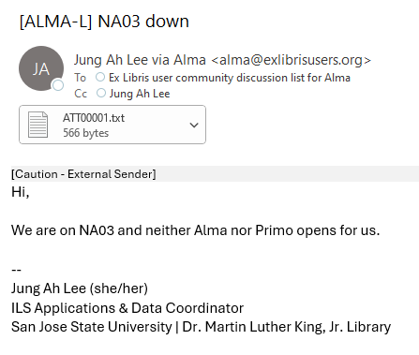
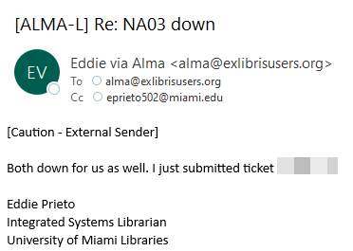
Check ALMA-L, PRIMO-L, etc.
Check the Ex Libris listservs
Notes:
*Another place to check are the Ex Libris product specific listservs – ALMA-L, PRIMO-L, etc.
*Once again, our own CSU folks were reporting in here, Jung Ah Lee from San Jose State and some others.
*But then we also saw that other non-CSU folks were reporting this, here’s someone at a Miami library, folks from several other institutions chimed in as well

Slide 13
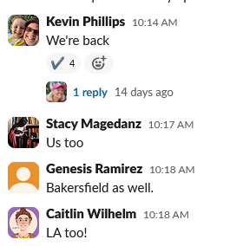
Good news! We are back
Let people know when you are back up
Ex Libris status might be behind the rest of us
Notes:
So then we just wait. We might need to open a Salesforce case but with something like this, Ex Libris was quite aware of the problem so no need to waste time opening a case.
*There’s not much you can do in the meantime but keep checking email and Slack and the status page
In our case, Kevin Phillips at Fullerton let us know they were back up, hooray! And others quickly chimed in about their campus.
*The Ex Libris status update came about 15 minutes later, they have to be sure it is really fixed first so check our Slack and ULMS listservs as we might have something first.

Slide 14
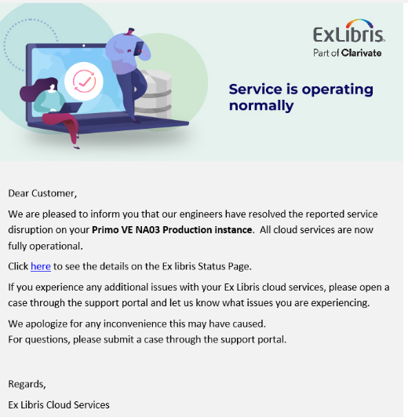
‘We are back’ emails
Notes:
And the we are back emails look like this
*Here’s the one from me on the ULMS listservs
*And the one from Ex Libris about 15 minutes later. The image is different on this one than the first email, they are visually showing you that all is well but they are still working.
That was just a really quick run-through of things you can check in the future when these things happen…there is a lot more we will cover in later webinars but I wanted to share this now while it was fresh.
Any questions?

Slide 15
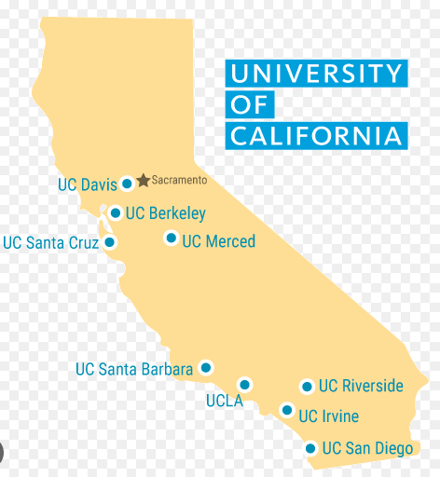
Our speakers
Adam Baron, UC Berkeley, Head of Metadata Services
Hermine Vermeij, UCLA, Team Leader, Subject Specialist Catalogers; Music Cataloger
Elizabeth Miraglia, UC San Diego, Assistant Program Director for Metadata Services and Head of Books & Serials Metadata
Notes:
Next up, I want to introduce our guest speakers from our University of California campuses that will be talking to us about their cataloging time tracking experience.
The speakers are (not necessarily in this order):
Adam Baron, UC Berkeley, Head of Metadata Services;
Hermine Vermeij, UCLA, Team Leader, Subject Specialist Catalogers; Music Cataloger;
Elizabeth Miraglia, UC San Diego, Assistant Program Director for Metadata Services and Head of Books & Serials Metadata.
We’ll have lots of time for Q&A after their presentations, so you can find out more about their processes and impact on their work and projects. This might give us some ideas of projects we could try in the CSU.
Take it away!

Slide 16
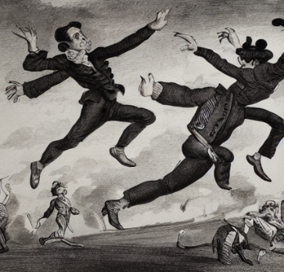
Next time!
Thursday, February 15, 2024,11am-noon
A few things in the works, maybe acquisitions
Notes:
Coming up next month!
*Thursday, February 15, 11am-noon.
*The day after Valentine’s Day or
*halfway to Leap Day, however you want to look at it.
*No official topics yet, we might have some speakers or an open forum about acquisitions issues, I’ll be sending email about that soon

Slide 17
Special TS Open Forum edition
Thursday, March 7, 2024,11am-noon
Organized by Host Emeritus Luiz Mendes (Northridge)
Using OCLC Record Manager to create and maintain LHRs
Training provided by Valerie Chase, OCLC Cataloging Specialist
Notes:
*Then in March, we are starting to find that we have so many things we want to share and talk about that it is too much to fit into one meeting a month!
So we’ll have two TS Open Forums in March, one at the regular time/date on the third Thursday of the month
And this special one on the first Thursday of the month in March, March 7 from 11am-noon
*This was organized by our host emeritus, Luiz Mendes of Northridge, thank you Luiz
*And this will be training on using OCLC Record Manager, which TJ Kao of UC Davis talked about last month at the forum, using that to create and maintain local holdings records, or LHRs
*Training will be provided by OCLC’s Valerie Chase, she is a OCLC Cataloging Specialist.
So look for that invite and more information in email soon.

Slide 18
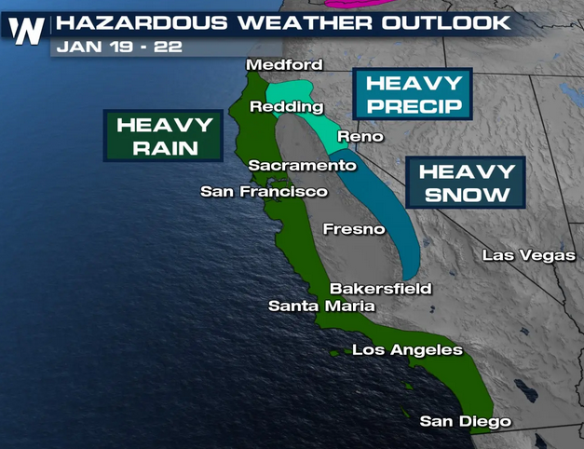
Thanks for attending!
Recording will be available & posted later this week
You are welcome to hang out until 1pm (recording off)
Stay dry & warm
Image: Weathernationtv.com
Notes:
Thanks for attending
*Recording will be available & posted later this week
*You are welcome to hang out until 1pm (recording off)
*And stay dry & warm, there is going to be a lot of bad weather across the state in the coming days.

