Slide 1
CSU Technical Services Open Forum
January 18, 2024
Hermine Vermeij (UCLA)
Elizabeth Miraglia (UCSD)
Adam Baron (UC Berkeley)

Slide 2
Cataloging Statistics at the University of California
Migrated to a shared system (Alma) for the first time in 2021
No previous harmonization for statistics at all
Defined local field in NZ (949) for Shared Cataloging Program cataloger statistics
Harmonization of local fields: https://uc-sils.atlassian.net/l/cp/8i1qtGDm
Example:
No other harmonization for cataloging statistics--campuses may define available local fields if they wish.

Slide 3
UCLA

Slide 4
History of cataloging statistics at UCLA
We’ve kept statistics for as long as anyone can remember.
There has also always been a 9XX field for cataloger initials (just initials and date).
Originally more detailed statistics were recorded on paper; in the mid-2000s we moved to recording them in an additional 9XX field.
Old (pre-migration) practice:
910 ## $a hv 240116
948 ## $a cmc $b hv $c 20240116 $d 4 $h bf $h e $i 1n
After migration, we had to change 9XX fields, and we discontinued the duplicative 9XX field (it’s now only used for vendor loads).

Slide 5
Current practice
962 field - required fields
$a - Cataloging Center code (e.g., rams for Resource Acquisitions & Metadata Center; clk for Clark Library
$b - initials (we keep a master list on Confluence)
$c - date (YYYYMMDD)
$d - effort level
1 - Copy cataloging with no editing
2 - Copy cataloging with some editing
3 - Original minimal record OR copy cataloging with significant editing (e.g., addition of subject heading)
4 - Full original cataloging (including from minimal vendor record)
When revising records, we add a suffix to the effort level, e.g. 2rev for a minor revision; or 1loc for processing an added location
Full documentation

Slide 6
Current practice (cont.)
962 field - optional fields
$e - Format of material (we use “in” for internet; other cataloging centers use other codes)
$f - Number of physical pieces (not widely used anymore)
$g - Specific maintenance information
$h - National contribution (e.g., e = Enhance (replacing the record in OCLC))
$i - NACO contributions (e.g., 1n = 1 NACO record created)
$j - SACO contributions
$k - Locally defined (used for electronic collections; tracking projects)
Catalogers add the 962 using Alma templates or via a Macro Express macro.
Full documentation

Slide 7
Current practice (examples)
Basic copy cataloging:
Originally cataloged in 2020 (with some edits); copy added in 2023:

Slide 8
Current practice (vendors)
951 field with code and date - no information about difficulty level
Really just used to get numbers and trace record provenance
Example:
All statistics fields are coded as local extensions, so they are not visible to other campuses.
We’ve defined local indexes for them, so anyone can search for their own records in Alma.

Slide 9
Reports
Pre-Alma, we had a homegrown web form for retrieving statistics information.
After migration, we investigated using Analytics, but there were too many problems
No parsing subfields within the 962
All 962 fields were strung together
Luckily, an in-house programmer was able to recreate the form using an Analytics report as the base:
F
Full work on GitHub: https://github.com/UCLALibrary/cataloging-statistics/tree/main

Slide 10
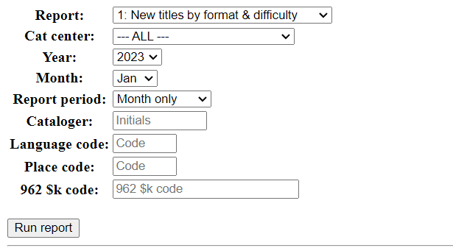
Current Reporting Tool
Available by direct link; generally not shared beyond cataloging supervisors.

Slide 11
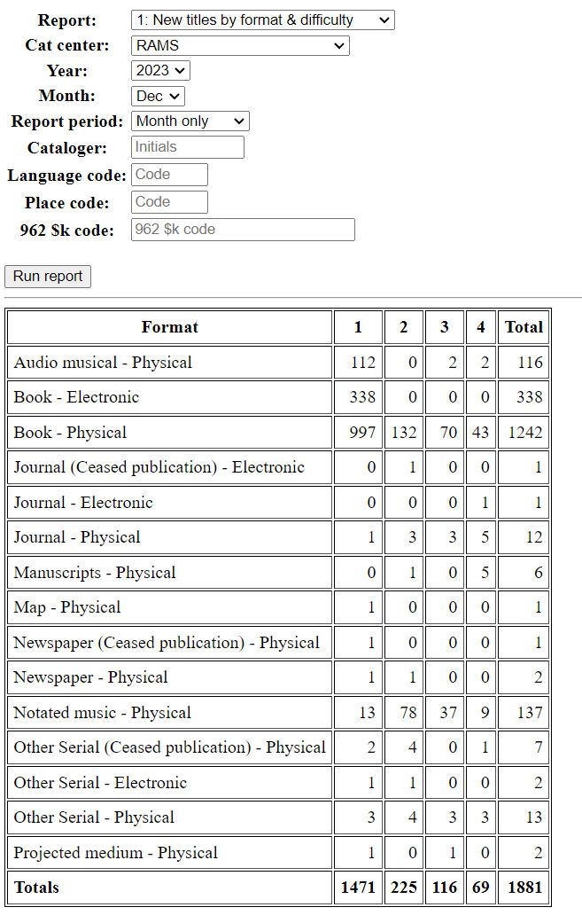
Everything cataloged by RAMS in December 2023, including difficulty level.

Slide 12
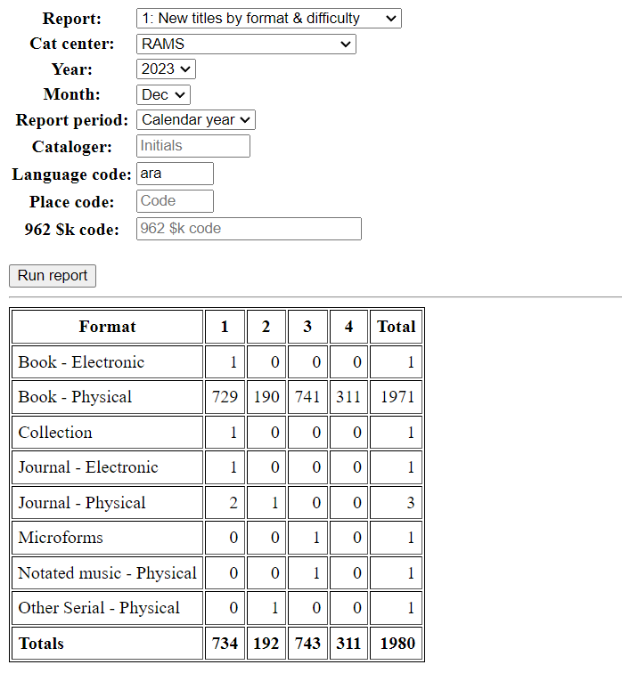
Arabic titles cataloged in 2023

Slide 13
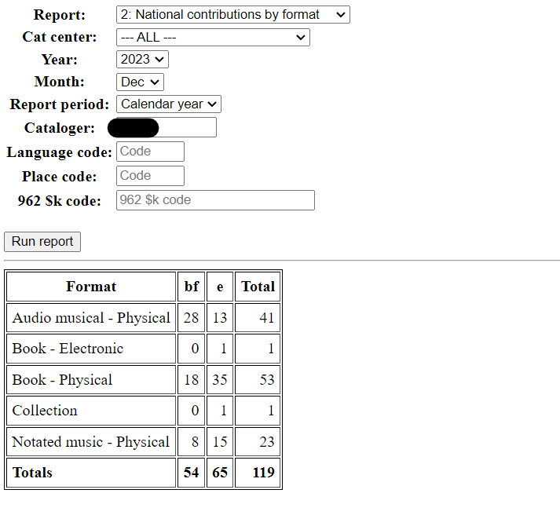
BIBCO (bf) and replace (e) statistics for a particular cataloger in 2023

Slide 14
Benefits
Helps with staff evaluations
The obvious: so-and-so cataloged more this year than last year!
The less obvious: so-and-so cataloged less this year, but more records were at a higher difficulty level, requiring more time and expertise.
Provides information about department productivity - tracking workflow improvements, effects of losing or gaining staff, etc.
Estimating how much time/money would go into cataloging a project in house vs. outsourcing

Slide 15
UCSD

Slide 16
History
Like UCLA, have been collecting stats for as long as anyone can remember. Our current shared drive has reports dating back to 1987
In Millennium we used a 949 field (more or less identical to the one still used by SCP) and often relied on text strings and macros in Connexion to export stats into our local system
Stats notes were stored in item records (converted during export or added manually)
Reports have always included information about the type of cataloging being performed, number of items/titles, and resource types
UCSD also developed a local tool that catalogers and managers could use in conjunction with stats reports to assess progress and standardize expected productivity

Slide 17
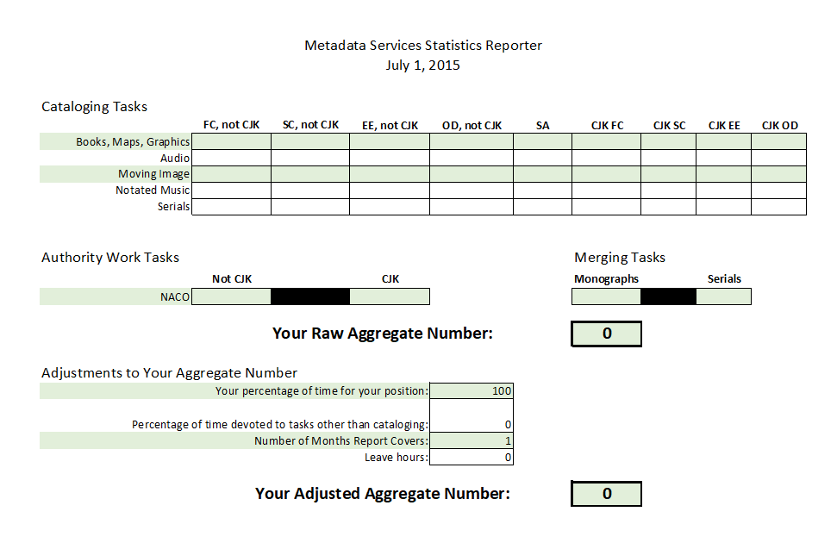

Slide 18
What we collect now
Types of cataloging: original, subject analysis, copy, updates to existing records, merges in OCLC
Number of impacted titles
PCC work: CONSER and BIBCO (NACO is tracked separately)
Batch statistics: package names, title counts, partial vs. full batch

Slide 19
Current practice
Stats are stored in local 993 fields using this structure:
993 $$a cat[mmm][yy];[initials];[title count];[task code]
Catalogers add stats via Alma templates or manual keying, we are not able to use Connexion to export the data any longer
We maintain tables of cataloger initials and task codes
A saved Analytics report is updated each month to collect stats
A custom script is run using the Alma IZ API to gather the Analytics data and generate reports for each cataloger, along with raw data and any stats with errors in them
Reports are sent to each cataloger and their supervisor by designated staff along with a picture of a cat
Notes:
Stats reports can also be generated using the data from Analytics in excel and lookups to the cataloger/task code tables

Slide 20
Alma Analytics

Slide 21
Sample report

Slide 22
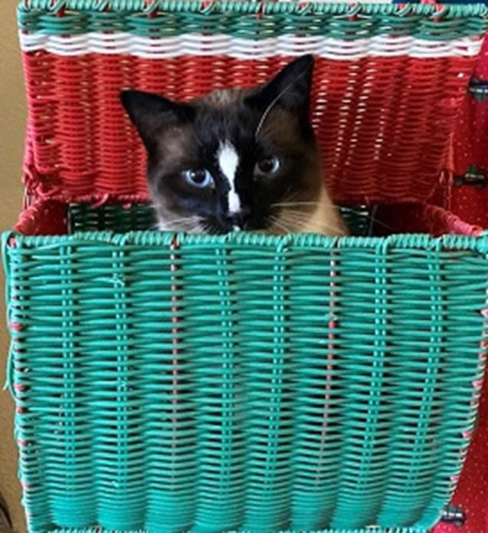

Slide 23
Applications and benefits
Catalogers and their supervisors can track progress regularly and often use stats reports in their 1:1 meetings
Quantifiable data for goal setting and annual reports for catalogers, units, and the entire program
Justifications for recruitment
Workload assessment
Data for tracking trends (increased shelf ready, more batch processes, etc.)

Slide 24
Continuing development
Reassess our task codes
“Subject analysis” varies widely in the time/expertise needed
Identify new areas for reporting, particularly in e-resources
Try to reduce manual input for catalogers
Monitor Alma developments for ways to rely on system data
Revisit reporting tool

Slide 25
UC Berkeley

Slide 26
History
UC Berkeley has been recording cataloging statistics in MARC bibliographic records for over 10 years.
After the migration to Alma in July 2021, staff recorded cataloging statistics in local extension 955 following the previous practice. In addition, staff were required to enter their statistics in a spreadsheet because it was unclear how to generate the reports from Alma Analytics.
On July 1, 2022, UCB fully implemented recording cataloging statistics in Alma, with revised practices and definitions.

Slide 27
955 Cataloging Statistics
Field definition and scope
A local extension used to record cataloging statistics.
Subfield codes
$a - Date
In either yyyymmdd or yyyymm format depending on department
$b - Cataloger initials
Initials include the library code followed by initials of the cataloger
$c - Statistics code
$d - Format code (Optional)
$e - Library/department code (Optional)
Documentation

Slide 28
955 $c Statistics Code
Over 30 codes defined to record the type of work performed, including archival cataloging, PCC work, special projects, and deposits at the Northern Regional Library Facility (NRLF).
Codes are assigned for the type of cataloging, with additional codes for PCC work and special projects.
Libraries/departments can choose which codes to use and may decide to use codes with slightly different definitions from each other.

Slide 29
955 $c Statistics Code: Commonly Used Codes for Cataloging
Code | Type of Work | Definition
CC | Copy cataloging, No edits | Use when a MARC record exists in WorldCat or the Alma NZ and exactly matches the item in hand, including classification and subject headings.
CCE | Copy cataloging, Edits | Use when a MARC record exists in WorldCat or the Alma NZ with classification AND subject headings but requires the addition or correction of other bibliographic elements.
CO | Cataloging, Original | Use when no matching MARC record is found in WorldCat and a full record will be created or derived.
COM | Copy cataloging, Complex | Use when a MARC record exists in WorldCat or the Alma NZ but (1) lacks classification, subject headings, or both; or (2) requires complete re-creation, including classification, subject headings, and access points.

Slide 30
955 $c Statistics Code: Commonly Used Codes for PCC
Code | Type of Work | Definition
BSR | BIBCO standard record (PCC) new | Use when no matching MARC record is found in WorldCat and a BIBCO record will be created or derived or when a non-BIBCO MARC record exists in WorldCat and will be authenticated as a BIBCO record.
BSRM | BIBCO standard record (PCC) enhanced | Use for all updates to existing BIBCO records in WorldCat by a BIBCO member.
NACO | NACO new | Use for new NACO authority records contributed to the LC/NACO Authority File. Include one 955 field for each NACO authority record contributed.
NACOM | NACO enhanced | Use for all updates to existing NACO authority records. Include one 955 field for each NACO authority record updated.

Slide 31
955 $c Statistics Code: Codes Used for Special Projects
Code | Type of Work | Definition
OMP | OCLC member merge project | Use when merging WorldCat records. Regardless of the number of records merged in WorldCat, only add one 955 field with this code.
Remote | MdS remote work | Use when cataloging from scan. Add as separate field from cataloger statistics field: 955 $$a yyyymm $$b [initials] $$c Remote
REQUEST | MdS requested item | Use when cataloging a requested item. Add as a separate field from cataloger statistics field. Include a 955 field for each item requested.

Slide 32
Entering Cataloging Statistics in Local Extension 955
Catalogers are strongly encouraged to enter their cataloging statistics in Alma using templates to ensure the field is entered correctly.
Catalogers create their own private templates, which they update each month to change the date.
See UCB procedure Cataloging statistics in Alma for creating and managing templates, and entering cataloging statistics using templates.

Slide 33
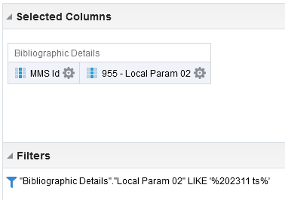
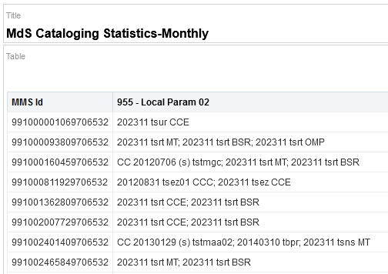
Obtaining Cataloging Statistics
In Alma Analytics, create a new report using Local Param 02 and filtering by date or library. Export the report as an Excel data file.
Documentation

Slide 34
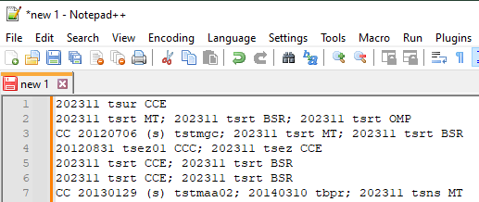
Obtaining Cataloging Statistics
In Excel, select and copy all results in the Local Param 02 column and paste into Notepad++.

Slide 35
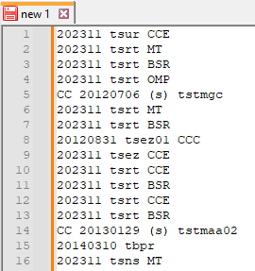
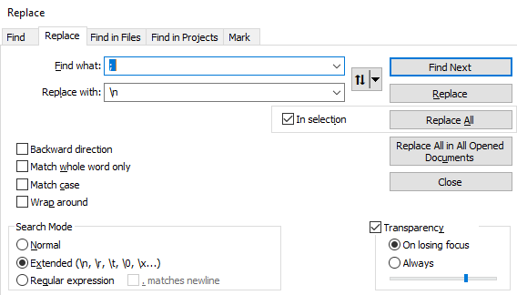
Obtaining Cataloging Statistics
In Notepad++, split multiple 955 fields into separate lines.

Slide 36
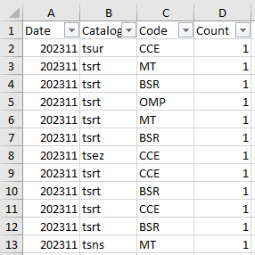
Obtaining Cataloging Statistics
In Excel, review and modify the data as follows:
Separate the different 955 subfield values into columns.
Insert a header row.
Use the filters to identify and delete irrelevant data or correct incorrect data
After verifying the accuracy of the data, add a 1 in the Count column for each row.

Slide 37
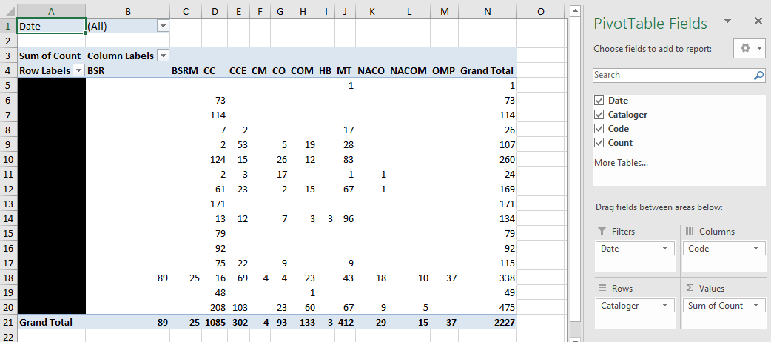
Obtaining Cataloging Statistics
In Excel, create a pivot table to calculate the cataloging statistics.

Slide 38
How Cataloging Statistics are used in Metadata Services
Report is run monthly and “cleaned” data is added to bottom of an existing spreadsheet.
The “cleaned” data populates three pivot tables:
(1) Broken out by cataloger with date filter
For a selected month(s), can compare cataloger productivity
(2) Broken out by date with cataloger filter
For department, can see productivity by month
When filtered to a specific cataloger, can see their productivity by month over time
(3) Titles cataloged
Includes only those codes that likely indicate a title was cataloged for the first time (i.e., CC, CCE, CM, CO, COM)
Excludes all PCC and special project codes

Slide 39
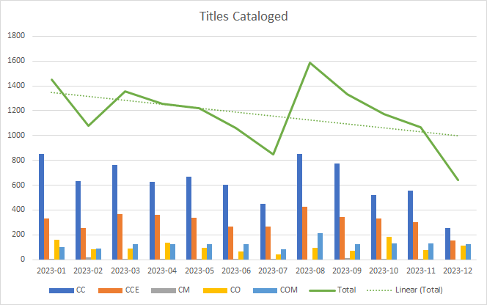
How Cataloging Statistics are used in Metadata Services

Slide 40
Cataloging Statistics for Shelf-Ready Materials
In November 2023, UCB asked our shelf-ready vendors to add cataloging statistics in 955 fields in all of their records they send us.
Each vendor was assigned a code to use in subfield $b.
Vendors are using a subset of the cataloging codes in subfield $c, namely:
CC = Copy cataloging, No edits
CCE = Copy cataloging, Edits
CO = Cataloging, Original
Vendors include $9 LOCAL so it is loaded as a local extension.

Slide 41
Questions?
hermine@library.ucla.edu
emiraglia@ucsd.edu
adam.baron@berkeley.edu

