Slide 1
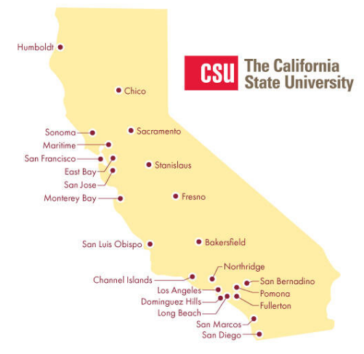
February 15, 2024 Technical Services Open Forum
Notes:
Welcome to the February 15, 2024 edition of the Technical Services Open Forum.
Hope you had a nice Valentine’s Day yesterday, or Ash Wednesday, or whatever you might have been observing yesterday,

Slide 2
Today’s agenda
Announcements
ULMS updates from me
Share California GovPubs in the NZ
Broadcast message in your Alma
Ex Libris satisfaction survey
What else?
Hang out
Notes:
Here’s the agenda for today.
Any announcements not on the agenda
There is a lot going on in the ULMS lately, I am late in getting my monthly ULMS report to all of you since new things keep coming up that I want to tell you about so I revise it again and again and again, so I want to give you the latest on Zoom to help you in your planning and doing your work. I’m going to give an update on some new and old task forces, ULMS-related conferences, and some recent Primo interface updates that we have learned about from Ex Libris webinars in the last few weeks.
Then Jill Strykowski of San Jose State and Marcus Jun of SFSU will share a Proposal to create a Network Zone-based California GovPubs collection, I don’t know much about that so I look forward to hearing their presentation.
One thing I do in my new job is visit all your different Almas and Primos to check and compare configurations. I had noticed a nifty hack in San Diego’s Alma, that they have a broadcast message in there that is shown to all staff in Alma, Brian Moore of San Diego State let me know how to do it and I wanted to share that with you, it is fairly easy and you might want to start doing it too!
You should have seen an email from me on the Ex Libris Satisfaction Survey, it is a little different this year so I wanted to share more about that and let you ask questions
Anything else if we have time
Then at noon we’ll turn the recording off, we can hang out and talk about library work, what’s going at your campuses.

Slide 3
Announcements
Notes:
So now I want to open this up to any announcements that folks have that might not be on the agenda, this is your time to speak and share!
From Jessica: JSTOR Archival and Primary Sources:
JSTOR is now considered one collection, Archival Journals and Primary Sources. Please see the JSTOR information page to see what the subsets are included in either Archival Journals and Primary Sources. The title lists are also available from this page. The Arts & Sciences I-XV collections have been removed from the Alma NZ. ***Your library may need to update local POLs to adjust for the changes to the collections in the NZ.
There is also some text on the printout I have that she would like me to read about Gale Access Program.
Luiz OCLC-Cat email
Reminder of Feb 8 Analytics Open Forum on ACRL stats, Natalya presenting at I-SPIE at 2pm today

Slide 4
ULMS updates: data issues task force
Jill Strykowski | SJSU | Cataloging Lead
Christian Ward | Sacramento | Web Developer
Can Li | SFSU | Discovery & Systems Librarian
Tim Fluhr | Chico | Library Systems Office Lead
Corinne Ornelas | Bakersfield | Circulation, Reference
Heather Cribbs | Cal Poly SLO | Systems Librarian
Dolly Lopez | Fresno | Electronic Resources Librarian
Notes:
Now that I’ve been in my new job a few months, I have been putting together some task forces to get some special things done either through the functional committees, or outside of the functional committees. Thank you to everyone that volunteered, thank you to those that I reached out to asking suggestions, seeing if you were interested, and so on. I have two task forces to announce so you’ll be seeing their work over the coming months.
To clarify, the task forces are to work on some particular projects, usually short-term, it is not the same commitment of functional committees (which is two years), you might be on a task force for short time, or like some of our task forces, you could stay on for years, it really depends on the projects.
So here’s our group that will be working on the data issues task force, we had a few open forums in November and December to get some ideas on what that group can be working on but they will be getting started soon.
Jill Strykowski of San Jose State will be leading this group

Slide 5
ULMS updates: acquisitions task force
Christina Hennessey | CO | Director, ULMS
April Porterfield | Sacramento | Collection Management Services
Catrina Mancha | San Bernardino | Acquisitions/Gifts/Receiving
Bernadette Humphrey | SJSU | Head of Acquisitions & Collection Management
Michelle Sharla Navarro | Pomona | Electronic Resources Management (ERM) Librarian
Anthony Davis | Fullerton | Copyright & Policy Librarian
Notes:
In our open forums for the data issues task force, we discovered that there was really a need to restart a group for acquisitions in the ULMS.
We have had these in the past, they have been their own group, then part of the ERM group, then task forces, there is lots of history here
But we really needed a new group now in 2024 for acquisitions-specific issues, so this group will be looking at things like: the new Unified PO Task list, working with Rialto in relation to acquisitions, helping other campuses with instructions on implementing PeopleSoft integrations, updating the acquisitions-related pages on the ULMS wiki as they have changed a lot, and best practices on license creation and management, amongst other acquisitions issues in the ULMS. You can see there is a lot to cover!
So here is that group. No lead named yet, it might be me to get this started, you are welcome to contact me with any ideas or questions in the meantime, but we’ll meet soon and have some updated information about that. Jessica isn’t listed here but she’ll be the liaison between acquisitions and ERM and involved somewhat.
Thanks again to all those that I reached out to and gave suggestions and shared your interest.

Slide 6
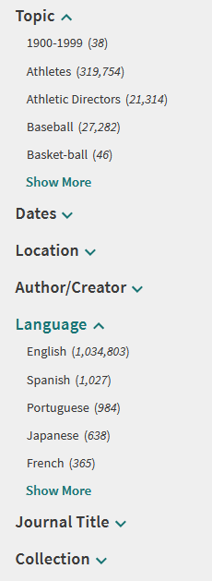
One more task force: normalization rules task force recruitment
Creates rules to display, search and/or facet data in your Primo
Rules can be CSU-wide or local
Norm rules task force under Discovery but works with Resource Management as well
New requests for genre & audience facets
No experience needed!
Call will go out shortly
Notes:
I also wanted to announce recruitment for one more task force – the normalization rules task force, also known as the norm rules task force
This group has existed for quite a while, but as the nature of these task forces go, people get a different job in their institution, leave for other institutions, the work no longer fits in their position, and so on. I was on it when I was at Northridge, and I discovered I was the only member left now!
So we need new members!
So what is the norm rules task force and what do they do?
The best way I can explain it - Normalization rules are the configuration part of Primo that determine how MARC fields are displayed, can be searched, and/or faceted in our Primo. Sometimes this is very clear, like an ISSN, but sometimes you want to show or make searchable some parts of the field and not others. You can use norm rules to do this.
Rules can be CSU-wide or local, this group helps create and test new rules so each campus doesn’t have to duplicate that work. And we can distribute some of them from the NZ and then you can change them locally if you like for your own preferences.
Structurally, this task force lives in the ULMS under the Discovery Functional Committee but also does a lot of work with the Resource Management Committee.
So what comes to this group are requests of either someone in the CSU would like a new facet, or help with display of an item, or the work that has been done by the Inclusive Description Task Force in transforming offensive or outdated Library of Congress subject headings. And we have some requests for some of these items right now! We would like to pilot a genre facet and an audience facet based on the data in our bibliographic records, Nerissa Lindsey of San Diego has already done a test view of this with some norm rules, so I need a team to help with that and other upcoming projects
Norm rules can be a little scary, I’ll show some screenshots on the next screen. I don’t need people that know anything about norm rules, we can teach you, I mainly need people to help with testing and creating rules. Cataloging experience would be helpful so you know the fields but a willingness to test and learn is what is needed most.
So look for this call for the task force members later this week, I’d like to get started in the next few weeks with this work. Thank you for considering!

Slide 7
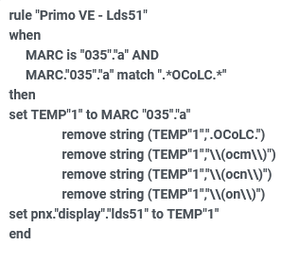
Norm rule examples
Notes:
I wanted to show you a few norm rule examples in case you had never seen one
Here’s an example of a simple one for an ISSN and MARC 022, this says, when MARC 022 subfield a is in use in a record, then just show that in the display of the record
But here’s an example of one that’s a little more complicated, the MARC 035 has the OCLC number but there can be a lot of prefixes on those that you don’t want to display in your Primo, so strip them off the front and then display that

Slide 8
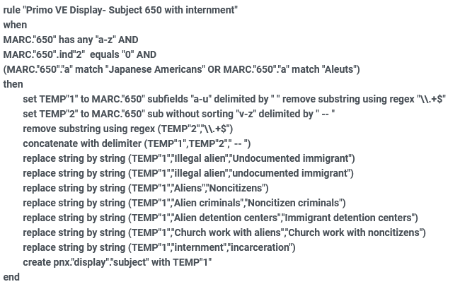
Norm rule example from IDTF
Notes:
And then here’s the partial part of a norm rule for some of the transformations that came out of the Inclusive Description Task Force,
You don’t need to know much here except that some text in subject headings gets replaced with a bunch of other text in subject headings in the display
So that’s my brief pitch on getting some folks for the norm rule task force, we mainly need testers so we can put the norm rule in your system, and then you test that it works, find exceptions, ways to break it. Also, the documentation on the wiki is still referring a lot to how this was done in Back Office, which we left in 2021 when we upgraded to Primo VE, so we need to update that documentation for how to do it in Primo VE. And I’d really like to share more details on how norm rules are done, we’ve done some education on this in the past but it’s been a while and there are lots of new people so I’d like to educate more folks on how to do this work so you can configure your own Primos.
Anyway, if you are interested in getting in the details of applying norm rules to display, search, and facet, this is a great place to learn! So please look for that call in the next week or so.
Any questions about the norm rules task force and what they do?

Slide 9
ULMS-related conferences
eCAUG 2024 update
ELUNA 2024 conference update from Feb 12 webinar
Annual conference May 15-17. Cost $750*
Evening reception Wednesday, May 15 (not Tuesday)
Knowledge Days May 13 & 14. Cost +$750*
Developer Days+ May 13 & 14. Cost +$450*
Analytics Afternoon – May 14, Cost +$100*. Still accepting proposals through tomorrow (Feb 16)
*$100 discount as consortial member, $100 speaker discount, bundle prices
Program ready around Feb 21?
Registration early March
Early bird prices end March 29
Notes:
Next I want to give you some updates on ULMS-related conferences.
eCAUG update – eCAUG is the California regional users group for ELUNA. They had their first in-person conference last year in Oakland and are in the midst of planning the 2024 conference. Kun Lin, the current chair of the group, sent out a brief survey asking for interest in topics on ALMA-L on Tuesday, February 3 please fill that out by March 1, I will send it along with the notes here.
We will not have a ULMS-specific conference this year, eCAUG WILL be our in-person conference this year. It is likely going to be hosted at the Chancellor’s Office here in Long Beach, I’ve given them all the information they need for us to host, it will likely in late August or early September again, but I am waiting to see what time range they choose and what the availability is at the CO during that time. I will share as soon as I know more, especially in relation to the month it will be held, hotels, cost.
*
ELUNA 2024 conference update, first, I hear we have many of our CSU colleagues that have presentations accepted for the conference, hooray! Once I see the official program, I will reach out to CSU folks and see if they want to practice their presentation here at the TS Open Forum, they are welcome to do that.
There was a webinar this Monday, February 12 about the Minneapolis conference. If you missed the that webinar you can get access the recording by registering and will immediately get a copy of the recording in email.But here are some of the things you might want to know:
All the prices I’m going to mention here are early bird prices without discounts. Annual conference May 15-17. Cost $750. No one day pricing, it’s $750 whether you go to 1 session or all of them.
Evening reception Wednesday, May 15 (not Tuesday). Optional but useful to know with deciding when to arrive in Minneapolis, it is a great way to catch up with colleagues from other campuses, especially our CSU friends. Very casual, usually good food and drink, all included.
Knowledge Days May 13 & 14. Cost +$750. For beginners
Developer Days+ May 13 & 14. Cost +$450. For coders but more ideas than code, you could attend and tell your coders about what you learned there. I am always surprised at Dev Days how little code there actually is. So don’t be intimidated by the developer name, you won’t be called upon to code on the spot. I went to my first one when I had been in the Ex Libris world for two weeks and I still found it useful for ideas that I could ask someone about later.
Analytics Afternoon – May 14, Cost +$100. Still accepting proposals through tomorrow (Feb 16). The Analytics afternoon is NOT for beginners, they ask for intermediate and advanced experience with Analytics, the webinar actually says, you should have watched a particular series before attending and I feel like that one is pretty advanced. This one will have a cap of 50 attendees. This is new this year by demand of attendees so it should be interesting, I hope to attend myself.
I am personally a little confused about the pricing and how many discounts you can apply and I will clarify on this later. You definitely get a $100 discount as a CSU consortial member, there is also a $100 speaker discount, and there is bundle pricing. I don’t know how it all works together yet.
Program ready around Feb 21?
Registration early March, I see the hotel rate at the Hilton Minneapolis is $199/night, that is probably before taxes but should be under the hotel limit for most of your campuses.
Early bird prices end March 29; $100 speaker discount, including if you did something at Developer Days or Analytics afternoon.
The Minnesota Twins are playing the New York Yankees Tuesday – Thursday in town that week, I hope to organize a CSU outing for those interested if the schedule works out.
Questions about either of these conferences? It is in person only, some of the Ex Libris sessions will be recorded and shared much, much later but not the customer sessions. I am not presenting this year (even though I love to present) as my focus at this year’s conference will be talking to a lot of other consortial folks and making relationships with other consortia, but feel free to reach to me if you need help with costs, making a case to go, convincing your Dean, convincing your family, etc. It is a good use of your time and budget if you can make it work. I will get clarification on the cost with all the discounts but feel free to reach out about costs specifically and they will probably clarify on the website when we ask our questions.

Slide 10
Recent Primo updates from webinars
January 24, 2024 – What’s New in Primo Q1 2024.
February 14, 2024 – Primo Roadmap Highlights 2024
January – February 2024: Primo VE: Become an Expert
https://knowledge.exlibrisgroup.com/Primo/Training/Webinars/Primo_VE%3A_Become_an_Expert
Notes:
Next up, there were a recent webinars on Primo or OneSearch that I wanted to draw your attention to.
January 24 – What’s New in Primo Q1 2024, this is the regular webinar they do quarterly before the next Primo release, this latest release was installed February 4, 2024. The ULMS Discovery team and in particular, the VETT or VE Testing Team is looking at things that were mentioned here, particularly changes that are coming to the setting of QuickLinks, HTML coding is available in more labels, and what is coming for the Author Card.
Feb 14 – Early yesterday morning, 7am, there was a different webinar on what is coming on the Primo VE roadmap covering what is coming up for the next year or two. This had some of the same information as the January 24 Q1 2024 webinar, but this was the first time I had seen a recent update on the new interface that they are working on for Primo, and an update to what they might be doing with AI. I get a lot of questions about what is coming for that so I have a few screenshots to share, these are just prototypes but it can get you thinking about what might be to come.
Finally, there are Primo webinars all the time but they are doing a reprise of the ‘Primo VE: Become an Expert’ series many of us did when we migrated to Primo VE in 2021 with an hour on different parts of configuration, including topics like, Search Configuration, Display, Local Data, etc. I’ve been re-attending these, they make for nice webinars while I am making and eating breakfast, and I always get something new about them. They are recorded and shared a day or two later so you do not need to watch them at 6am or 7am each week (unless you want to). There’s an exam you can do at the end of the series and get a nice certificate that you are an Expert on Primo VE. I would recommend this series if you are new to Primo VE configuration, or if you want more information about a particular area of Primo VE. Here’s the link for that series but I will send this link with the recording and notes as well.

Slide 11
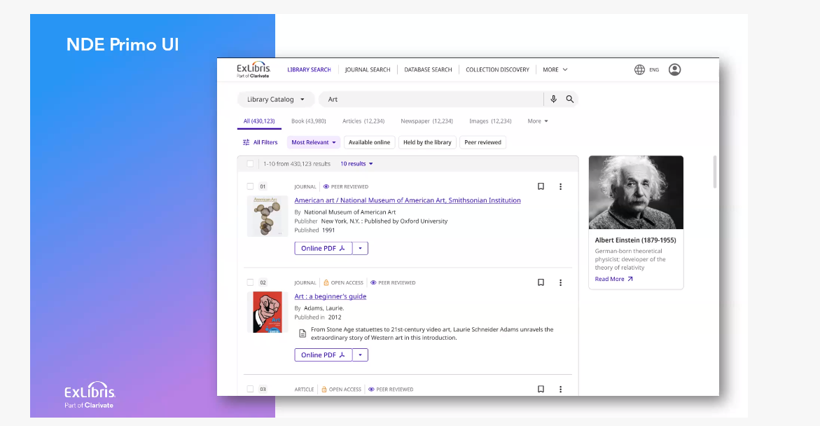
Prototype for new user interface
Notes:
Here’s a quick screenshot of the new UI, thank you to Christine Holmes of SJSU for sharing this screenshot with me after the webinar, it wasn’t on the screen very long in the webinar yesterday so maybe you missed it as well!
I’m not sure if this tells us much but I wanted to share it now
This is planned for the first half of 2025, that probably means May 2025, so we’ll see more at ELUNA and in the coming months

Slide 12
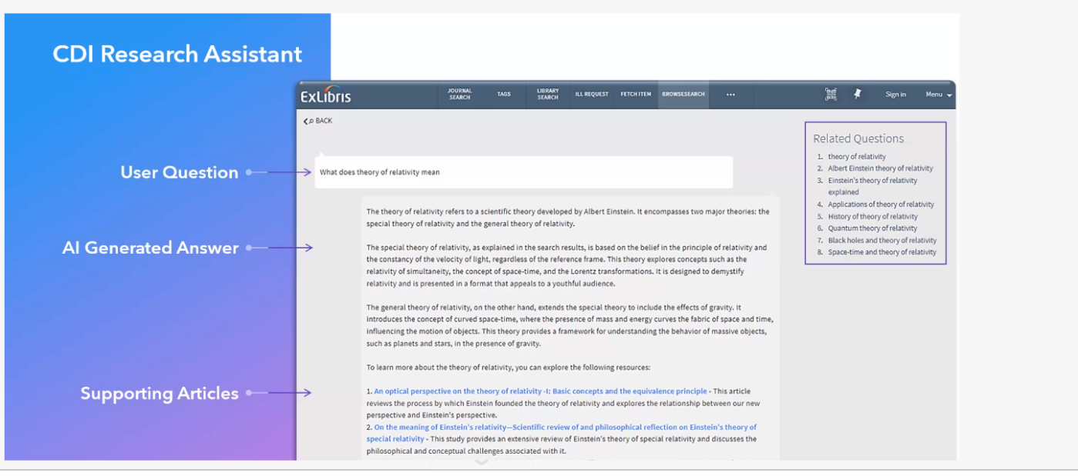
New CDI Research Assistant
Notes:
This was also the first time I had seen the new CDI Research Assistant, that’s an interesting title as we certainly have some more negative connotations with our thoughts on CDI, I can imagine that name will change
Anyway, you can see here, so far, this looks similar to using ChatGPT, you ask a question: What does theory of relativity mean?
There is an AI-generated answer
And this answer will have citations to go with it, that’s the CDI part, these will be real citations and not hallucinations
So this will be interesting to keep an eye on it, we’ll share more screenshots and prototypes when we see them!
The roadmap for this one is second half of 2024, so probably the November 2024 release. That seems a little soon.

Slide 13
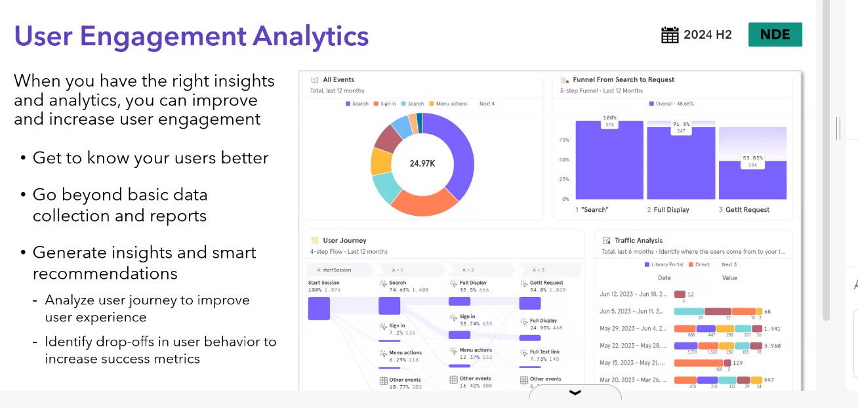
New Analytics backend
Notes:
This last update I’ve heard a little bit about, Ex Libris is interested in moving away from the Oracle or OBI back end in Analytics and to using something named mixpanel
They will be leaning more into visualization of data
I don’t know much about this yet but early adopters are working with it this year, 2024, we have folks in the CSU testing some dashboards, some of us have a demo about some new consortial dashboards and Analytics early next week that are being developed, I just wanted to let you know changes are coming to Analytics as well. The only thing listed on the timeline is that early adopters are doing something in 2024 and we have some folks in that early adopter area that maybe can tell us more.
Anyway, there were lots of other details about ULMS-related changes recently across those two webinars, we will learn more in the coming months, especially at ELUNA in May 2024, so stay tuned for updates from me and the functional committees on these topics.

Slide 14
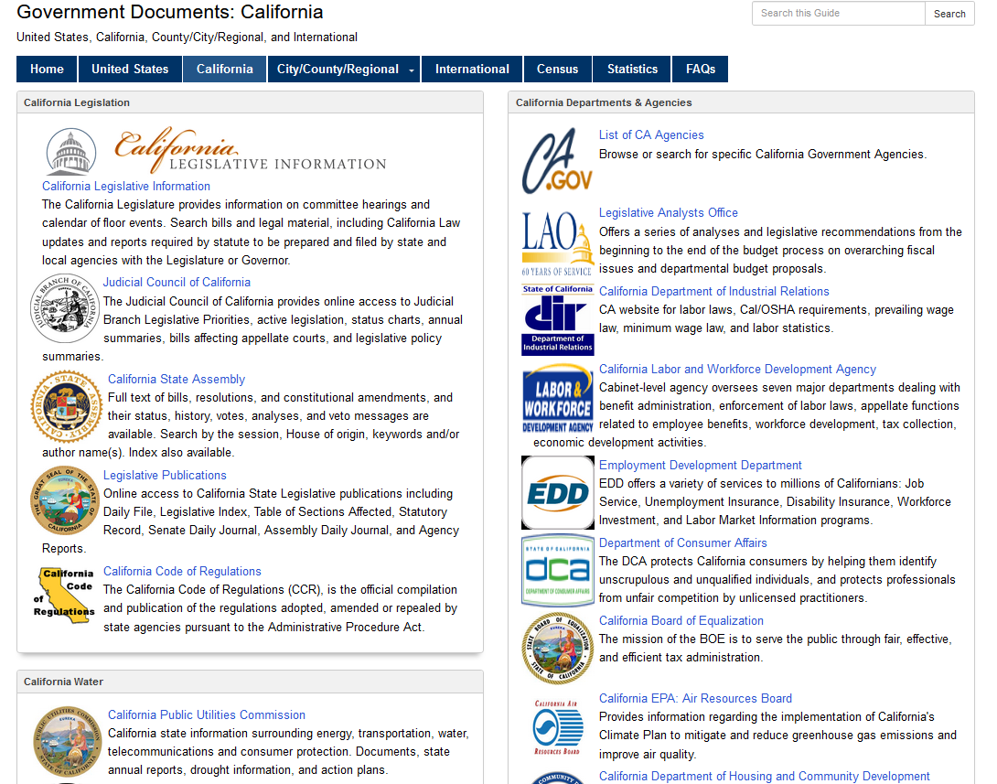
NZ-based California GovPubs collection
Screenshot from CSUF’s LibGuide:
https://libraryguides.fullerton.edu/c.php?g=189838&p=5350648
Notes:
Next, I’ll hand it over to Jill Strykowski of SJSU and Marcus Jun of SFSU who will be telling us about a proposal to create a Network Zone-based California GovPubs collection. I don’t know much about this, I believe it had been discussed in the past but that was before we were in Primo VE and lots of new developments in Ex Libris products so let’s see what we can find out.
I have no idea if this screenshot is relevant to what they are talking about but I wanted to share that Fullerton had a nice LibGuide on California Government Documents on this slide.
Anyway, take it away, Jill and Marcus!

Slide 15
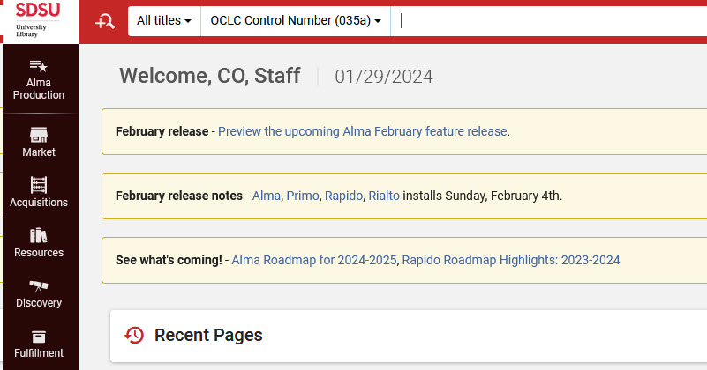
Broadcast message(s) in your Alma
Thanks to Brian Moore/SDSU for this idea
Notes:
One of the things I do in my job is look in a lot of your Almas for configurations and settings, I had noticed that San Diego State has these nice messages when you enter their Alma
You can have one or several, Brian uses them to link to Alma release notes, letting you know a new release was just installed or is about to.
I think this is a great idea as you can send all the emails, and Slacks, and Teams messages you want, but for those not tuned into the ebb and flow of Alma, Primo, and Rapido releases, bleary-eyed on a Monday morning or Sunday morning for those of you that work on Sundays…you might have something new on your Alma interface, something broke, something new is happening with Rapido, and you aren’t sure why.
This is an easy to way be reminded of a new release, a direct link to the release notes, and anything else you want to share with your staff through Alma. One thing you can’t do is have a message that Alma is down…since you have to be in Alma to see it.

Slide 16
Configuring a broadcast message
Alma Config > General > General Configuration: Institution Notifications > Message column
Notes:
Here’s the path to configure one of these.
That table looks like this, SDSU has 4 different notifications in there today, 3 are active

Slide 17
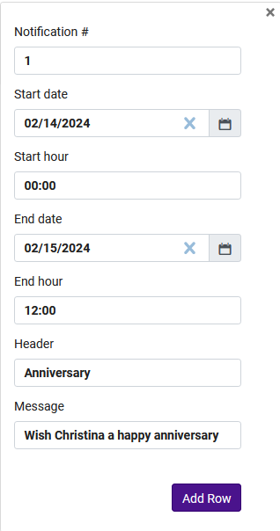
Configuring a broadcast message (continued)
Notes:
To create a new notification, you are inside that table
Add Row
Add notification number for the order you want these in on the Alma home page
Start date and time, end date and time
Some header, and then your text
Add Row (again)
Then Customize
For this example, it appeared in the NZ Alma and everyone’s NZ Alma, until noon today.
And to do something more like what Brian had in his example, you can add HTML links in the Message area, I really like what he did here with adding links to the release notes in the messages for a week weeks before and after the release.

Slide 18
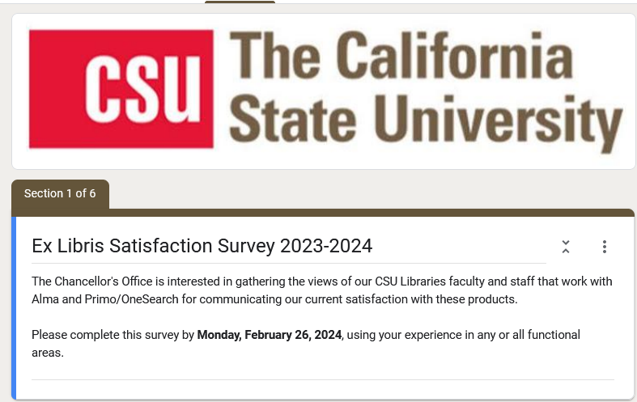
Ex Libris satisfaction survey
Sent via email February 7 to ulms-announce
For everyone
Only one survey this year
Will send information on to committees after survey closes
Big report for Ex Libris (you will see it too, also your deans)
Deadline February 26
Notes:
The annual Ex Libris support satisfaction survey was shared on February 7, 2024 on ulms-announce.
The survey is for all library administrators, faculty, and staff: technical services, public services, and anyone who uses Alma, Primo, and Rapido. So you don’t need to forward it to everyone in your campus (except maybe as a reminder or to answer questions), everyone should have gotten it. ulms-announce is a listserv we manage manually so I might have missed newer folks with the survey, you can forward it to them if you feel like they have something to share but also it would be great if someone lets me know if you have a new person that should be on ulms-announce.
There is only one survey this year, we used to have a staff one, and then one for each functional area, but now there is only one.
Multiple answers per campus are encouraged.
Once the survey is closed, the ULMS functional committees will work with your feedback to inform the report we share with Ex Libris each year so they can improve our services.
There will be a very long report and Ex Libris takes it very seriously. After that, I don’t think we’ll have those same meetings like we had last year, I think we didn’t find those useful on either side, we will keep figuring out how to do this with Ex Libris. I do want to make sure meetings that we have are useful and productive.
The deadline for the survey is Monday, February 26, 2024. Thank you to those that have already filled out the survey! I see 18 responses already with lots of thoughtful comments.
Any questions about the satisfaction survey?

Slide 19
Special TS Open Forum edition
Thursday, March 7, 2024,11am-noon
Organized by Host Emeritus Luiz Mendes (Northridge)
Using OCLC Record Manager to create and maintain LHRs
Training provided by Valerie Chase, OCLC Cataloging Specialist
Notes:
Coming up next month!
*In March, we are starting to find that we have so many things we want to share and talk about that it is too much to fit into one meeting a month!
So we’ll have two TS Open Forums in March, one at the regular time/date on the third Thursday of the month
And this special one on the FIRST Thursday of the month in March, March 7 from 11am-noon
*This was organized by our host emeritus, Luiz Mendes of Northridge, thank you Luiz. Luiz has a conflict for the meeting today so he wanted me to tell everyone hello, he might stop by for the after-meeting if he has time.
*And this will be training on using OCLC Record Manager, which TJ Kao of UC Davis talked about in December 2023 at the forum, using that to create and maintain local holdings records, or LHRs
*Training will be provided by OCLC’s Valerie Chase, she is a OCLC Cataloging Specialist.
This will be recorded as always if you cannot make it.

Slide 20
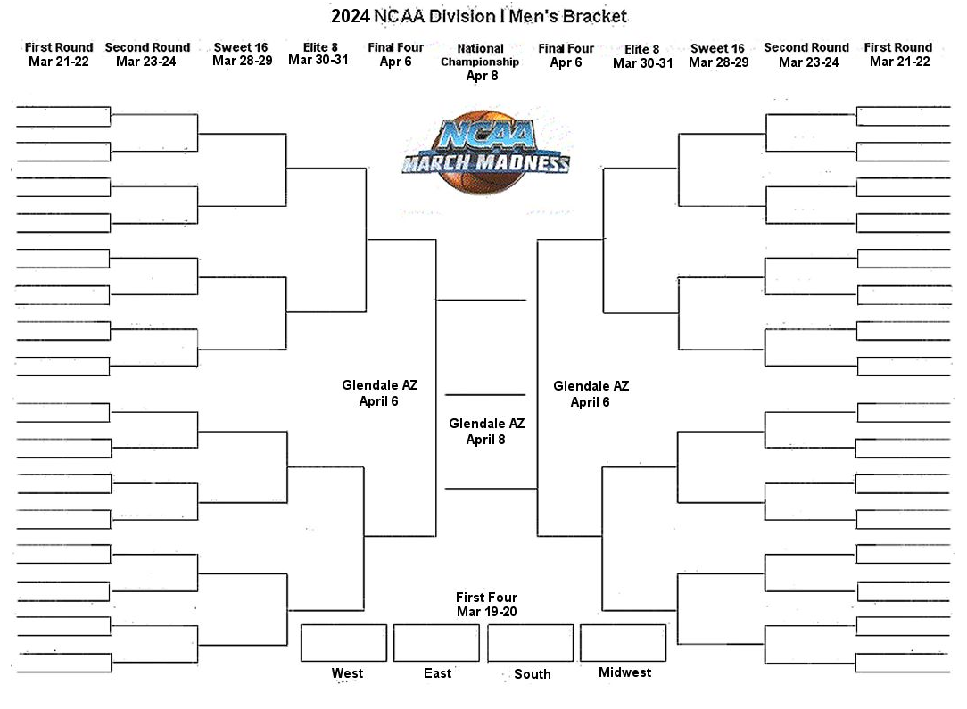
Next regular meeting!
Thursday, March 21, 2024,11am-noon
ERM Problem Reporting; Best Practices for opening SalesForce cases
Notes:
Coming up next month!
*Thursday, March 21, 11am-noon. Yes, for those March Madness basketball fans, the tournament will be underway, but I will still be here and I hope you will too.
The ULMS ERM group is aiming to do a presentation on problem reporting, I might also have a webinar with some of my collegues on best practices for opening SalesForce cases
Please give me any other topics in the meantime, our two new task forces will be getting to work and I’ll hopefully have norm rule task force folks to help and we’ll have things to report.

Slide 21
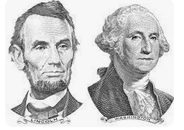
Thanks for attending!
Recording will be available & posted later this week
You are welcome to hang out until 1pm (recording off)
Notes:
Thanks for attending
*Recording will be available & posted later this week
*You are welcome to hang out until 1pm (recording off)

