Slide 1
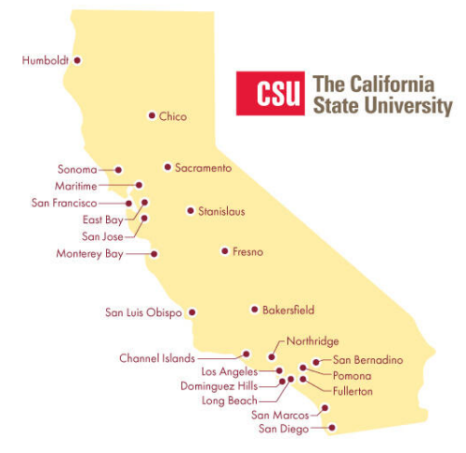
March 7, 2024 Technical Services Open Forum
Notes:
Welcome to the March 7, 2024 edition of the Technical Services Open Forum, a special edition off our regular schedule.
Welcome if this is your first time at one of our meetings, we hope you come to see us for our regular meetings as well on the third Thursday of each month at 11am-noon.
We have a guest speaker today from OCLC, her name is Valerie Chase, she is a Library Services Consultant for them.
Valerie will be talking more generally about the move from OCLC Connexion Browser to OCLC Record Manager. As you probably know, OCLC Connexion Browser will be deprecated, sunsetted, whatever you want to call it on April 30, 2024, that is only 54 days from today! Valerie’s been doing lots of these trainings for institutions and consortia recently to get them ready for the move. But she will also be focusing on how to do the Local Holdings Records (or, LHRs) in Record Manager per our particular request for the CSU.
There will be plenty of time for questions during the session but Valerie is also ready to answer questions in email after the session if you have them later on.
This session will be recorded and I will be able to share it with you all so you can reference it later. Valerie will also share her slides with me and I’ll distribute those as well.

Slide 2
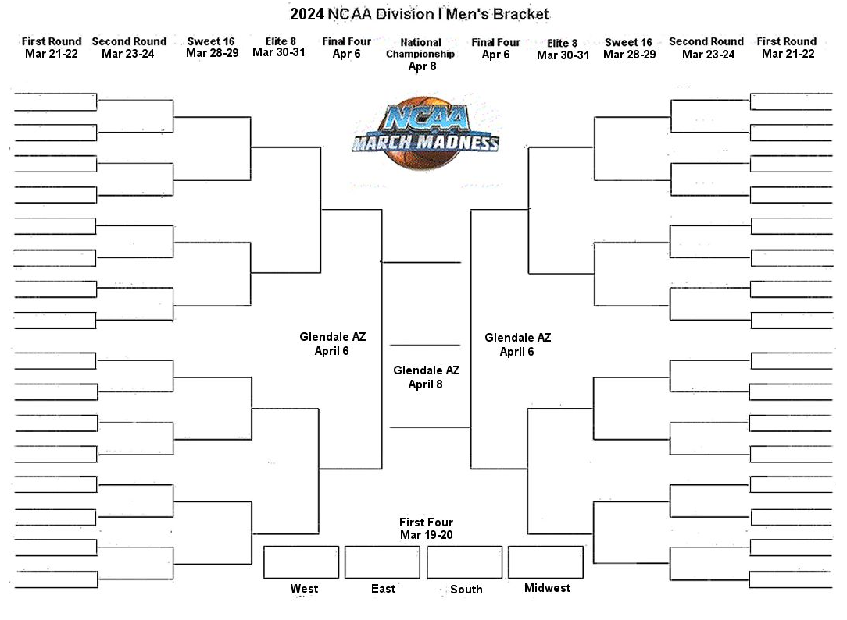
Next regular meeting!
Thursday, March 21, 2024,11am-noon
ERM Problem Reporting; Best Practices for opening SalesForce cases
Notes:
Thank you to Valerie for your presentation today and answering our questions. And thanks again to Luiz Mendes from Northridge for setting up this training for the CSU.
Coming up in two weeks:
Thursday, March 21, 11am-noon. Yes, for those March Madness basketball fans, the tournament will be underway, but I will still be here and I hope you will too, I do hope none of our Cal States or any of the other teams I follow are playing during this time.
At the meeting on the 21st, Kirstie, Ying, and Jessica from the Chancellor’s Office and SDLC department are going to do a presentation on ERM problem reporting. They’ve been doing lots of work on how to make this reporting more efficient and want to share these ideas with you. I will follow this with a short presentation of best practices for opening SalesForce cases with Ex Libris, we’ve made some changes here as well. So please join us for part of this meeting or the whole thing, it will be recorded as usual and posted on the Technical Services Open Forum page.

Slide 3
Thanks for attending!
Recording will be available & posted later this week
Notes:
Thanks for attending; Recording will be available & posted later this week

