Slide 1
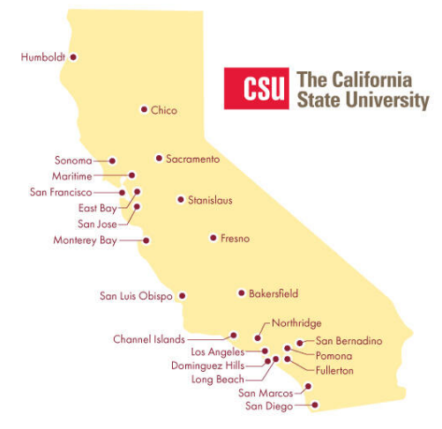
May 30, 2024 Technical Services Open Forum
Notes:
Welcome to the May 30, 2024 edition of the Technical Services Open Forum: ELUNA Annual Conference edition!
Sorry that I didn’t get to hold this meeting after the conference, I won’t make the mistake again of taking vacation right after ELUNA in the future! I did get to drive through tornado weather in Des Moines Iowa last week on my vacation, I don’t want to do that again either.
I have seen that there were discussions and reports on the conference already at I-SPIE and ERM Office Hours last week, I will try not to repeat too much of that here and I will link to those recordings on the TS Open Forum web page as well.
ELUNA conference reports at ERM Office Hours May 23, 2024 – link goes directly to conference discussion
I-SPIE video not available yet

Slide 2
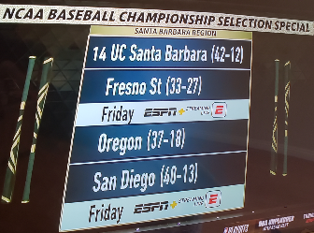
Today’s agenda
Announcements
ULMS FC nominations reminder
I-SPIE conference proposal reminder
ELUNA conference reports
A-Z list vs. OneSearch?
What else?
Hang out
Notes:
Here’s the agenda for today.
I’ll call for any announcements not on the agenda, as usual
Reminder of the ULMS nominations that are due tomorrow, Friday, May 31
I-SPIE conference is coming up in July online, a reminder of proposals for that
Then the meat of the meeting will be spent on ELUNA conference reports. I have some general updates from things I went to and heard but I could not be in 12 sessions at a time so you all heard and learned things I did not, I am looking forward to what you have to share. There were also things I didn’t quite understand and many of you are experts in these areas so you can correct or inform me if I share anything that isn’t correct.
After the conference discussion, Ilda of CSU Fullerton asked me to start a discussion on what campuses have done with their A-Z list vs. OneSearch, what is user preference on this. we’ll get that going
Anything else if we have time
Then at noon we’ll turn the recording off, we can hang out and talk about library work, what’s going at your campuses, who do you like in the NCAA baseball regional contests…Fresno State is the only CSU in the NCAA baseball regionals, they play at UCSB tomorrow at 6pm.

Slide 3
Announcements
Notes:
So now I want to open this up to any announcements that folks have that might not be on the agenda and aren’t related to the ELUNA conference, this is your time to speak and share!

Slide 4
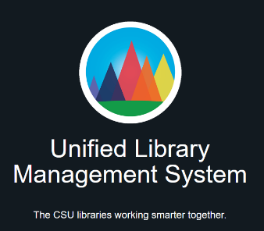
Reminder of ULMS FC nominations
Nominations due May 31
Two-year terms
You must be nominated by your library dean or your current library leader
Still openings for:
Resource Management
Resource Sharing
Notes:
I want to give one last reminder that we still have some openings on the ULMS functional committees, I sent a reminder yesterday in email.
Nominations are due tomorrow, May 31
This is to serve on one of the six ULMS functional committees for the next two years
You must be nominated by your library dean to make this official, that’s part of the rules as the ULMS functional committees all eventually report to COLD, the council of library deans in the CSU. I also include the caveat of ‘your current library leader’ as many of you have interim deans or deans that are returning to faculty or moving out of the dean position at this time, if you are not sure who to ask, please reach out to me directly and we can sort it out.
I have updated this slide a few times already as the nominations keep coming in, but as of now, Openings are still available in Resource Management, Resource Sharing
I should be able to announce who is on the committees next week but due to changing library deans, it might take a bit longer. Stay tuned! And thank you to everyone that has contacted your dean and been nominated already.

Slide 5
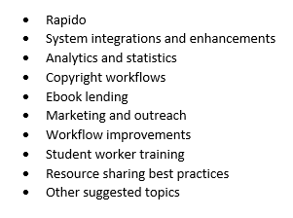
I-SPIE conference proposals
Online conference on resource sharing July 24-25, 2024
Free
Proposals due May 31, proposal submission form
More conference information
Notes:
* I also want to make another call for an upcoming CSU-related conference, the I-SPIE conference is mostly CSU resource sharing folks
But even if you are not in resource sharing, you might have a presentation on Analytics or letters that you can modify for a resource sharing audience, I presented there last year and just loved the conference, this a very receptive and inquisitive group that is welcoming to all
The conference is free to attend online
The conference is still looking for proposals but they are due tomorrow, May 31, the link to the proposal form is in these slides which I will distribute with the recording. The conference committee is looking for full length presentations (30 to 45 min.), lightning round presentations (10-15 min.), and poster presentations. Here’s a list of suggested topics.
* More information about the conference at this link.

Slide 6
ELUNA conference – May 13 – 17, 2024
Minneapolis, Minnesota @ Hilton Downtown
Annual meeting Wednesday, May 15 – Friday, May 17, 2024
Other options Monday & Tuesday:
Knowledge Days Monday & Tuesday
Developers Day+ Monday & Tuesday
Analytics Afternoon Tuesday
823 attendees, ~100 from Ex Libris / Clarivate
26 attendees from the CSU, 15 presenters
85 from California overall
Notes:
Now I’ll talk quite a bit about the ELUNA conference that was held two weeks ago, some more general things before we get reports from some of you.
As a reminder for those that didn’t attend and to give some context for the conference –
This is the annual conference for the Ex Libris Users of North America, also known as ELUNA. The conference was held in Minneapolis, Minnesota in the Downtown Hilton, this is a popular hotel for library conferences, this is the third library conference I’ve been to at this hotel and you probably have been there for other conferences too.
The bulk of the conference is the annual meeting, held Wednesday – Friday
There are three pre-conference options: Knowledge Days, Developers Day+, and Analytics Afternoon, that are held on Monday and Tuesday.
I* This year, there were 823 attendees, approximately 100 of them were Ex Libris or Clarivate employees. That 823 attendance is still down quite a bit from pre-pandemic and better budget times, 2018 and 2019 had about 1000 attendees.
We had about 26 attendees from the CSU at my best count, and 15 presenters from the CSU. I wish I could have gone to more of the CSU sessions – thank you to all of you that supported your CSU colleagues in person for their presentations and shared photos!
There were 85 total attendees from California, we had the biggest attendance for a state, as it should be! We will be seeing many of these folks in person again in October at the eCAUG regional conference for California in Long Beach.
Other notes I had not necessarily from the conference but about Ex Libris products in general – they are in 94 countries, 6500 institutions, 80 national libraries, 2150 institutions in Alma and 3700 in Primo or Primo VE, and 1800 libraries doing something with resource sharing. And there are 42 consortia live in Ex Libris products.

Slide 7
Overall themes
Artificial Intelligence (AI)
Open Library Systems? Open Library Workflows? Open Platform 2.0? – no-code, lo-code, n8n
Alma New UI, Alma All Titles Search, new UI for patron services
New/Next Discovery Experience (NDE)
Linked Data, June 4 webinar registration
New products ending in ‘o’: Specto & Collecto
Talking to Ex Libris support & trainers directly
Notes:
So I had these visions of having a presentation for you today with all the screenshots of all the new things, but that proved to be a extremely long presentation so I had to cut that. So I am going to hit some of the overall themes and things we want to be aware of that are coming up. For the best screenshots from presentations, look at the presentations from the conference, and there will be many webinars to come in the following months that will go into lots of detail on what these things will look like, and we’ll cover them in future open forums as well. Now on to the themes.
There was a lot, I mean A LOT of talk about AI at this conference as there is everywhere these days. They showed us new Primo AI options, automatically applying subject headings to records, Research Assistant, Cataloging Assistant, Althea (Ai-based academic coach) and so on. Others can talk more about this in detail. But there was also a little backlash to all this AI at the conference, one of the first comments to management in the big open room in the opening session on Wednesday was something like, I don’t want to hear about AI, I want you do fix bugs and documentation and have fewer clicks In your software. But Ex Libris does need to move ahead as a company and in development to keep up and be viable, and that includes embracing AI.
There were a few demos of something called Open Library Systems, maybe Open Platform 2.0, Open Library Workflows tool, also called n8n, no-code, or lo-code, there might be other names – those at Dev Days saw a lot more of this, it’s the idea of lo-code or no-code development to create your workflows, removing a barrier to entry for working with API and coding solutions. very interesting. Others can tell us more.
We saw a little bit of something called Alma All Titles Search or Alma New UI. Coming in November 2024, might be available for early adopters if we want it, I’ll be looking into that? The demos show that it looks a lot like the recent changes to Rapido and PO line Task List in Alma. There also will be a new UI for patron services. Others can tell us more.
We saw more of the New Discovery Experience (or is it Next?) or NDE, this will be something the Discovery group will work on as many of our Primo customizations will need to be updated. Will there be an impact on performance? More to come.
There was quite a bit of talk around Linked Data. The author info cards are available NOW for testing, if we have time later today, SFSU has it on in their production already for one week only so I can do a quick demo or you can try it yourself after the meeting today or tomorrow. But there were meetings about linked data and future plans that others can update us on. There is also a session on Linked Data on the Alma roadmap next Tuesday, June 4 at 7am, I have included the link here for registration.
* To add to Primo, Rapido, and Leganto…comes more new products ending in O! There are two.
* Specto – this will be the future of Rosetta and Alma-D, which a few of the CSU libraries have. Specto will be one platform for all your digital assets. The name sounds like a Marvel superhero but there you go. Customers on Alma-D and Rosetta will be migrated to the new Specto.
Collecto – something to manage all your collection development workflow, some of our CSU folks have been involved in the testing and development input. This will have information for use in retention and deselection, space optimization (or weeding). Someone else can talk more about this, but I saw in the project Basecamp recently that currently the plan is to build it as a “freemium model”. This means that there will be elements included in Alma but certain elements which require heavier infrastructure and include external data will be a premium service.
I also wanted to mention the importance of being there in person and getting some things solved that way. For example, wehad a bad launch with our secondary resource types at the end of last month. This is still a fairly new feature for Ex Libris; I talked to some support directly on this and they made some new suggestions on how to set it up, we found out that we don’t need to wait six months to do a reindex (despite me opening a case asking exactly that), and that our SJSU records in other CSU catalogs is indeed a bug and they will work on it once I open the case. So there is still hope for our secondary resource type plans and making it easier for our patrons to use facets. But I had opened cases and asked these questions already, but asking them in person was clearer, I guess, and we are getting closer to a solution.

Slide 8
New enhancement software/process in 2025
Submission changes from NERS to Aha!: https://www.aha.io/
Voting changing from NERS to ElectionBuddy: https://electionbuddy.com/
Not sure which product submission cycle will be first (Rapido? Rialto?) but CO will keep you updated with instructions, etc.
Notes:
So we’ve been waiting a few years for the new software for ELUNA enhancement voting and here is the latest.
There will be two software programs at work. Aha, the software that they have talking about for a few years and demoed a few times, will be used for SUBMISSON of enhancements
Then once the VOTING for the enhancement begins, that will be in something called Election Buddy. We’ll learn more about the details on all this later but this should be easier to use and manage, especially for the working groups that go through and track the submissions and voting. Things we’ve learned about ElectionBuddy: Can set reminders to only go to organizations who didn’t vote yet – I like this; can only vote once for each cycle (and not change your mind later – I usually vote really early since I know I can change it later and I don’t want to miss the deadline, so that will go away); can only vote on groups/products your organization has – we have certainly ‘gamed’ this in the past as only a few of us in the CSU have Leganto but we could all vote for it so we encouraged non-subscribers to vote for what the CSU Leganto libraries wanted – that goes away)
We don’t know much more than that at this time, one of the groups with fewer enhancements like Rapido? Rialto? Content? Might be the first to do this process. Maybe Chris has some updates since he is still the Rapido Working Group chair until July? Anyway, the CO will keep you updated with instructions and so on.

Slide 9
Consortial updates
Seeing each other’s SalesForce cases!
Consortial Community of Practice (CCOP) report
Ex Libris now has dedicated personnel for consortial needs
New consortial webinar series
More mentions of consortial needs/settings in release notes and documentation
Notes:
A few consortial things that might interest some of you –
* There was an offhand comment by one of the Ex Libris executives in one of the plenary sessions that ‘6 consortia can now see each other’s SalesForce cases again, just fill out a form on our website’. Well, this was news to us in the CSU, we have certainly been complaining about how much not seeing each others cases this hinders our work, so many of you were always so good at looking at each other’s cases to help in your own troubleshooting. Chris, Jessica and myself can currently see all your cases but not the rest of you. I had to ask quite a few people in Ex Libris to track down the actual answer and if this was actually true, but it is! (again, this was possible since we were there in person and I could ask several people) This is in a beta right now so I requested to add a few CSU folks to test this for us so we’ll see what they are able to do and report back. We have very little details so far but it seems this will be real again and out of beta maybe by Fall 2024. I will tell you more once I know more!
* All of us at the CO in my department are part of something called the Consortial Community of Practice, or CCOP, where we meet bi-monthly with other consortial employees to share our common woes, complaints, and/or ideas. This is a fairly new group but is becoming a powerful one as over 50% of the Ex Libris customers are in a consortium. And we have similar woes – consortial-related enhancements never get enough votes, support doesn’t understand when we are reporting Network Zone or consortial-related issues, and so on.
Also noting that Ex Libris now has a few personnel dedicated to consortial needs, we have met with them a few times this year and they are very interested in CSU input. Things that have already changed –
New consortial webinar series, this got off to a rocky start but debuted this morning at 7am, I will post some notes about that session later in Slack and share the powerpoints, this link goes to that series.
We have complained that the Ex Libris documentation is either unclear or wrong in relation to consortial networks, that is being improved and you can see that already in last month’s release notes – there are a few references to ‘hey, this is for consortia’.

Slide 10
ELUNA things you can get involved in
Looking for development partners for:
Collecto
N8n (no-code, lo-code)
Specto
Alma Working Group is looking for a new member to serve as a Communications/Education Coordinator for a two-year term. Please indicate your interest on the google form by June 10.
Documentation Advisory Group
Notes:
We heard several times at the conference that Ex Libris is looking for development partners and we will do our best to pass this along to you when we hear/see it.
The CSU already has quite a few campuses and people involved in Collecto, the collection development dashboards and tools, and it’s not too late to get involved in that if you are interested.
The Open Library Systems work, this no-code or lo-code development. We did talk to them about being a development partner but it seems like a rather aggressive development schedule and we’re not quite sure what this might be used for. We are also hearing that it might not be free to use and a cost would be involved. But you might be super-interested and ready to test, let us know if that is the case!
Specto, the new product for Rosetta and Alma-D – we do have some Alma-D sites so you might be interested in that as well. Let us know
In addition to these development partners, I’m always looking out for folks that might need more service for their tenure or general c.v., please note this recent call from the ELUNA Alma Working Group. They are looking for a new member to serve as a Communications/Education Coordinator for a two-year term. The link is on the slides if you want to apply
A new documentation advisory group was announced at the conference. I’m not sure how this is different than the Documentation & Training Focus Group that a few of us in the CSU were on a few years ago that really became a ‘Training Focus Group’, but maybe this one will actually work on Documentation. I have not seen a call for this yet but stay tuned!

Slide 11
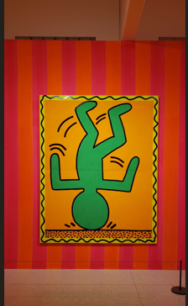
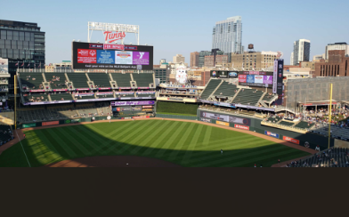
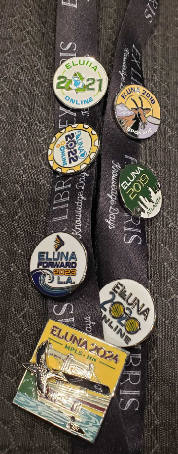
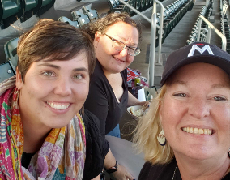
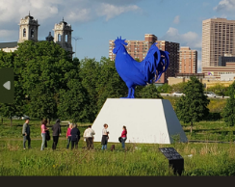
We also had fun
Notes:
It wasn’t all sessions and notes and products ending in O. We also had fun.
Some of us went to a Minnesota Twins vs. New York Yankees baseball game, there was a free night at the local art museum, there was the famous sculpture garden, and Ex Libris had a fun reception with great views and moon balls. I also went to a women’s professional hockey playoff game, the PWHL Minnesota team ended up winning the whole league last night so I saw the champions! Some folks went to a NBA playoff game during the conference as well. Minneapolis is such a fun town!
You could also buy pins to commemorate any previous ELUNA conferences you attended and those go towards scholarships for the conference. Neat idea!

Slide 12
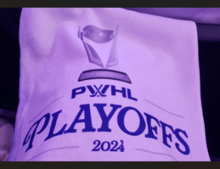
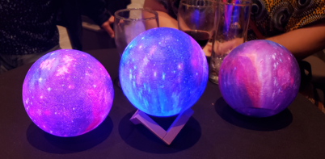
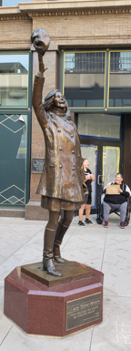
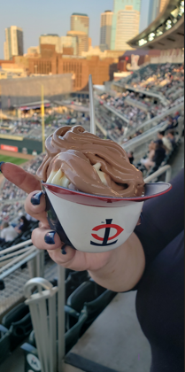
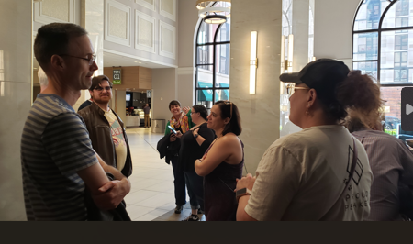
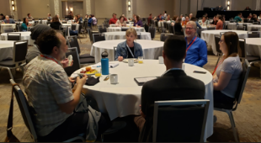
More fun
Notes:
Here’s some more pictures of fun and CSU folks, Mary Tyler Moore throwing her hat in the air

Slide 13
What’s next? ELUNA conference wrap-up webinars
Ex Libris will host 5 sessions of wrap-up, three hours a day (10am-1pm). June 3-13, 2024
Almost NO new content. Recordings, some Ex Libris, some customers
$25/session; FREE if you attended ELUNA
Ex Libris Management Q&A Monday, June 3 noon-1pm
More webinar information; register if you did not attend ELUNA
Notes:
So before I hand it over to the rest of you for your input, you might be wondering what is next. Of course we will have the eCAUG conference at the CO in Long Beach in October, but I also have a few follow-ups for you: ELUNA conference wrap-up webinars, the IGeLU conference in Sept., and what is happening with next year’s ELUNA annual conference.
* You’ve probably seen on ALMA-L that there will be 5 sessions of wrap-up from the conference. These are three hours a day (10am-1pm) on June 3,4,5, 12, and 13, 2024. That is starting next Monday!
* However! It is almost all recordings and almost no new content – some Ex Libris sessions (maybe you wanted to get some screenshots or catch what they said about something…you can watch those again), some customers – I noticed when Jill was doing her presentation on the Data Issues Task Force, there was a cameraperson running around filming everyone that talked and asked questions, including me and Can Li, I didn’t know what they were using that for so I am afraid to see what that looks like…anyway, some of the customer sessions in the big room were also recorded
It’s a little confusing about the charge for this so I wanted to clarify. If you attended the ELUNA conference in person, these are free to you and you don’t need to register. But if you didn’t attend and still want to see the sessions, it is $25 a session for each of the three hours. There is no group or consortial pricing. The presentations are also available if you just want to look at those.
The one part that is new is the Ex Libris Management Q&A session on Monday, June 3 from noon-1pm, not sure if that will be pre-taped but the questions are pre-selected so it might not be that spicy. The text does say you can ask a question in real time too so we’ll see!
Here is a link for more information on all that. I assume that those of us that attended ELUNA will get link information soon (since we aren’t supposed to register) but it’s already Thursday and I don’t have anything yet.

Slide 14
What’s next? IGeLU online September 2024
IGeLU = International Group of Ex Libris Users
In person in Copenhagen, Denmark, September 9 - 12, 2024
Much less expensive online
100 euros for annual conference
Developers Day is free
Sessions in middle of the night
Conference program coming soon
More conference information
Notes:
Another option for more Ex Libris knowledge is the IGeLU annual conference in September.
IGeLU = International Group of Ex Libris Users, this is essentially ELUNA (which is Ex Libris Users of North America) for those customers and libraries not in North America, mostly Europe and Asian countries
The conference is in person in Copenhagen, Denmark this year, which I can imagine would be very expensive to attend in person
However! There are very inexpensive options to attend online. Unlike much of ELUNA, the IGeLU conference is live streamed so you can get a good conference experience even though you are not there in person.
The annual meeting is three days just like ELUNA and it is online for only 100 euros, which is about $108 today
If you want to add on Developers Day online, that is free
No discount for membership, we don’t have one anyway in the CSU
The only caveat is some of the sessions are in the middle of the night but they do have a lot of sessions that start around 5am-8am, just right for not interfering with your work day too much. And there will be recordings of many things.
Conference proposals just closed this week so there is not a program yet but I will let you know when it is available! Not sure if we have any presenters this year but we have had many CSU folks present at this conference in the past.
The link to the website with more information is here in the slides and I’ll send it out with the recording.

Slide 15
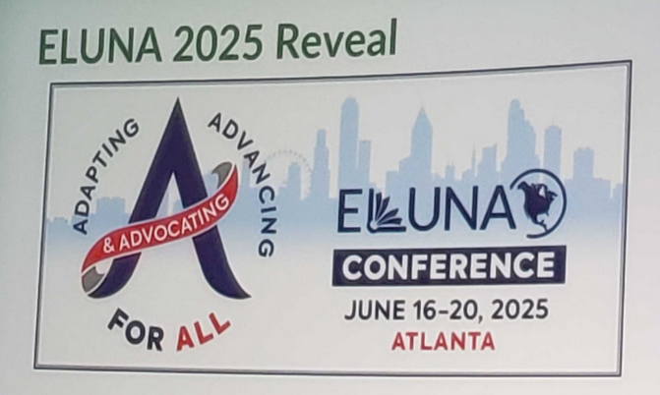
ELUNA 2025 conference
Atlanta, GA (again)
June 16-20, 2025
Cost? We don’t know
Baseball plans
Notes:
* The last thing I want to share about the future is at the very end of the conference, at the closing session, they announced the next location for the ELUNA conference: Atlanta, Georgia. Where we have not been since 2019 but that was only 2 in-person conferences ago so it seems kind of recent.
* Also note the dates, it is not in May next year, it is in June: June 16-20, 2025. Yes, that is awfully close to fiscal close for many of you, so you will want to plan accordingly. It will also be hotter and more humid. But this is also out of the way of the ALA Annual Conference, for those of you that attend both conferences, it is in Philadelphia next year from June 26 - July 1, 2025. So you have time to come home for a few days before going back to the East Coast
We don’t know much more about it yet, hotel cost, registration cost, travel cost, but please keep this in mind for your conference budget & requests for 2024-2025, I know some of you have to make your requests for next year soon. I would estimate the costs to be about the same - $600-$700 for registration for the annual conference, $300 plane flight, $750 for hotels, so maybe a $2000 request. Feel free to reach out with help estimating for your conference budget next year as the costs depend on if you are just going to annual meeting or some of the pre-conferences.
And for those of you that would like to do baseball again, hopefully the Atlanta Braves will be in town during this week and we can head up there again like we did in 2019 for a game. My husband, some of you met him at the conference, he already has all his plans for minor league baseball teams in the region.

Slide 16
Reports on pre-conference sessions
Knowledge Days
Developers Day+
Analytics Afternoon
Notes:
I think I was the only one from the CSU that attended Knowledge Days?
- I think Knowledge Days has really changed over the years – it might have just been for beginners in the past, new customers, those new to Ex Libris. But I found some of it quite advanced and on the level. This is where I got the information about secondary resource types, for example, more about discovery import profiles, Discovery Interface Display Logic examples, also Yoel Kortick of Ex Libris went deep into creating some linked data live in a session. But I also learned about the foundations of acquisitions, I didn’t do much with that as a systems librarian in Ex Libris so it was great to back up and learn the basics there: funds, ledgers, vendors, orders, licenses, receiving, invoicing, how it all fits together. There were several Foundations morning and afternoon sessions but also these smaller sessions on specific topics. It does cost extra to attend and it is more days at the conference but I found it very worth it and would recommend it highly. We have saved all the presentations from there if you would like to see any of them.
**
I know that at least 5 of you attended Developers Day+, I dropped in from time to time, can you talk about that?
Thank you to Chris & Brian for downloading all these presentations for us, thank you to Chris for your notes in real-time, I felt like I was there!
**
Analytics Afternoon – I know Chris Lee and a few others attended that
Chris also had detailed notes on this, he was everywhere!

Slide 17
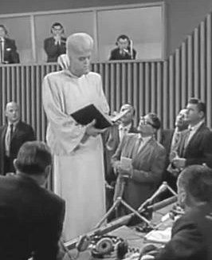
Reports/observations from ELUNA annual conference
Notes:
Now that we’ve talked about the pre-conference sessions a bit, what else can you share from the regular annual conference?
What did you learn?
What are you concerned about? (Kanamits?)
What should the CSU be thinking about and preparing for in the coming months and years?

Slide 18
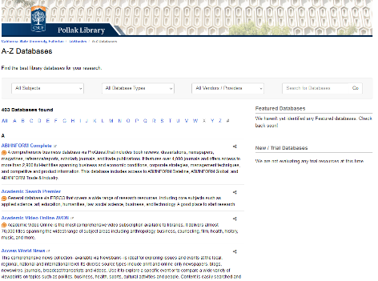
A-Z List or OneSearch?
What do students, faculty, staff prefer?
What do you hear anecdotally?
Have you done assessment or usage stats on these to see a clear favorite?
Notes:
Ilda of CSU Fullerton wanted to bring this question/discussion to the group.
Do users prefer OneSearch or Database A-Z list?
She’s been playing around with this question a little bit. She’s using some Springshare data and some Alma Analytics to start with and can’t definitively say if Fullerton users prefer OneSearch over the databases.
What do students, faculty, staff prefer? What do you hear anecdotally?
Or, have you done assessment or usage stats on this?
Ilda, why don’t you get us started on what you’ve seen so far and then others can chime in.

Slide 19
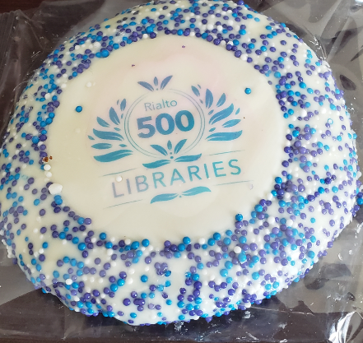
Next regular meeting!
Thursday, June 20,11am-noon
Rialto demos!
Soon: best practices for opening SalesForce cases; who does what in the CSUCO
Notes:
Coming up next month! Yes, TS Open Forum is continuing in the summer! I will set up some dates and Outlook invites soon so you have them in your calendars.
Thursday, June 20, 11am-noon. Yes, that is right after the Juneteenth day off in the middle of the week so don’t forget to come back to work and to the forum! The acquisitions task force has been telling me more about Rialto, we have 7 CSUs using it already so I attended a few sessions at the conference about it. I also spoke to the product manager and he was keen on doing a demo for the CSU soon, I know we had them in the past as well…no obligation but you might want to see the latest demo of Rialto for your collection development needs. I will note that Rialto is free with your Alma and there are no purchasing requirements or obligations anymore, so it might be a budget consideration for you. Even if you are already using Rialto, you may want to attend to learn some of the best ways to use the product. They were giving out cookies at the conference to celebrate 500 libraries on Rialto, that’s the picture here. Although Jill told me that was not a good cookie.
Another upcoming meeting will have best practices for opening SalesForce cases, I was originally going to do this in March before I got shingles but I’ll schedule this soon. And there has been requests for a ‘who does what in the CSUCO’ presentation so the people in my department: David, Chris, and Jessica; and in Ann Roll’s department, including Kirstie will put something together for you, so it is clearer who to ask what questions about CSU system-wide things, even outside of libraries. You can always let me know about topics for future meetings, topics always help with the planning!

Slide 20
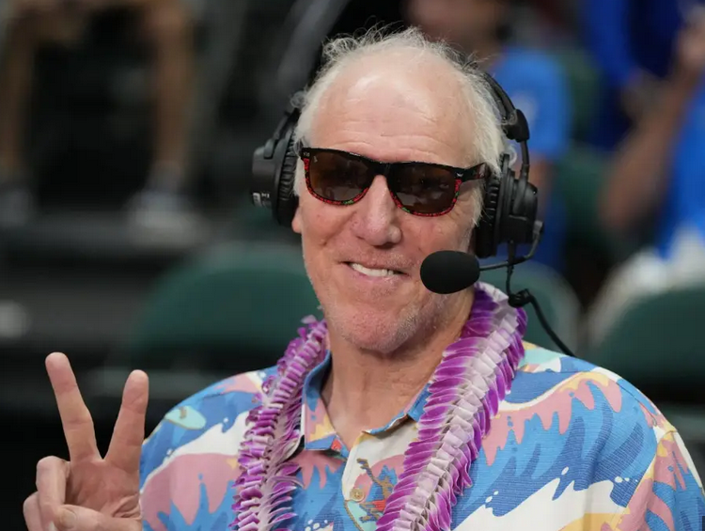
Thanks for attending!
Recording will be available & posted later this week
You are welcome to hang out until 1pm (recording off)
Notes:
Thanks for attending, Bill Walton says Peace Out
*Recording will be available & posted later this week
*You are welcome to hang out until 1pm (recording off)

