Slide 1
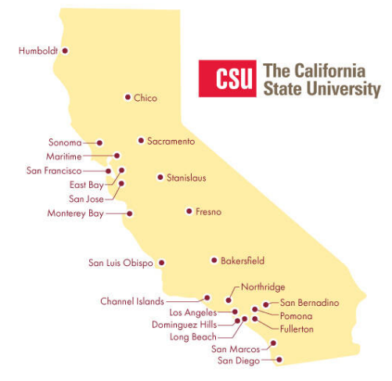
June 20, 2024 Technical Services Open Forum
Notes:
Welcome to the June 20, 2024 edition of the Technical Services Open Forum.
I hope everyone had a nice day off yesterday for Juneteenth, thank you for the CSU for giving us a day off yesterday to celebrate or reflect or spend time with friends and family.
For those of you that it is your first time at the Technical Services Open Forum, welcome, and we are glad to have you here. I am Christina Hennessey, director of the unified library management system or ULMS for the California State University system, and I am your host for today. We meet once a month at this time, 3rd Thursday of the month at 11am-noon.
I believe we have some new attendees since this particular presentation was announced to all 900+ CSU library employees, so you might be here to hear about Rialto from our Ex Libris and Clarivate colleagues. But you are welcome to join us any month or check out our recordings on this page (link to it). You don’t have to be in technical services to share with your CSU colleagues and attend this meeting and all are welcome always.
https://calstate.atlassian.net/wiki/spaces/URM/pages/144572459/Technical+Services+Open+Forum

Slide 2
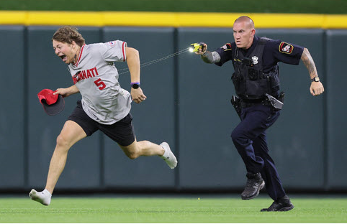
Today’s agenda
Announcements
Rialto presentation from Ex Libris/Clarivate
Rialto Q&A
Hang out
Notes:
Here’s the agenda for today.
I’ll call for any CSU library-related announcements not on the agenda, as usual. We have a lot to get through with our Rialto presentation so we’ll limit the announcements to 10 minutes but please speak up if you have something to share!
Then we’ll do the meat of the day, what you all came for, we have 4 presenters here from Ex Libris/Clarivate. The ULMS acquisitions task force has been talking about Rialto a lot in the CSU, 7 of our CSU libraries are using it now, and Fullerton is adding it now, so that’s 8 of our 23 CSU libraries. I attended a few presentations on Rialto at the ELUNA conference last month and Mike Hommel from Clarivate reached out to me and asked if I would like a presentation specifically for the CSU on Rialto, and yes, I would, so here we are. I don’t think we’ve done a system-wide presentation in the CSU on Rialto yet so I wanted to bring this to all of you so you can find out about it and how it can help you and your library, you can see what it looks like, and ask your questions directly to the folks that work with it.
A lot has changed with Rialto since the last time you might have seen a presentation on it, we have new employees all the time, we have some new deans and associate deans, so I wanted to bring this to all of you to help with your future collection development and acquisitions planning and workflows. We won’t be able to manage your contract at the CO for this one but we can share presentations and training through the ULMS in relation to Rialto going forward. We also have access to Rialto on one of the sandboxes if you want to look at it there.
When the presentation is over, we’ll have some Q&A for our presenters from all of you. That Q&A might run over the end of the hour so we’ll stay in my Zoom room as long as you have questions.
After the Q&A, we’ll turn the recording off, we can hang out and talk about library work, what’s going at your campuses, and a reminder to not run on Major League Baseball fields or you might get tasered like this guy.

Slide 3
Announcements
Notes:
So now I want to open this up to any timely announcements, this is your time to speak and share! I have a few that people have passed on to me in the last few weeks so I will go first.
Lee Adams update on citation generator in Primo – need to update label/edition
CSU @ ALA, Clarivate link
Update on seeing each other’s cases in SalesForce in the CSU
Luiz/CSUN – Let him know if you want to meet with our OCLC rep, Eric, if you are at ALA next week.
Christine H/SJSU – EBSCO UI update
Jessica/CO – update on Project Muse integration profile, she has the tokens you need

Slide 4
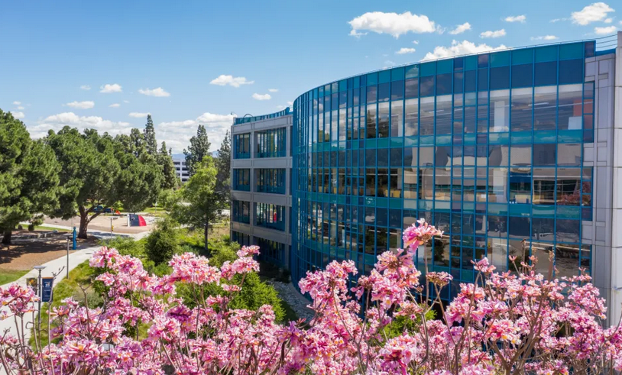
Next regular meeting!
Thursday, July 18,11am-noon
Analysis of AI-generated cataloging from CSU Fullerton
Soon: best practices for opening SalesForce cases; who does what in the CSUCO
Notes:
Coming up next month!
Thursday, July 18, 11am-noon. Here is a description - Artificial Intelligence (AI) is a hot topic in higher education, in mass media, and at the recent ELUNA annual conference. What are we doing in the CSU libraries in relation to AI? CSU Fullerton would like to share an illuminating and interesting pre-recorded analysis of AI-generated cataloging by Fullerton’s Jen Mitchell (LSS III Cataloger), with a live introduction by Fullerton’s Samuel T Barber (Cataloging and Metadata Librarian).
That won’t take the full hour on July 18 so we’re still looking for more topics. Another upcoming meeting will have best practices for opening SalesForce cases from me and some folks in the CO, I was originally going to do this in March before I got shingles but I’ll schedule this soon. This might be at the July 18 meeting, it depends on what else comes up between now and then.
And there has been requests for a ‘who does what in the CSUCO’ presentation so the people in my department: David, Chris, and Jessica; and in Ann Roll’s department, including Kirstie, will put something together for you, so it is clearer who to ask what questions about CSU system-wide things, even outside of libraries.
You can always let me know about topics for future meetings, topics always help with the planning! And this is a great place to get online presentation experience, things to add to your c.v. and resume, we are a friendly group.

Slide 5
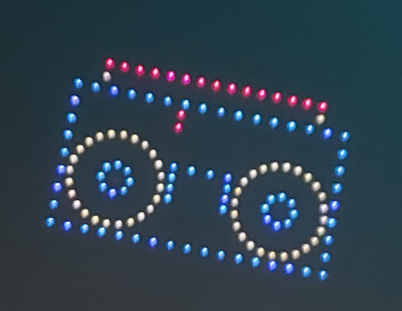
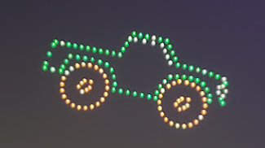
Thanks for attending!
Recording will be available & posted later this week
You are welcome to hang out until 1pm (recording off)
Notes:
Thanks for attending, I hope you have a nice first day of summer, and 4th of July enjoying fireworks or however you celebrate. I went to a drone show this last weekend, here are some pictures I took from that - and that is my new favorite sky celebration thing, quieter for all our furry friends and better for the environment than fireworks!
*Recording for this meeting will be available & posted later this week
* You are welcome to hang out until 1pm (recording off). Thank you for coming!

