Slide 1
Rialto™, Selection and Acquisition Simplified
An Overview for
The California State University Libraries
Presented by Nathan Grey, MSI and Jennifer Cornell, MLIS
Content and Workflow Strategy Consultants
Joined by Mike Hommel, Director Sales Program Development & Maria Hugger, CWSC
June 20, 2024

Slide 2
Today’s Objectives
After today’s Rialto Intro, you will
Understand Rialto’s role in streamlining time consuming acquisition processes for print and ebooks
Connect the tech services and selector workflows
Identify the types of content that can be found in the Marketplace (Rialto)
Recognize that Rialto is a visual tool helping you know when something is in holdings, in a list, in a cart, in a DDA, etc.
Be aware of the analytics functionality available in Rialto
Plan for a stress-free, short implementation of Rialto
Feel reassured you have partners post-implementation to help you adopt Rialto fully
Notes:
Our overview today is guided by what we want you to take away from the presentation. So instead of a typical agenda, we are using objectives to help drive what you will take away from the presentation.
READ OBJECTIVES

Slide 3
Meet Rialto
Rialto is a comprehensive academic marketplace designed for informed decisions and seamless, end-to-end workflows.
Rialto is available for Alma libraries at no additional cost*.
Work Efficiently
Unification with Alma automates previously manual steps
Work Together
Easy to coordinate with staff through shared lists, real-time activity indicators, and more
Work With Ease
Simple to learn, navigate and use, with everything you need in one place
We’ll Handle The Rest
Expert team of consultants support your journey every step of the way
*Must have Alma Acquisitions
Notes:
In case you aren't familiar with Rialto yet, let’s begin with a quick overview.
Rialto is an academic marketplace that creates a seamless workflow for selection and acquisition and allows you to make informed decisions in the book-buying process. Rialto’s marketplace includes millions of books from thousands of publishers, as well as publisher-direct digital platforms.
Rialto is built on Alma and is available to Alma libraries at no additional cost.
Rialto can help your library in four key areas:
1. Rialto can help your team work efficiently.
Rialto was designed specifically to improve the purchase process efficiency and save time in the selection workflow. Through its unification with Alma, Rialto creates seamless workflow that eliminates a lot of the manual steps and work librarians do today to synchronize the workflow between systems.
2. Rialto can help your team work together all within one system
Rialto has many tools that support collaboration among teams and raise awareness of other staff’s activities, so you’re always in sync. We’ll share some examples of this later in the presentation.
3. Rialto can help you work with ease.
A simple, intuitive user experience is foundational to Rialto. It’s easy to learn and easy to navigate, with everything you need in one place.
Because Rialto is in Alma, POLs will automatically be created for you when purchasing.
4. Your team can enjoy these benefits – and we’ll handle the rest.
We have an expert team here to support you every step of the way – from the initial implementation, to your first few months purchasing on Rialto, and for the rest of your journey. We can do the heavy lifting so that you can focus time on supporting your patrons.

Slide 4
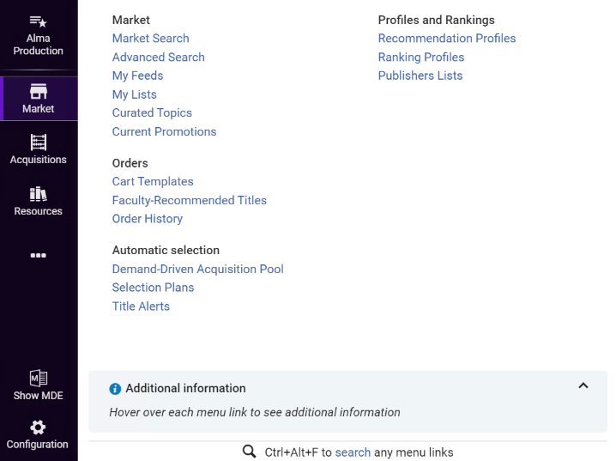
Rialto is in Alma—but you don’t need to take an Alma “seat”
Notes:
As previously mentioned, Rialto is built into Alma and adds another menu tile to the left-hand navigation called Market. The menu is as streamlined as you see here with some variability based on your user role. You will be able to do basic or advanced searches, create lists, benefit from curated lists that our teams of degreed librarians put together, and easily see our Current Promotions.
For efficiency in adding fund codes, location, and reporting codes, we offer the ability to design cart templates. Engaging faculty or others outside Rialto but within Alma is easy well.
Finally, assigned Rialto users such as Selectors who don’t otherwise use Alma will not take up an Alma “seat” thus not working against your contracted number of assigned Alma users.

Slide 5
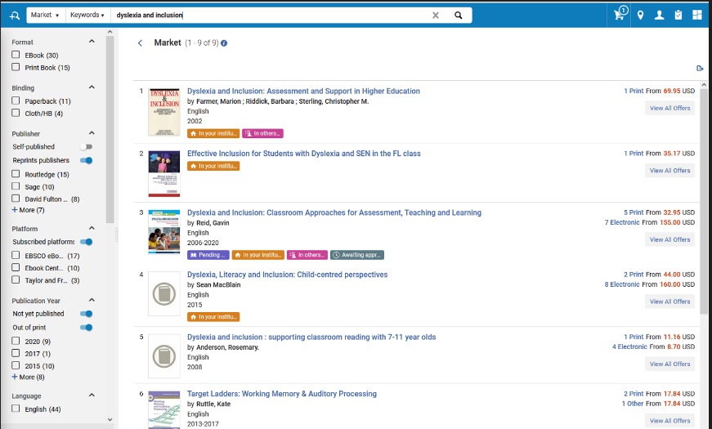
What is in the Marketplace
Notes:
In the Marketplace, you will find formats for softcover, cloth, ebook of various license types and more.
Here we searched for the keywords dyslexia and inclusion and came up with 9 results. There are only 9 results because what you see are called “works”. Within these works are individual “offers”. In the facts on the left side, by the purple arrow, you will see there are actually 35 offers in both ebook and print format. Glancing over to the right where the yellow arrow is pointing, you will see which offer has which formats. And one of the most informative features of Rialto is the ability to use the badges to inform what is happening with a work. Looking by the green arrow, you will see this title has several badges that can inform a purchasing decision: It’s in someone’s list, it’s also in my institution, it’s awaiting approval, and it is pending purchase!

Slide 6
What Content Is On Rialto?
Notes:
In addition to over 53 million print titles we have over 3.3 million ebooks from 24 different publisher and aggregator platforms. We work closely with our publisher partners to make their content available to you through Rialto, which makes acquisitions easier as everything can be done in Rialto – from search and selection, to ordering, to invoicing and activation.
If DDA is of interest to you, we can provide profiling for Ebook Central, EBSCO, and JSTOR. Having DDA on Rialto provides visibility into titles in the DDA pool, and thus reduces the possibility of duplicating titles that are up for selection by users when they need the content, not if they need the content.
For EBA, or Evidence Based Acquisitions, Taylor and Francis is available for hosting on Rialto

Slide 7
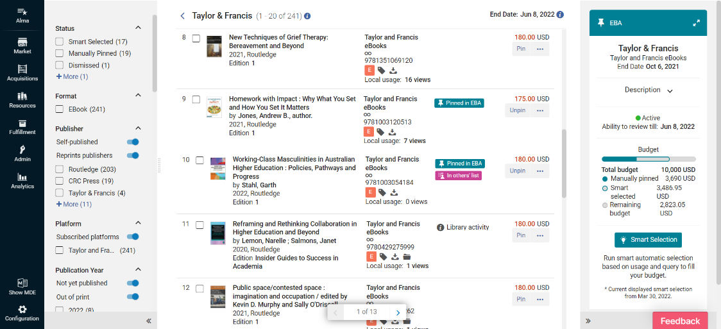
Monitoring EBA on Rialto
Notes:
When hosting an EBA on Rialto, tools such as faceting, seeing library activity, having real-time spend monitoring is essential when making choices for what will be permanently added to your collection. We also provide a Smart Selection query based functionality for assistance in selecting,.

Slide 8
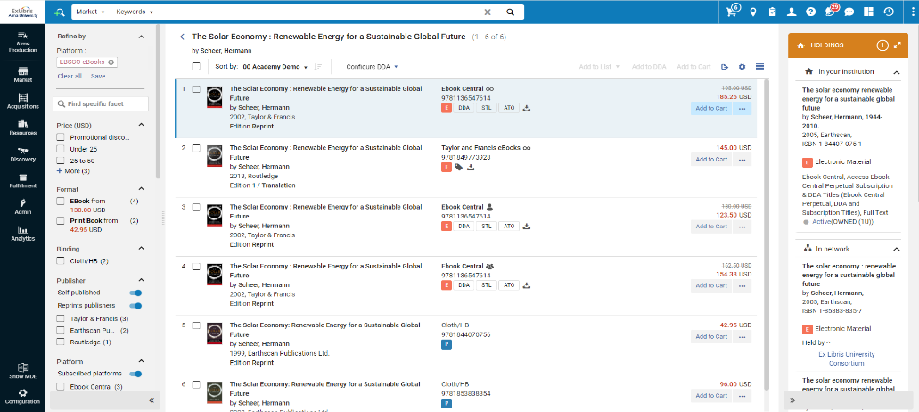
Seeing Holdings in Real-Time
Notes:
Holdings available for owned, subscribed, and DDA titles in your institution, as well as any libraries in your Network.

Slide 9
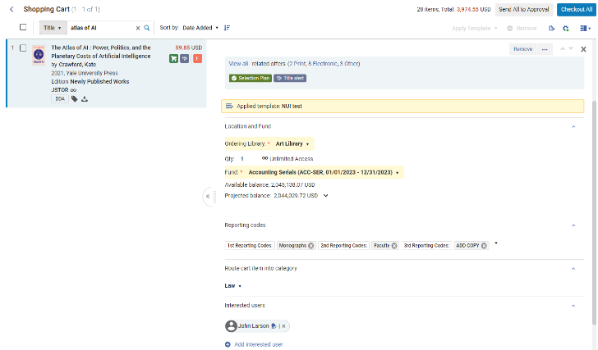
An informed checkout and acquisition experience
View available and projected fund balances in real time
Apply cart templates to eliminate the need for manual data entry
Add interested users to be automatically notified when a title is available
Notes:
Fund balances shown in real-time from Alma fund balances. Cart templates can be created and edited and shared to reduce clicks and ensure accuracy when submitting titles for approval for purchase. Interested Users can be added to orders to alert students faculty and staff when an ebook or print book has been received.

Slide 10
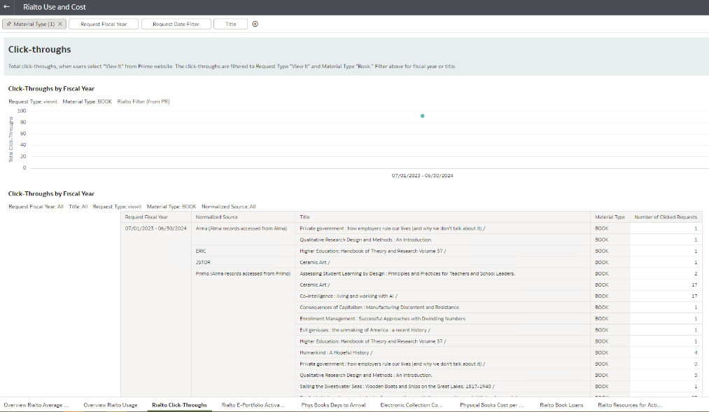
Rialto Cost Per Use Dashboard (Acquisitions Dashboard also available)
Notes:
When trying to stretch ever shrinking budgets and trying to do more with less, any type of data driven decision you can make is essential. Building upon Alma’s powerful analytics tool, Rialto can provide usage information such as Click-Throughs of items seen in Primo.
There are many other ways to extract data from this dashboard for physical and electronic books, their usage, and cost as can be seen at the bottom. There is a link to more information on Rialto Dashboards at the end of the presentation.

Slide 11
Rialto Customer Journey
Set Up
Adoption
Expansion
Ready to Use
Rialto Activation & Training
Customer Success as Primary Focal Point
Scale Up
Increase Use & Purchasing Models
Getting Ready
Rialto Implementation
Rialto Expansion
Expansion Outcome:
Strong adoption and increased usage
Customer Needs
Business Objectives Review
Decision
Notes:
The Rialto Customer Journey includes technical implementation with our Professional Services team as well as partnering with a consultant librarian during an adoption phase. A visual representation of that journey is shown here.
After a Getting Ready phase, where we’ll focus on identifying your library’s primary business objectives and stakeholders, confirm target dates, and gather required configuration inputs, the Setup phase (approximately two weeks) is a brief one, designed to allow your library to begin placing orders quickly through the purchasing model(s) in scope for your Implementation cycle.
Once ordering begins, we’ll guide you through an Adoption phase (approximately four weeks) designed to assess whether there’s a need for additional configuration adjustments, or staff training, in order to realize the objectives and goals your library set out for the Implementation cycle. A dedicated ProQuest Professional Services team will be with you throughout this technical implementation process.
When coming to a close on the technical aspects of implementation, you will be assigned a dedicated Content and Workflow Strategy Consultant who will be your partner in adopting Rialto.
On the call with us today is Maria Hugger, our California consultant. She will proactively monitor your library’s progress with Rialto, to ensure your library’s business objectives are met, assist with rollout efforts, help you determine when you would like to add a new purchasing models, and coordinate planning for a new Implementation cycle.

Slide 12
Now you have learned how
Rialto can
streamline your workflows and reduce inefficiencies
visually provide information on holdings and funds
promote the partnership between selectors and acquisitions staff
have you placing orders by the second week of implementation
help prevent your library from overspending the collections budget with fund awareness and tools for not duplicating purchases
A more in-depth conversation regarding Rialto is on your horizon!
Notes:
Summarize

Slide 13
Thank You!

Slide 14
Additional Resources
Rialto Product Page
Case Studies, Product Features, and more
Product Documentation
Guides for selectors, purchasers, admins
LibGuide
Implementation, Alma Interoperability, and more
Analytics Dashboards
Acquisitions Dashboard
Use and Cost Dashboard
“Rialto saved our rapidly shrinking staff so much time and effort”
Washington & Lee University

