Slide 1
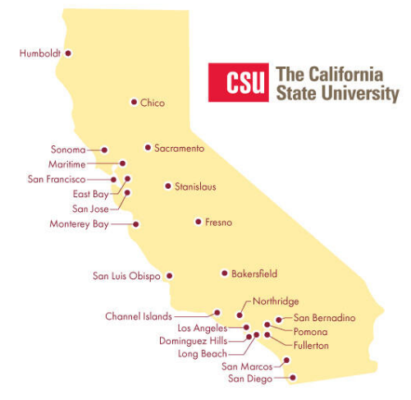
July 18, 2024 Technical Services Open Forum
Notes:
Welcome to the July 18, 2024 edition of the Technical Services Open Forum: Olympic & Paralympics edition!
For those of you that it is your first time at the Technical Services Open Forum, welcome, and we are glad to have you here. I am Christina Hennessey, director of the unified library management system or ULMS for the California State University system, and I am your host for today. We meet once a month at this time, 3rd Thursday of the month at 11am-noon.
This is our last Technical Services Open Forum before the Olympics start in Paris, the opening ceremony is 8 days from today. And then the Paralympics will start in late August, also in Paris.
Do remember that the Olympics and Paralympics are coming to California in less than four years, mainly Southern California but many of our campuses will be involved in preparing and supporting these events. CSU Dominguez Hills will actually be a host for several events including tennis, track cycling, field hockey, rugby sevens, and modern pentathlon which is very exciting.
I am a bit of an Olympics nerd, as you can probably tell, I am very interested in the pictograms and symbols for these events so I have sprinkled them throughout these slides.

Slide 2
Today’s agenda
Conference reminders
Announcements
ULMS updates
NZ Mgt Group
AI cataloging
ALA updates/share
Hang out
Official pictograms from: https://olympics.com/en/paris-2024/the-games/the-brand/pictograms
Notes:
Here’s the agenda for today.
Conference reminders of technical services interest
I’ll call for any CSU library-related announcements not on the agenda, as usual. Please speak up if you have something to share!
I have some updates on things in the ULMS, also some new features coming up in Ex Libris products, some we have early access to
After that, we’ll have a brief update from the Network Zone Management Group, this is a group of four CSU library folks that work very hard to keep the Network Zone clean and running well. They have some reminders for you on things you need to be doing at your campuses on a regular schedule.
Then we’ll go to our featured speakers, Jen Mitchell of CSU Fullerton has a presentation for us on work Fullerton has done in relation to AI cataloging. I have seen the slides ahead of time and this looks great. Samuel Barber of Fullerton will be doing the introduction.
Finally, if we have time, it would be nice if some folks that attended ALA at the end of last month in San Diego could share some of what they saw and what they learned that others might find useful in their daily work and future plans.
After the hour, we’ll turn the recording off, we can hang out and talk about library work, and what’s going at your campuses.
Pictograms: Triathlon & Surfing

Slide 3
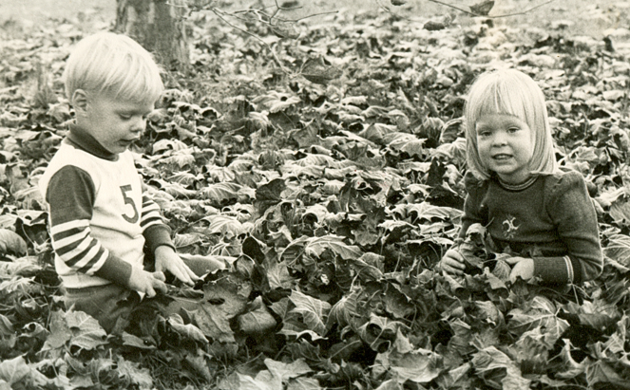
Conference reminders
I-SPIE conference: July 24 & 25, 10am-noon and 2pm-4pm. Free!
https://ispie.calstate.edu/conferences
IGeLU conference: September 9-13
https://igelu.org/event/igelu-2024-conference/
Dev Day is free; annual conference is 100 euro
Notes:
Before we get into general announcements, I wanted to remind you about two upcoming conferences of interest to technical services folks:
I-SPIE, the resource sharing conference for mostly CSU folks, is happening online next week, Wednesday, July 24 & Thursday, July 25, 10am-noon and 2pm-4pm each day. The conference is free!
You can still register! You don’t have to stay the whole time, you can just come to one session or all, whatever works with your interests and schedule. You can see the program from this link to decide. All are welcome! I will share this link and all links from the presentation when I send the recording.
If you are attending, the conference committee is doing a game of ‘guess who this is as a baby or young child’, so please submit a baby picture of yourself. This is not the picture I submitted because my brother is also in this photo but you get the idea.
* I also wanted to remind you about the IGeLU conference coming up in September, I talked about this at the May Technical Services Open Forum meeting in more detail but I wanted to remind you of its existence.
IGeLU = International Group of Ex Libris Users, this is essentially ELUNA (which is Ex Libris Users of North America) for those customers and libraries not in North America, mostly from Europe and Asian countries
* The program is complete and you can review it at this link, we do have one presenter from the CSU at the conference this year, Can Li from San Francisco State will be presenting on Creating a microform resource type assisted by ChatGPT [Zoom session]. We’ll be hearing more later today from Fullerton about their work with ChatGPT and other AI tools so there is a lot happening in the CSU libraries in relation to AI.
You also can still register for this conference, there is no early bird or membership discount, it is the same price today and in September. Almost everything is LIVE online if you register, unlike the ELUNA conference, which only recorded some sessions, and you could not see them until a few weeks after the conference was over.
* If you want to go to Developers Day online – it is free
If you want to go to anything in the annual conference online – it is only 100 euro (which is about $109 today), compare that to the 750 dollars plus that you have to pay for the ELUNA conference
The conference is actually happening in Copenhagen, Denmark, held midnight – 9am each day our time, so plan accordingly.
I am not sure of the access to recordings and presentations if you don’t register but we’ll see what we can do from the Chancellor’s Office.

Slide 4
Announcements
Notes:
So now I want to open this up to any timely announcements, this is your time to speak and share!
I have one update here - there might be some updates about the EBSCO UI that someone else can share, but it was suggested to me to remind folks of this:
Many platforms are in the midst of migrations, including EBSCO, and so a lot of campuses are dealing with migration struggles. This touches on a lot of other departments, especially those that are involved with resource sharing and may receive troubleshooting tickets. So keep these migrations in mind. Others may expand on migrations in their announcements
Pictogram: Badminton

Slide 5
ULMS functional committee new chairs & Steering members
New (2024-2025):
New liaison from COLD: Amy Kautzman, Sacramento
At-large members of ULMS Steering: Erik Beck, Sacramento &
Wendy Vermeer, Fullerton
Assessment & Analytics : Jung Ah Lee, SJSU
Discovery: Ken Herold, Los Angeles
ERM: Genesis Ramirez, Bakersfield
Fulfillment: (pending)
Resource Management: Corinne Ornelas, Bakersfield
Resource Sharing: Rosemary Farr, Fullerton
Notes:
Now for some ULMS updates.
First, we have changed over to a new ULMS year as of July 1, so I wanted to announce our new chairs for the incoming year, these are the folks that you can reach out to with questions about these areas and they can work on your questions with their groups over the next year.
In addition to the new chairs, we also have new Steering Committee members: we have Amy Kautzman, the library dean at Sacramento, who will be our new liaison from COLD to ULMS, replacing John Wenzler of East Bay who is returning to library faculty in the coming year.
We also have two new at-large members, we do try to have Associate Deans in these roles and we got them – Erik Beck of Sacramento and Wendy Vermeer who you may have missed moved from CSUDH to be an Associate Dean at Fullerton earlier this year.
And then here are all the new chairs. You’ll be hearing more from them as the school year starts up.
Pictogram: Water Polo

Slide 6
ULMS functional committee outgoing chairs
Outgoing (2023-2024):
Liaison from COLD: John Wenzler, East Bay
At-large member of ULMS Steering: Marianne Foley, Fresno
Assessment & Analytics : Natalya Serge, San Marcos
Discovery: Keven Jeffrey, SDSU
ERM: Kirstie Genzel, CSUCO
Fulfillment: Gabriel Castaneda, CSUN
Resource Management: Nerissa Lindsey, SDSU
Resource Sharing: Priscilla Ortiz, CSUSB and Rosemary Farr, Fullerton
Notes:
I also wanted to acknowledge our ULMS outgoing chairs and steering committee members
It was not an easy year for them with me learning my new job and policies and procedures and how things get done, so thank you to them for their patience and guidance and support.
Pictogram: Track & Field

Slide 7
Current ULMS task forces
Inclusive Description Task Force: Allison Bailund, SDSU
Linked Data Task Force: Michael Herrick, SFSU
Data Issues Task Force: Jill Strykowski, SJSU
Normalization Rules Task Force: Christian Ward, Sacramento
Acquisitions Task Force: Christina Hennessey, CSUCO
Network Zone Management Group: (no official lead)
Notes:
I also wanted to acknowledge some other ULMS groups and task forces that are not on the academic year cycle but are also doing a lot of work and they continue on regardless of the academic year.
Thank you to these leads, also Luiz will be talking about Network Zone Management Group in a few minutes but they don’t have a lead, it is a group effort for sure but I wanted to mention them in this list as well.
Pictogram: Wheelchair Rugby

Slide 8
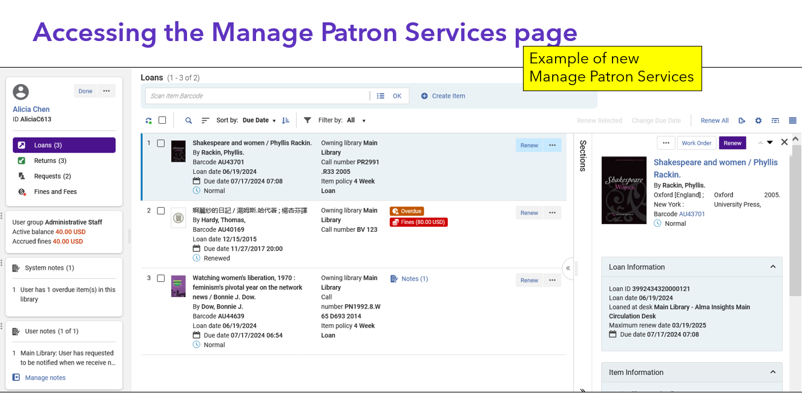
Manage Patron Services timeline
Webinar July 17 7am; recording
November 2024, opt-in. Sandbox two weeks earlier
February 2025 – on by default
Notes:
Next up: new features to be aware of.
I realize this is a Technical Services Open Forum, and this is more of an access services update, but I want to share this anyway as many of you do those things as well or support people that do. There will be a major change to the look of the Manage Patron Services interface in Alma coming this fall, here’s one screenshot of it.
* There was a webinar yesterday on this new interface, the webinar was a bit scattered but there was a PowerPoint that went with it that had 91 slides, I will post that with the recording so you can look at it
The rollout for this features is as follows:
* November 2024, this new interface will be available for everyone, you can opt-in to use it per user.
* February 2025 release – everyone has to use this new interface by default although it sounds like you still might be able to opt-out for a while.
This timeline gives you and your staff plenty of time to get used to the new interface, like we did with the new Analytics interface, update manuals, training documents, etc.

Slide 9
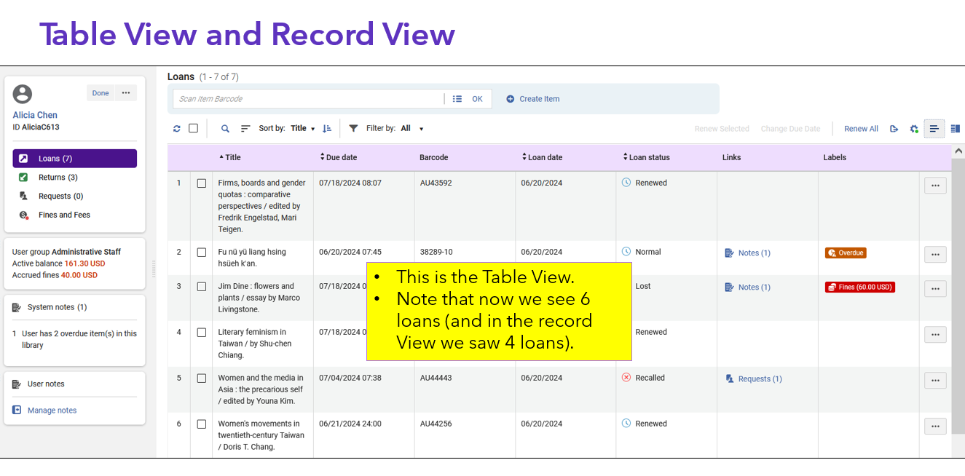
Manage Patron Services: Table view, labels
Notes:
And here’s one more screenshot worth showing, there is this nifty new table view where you can see all the loans, or requests for a particular user, in table form
There are also labels to give you visuals of what you are seeing at a glance, labels for overdues, fines. That’s the red and orange boxes you see here, those that work in Rapido are familiar with these colorful boxes.
This was just a quick preview for you on this, I recommend you look at the PowerPoint and check out the webinar
The ULMS Fulfillment group will be doing some things in the fall to update us on this and what to expect.

Slide 10
New All Titles Search timeline
CSU will have early access in Fresno State sandbox August 18
Will be available in production November 2024 release (also opt-in)
Webinar on September 4 7am, register
Notes:
Another new interface thing in Alma we don’t have too much information about yet is the new All Titles search in Alma.
If you attend Ex Libris webinars regularly, or if you attended the ELUNA conference, you’ll see sometimes they do the demo on a later version of Alma and they say, ‘this is the new titles search that you don’t have yet’
* The good news is that the CSU will have early access to this one – we will have access to this new interface in the Fresno State sandbox on August 18, so six weeks ahead of the production release.
* Then it will be in production in the November 2024 release, that is November 3. Just like the Manage Patron Services changes, this will be opt-in by user.
Not sure when it will be on by default but it will be a few months later.
* There is a webinar on this one as well in the beginning of September, we’ll have access to the new interface in the CSU before then so we can bring our questions to the live webinar.
Pictogram: Wheelchair Tennis

Slide 11
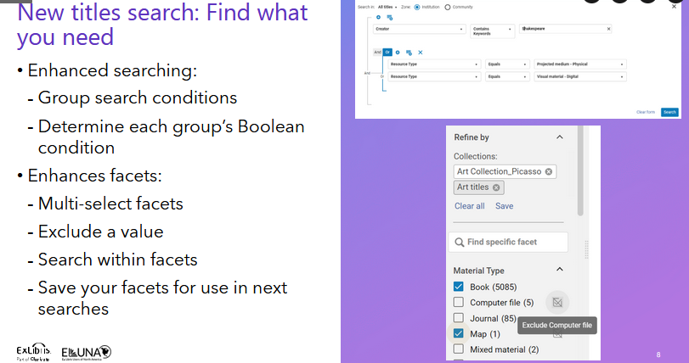
New All Titles Search screenshots
Notes:
Some of the only screenshots I had on this were from the ELUNA conference wrap-up sessions but I guess this is better than nothing:
Enhanced searching
Enhanced facets
And being able to do more directly from the search results

Slide 12
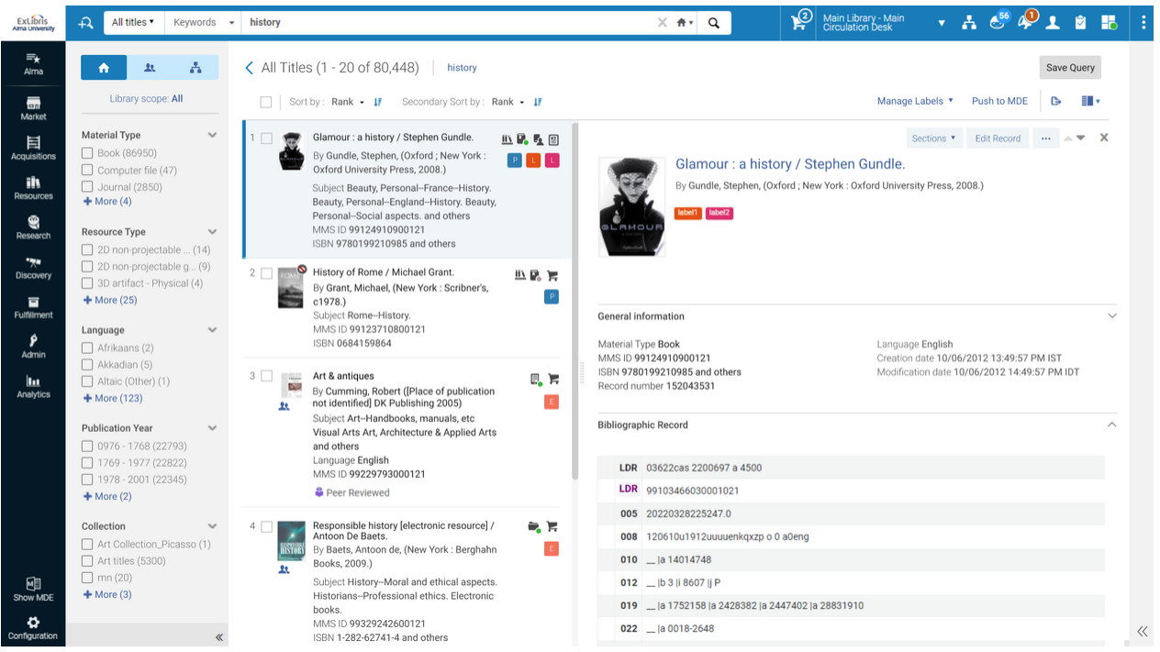
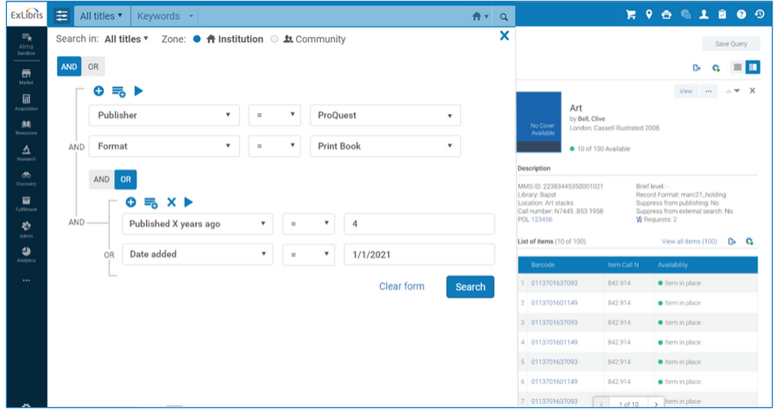
More new All Titles Search screenshots
Notes:
Here’s two more screenshots I found on an Alma roadmap page, you can see the facets and the layout on the left,
You can see the nested query in the search options on the right.
So stay tuned on this, I’ll share more information as I get it. And better screenshots.

Slide 13
Other Ex Libris/ELUNA updates
Consortial Configuration dashboard, webinar July 24 7am, register
BIBFRAME access in Fresno State sandbox
ELUNA enhancement voting is changing (NERS->Election Buddy)
Notes:
Then there are some other random ULMS things I want to update you on, and then I’m done.
You may have heard about a consortial configuration dashboard coming soon, there is a webinar on this topic on July 24. The CSU was one of the testers for this, we gave a lot of feedback so it will probably be different than what we tested, I am looking forward to seeing the new version. The point is that we will be able to update more configurations from the Network Zone, and it can be very granular where we update settings on some campuses and not others. We will get access to it in our sandbox again on July 21 for an August 4 release in production. Nothing that you need to know too much about except in your committees and campuses, you often have the question, can that be managed or distributed from the Network Zone? This will be available for many more settings now if we wish to use it.
The Linked Data Task Force had requested access to BIBFRAME features and options in the sandbox, that was turned on in the Network Zone and in the Fresno State sandbox on July 8. If this interests you and you are not part of the Linked Data groups, please reach out and they might be able to give you access and you could help with testing.
I wanted to alert you that ELUNA enhancement voting is changing really soon. If you are one of the 10 CSU campuses with an individual membership, I sent an email yesterday (late) with more information to the voting contact for your campus on what you needs to be done in the next week. The short version is that you need to update your ELUNA account if you want to vote in the RapidILL/Rapido and Esploro enhancement cycle and you need to make sure the correct email is on the account to get the voting ballot. If you didn’t get this email from me yesterday and you should have, please let me know.
Pictogram: Artistic Swimming

Slide 14
NZ Management Group: reminders
Notes:
Next up, I’m going to hand it over to Luiz Mendes, our host emeritus of the TS Open Forum
Luiz is also a member of the Network Zone Management Group, he is going to give you a brief update on what that group does and is doing
And then some reminders of things you need to do in order to make the Network Zone work.
Take it away, Luiz!
Pictogram: football/soccer

Slide 15
Analysis of AI-generated cataloging
Notes:
Next up, you may have heard a little bit about what Ex Libris is trying out with artificial intelligence in some of their products, specifically in cataloging.
CSU Fullerton has been taking a closer look at this, did some analysis on what Ex Libris had done in relation to AI cataloging, but also what Fullerton catalogers could do as well using other AI tools, and they want to share what they have found.
We’ll have an introduction by Samuel Barber, then a presentation by Jen Mitchell, then time for Q&A.
Take it away, Samuel & Jen!
Pictogram: Taekwondo

Slide 16
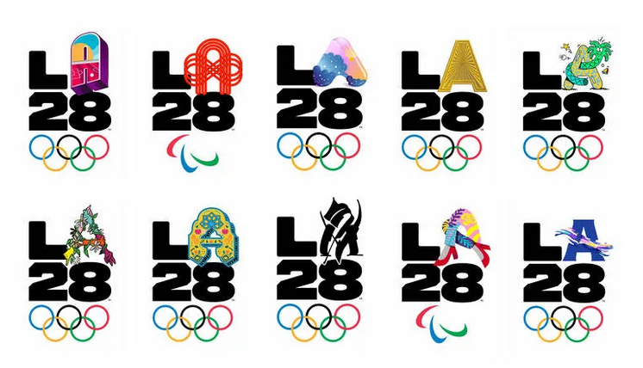
Next regular meeting!
Thursday, August 15,11am-noon
E-licenses and interlibrary loan
Other topics?
LA2028 logos: https://la28.org/en/la-stories.html
Notes:
Coming up next month! Our next meeting will be August 15, 11am-noon.
* As I mentioned earlier, the I-SPIE conference is next week, one of the sessions there is by Jessica Hartwigsen and Kirstie Genzel of the Chancellor’s Office on what we have all been working on in relation to licenses on our e-resources and how those relate to interlibrary loan. The session is titled: “Will it lend? How license terms impact ILL lending”. The one they are doing next week is more focused on resource sharing, but they will do a broader version of that presentation here next month for acquisitions and collection development folks, coming out of the discussions from that presentation and what we’ve learned and decided.
* That presentation won’t take the whole time, so please pass along anything else you would like to share or discuss for the August meeting.
Along the lines of the ‘next meeting’, I thought I’d throw in a few of the LA 2028 Olympic and Paralympic logos, these will be considered the “Los Angeles Olympics”, I guess, but an awful lot of the event venues are going to be in the city where I work, Long Beach, some will be in the San Fernando Valley where I live (close enough for me to walk to them), and the soccer stadiums will be all over the state, closer to many of you. And some of the events will be held in Oklahoma City, which is not a city in California.

Slide 17
Thanks for attending!
Recording will be available & posted later this week
You are welcome to hang out until 1pm (recording off)
Notes:
Thanks for attending
* Recording for this meeting will be available & posted later this week, I am off tomorrow so it will likely be today!
You are welcome to hang out until 1pm (recording off). Thank you for coming!
Pictogram: Boccia (Paralympics); Wrestling

