Slide 1
NZ Management Group
Reminders & Updates
Technical Services Open Forum
July 16, 2024

Slide 2
Contents
NZ Management Group: Recap
Reminders
  OCLC Connexion/Record Manager Setting (UTF-8 Unicode)
    Bad Diacritics in NZ Records
  Policy: Do not import duplicate OCLC records!
    Duplicate Records in NZ
  Policy for Local Notes
    Local Notes in NZ

Slide 3
Who Are We?... Remember Us?
Pam Anan (Pomona)
Luiz Mendes (Northridge)
Kara Rogers (Sacramento)
Eva Sorrell (San Bernardino)
in collaboration with Christina Hennessey (CO Liaison)

Slide 4
What Do We Do?
Charge
Provide assistance for the management of the Network Zone (NZ), the shared bibliographic database of the consortium.
Identify issues impacting records in the NZ and collaborate with campuses on record resolution.
Propose best practices for loading and sharing bibliographic records in the NZ.
Report to Ex Libris problems related to the NZ, if needed.
Tasks
Check Daily OCLC record loads to merge & combine inventory.
Perform monthly NZ clean up (to remove records not used in the NZ).
Troubleshoot problems with Network Zone bibliographic records or processes.
Perform special projects (e.g., correcting “bad diacritics” in NZ records; etc.)

Slide 5
Issue #1. Bad Diacritics in NZ
In Descriptive fields:
  245 00 |a Pok<U+fffd>emon violet.
  245 14 |a Les exploits d'un jeune Don Juan : |b roman / |c Guillaume Apollinaire ; pr<U+fffd>ef. de Michel D<U+fffd>ecaudin.
  260 __ |a New York : |b Ballantine Books, |c <U+fffd>1988.
  264 _4 |c �2023
  264 _4 |c <U+fffd>2024
In Access points:
  Names
  100 1_ |a C<U+fffd>ordova, Zoraida, |e author. |4 aut
  710 2_ |a Nintend<U+fffd>o Kabushiki Kaisha, |e publisher.
  Subjects
  _0 |a Pok<U+fffd>emon (Fictitious characters)
  650 _0 |a Pur<U+fffd>epecha art |z Mexico |z Tzintzuntzan Site.
  *650 _6 |a Universit�es |x Choix |x Aspect social |z �Etats-Unis.
  *650 _6 |a Roman fran<U+fffd>cais. |0 (CaQQLa)201-0044648
  *655 _7 |a Films de superh<U+fffd>eros. |2 rvmgf |0 (CaQQLa)RVMGF-000000157
  *Do not display in Primo.

Slide 6
Causes of Bad Diacritics?
Incorrect “character set” selected in OCLC Connexion or Record Manager (MARC-8 ). [Yes, it is your fault!]
or
Non-Unicode compliant characters present in the WorldCat record. [No! It is not your fault!]

Slide 7
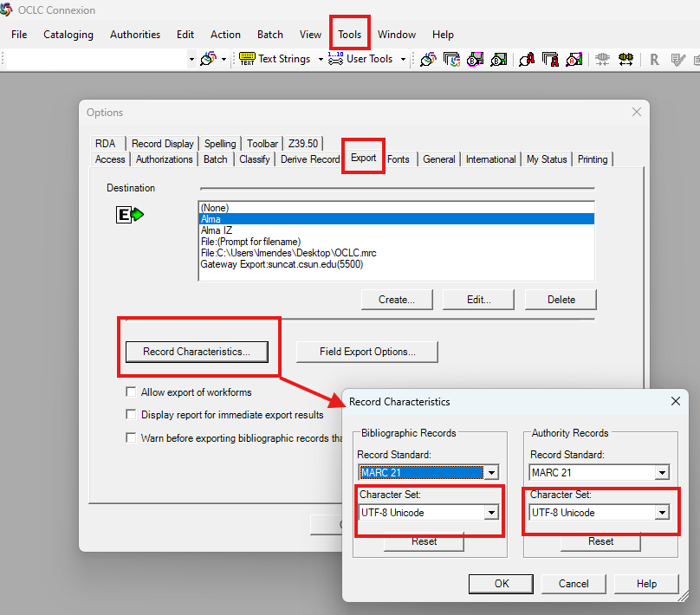
Setting Up Connexion
Steps:
Tools > Options > Export
Select the destination (Alma)
Select “Record Characteristics”
Set Character Set to:
UTF-8 Unicode

Slide 8
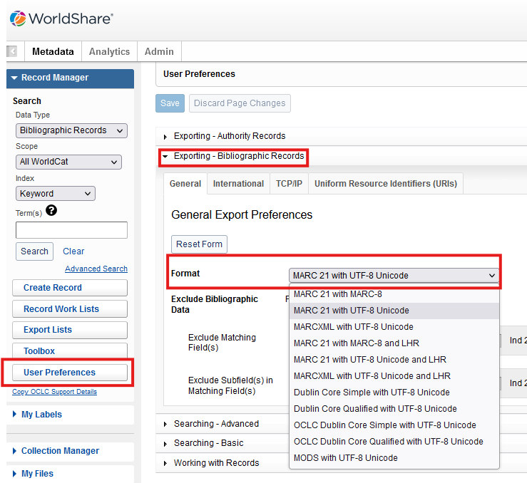
Setting Up Record Manager
Steps
Select “User Preferences”
Expand “Exporting – Bibliographic Records
Under “General” tab, make sure “Format” is set to:
MARC 21 with UTF-8 Unicode

Slide 9
Reminder 1.
Please make sure all members of your library who export records from OCLC have the “Character Set” to “UTF-8 Unicode.”

Slide 10
Issue #2. Duplicate Records in the NZ
Remember the ULMS Resource Management Functional Committee policies?
Overlaying Bibliographic Records in Alma
  Document describes policy and methods for replacing (that is, overlaying) individual bibliographic records in Alma with records exported from OCLC Connexion client or brought into the Network Zone (NZ) from daily OCLC loads. This policy does not apply to batchloads. The objective is to avoid unintended overlays and duplicates in the CSU shared environment. See also Overlaying Bibliographic Records in Alma (Procedures) for more details.

Slide 11
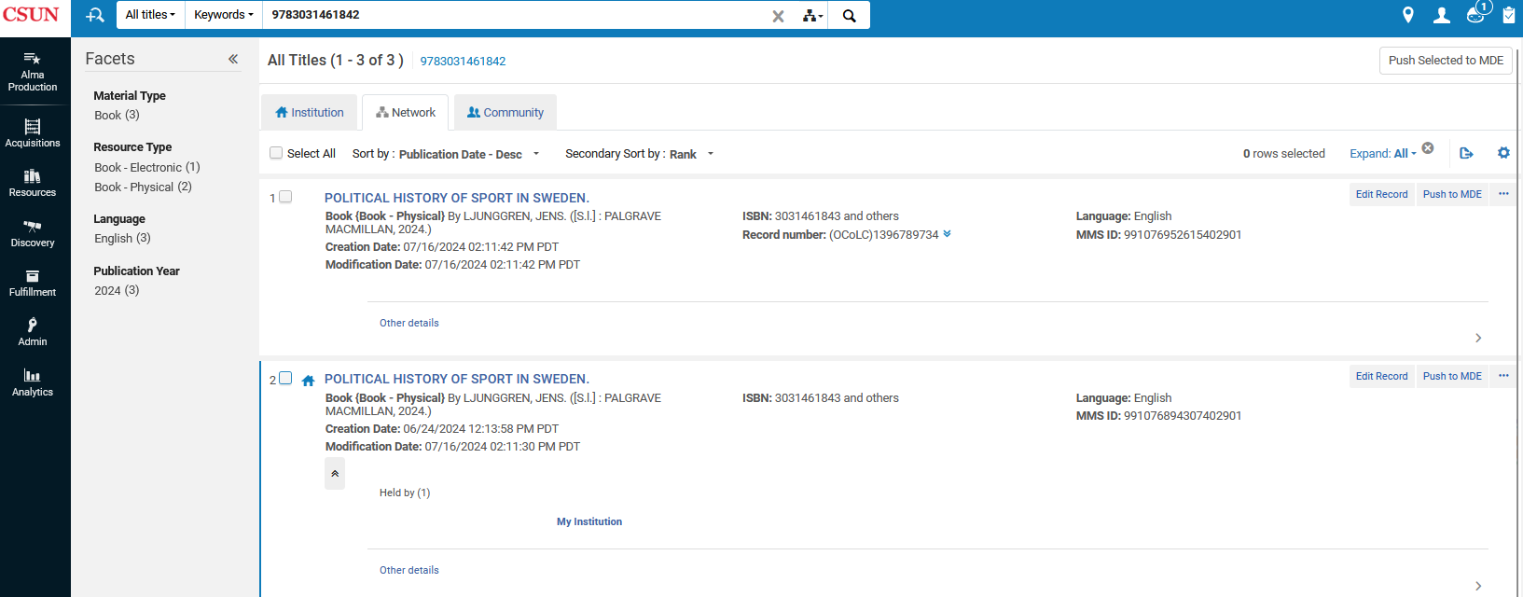
Duplicate Records in the NZ

Slide 12
Reminder 2.
Please remember to search for a title in both the IZ and the NZ. Do not add duplicate records to the NZ.

Slide 13
Issue #3. Local Notes in NZ Records
Again…remember the ULMS Resource Management Functional Committee procedures for adding…?
  Local Fields in Alma & Primo VE
Some examples of notes in NZ records:
590 __|a ProQuest Books |b Firm Orders (Rialto ProQuest/ExL) : Print Physical Processing
590 __ |a American Antiquarian Society copy unopened.
590 __|a Added to collection customer 56279.3
Remember: Local fields in NZ records are not protected!

Slide 14
Reminder 3.
Remember that local fields are no longer input in OCLC at the point of cataloging. Follow the policy and procedures to add “local extensions” using the Metadata Editor or the Normalization Rule method, as outlined in the procedures Local Fields in Alma & Primo VE.

Slide 15
Resources
NZ Management Group
https://calstate.atlassian.net/wiki/spaces/URM/pages/159547638/NZ+Management+Group
ULMS Resource Management Functional Committee Documentation
https://calstate.atlassian.net/wiki/spaces/URM/pages/144572454/Functional+Committee+Documentation

