Slide 1
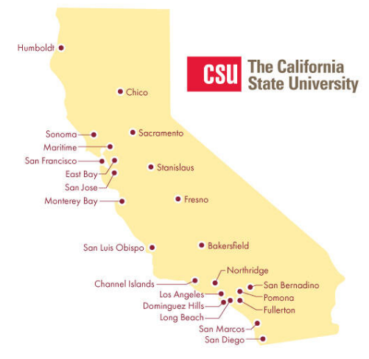
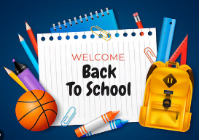
August 15, 2024 Technical Services Open Forum
Notes:
Welcome to the August 15, 2024 edition of the Technical Services Open Forum: Back to School edition!
For those of you that it is your first time at the Technical Services Open Forum, welcome, and we are glad to have you here. I am Christina Hennessey, director of the unified library management system or ULMS for the California State University system, and I am your host for today. We meet once a month at this time, 3rd Thursday of the month at 11am-noon. The meeting is always recorded and posted shortly after the meeting.
It has been a hot, earthquake-y summer across California, and quite a few of the CSU campuses start classes next week – August 20 – 22 and most of the rest start the next, next week in 9 days on Monday, August 26. And San Luis Obispo, our lone quarter system campus, will be starting Fall classes on Sept 23. So if you have been away, welcome back!

Slide 2
Today’s agenda
Announcements from me
Announcement from all of you!
NZ Mgt Group reminders and updates
ULMS updates
Rapido & Primo search profiles
CSU Primo search profiles
Hang out
Notes:
Here’s the agenda for today.
I have a few announcements to pass on to you that people have sent to me
Then I’ll call for any CSU library-related announcements not on the agenda, as usual. Please speak up if you have something to share!
Luiz Mendes will give us some updates & reminders from the NZ Mgt Group
I have some updates on things in the ULMS, also some new features coming up in Ex Libris products, some we have early access to
Then we’ll go to our featured speaker, Christopher Lee of the Chancellor’s Office. Chris will talk to us about options and recommendations for your Primo search profiles that include Rapido.
When Chris is done, I had hoped to share a new completed wiki page of the search profiles at each CSU campus so you can see what different campuses have done but I ran out of time - perhaps we will have discussion and I’ll send out the wiki page later, you can study these and we can talk about them next time.
After the hour, we’ll turn the recording off, we can hang out and talk about library work, and what’s going at your campuses.

Slide 3
Announcements from me
ELUNA Learns proposals due September 1
https://el-una.org/meetings/eluna-learns-2024/
I-SPIE conference recordings
https://ispie.calstate.edu/conferences
Licenses & ILL session recording not available
Lots on licenses and Alma in the November 2023 TS Open Forum recording from Anthony Davis/Fullerton
Notes:
First, here are some general announcements from me that I want to share. Thanks to those of you that sent me these ideas/announcements to share.
Most of you are familiar with ELUNA Learns, that is the online version of the ELUNA conference that started in 2020 during the pandemic when we could not have in-person conferences. These will be a series of topics in Fall 2024, they are looking for proposals now and the proposals are due September 1, 2024. The ELUNA Learns series is free now to all of you due to your consortial ELUNA membership (it used to cost money to attend but no more). And if you need presentations for professional development or tenure or promotion or your c.v., it is a nice way to get a presentation in without using any travel budget. Quite a few CSU folks have presented at the ELUNA Learns in the past, including myself, and Kevin Phillips, and Jill – please reach out if you have any questions about how it is.
Show: https://el-una.org/meetings/eluna-learns-2024/
The I-SPIE conference was held online on July 25 – 26, it was very successful with an average of 50+ in attendance for each session for the two days. Thank you to the organizing committee for a great conference. If you missed any of it, the recordings are now posted on the I-SPIE website.
Show: https://ispie.calstate.edu/conferences
I will give the caveat and update that we originally said there would be a version of one of the I-SPIE presentations today, this was Kirstie & Jessica’s presentation, which was called “Will it lend? How license terms impact ILL lending”. It turns out there were some things shown and discussed in that session that we can’t necessarily share on a recording so the recording will not be posted and we will not cover that topic again here. However, there will be redacted versions of the slides from that session available on the I-SPIE website soon.
I will remind you that we had an excellent presentation on licenses in Alma at the November 2023 TS Open Forum by Fullerton’s Anthony Davis, you can find that recording and demo on the TS Open Forum recordings page and even jump right to that part of the recording. But please reach out if you still have more questions about licenses in libraries, in Alma, in Primo, in relation to ILL, and we can maybe do more presentations.
Show: https://calstate.atlassian.net/wiki/spaces/URM/pages/144572459/Technical+Services+Open+Forum+Recordings

Slide 4
More announcements from me
eCAUG conference is looking for lots of input! Submit by August 30.
https://sites.google.com/view/ecaug/2024-ecaug-conference/call-for-proposals?authuser=0
ILLiad 9.1 will reach end of support on September 1st
https://support.atlas-sys.com/hc/en-us/articles/360011911933-ILLiad-Release-Schedule
Notes:
More from me!
The eCAUG conference, our in-person conference for California Ex Libris libraries being held at the CO in October 2024, put out a call for many helpers and input at the end of July.
Show: https://sites.google.com/view/ecaug/2024-ecaug-conference/call-for-proposals?authuser=0
This year the conference theme is “Ghost in the Machine 👻 - What We Do in the System”. This theme was explained as: The conference focuses on our work within our libraries. Whether you want to share your best practices, innovative configurations, projects on AI and data analysis, or tips and tricks to improve processes, then they are excited to have you! Expect a mix of insightful presentations, interactive workshops, and engaging discussions designed to entertain and enlighten. They are taking an "unconference" approach to create an interactive and inclusive experience.
The planning committee is looking for facilitators to run discussion roundtables and help with troubleshooting
Presenters for lightning talks, poster sessions, presentations, or to run workshops. Lots of options to get involved!
Again, lots of things to help with professional development, tenure, promotion, and your c.v.
Please submit your ideas and interests by August 30, 2024, that is just a few weeks away.
For those libraries that have ILLiad, one more reminder that the support for ILLiad version 9.1 ends Sunday, Sept 1, 2024. Unlike with Ex Libris products, we cannot get access to your ILLiad to help with this from the CO so please check the version of your ILLiad as soon as you can so you can schedule an update. 9.2 is the current version and has been around since March 2022 so hopefully you have all had time to upgrade but I know we have all been busy so you may have missed this announcement. Chris Lee tells me: The NCIP in ILLiad has been known to break with updates. Please let me know if the NCIP does break and he can help get you a new version to go with your updated ILLiad. Chris Lee can answer more questions about this so please reach out!
Show: https://support.atlas-sys.com/hc/en-us/articles/360011911933-ILLiad-Release-Schedule

Slide 5
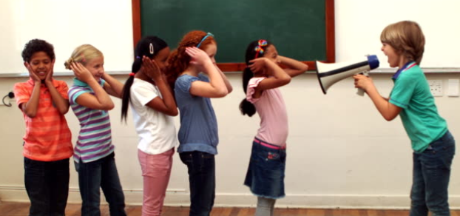
Your announcements
Notes:
So now I want to open this up to your timely announcements, this is your time to speak and share!

Slide 6
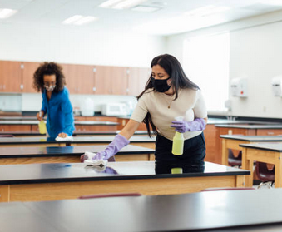
Network Zone Mgt Group
Thank you for all your work and responses to messages from the NZ Mgt Group for cleanup
Finish local notes cleanup by end of August
Other reminders/updates
Notes:
The Network Zone Management Group gave us some updates and reminders at the July TS Open Forum
Thank you to all the campuses and catalogers that have responded to the emails from them and helped with the cleanup
Luiz wanted me to remind you to finish your Local Notes cleanup by the end of August, you have two more weeks.

Slide 7
ULMS updates from last meeting
All Titles Search interface in Fresno sandbox Sunday, August 18
Webinar on September 4 7am, register
Will be in production in the November 2024 release, that is November 3 (opt-in)
Reminder of ELUNA enhancements
Format has changed: NERS->Election Buddy
Currently voting on Rapido/RapidILL (deadline: August 30) and Esploro (deadline: August 20)
Chris has a SmartSheet for Rapido/RapidILL input for the CO vote, he will share that vote so voting campuses can follow that if you like (deadline: August 28)
Notes:
Now to some ULMS updates. Thanks to those of you that sent me these ideas/announcements to share.
Some updates on things I mentioned at the last meeting -
I mentioned the All Titles Search interface last Forum and showed a few screenshots. That will be available in the Fresno sandbox this coming Sunday, August 18.
I’ll send some information and screenshots out to everyone once we have it turned on this weekend, but there is also a Ex Libris webinar about it on September 4 at 7am, you can register here or get the recording about a day later.
All Titles Search interface will be available in production in the November 2024 release, that is November 3, it will be opt-in, not sure when it will be opt-out
Another reminder that the ELUNA enhancement process has changed recently
Ex Libris enhancements are no longer voted in the NERS system, there is a new system named Election Buddy. If you are a voting campus, one person at your campus got an email with the ballot already.
We are currently voting for Rapido/RapidILL enhancements and Esploro enhancements. Unfortunately these are due on different dates, the deadline for Esploro is August 20 and the deadline for Rapido/RapidILL is August 30.
We only have one Esploro library so not much to coordinate there [Bin from Sacramento sent me his input this morning, thank you Bin], but we are all Rapido/RapidILL libraries so Chris Lee put together a SmartSheet to give your input on what we should vote for in the CO, the deadline on that to Chris is August 28. Once we have those results, we will share them with you in case you want to have CSU-wide input in your vote (or if you aren’t sure what to vote for).
Show Chris’ SmartSheet: https://app.smartsheet.com/b/form/63894d9db7be4b2d8a94413a9451b709
This is a new process for all of us so please reach out with any questions.

Slide 8
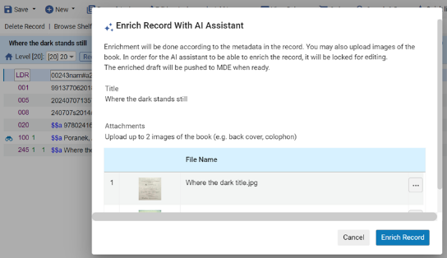
ULMS updates: AI Metadata Assistant
AI Metadata Assistant in SJSU sandbox Sunday, August 18
What is it?
Demo
Still looking for testers
Notes:
Also since our last Open Forum, we’ve been given the chance to be part of the early testing of what Ex Libris is calling: the AI Metadata Assistant. I sent out an email about this as Ex Libris wanted me to make sure that we had some interested testers. This will be available in the San Jose State sandbox starting this Sunday, August 18. Different sandbox than the All Titles Search interface.
* What it is: The AI Metadata Assistant in Alma’s Metadata Editor is one of several AI projects underway at Ex Libris & Clarivate. They are designing it to help catalogers in their work by suggesting metadata they can use when cataloging a resource, saving time and effort on researching and searching information, and freeing catalogers’ time to handle more complex cataloging tasks.
Their vision is that a cataloger will be able to easily create a new bibliographic record or enrich an existing brief record using the resource’s metadata (such as title, author, content note, etc.) and/or images (such as a book’s back cover or title page). After receiving the AI’s suggested metadata, generated from the provided information, they will be able to accept, correct or discard the suggested changes, as well as add metadata of their own as needed.
The first phase of the Metadata Editor AI assistant will help with creating English MARC 21 records for books, with more formats and languages support to follow.
So I really wanted something to show you all since we are a little bit in the dark on what this might look like, so Ex Libris shared a little video demo with me that I’m going to share with you now and email to you later as well so you can study it if you like. There is no sound with this demo, just captions, but I’ll read the captions as we go along.
Show: https://share.vidyard.com/watch/W2Eszr451TeyxRafPJ18o8?
If you would like to be a tester! We currently have 9 interested testers from 6 different CSU campuses, but if you are newly interested or missed the email where I called for volunteers, you can still be involved, just send me an email today or tomorrow so I can get you in the project.
* The testing instructions from Ex Libris are kind of free-form, the only instructions we were given were:
Your team can then conduct tests of record creation and enrichment, according to your judgment (we will appreciate it if the test materials include diverse materials and metadata, to get as much information from this testing process as possible…).
I think just try some English-language MARC21 books that you have around or are about to catalog and give that a try
Nerissa @ SDSU suggested to me that they might try doing some work on sets in bulk, that sounds great, give lots of things a try and try to break it!
I will create sandbox logins for all the testers early next week, then you can all send your own individual feedback to Ex Libris. I’m assuming there will be a big red FEEDBACK button in the sandbox like Ex Libris has for other testing projects, that sends messages directly to the developers. There is also a Basecamp for the project so you can see what other testers are finding out at other non-CSU campuses and institutions.
I don’t know when the testing period ends (even though I asked), I would assume it would be a month or two from Sunday.
It should be very interesting and this gives us a chance to give feedback really early in the development process and help design a system that will work better for us.

Slide 9
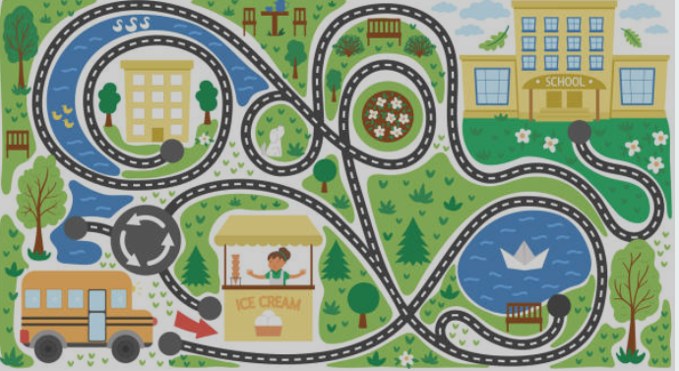
ULMS updates: Alma roadmap & new features
The Alma roadmap was just updated
What’s new in Primo Q3 2024 webinar (July 22, 2024): recording
Alma release highlight videos for 2024
Notes:
Ex Libris keeps a rolling two-year roadmap, they just updated it again so it has the information for the second half of 2024 and then 2025
Show: https://knowledge.exlibrisgroup.com/Alma/Product_Materials/010Roadmap/Alma_Roadmap_Highlights_(2024-2025)
Enhanced User Experience: Streamlined and intuitive interface & workflows for Title Search and Patron Services
AI Metadata Assistant: Advanced tool for the cataloger to improve metadata accuracy and efficiency
Robust Consortia Functionality: Improved collaboration and administration capabilities for consortia
Workflow Simplification: More efficient processes to save time and reduce complexity.
Linked Open Data and Authority Management: Enhanced data integration and management.
Open Access: Support for open access initiatives and compliance.
Take a look at this at your convenience, it has lots of details and screenshots.
Show Metadata link: https://knowledge.exlibrisgroup.com/Alma/Product_Materials/010Roadmap/Alma_Roadmap_Highlights_(2024-2025)/Metadata_Management
Show Collab Networks (that’s us – that means consortia like us): https://knowledge.exlibrisgroup.com/Alma/Product_Materials/010Roadmap/Alma_Roadmap_Highlights_(2024-2025)/Collaborative_Networks
Some other updates –
What’s new in Primo Q3 2024 webinar recording is here, that was held July 22
Included information about linked data, New Discovery Experience, and the Primo Research Assistant, which is not the same thing as the AI Metadata Assistant
Show: https://www.youtube.com/watch?v=Yj0lgu4ieiE
And for those who don’t like to read and just want short videos on new and upcoming features, a reminder that Alma puts out short release videos quarterly that demonstrate & explain the new features. Those are at this link:
Show: https://knowledge.exlibrisgroup.com/Alma/Training/Release_Highlights_Videos/76_Alma_2024_Release_Highlights_Videos?mon=All

Slide 10
ULMS updates: eresourceshelp email reminder
Reminder of email contact for e-resources help!
eresourceshelp@lists.calstate.edu
Goes to more than one person
Better coverage on hours throughout the day
Slack is also a good choice
Shared e-Resources (ECC and Opt-in) - Problem Reporting Best Practices and FAQ
Notes:
Here’s my last slide before I hand the meeting over to Chris Lee.
I also wanted to take this time to remind you of a new email we set up in the CO recently that you should contact for e-resources help
It is: eresourceshelp@lists.calstate.edu
Please use this email instead of contacting Jessica or Kirstie directly as they can sort out who might be the best person to work with you on your issues.
Also! People take vacation, even Jessica. And Jessica is taking a very long vacation in late September and early October. I will be her back-up during this time and will pretend to be 10% of Jessica for 17 days, so send the emails to that address and me & Kirstie will sort it out. But we all work different hours of the day so you have the best chance of getting SOMEONE to answer if you use this email now and going forward.
If you forget and email Jessica or Kirstie directly, they will probably remind you of this email.
Also a reminder that asking on CSU Libraries Slack is a good choice too, your colleagues at other campuses might be having similar issues and can help you out.
Kirstie, Jessica, did I get that right, anything to add?

Slide 11
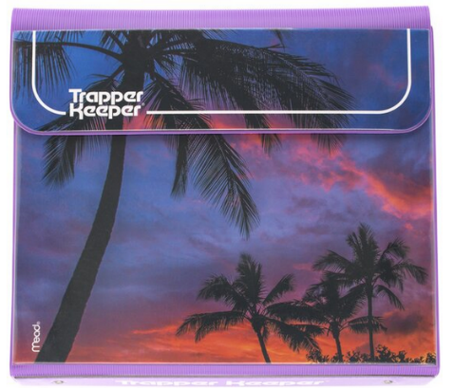
Rapido & Primo search profiles
Notes:
Now I’m going to hand it over to Chris Lee to talk to us about options and recommendations for your Primo scopes and search profiles that include Rapido.
I didn’t have a good back-to-school picture for this topic so I just included a reminder of the awesome Trapper Keeper.

Slide 12
CSU search profiles
Notes:
Ran out of time to finish this but Chris & I will be working on this chart
Let us know what else we should include here
It’s hard to visualize/design correctly
Chris’ page: https://calstate.atlassian.net/wiki/spaces/URS/pages/3133833219/Rapido+Search+Profile+and+Global+Title+Index
Wiki: https://calstate.atlassian.net/wiki/spaces/ULMSD/pages/3152576536/CSU+Libraries+scopes+search+profiles

Slide 13
Next regular meeting!
Thursday, September 19,11am-noon
Updates from IGeLU conference
Other topics?
Notes:
Coming up next month! Our next meeting will be September 19, 11am-noon, we’ll be meeting throughout the fall on the third Thursday of every month, 11am-noon. You should have received Outlook invites for the Fall meetings last week from me, let me know if you did not.
As I’ve been mentioning in previous Technical Services Open Forums, the international version of ELUNA, the International Group of Ex Libris Users, or IGeLU, conference is next month in Copenhagen. I will be attending online from California and hopefully will have exciting things and updates to share with you from the conference. So I’ll have that for you at the next meeting. I will distribute the full program again in case there is something you would like me to attend on your behalf and take notes, let me know!
Full program here: https://mtgsked.com/p/1662/c
* That presentation from me on IGeLU won’t take the whole time, so please pass along anything else you would like to share or discuss for the September meeting.

Slide 14
Thanks for attending!
Recording will be available & posted later this week
You are welcome to hang out until 1pm (recording off)
Notes:
Thanks for attending
* Recording for this meeting will be available & posted later this week.
You are welcome to hang out until 1pm (recording off). Thank you for coming!

