Slide 1
SILO SMASHERS!!!
Resource Sharing colliding with Primo Search Profiles
Notes:
Hello Tech Services! I wanted to smash through my Resource Sharing silo to discuss a topic that crosses multiple areas. Primo Search profiles are primarily a Discovery thing, but with the addition of Rapido and the Global Title Index they can have a massive impact on Resource Sharing. So, I want to share my perspective from Resource Sharing. Let's smash this silo!

Slide 2
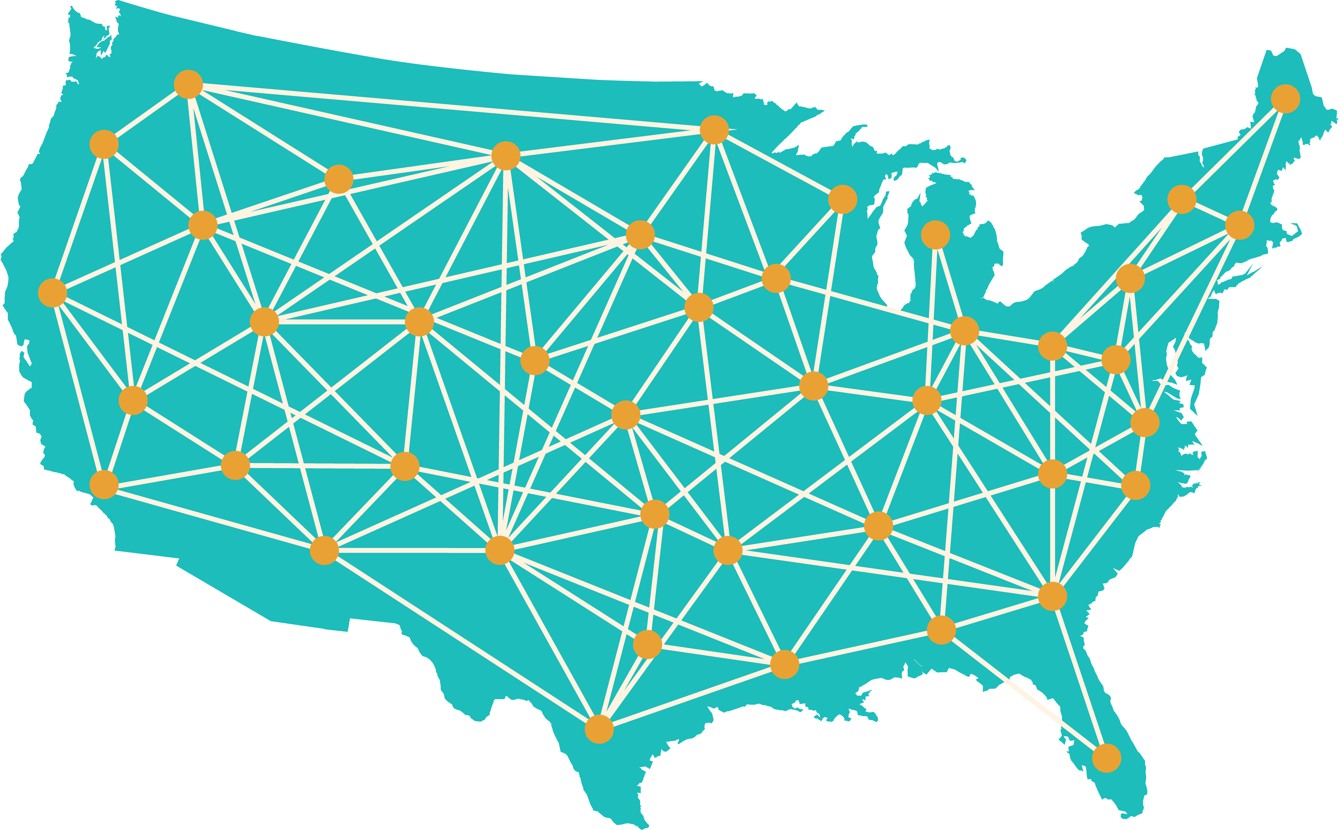
Global Title Index
The Global Title Index (GTI) lets patrons search item records contributed by Alma libraries across the globe
Everyone on Rapido has access to the GTI and contributes to the GTI
Libraries not on Rapido can choose to contribute records to the GTI
This is how patrons can request items from outside the CSU
Notes:
So to start, what is the Global Title index and why is it important for Resource Sharing? The global title index, or GTI, is a searchable set of records gathered from every Rapido library and Alma libraries who have decided to add their records for potential Resource Sharing partnerships. It is a key component of Rapido and is where our patrons can Discovery materials held by libraries outside the CSU. Through the GTI patrons can find books held by St Mary’s here in California or SUNY Albany in New York. Without the GTI, patrons can only really discover materials held in our local collections or the CSU collection, and the only requests going outside the CSU are requests for items we own but are currently checked out.
Put simply, the GTI is the backbone of Rapido and is necessary to request items from partners outside the CSU.

Slide 3
How to Access
Notes:
So how do patrons access the GTI? You may have noticed a link at your library that says something like “Didn’t find what you were looking for? Click her to expand your results.” Clicking expand will take you to the GTI search profile at your library. You can also manually select the GTI search profile from a drop-down list. In this example the GTI search profile is named Articles, probably because the articles search profile fit the criteria for the GTI during implementation. It is worth looking at how the search profiles are named because the GTI has everything from everywhere and not just articles.
Once you are in the GTI the expand your search link will change to the “Still didn’t find what you need” link. This new link will take you to the blank Rapido form where patrons can manually enter the information for the item they want or need.
So, in short, you know you are in the GTI if there is a link to the blank form and you access the GTI by clicking expand. You can also access the GTI by manually changing Search Profiles. All of these links can be edited to have different wording, which a few libraries have already discovered and updated.

Slide 4
Issues with the GTI
Notes:
So the GTI lets you access records from outside the CSU! Yay! But that also means it is filled with records outside the control of the CSU. Sometimes libraries will make slightly different decisions when cataloging the same book and both records will end up in the GTI with different libraries using each record. Since the GTI cannot be ordered, the version of the record used outside the CSU may appear above records for the local copy of the same book. Unfortunately, this can lead to patrons requesting items from across the country even though we own the book locally. Since requesting is unmediated the request will go directly to the other library who will likely fill it. We can’t do anything about the items that are filled, but items that aren’t immediately filled can be switched to another record in a slow manual process we would prefer to avoid.
Even with this issue, the GTI is still extremely important for when materials are not available locally. The issues with the GTI can also vary in severity depending on how your search profiles are ordered in Alma and Primo. More on that in a bit.

Slide 5
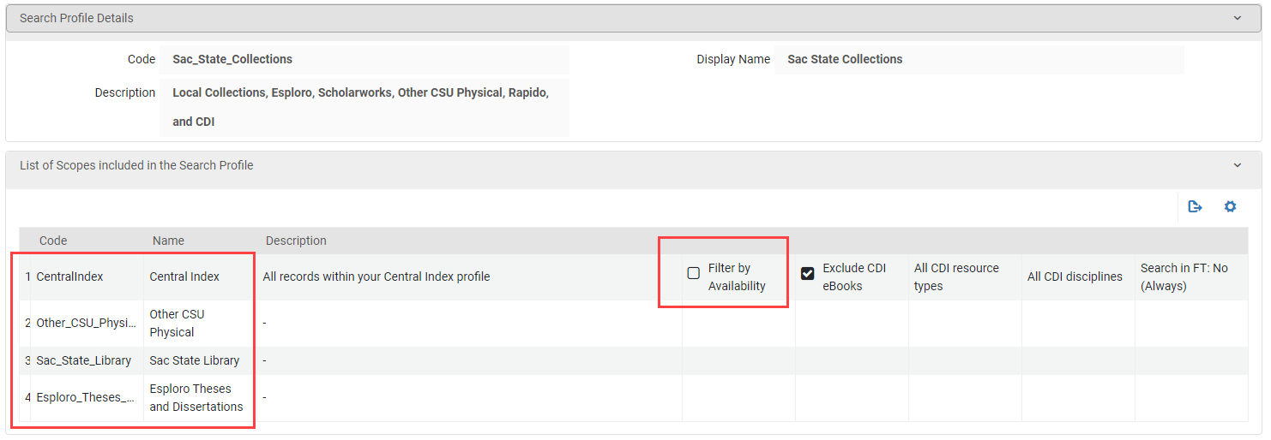
Making the Search Profile
Configuration > Discovery > Search Configuration > Search Profiles
Notes:
So that’s how to use the GTI on the patron side, but where is it in Alma? Unfortunately, it is complicated and confusing. There is no GTI button or pre-made Search Profile. To create or configure the GTI Search Profile go to Configuration > Discovery > Search Configuration > Search Profiles and either edit an existing search profile or make a new one. To make a search profile that includes the GTI it simply needs the Central Index scope and it needs the Filter by availability option unchecked. That’s it. With an unfiltered Central Index you will have the GTI.
While that certainly works for the basic GTI, it is a good idea to add a few more additional scopes. I recommend adding a scope for the whole CSU collection and a scope for your local collection. This will ensure your records will appear in searches of the GTI in your library so patrons can always find them. I have also been told it is a good idea to activate CDI records for those scopes to actually show different Electronic Resources. For questions about that I would contact Jess Hartwigsen or Kirstie Genzell since that is a different kind of grain in a different silo than what I normally deal with.
It is also possible to create multiple GTI Search Profiles. If multiple search Profiles have the Central Index unfiltered they will all contain results from other libraries.

Slide 6
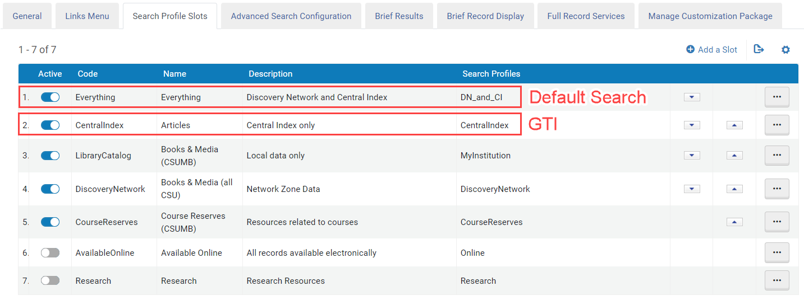
Ordering Search Profiles
Configuration > Discovery > Display Configuration > Configure Views > Ellipsis/Edit > Search Profile Slots
Notes:
Once you have made a search profile you need to add it and activate it in a Search Profile slot. This will determine what Search Profiles are usable through Primo and the order they appear in, which is far more important than I originally thought. Whichever search profile is listed first is your Default Search Profile. This is the profile the patron will start in when starting a request in OneSearch. If you add multiple GTI Search Profiles the version highest on the list is the profile patrons will be directed to when they click to expand their results, but all of them will have records from beyond the CSU. This is why I recommend only having one GTI Search Profile to make things less confusing for patrons.
So that’s what the GTI is and how to configure it. But how can we continue to get the benefits of the GTI while minimizing the drawbacks as much as possible? I think the answer lies on this page in configuration, which Search Profile is the default search profile.

Slide 7
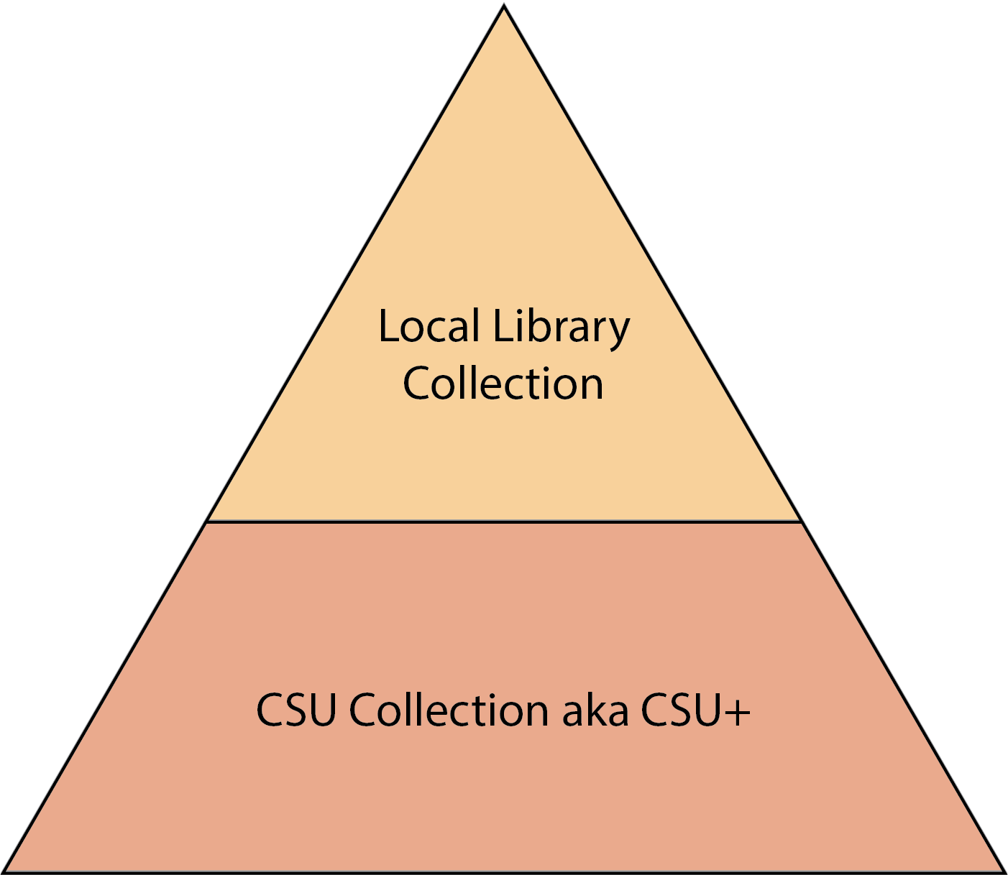
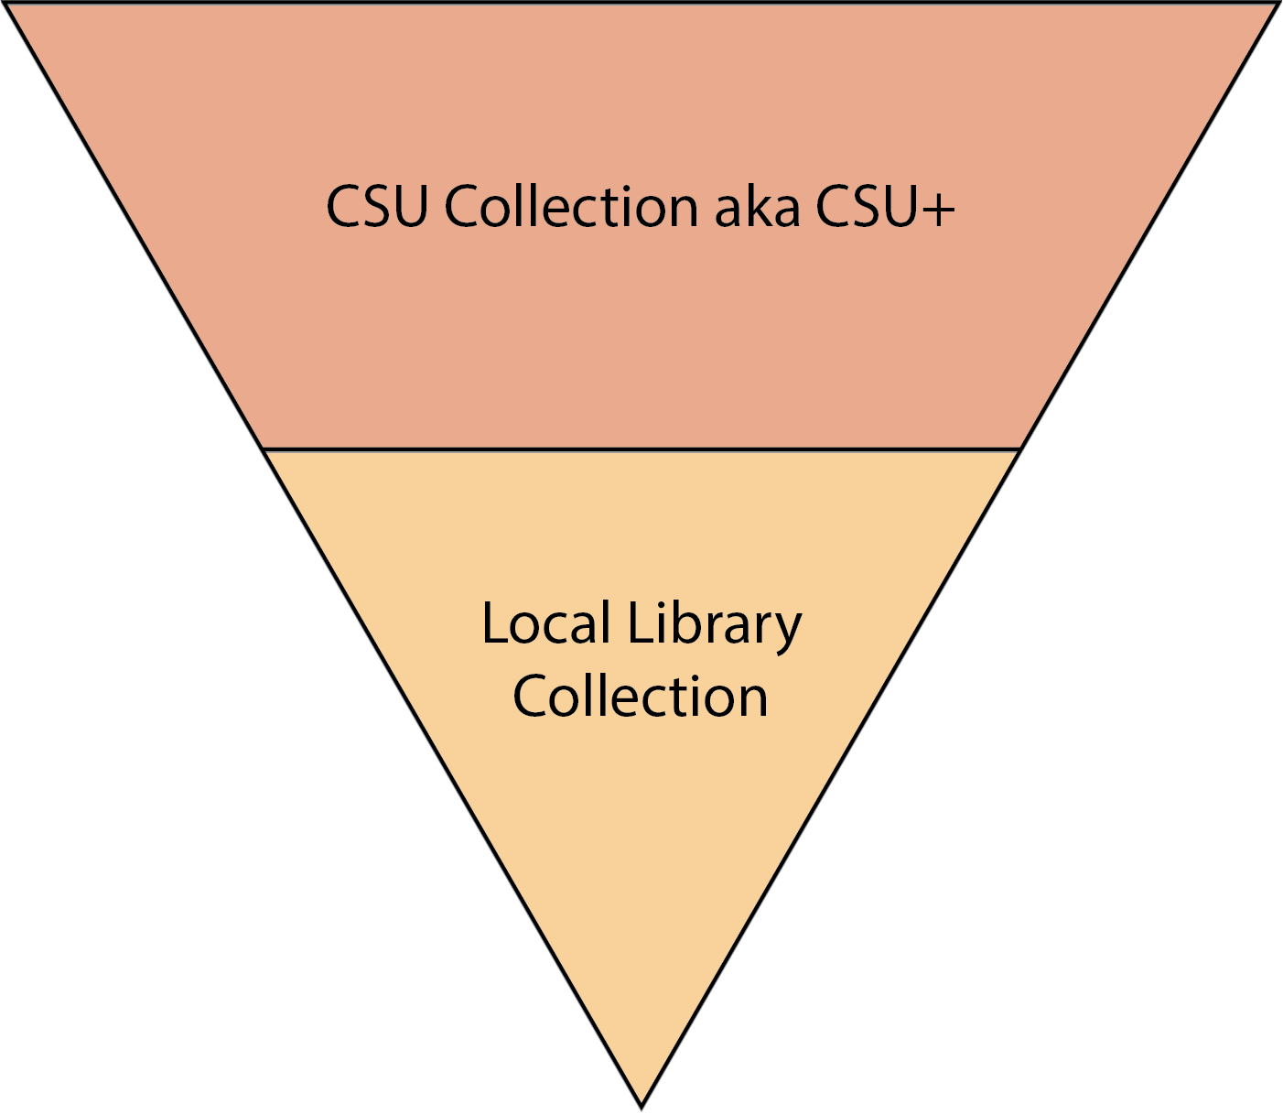
Before Rapido
Notes:
Before we went to Rapido there were two basic ways of thinking about Search Profiles with some variation. Do we start with a narrow search of our local collection and go wide to the full CSU collection, commonly referred to as the “Everything” search profile? Or do we start with a wide search of everything in the CSU and patrons could narrow the results to the local collection? A few libraries even decided to only have the Everything Search Profile and not a separate one with only the local collection inside.
After a few years using CSU+ more and more libraries switched to the start wide and filter to narrow model. This made complete sense since it let patrons get more relevant results from across the CSU instead of the smaller subset of relevant results from the local library. These materials also came extremely quickly because all the CSU libraries were on the same courier, which also kept pricing consistent regardless of the number of books shared. This was fantastic for Resource Sharing stats and really made the CSU feel like a library system and not a bunch of disjointed libraries.
But the GTI came along and added some complications. The next three slides show the three main setups I have found around the CSU.

Slide 8
Narrow to Wide
Notes:
The first is the familiar narrow to wide pyramid but with the Global Title Index thrown in. From webinars and online trainings, I get the impression this is the model Ex Libris assumed everyone would naturally follow with Rapido. You start with your local collection and expand to the Global Title Index. In standard Ex Libris fashion though it fails to account for the consortia with a Network Zone.

Slide 9
Narrow to Wide
Notes:
So, this is closer to how it is likely used. Patrons who click the expand my results link will go immediately to the GTI Search Profile from the default search. So, the CSU wide search profile will often be overlooked, and patrons will easily end up in the GTI where they can find results from Washington State as easily as California State. This does not promote using the courier over USPS, UPS, or FedEx, which can make shipping costs increase and take longer to recieve. At least starting narrow will mean the local collection is not overlooked, so more requests should stay local than go out into the US pods.

Slide 10
Wide to Narrow
Notes:
Wide to Narrow however starts with the Global Title index. On paper this would be fantastic. Every search would bring the most relevant search to the top of the search results regardless of where the materials originate. In practice this means patrons may choose records with no local holdings attached over duplicate records with local or CSU holdings attached. This can increase shipping costs far more than is necessary and increase the time patrons wait for materials.
True, patrons can adjust the filters to look at the CSU or local library first. But I think they are unlikely to do this. They are in a hurry and will go for the first records to appear. When was the last time you went to page 2 of Google?

Slide 11
CSU+ as Default
Notes:
Finally the third model is a compromise of the two models and as close as a return to the most popular CSU+ setup as possible without being overwhelmed with junk duplicate records. This model searches the entire CSU by default which gives a wide but cleaner search and prioritizes using the courier more than either of the other two models. Patrons can still expand their results if they don’t find what they are looking for, but they are likely to find good materials through the CSU before that is necessary. In my opinion this is the best model for Rapido. That said, my perspective is from the Resource Sharing silo and you may have very different views based on other areas of the library. Hopefully though, this will give you things to think about if you decide to reevaluate how your search profiles are set up.
Thank you.

