Slide 1
Li, Cribbs, Ward, & Gardner, eCAUG 2024
LOOKING FORWARD
Set time for Analytics
Write scholarly article.
Seek collaborators and establish period where no configuration changes will be made.
Share findings and reproducible, collaborative approach – gap in literature on this topic.
01
03
02
04
API Testing
Make recommendations
Refine method and research framework to approach cross campus analysis of search configurations.
Create best practices related to ranking and boosting configurations.
Notes:
Speaker: Christian
Speaker notes:
Looking forward, we would like extend our testing to a wider range of CSU campuses in order to refine both our API and Primo Analytics analysis methods. We also want more use cases to better understand our users' needs. From this expanded testing we hope to form relevancy ranking best practices for Primo VE that can be shared with other CSU campuses, and eventually to our larger community of practice via a published article.
We are looking for other campuses to join us in our testing, so if your campus is experiencing issues with search results, this great opportunity to get involved, and hopefully improve your results.
One final thought before we conclude is that changes to relevancy ranking in Primo VE does have an impact on the overall search experience of your user. If they don't find relevant information in their results, they are less likely to continue to use the search tool. Providing results that meet the needs of your users will involve making changes and assessing the outcome. Even when the outcome is not in your favor, understanding what works and does not work can help guide to creating a more relevant search tool. Don't be afraid to try and fail because you still learn something form the experience.

Slide 2
Li, Cribbs, Ward, & Gardner, eCAUG 2024
CSU Collaboration Opportunity
Primo Search API
Control Group
Primo VE Analytics
Use our method to adjust your ranking and boosting settings over Winter break.
Agree to make
no changes to your ranking and boosting configurations.
Share your configuration settings and Primo VE Analytics reports.
Notes:
Speaker: Can
Speaker notes:
The four of us conducted a same set of searches to cover common search scenarios. For known titles searches, we selected titles that are available on all four campuses and evaluate results against such criteria: desired titles appear at the top of search results, locally available resource appear ahead of unavailable resources, and results offer multiple formats if exist. For keyword searches, success criteria include local availability, recent information, and diverse topics and resource types.

Slide 3
Li, Cribbs, Ward, & Gardner, eCAUG 2024
Next Steps
01
Contact one of us about your interest
02
Document your search profiles and settings
03
Send Primo VE Analytics Reports
04
Setup your Dev Network account and Primo Search API key access
Notes:
Speaker: Can
Speaker notes:
After my project overview, Gabriel will show you the analytics comparison. We will share our search configurations, priorities, how well those works. Lastly, we will lay out our project plan and how you can participate.

Slide 4
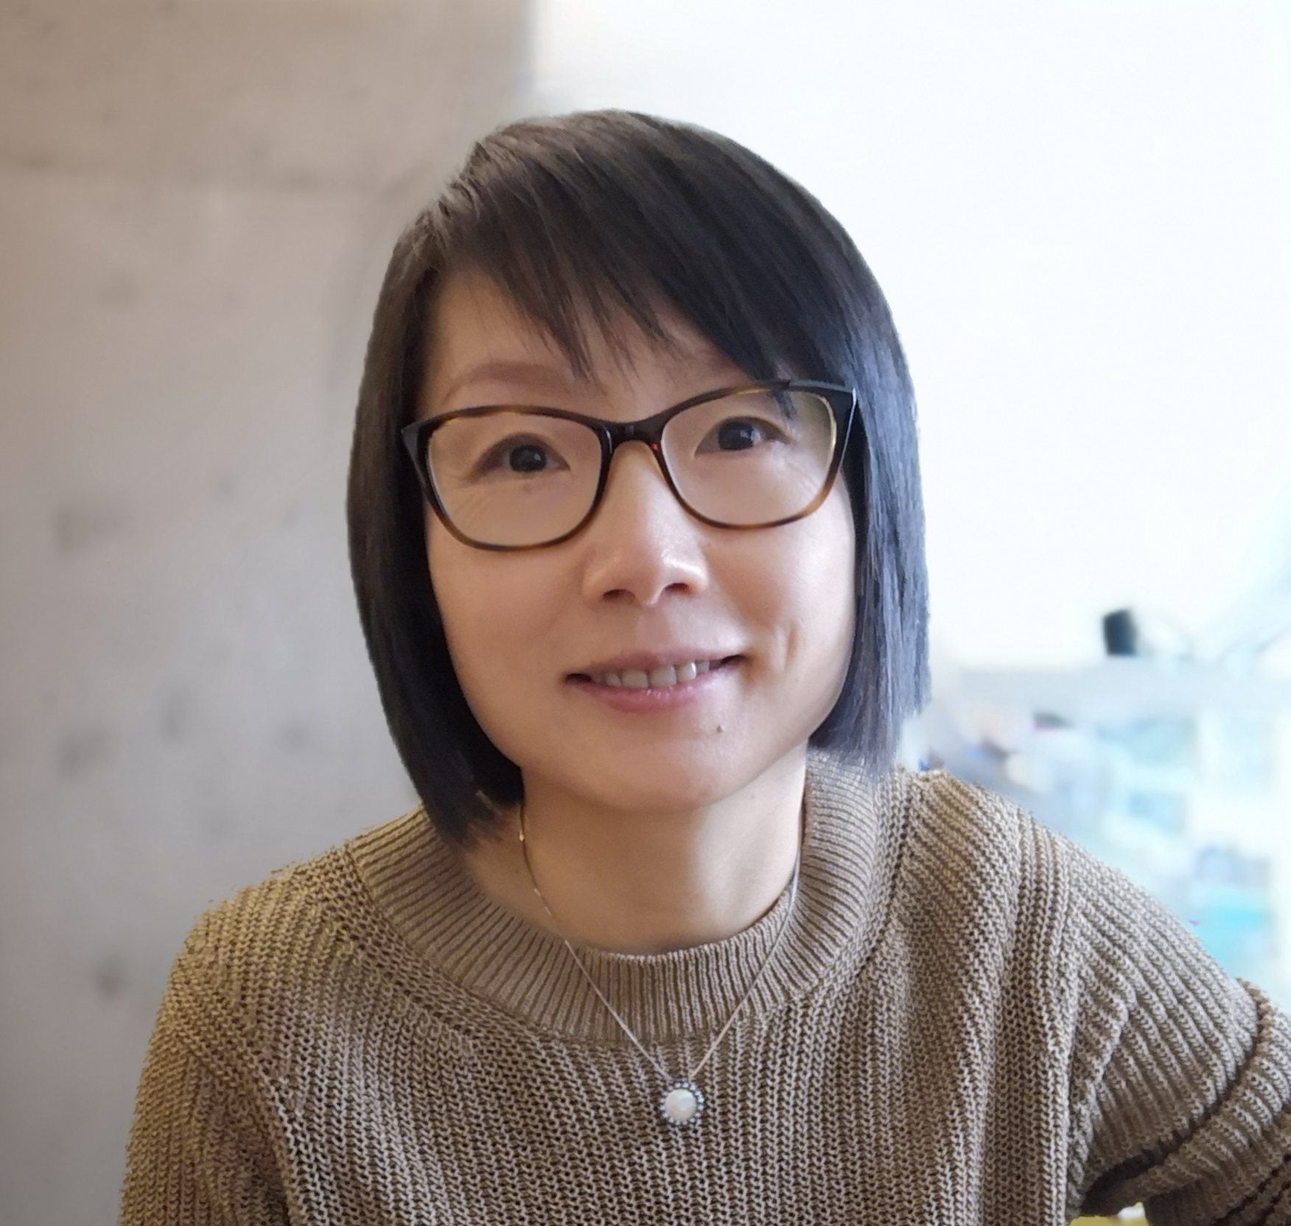
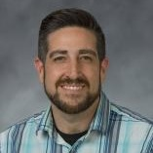
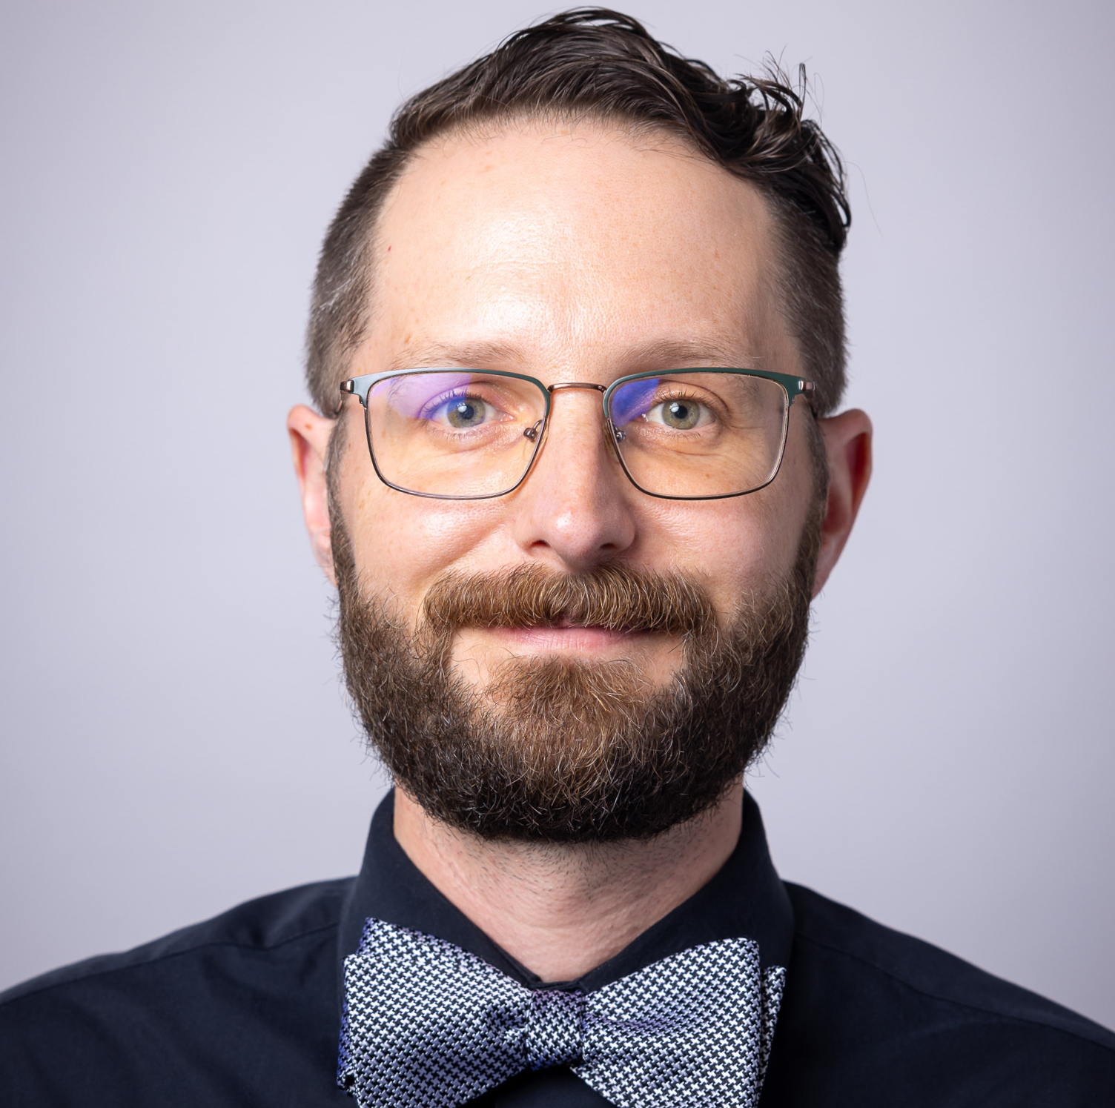
Li, Cribbs, Ward, & Gardner, eCAUG 2024
CONTACT US
CAN LI
Discovery & Systems Librarian
J. Paul Leonard Library
cli05@sfsu.edu
HEATHER L. CRIBBS
Systems Librarian
University Library
heather.cribbs@csun.edu
CHRISTIAN WARD
Web Developer
University Library
wardc@csus.edu
GABRIEL J. GARDNER
Assistant Director, Technical Services
University Library
gabriel.gardner@csulb.edu
Notes:
Speakers: ALL
Heather's intro:
Hello everyone! I’m Heather L. Cribbs, the new Systems Librarian at California State University, Northridge.
I recently joined CSUN in September, bringing with me over seven years of experience with Ex Libris products from my time at CSUB and Cal Poly, SLO.

