Slide 1
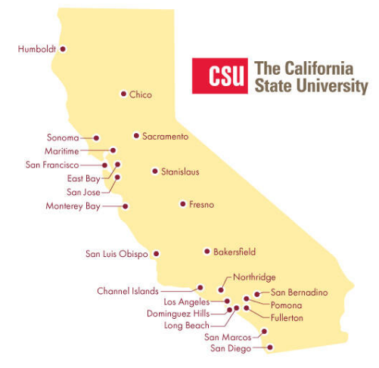
November 7, 2024 Technical Services Open Forum
Notes:
Welcome to the November 7, 2024 edition of the Technical Services Open Forum: eCAUG conference edition.
For those of you that it is your first time at the Technical Services Open Forum, welcome, and we are glad to have you here. I am Christina Hennessey, director of the unified library management system or ULMS for the California State University system, and I am your host for today. We meet normally once a month on Zoom, 3rd Thursday of the month at 11am-noon, but I wanted to have a wrap-up meeting about the eCAUG conference while the ideas were still fresh and November 21 was just too far away, so we will have two meetings this month.
The meeting is always recorded and posted shortly after the meeting and is always optional.
All the pictures in this presentation are either from the Long Beach area, where eCAUG was held, or from the eCAUG conference itself. All the photos are mine except for the Dark Harbor ones, thank you Chris Lee for the photos!

Slide 2
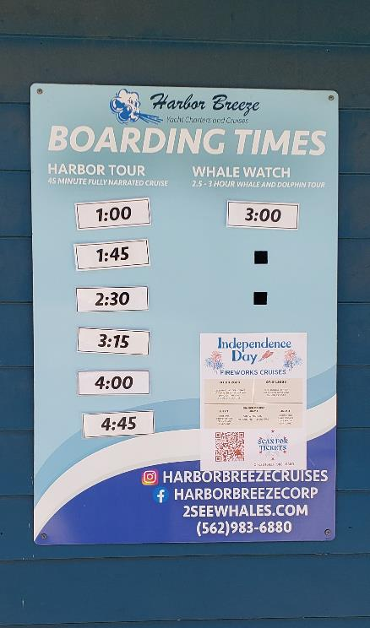
Today’s agenda
Announcements from me
Announcements from all of you!
Updates from Jessica
eCAUG conference wrap-up
Hang out
Notes:
Here’s the agenda for today.
I have several non-eCAUG-related announcements to pass on to you that people have sent to me
Then I’ll call for any CSU library-related announcements not on the agenda, as usual. Please speak up if you have something to share!
Jessica has a few updates on CDI linking and the Ex Libris Support Advisory Group that she would like to share
Then the focus of the meeting – the eCAUG conference wrap-up and discussions. I hope some of our board members, planners, our presenters, and attendees will share some of what they learned or found out, or would like to know more about.
After the hour, we’ll turn the recording off, we can hang out and talk about library work, and what’s going at your campuses.

Slide 3
Announcements from me: non-eCAUG
Chris’ presentation on Nov 19 10am-11am
Registration
Currently 149 libraries in Rapido
Reminder of ELUNA document repository
ELUNA Learns continues
Notes:
First, here are some general announcements from me that I want to share. Thanks to those of you that sent me these ideas/announcements in advance to share.
Chris Lee of the CO is doing a presentation on November 19 for Ex Libris with the title: CSU’s journey to unifying 24 campus libraries with one resource sharing system.
Here’s the description:
Juggling multiple systems for resource sharing across a library network can feel like an uphill battle. Join us for a webinar where the California State University (CSU) system reveals its journey and future plans for unifying 24 campus libraries under a single platform, Rapido. In this webinar, you’ll learn: - How CSU are bringing their campus libraries together under one resource sharing system with Rapido - Their approach to managing both physical and digital ILL requests in one system - How they are working to ensure effective staff adoption of the new system - CSU’s future plans for improving their resource sharing services Yes, we are CSU and this is us and you already lived through this. A couple reasons you might want to attend this:
To see Chris show off the wonder of the CSU
You’ll see your own work by your libraries in here and you should be proud
Might be so involved in the day-to-day and forgot how much we accomplished, also you’ll hear more about the future plans for the CSU here
4. Maybe you are new or new to your role and you don’t know the Rapido story with the CSU, here’s where you can get the basics.
Chris – do you have more to add?
I will send out the registration link with the recording.
I also wanted to note here that there are currently 149 libraries in Rapido, this number is going up all the time, thanks to the work of Chris and many of you.
Two more ELUNA items –
A reminder of the ELUNA document
I received a question last week about the ELUNA document repository: https://documents.el-una.org/. This website has most? all? of the documents from recent ELUNA conferences and ELUNA Learns. Sometimes it takes a while for them to be posted, but then they are there. It's a great way to find out what practical presentations have been done on a particular topic.
There is the same login for everyone, all ELUNA members at every site. I will send it out with the email with the recording but will not share it here. Once you get it, don't put this on a public website or the wiki but you can share it on intranet, SharePoint, email, whatever. It is the logon for all ELUNA members, which you all are through the consortial membership.
2. A reminder that we are deep in the ELUNA Learns season, these are every Wednesday from 10am-1pm, free to you as ELUNA consortial members.
Even if you can’t attend live, they will send you the recording pretty quickly after the session. Many of these are repeats of things that were presented at ELUNA and IGeLU but with updated information.

Slide 4
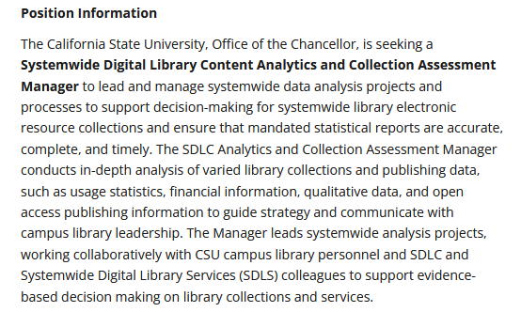
CSU library-related jobs
Katie’s sabbatical fill-in for Spring 2025 at Moss Landing
Apply by November 15
SDLC Analytics & Collections Manager at CSUCO
Apply soon
Notes:
I know we have a few jobs available at our CSU libraries and I don’t necessarily want to turn this into a job board but I did have two relevant positions I wanted to promote here that are timely and related to your work.
First. I have mentioned in previous TS Open Forums that Katie Lage at Moss Landing, who is a solo librarian at that institution, is going on sabbatical in Spring 2025 and that they will be hiring for a temporary replacement.
Here is the job posting for that which you can read at your leisure later
In short, it is a temporary librarian position that where you can get paid on top of your regular salary by working for them 10 hours a week for the spring semester, mostly remote
Not just systems, reference and instruction as well.
Also, I know it’s a little confusing as Moss Landing does a lot of their work through San Jose State…but this is a Moss Landing position.
If you are interested in this job, please apply by Friday, November 15, that is in 8 days.
*
The other job I want to mention is the SDLC Analytics & Collections Manager.
If you attended the Analytics open forum yesterday, you heard this from me but we want to promote it whenever we can.
Ying Liu who worked in the CO retired this summer
Retooled position, a lot more about stats, and data viz and in interpreting data and communicating it out in a way people would understand.
Show the job description
“systemwide analysis projects” is a phrase I really like in the description
Also “support evidence-based decision making on library collections and services”
It is an MPP position, it says Manager in it but it is manager of analytics and collections for the CO and not people
Reporting to Ann Roll in the Systemwide Digital Library Content or SDLC department, working with Kirstie and Ann and Lisa. Part of my larger Academic Technology Services department at the CO.
It is an open-until-filled positions but please apply soon.
Please spread the word to colleagues and friends that might be interested…
Reminder that this person does not need library experience, getting stats and communication and sharing with COLD and others is most important
Not necessarily even Alma and/or Primo Analytics experience, are you interested in assessment, saving libraries and the CSU money overall, doing charts and graphs, and so on.
I am on the hiring committee but it is okay if you contact me if you have questions about working at the CO, in this department, and more about the position in general.

Slide 5
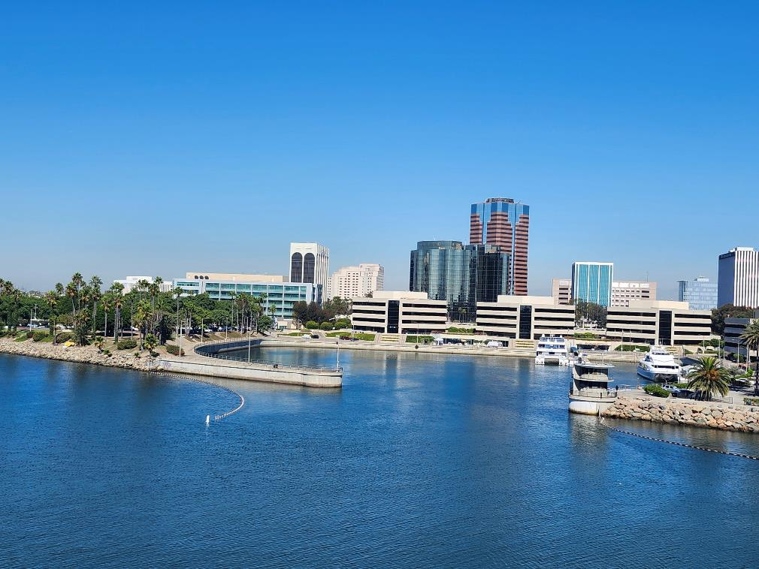
Your announcements
Notes:
So now I want to open this up to your timely announcements, this is your time to speak and share!
This is indeed a picture of Long Beach!

Slide 6
Updates from Jessica
CDI linking changes
Updates from Ex Libris Support Advisory Group, especially Known Issues application
Notes:
Next up, Jessica wanted to give a few updates on CDI linking changes, and some updates from the Ex Libris Support Advisory Group, or SAG, especially in relation to the Known Issues portal or application and the Defect Cleanup Project.
Take it away, Jessica!

Slide 7
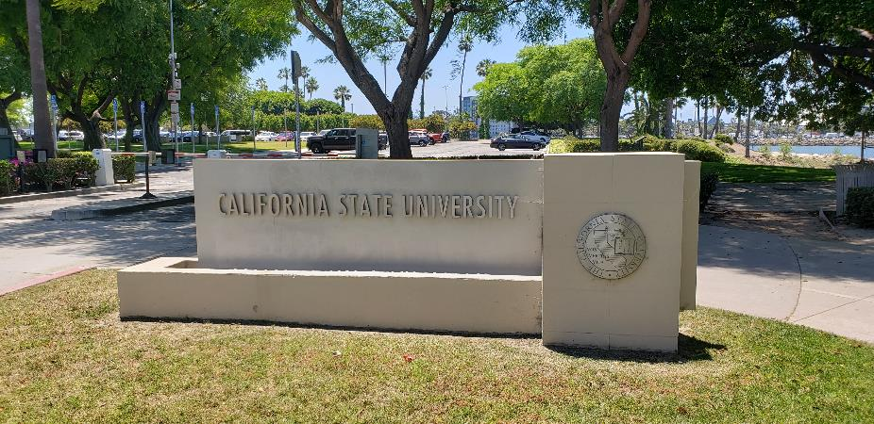
eCAUG conference wrap-up: stats
Was held at Long Beach at the Chancellor’s Office
October 24-25, 2024
Less expensive than ELUNA/Atlanta 2025
116 attendees registered
48 CSU
27 UCs
21 Community Colleges
Other California Ex Libris libraries
7 Ex Libris/Clarivate
Notes:
Now we’ll get into the meat of today’s session, a wrap-up on the eCAUG conference.
Some context
Held at Long Beach at the Chancellor’s Office, seen here in this picture
It was just held October 24 and 25, just two weeks ago!
Even though the conference was just two weeks ago, a lot has happened since then! Halloween! Dodgers won the World Series! Earthquakes, winds, fires. And there was the election and election results. But please think back to two weeks ago if you can to share with others that could not attend the conference.
The hope for these regional ELUNA conferences is that it is much cheaper to attend than something like ELUNA in Atlanta next year, and the committee did a great job of keeping it less expensive, at least the part they could control.
And here are the approximate stats on registrants, the committee did a great job of reaching out before the conference to make sure people were actually attending, which kept the numbers of registrants about the same as those that attended.
116 attendees
48 CSU
27 Ucs
21 from the community colleges
Others from other California Ex Libris libraries
And 7 from Ex Libris/Clarivate

Slide 8
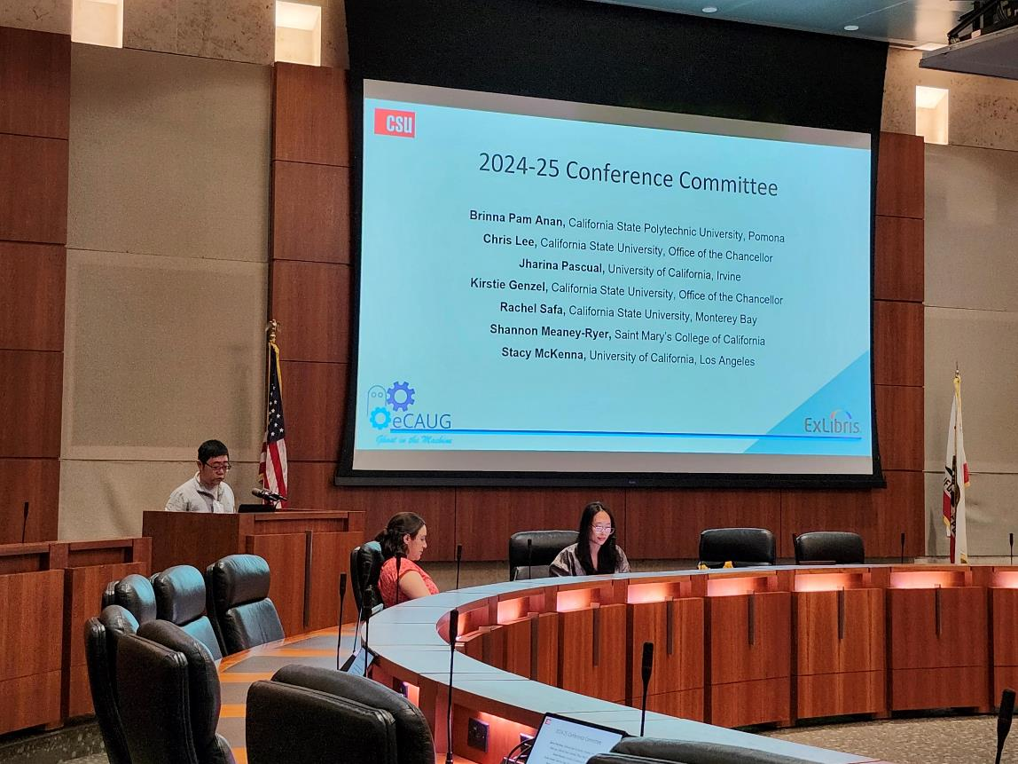
CSU contributions: Executive Board
Greta Heng (SDSU) (Vice-Chair)
Jill Strykowski (SJSU)(Secretary/Treasurer)
Notes:
Lots of people from all over California and our vendors helped out with this conference, but I wanted to acknowledge our CSU folks
First, our elected eCAUG Board members: Greta Heng from San Diego State was the vice-chair, I believe that makes her the chair next year.
Greta was the amazing organizer behind the awesome schedule of presenters, it was really well-done with a good balance of topics and Ex Libris institutions.
Greta had to leave for another meeting at 11:15am but she passed along her comments for the meeting already
Jill Strykowski was the secretary/treasurer, which meant things like working through planning a conference when you have a small budget and no bank account. But she figured it out!
We’ll hear from Jill shortly about what is coming next.

Slide 9
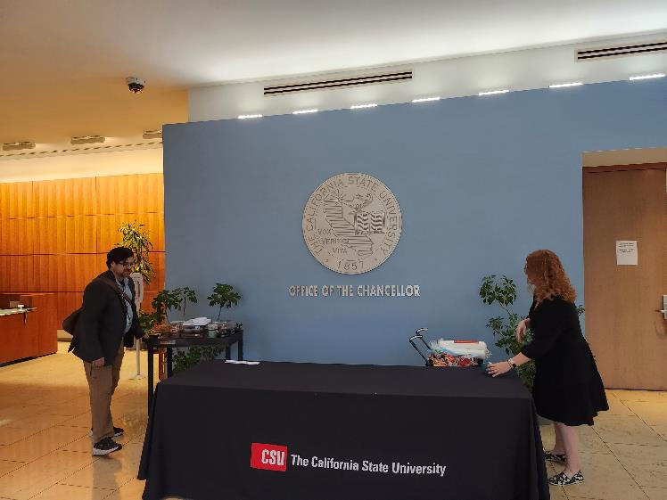
CSU contributions: planning/hosting
Conference committee: Kirstie Genzel (CO), Christopher Lee (CO), Pam Anan (CPP), Rachel Safa (CSUMB)
Other hosting help: David Walker (CO), Ann Roll (CO), Leslie Kennedy (CO), me (CO), CO facilities & IT
Notes:
There were also CSU folks that were part of the planning and logistic committees: Kirstie, Chris, Pam, and Rachel.
And also our hosts at the CO, my co-workers David, Ann, a special thanks to David’s boss Leslie Kennedy (she is an Assistant Vice Chancellor at the CO and the head of Academic Technology Services), she was instrumental in us getting approval to have a conference at the CO despite there being new rules discouraging hosting, this conference almost didn’t happen in person at the last minute and she was able to get us a special exception to host this meeting. Then there was also me, I stood in the parking lot and said hello and badged you in. Also a shoutout to the facilities & IT folks at the CO that were so helpful in us putting on the conference at the CO. I don’t think they are in this meeting but I still want to put a thanks to them on this recording as well.

Slide 10
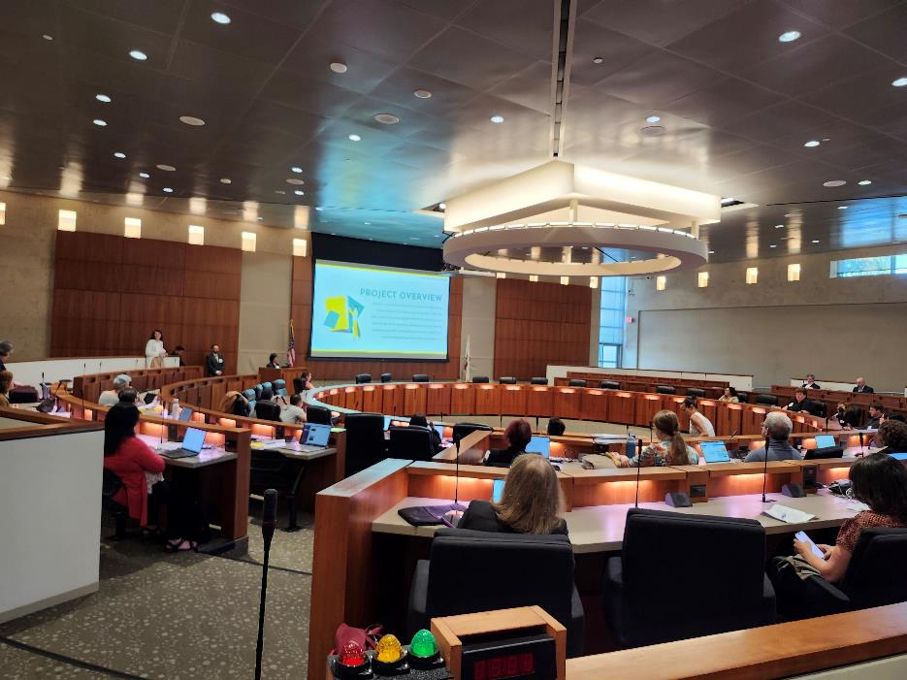
CSU contributions: presenters
Christopher Lee (CO), Michelle Navarro (CPP), Catrina Mancha (CSUSB), Pam Anan (CPP), Greta Heng (SDSU), Allison Bailund (SDSU), Can Li (SFSU), Heather Cribbs (CSUN), Christian Ward (Sacramento), Gabriel Gardner (CSULB), Connor Franklin Rey (SDSU), Jill Strykowski (SJSU), Stacy Caron (Fullerton), Kirstie Genzel (CO), Austin Lenzen (CSULB), Jessica Hartwigsen (CO), Caitlin Wilhelm (CSULA), Chris Acosta (SJSU)
Notes:
Finally, it’s not really a conference without presenters. We had a LOT from the CSU, here they all are, some of them presented more than once!
They are listed here in order of appearance on the program.
In all across the board and planning committees and presenters – we had contributions from 11 different CSU libraries and 1 CO, from all over the state. Thank you!

Slide 11
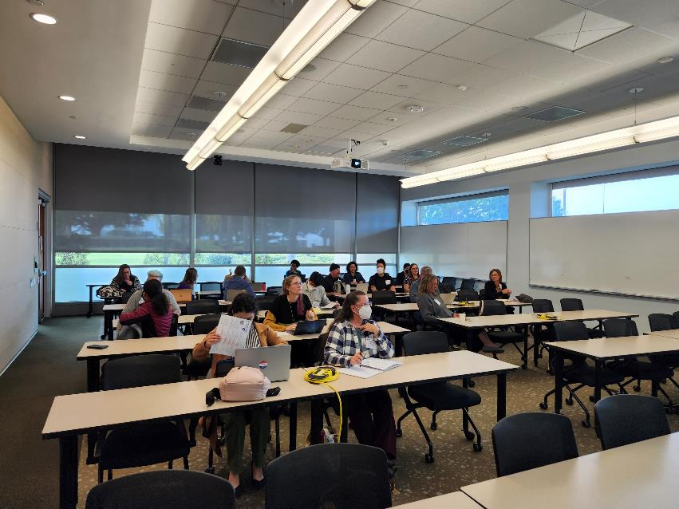
eCAUG conference: overall structure
No-AI Day and AI Day
Ex Libris presentations: roadmap, AI, new products, Provider Zone, metadata enrichment through AI, Rapido
Library presentations
Troubleshooting sessions: help from library and Ex Libris folks
Lightning Talks
Notes:
So for those that did not get to attend, here’s a bit about the structure for the 2-day conference
As we heard at the ELUNA conference in Minnesota back in May, a lot of people are kind of sick of hearing about AI but it is hard to avoid. So there was a No-AI Day on Thursday, and then an AI day on Friday. Although there was still some discussion and mention of AI on no-AI Day, it was hard to avoid
As I mentioned, there were several Ex Libris folks there, they were a big sponsor for keeping the conference registration free. So they presented on their roadmap, AI, some new products, the Provider Zone, the metadata enrichment through AI projects, and Rapido. We’ve presented on many of these topics at past TS Open Forums and they also have presented in many webinars over the last year, but it was great to have it all in one place and summary., and you may have new questions about what you saw/heard.
Then the core of the meeting were the presentations by many of you and our library colleagues across California
There were also troubleshooting sessions, I worked one of those and thought it went well, people from all the institutions brought their pointed questions to various feature and product experts. I was doing Analytics and had some pointed Analytics questions, it is always fun to see others’ Analytics reports in other institutions. We also found that when we were helping someone with their issue, others liked to listen and learn as well.
And there were lightning talks, I did not get to attend any of those as I was needed in other sessions so maybe someone else can talk about those, those looked like interesting topics.

Slide 12
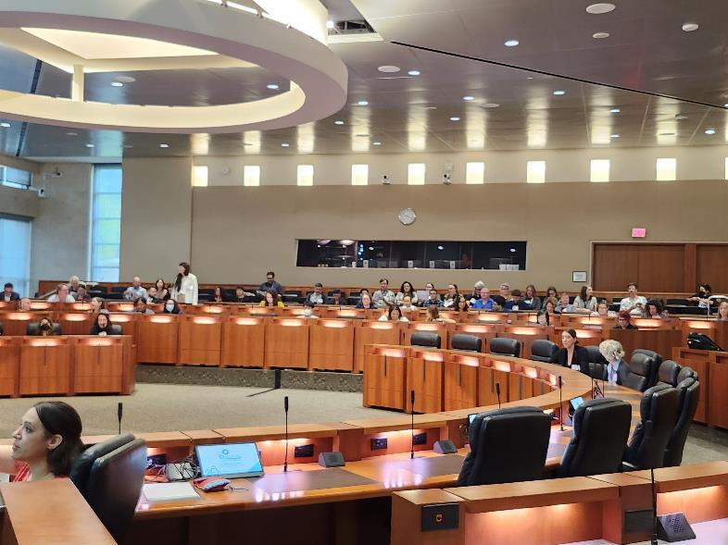
eCAUG presentation topics: part 1
Presentations from libraries on:
Discovery settings: harmful language, ranked configuration
Resource Management: BIBFRAME->Alma, Automating Post-Migration Cleanup of Serial Holdings
Acquisitions/Collection Development: SUSHI, Rialto
Resource Sharing: Rapido, ILLiad->Rapido, new partners
Alma Letters
Notes:
Among our library presentations, here are some of the topics covered:
Discovery settings: harmful language, ranked configuration (more on this shortly)
Resource Management: BIBFRAME->Alma, Automating Post-Migration Cleanup of Serial Holdings
Acquisitions/Collection Development: SUSHI, Rialto
Resource Sharing: Rapido, ILLiad->Rapido, new partners
Alma Letters

Slide 13
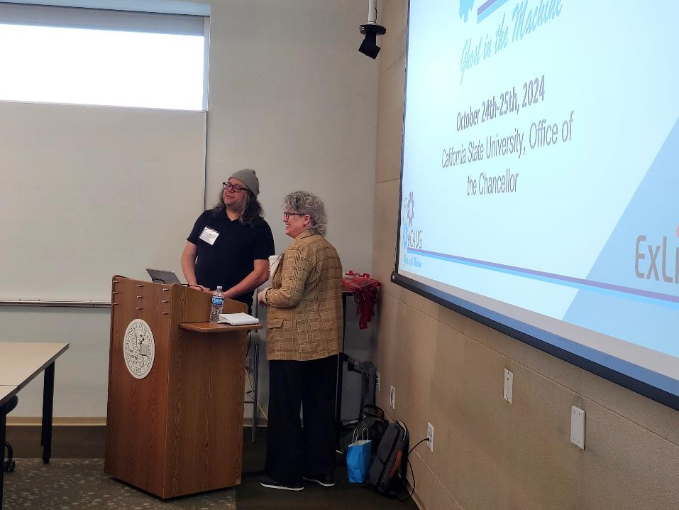
eCAUG presentation topics: part 2
Presentations from libraries on:
Alma reading rooms
Documentation & succession planning
API Key Management
ERM training
Leganto
Excel Tips
Full schedule
Notes:
Here are more of the topics covered by libraries:
Alma reading rooms
Documentation & succession planning
API Key Management
ERM training
Leganto
Excel Tips
I’ll be sharing a link to all the slides later in the presentation, so if you were not in attendance, and you see something that interests you, you can still get in on the fun.

Slide 14
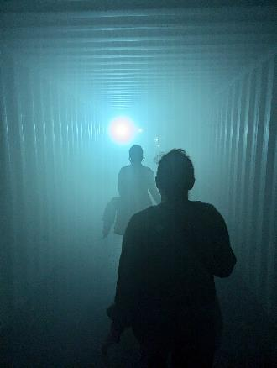
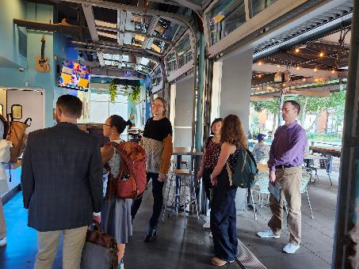
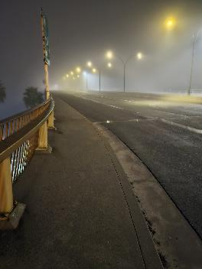
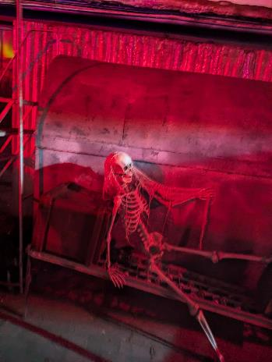
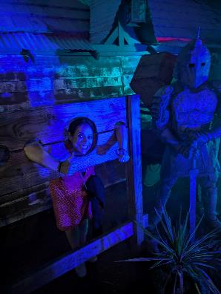
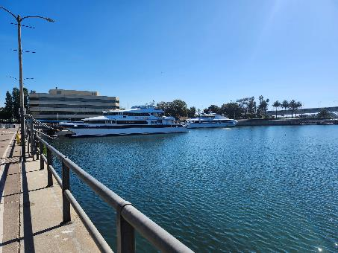
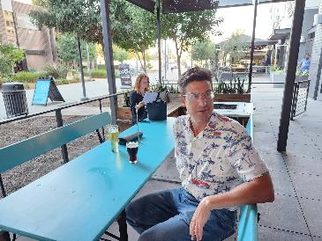
We had fun
Notes:
As with any conference, we also had fun.
Some folks went to Dark Harbor, which is a Halloween event in Long Beach on the Queen Mary, within walking distance of the CO
Some folks went to a local brewery together
Lots of mingling and getting to know our colleagues

Slide 15
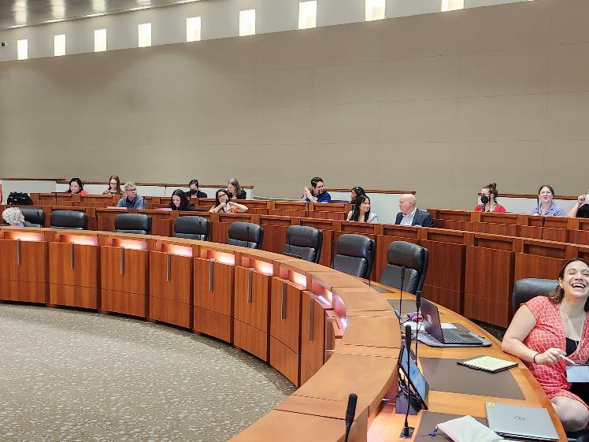
eCAUG leadership: Greta & Jill
2025 conference: Probably earlier in the year
If you attended, please fill out survey by November 21 to help with planning for the 2025 eCAUG conference: https://docs.google.com/forms/d/e/1FAIpQLSfDzd09dmWq7vu6Im6HK4QD74PKA0dTQX5xhRlfnZkoYwt4lA/viewform
All presentations can be found here once the presenter gives permission: https://sites.google.com/view/ecaug/2024-ecaug-conference/session-details
Current leadership will be meeting soon to work on planning for next year
Run for office or join the planning committees!
Notes:
2025 conference: Probably earlier in the year
October dates were what was available in CO from July – November
If you attended, please fill out survey by November 21 to help with planning for the 2025 eCAUG conference
All presentations can be found here once the presenter gives permission (show this site)
Current leadership will be meeting soon to work on planning for next year
Run for office or join the planning committees!
Do Greta and/or Jill have anything they want to add about the conference planning, recruiting for next year, plans for next year?
As Greta will become the chair, there will be an opening for vice-chair
Looking likely that community colleges will host next year, not sure which campus, maybe Sacramento.
Then maybe USC. This might turn into a round robin of hosting: UC, CSU, Comm Colleges, then other schools.

Slide 16
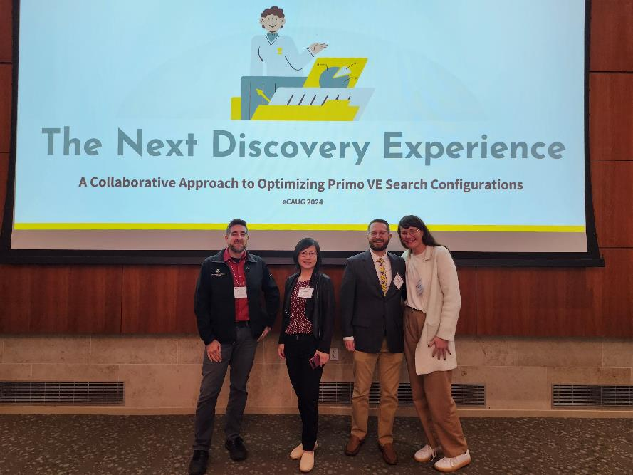
Discussion/information on Discovery settings
Scopes
Search profiles
Boosting
Ranking configuration
They are looking for contributors, testers
Notes:
First, I wanted to toss to the quartet of Heather, Gabe, Can, and Christian – I think maybe only Gabe and Heather are here as the others had conflicts
They can give a bit of a summary about their research
And they had a call to action of information they might like from you all in the coming months.
They have their own slides for this, put together by Heather
Christian will speak

Slide 17
Gov docs discussion
Discussion on general gov docs
Discussion on California gov docs
Shared experience from other libraries
Link to interest survey
Notes:
Next up, Jill Strykowski led a spirited discussion on gov docs at eCAUG
Including talking about general gov docs, working on a California gov docs collection
We heard about experience from other non-CSU libraries that was informative
Jill has started an interest survey on this
I’ll let Jill give you a summary and what she’d like to do next

Slide 18
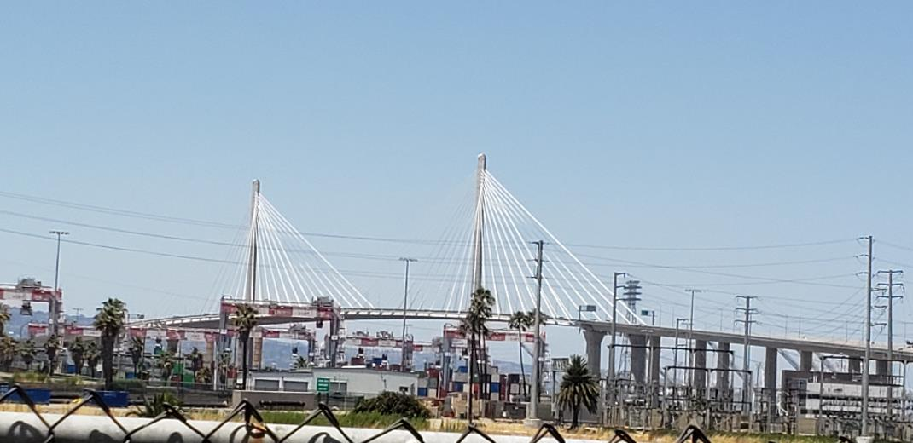
eCAUG open discussion, what you learned/attended?
Interesting ideas from other libraries?
Interest in new Ex Libris products
Being a development partner
What else?

Slide 19
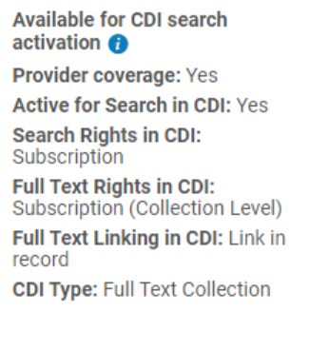
Next regular meeting!
Thursday, November 21,11am-noon
Topics: CDI activation in relation to Rapido, CSUBuy
One week before Thanksgiving
Notes:
Coming up in two weeks! Our next meeting will be November 21, 11am-noon.
First, we’ll have something from Kirstie Genzel at the CO:
"Kirstie Genzel (CO) will give a refresher and some new knowledge on how CDI activations (or lack thereof) may impact Rapido requesting via OneSearch. It has been over three years since the CSUs moved to Primo VE and CDI, and over two years since we started with Rapido. With new configurations being added each month, it is a lot to keep up with. Kirstie will review some settings in your Alma CDI configurations that can help improve your library's ability to take full advantage of Rapido. This presentation will be useful for folks working with ERM, Discovery, and Resource Sharing in the CSU Libraries.“
She’s going to keep it very high level, and relatively short and sweet. It's mainly going to be a PSA type of thing to encourage all these groups (Discovery, ERM, and ILL) to talk to each other and come up with a coordinated approach to activating (or not activating) CDI collections for discovery in OneSearch, and what the implications of those decisions might be on Rapido.
She might show a few actual settings in Alma (like how to activate a collection for CDI search from the CZ), but the ERM Committee will do the deep dive into the nitty gritty of the CDI settings (and corresponding display logic rules) in their follow up ERM Open Forum on Dec 6th a few weeks later.
She’s not planning on talking about the Search Scopes or any Primo settings at all, just CDI (which is controlled in the Alma Electronic Collections, not actually in a configuration area anymore), but we can refer to Chris's presentation from a few months ago on the search scopes.
After that, we’ll have a discussion about CSUBuy in relation to Alma and libraries
All CSU campuses will eventually be adopting CSUBuy Procure-to-Pay (P2P) for procurement solutions. Some of our libraries and campuses have already been impacted. There are 4-8 libraries that have done something with CSUBuy so far and they will share some of the best practices they have discovered so far in relation to libraries, Alma, workarounds, and issues they have run into. This will be an informal discussion for folks to share and ask and answer questions.

Slide 20
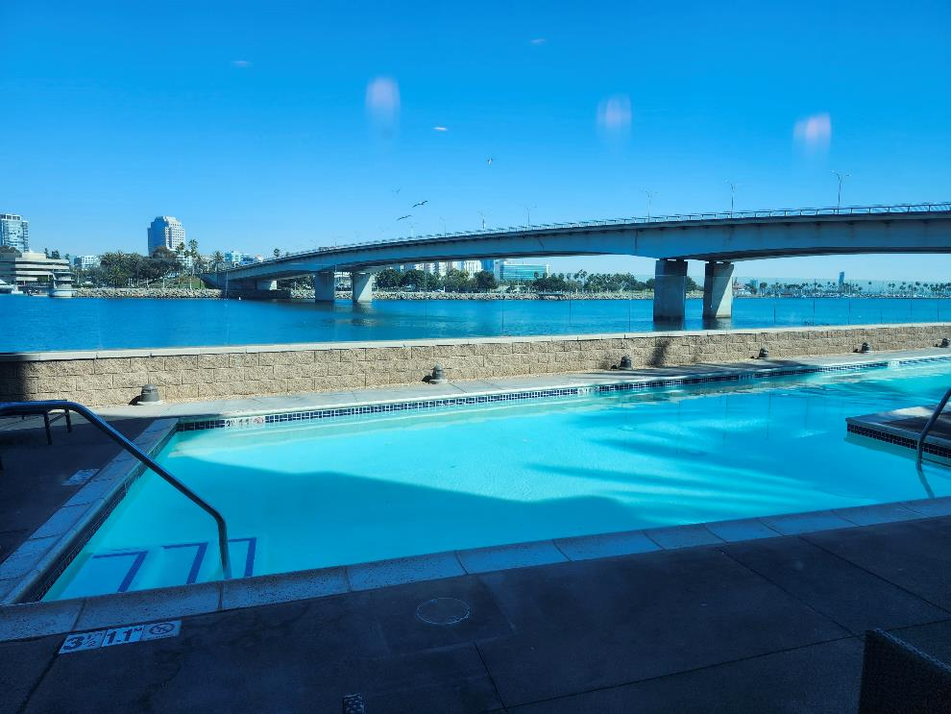
Thanks for attending!
Recording will be available & posted later this week
You are welcome to hang out until 1pm (recording off)
Notes:
Thanks for attending
* Recording for this meeting will be available & posted later today or early tomorrow morning. I am out of the office tomorrow so it will be one of those!
You are welcome to hang out until 1pm (recording off). Thank you for coming!

