Slide 1
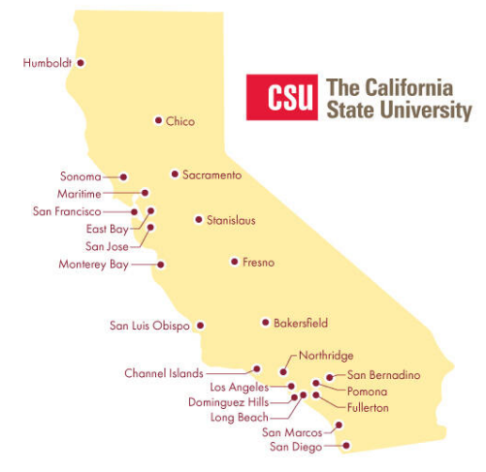
November 21, 2024 Technical Services Open Forum
Notes:
Welcome to the November 21, 2024 edition of the Technical Services Open Forum: Thanksgiving edition
For those of you that it is your first time at the Technical Services Open Forum, welcome, and we are glad to have you here. I am Christina Hennessey, director of the unified library management system or ULMS for the California State University system, and I am your host for today. We meet normally once a month on Zoom, 3rd Thursday of the month at 11am-noon.
The meeting is always recorded and posted shortly after the meeting and is always optional.
All the pictures in the presentation this week are of Thanksgiving-related things.

Slide 2
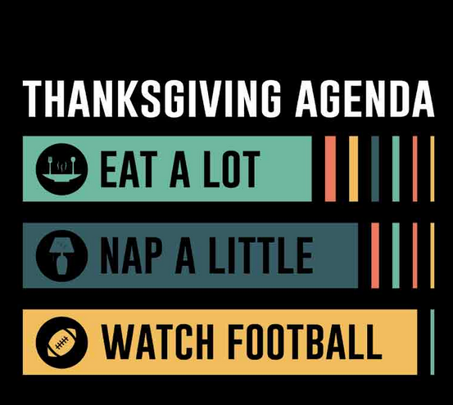
Today’s agenda
Announcements from all of you!
How CDI activations impact Rapido/OneSearch
CRDP->Collection Mgr for federal gov docs
CSU Libraries wiki plans
CSUBuy in relation to libraries
Hang out
https://atlantavinylstore.com/products/thanksgiving-agenda-dtf-transfer
Notes:
Here’s the agenda for today.
I normally have a lot of announcements I like to share with you in relation to the ULMS - we have a very full agenda today so I’ll send my announcements in the email with the recording. I did already send some Alma and Primo feature updates yesterday.
* So first we’ll have any CSU library-related announcements not on the agenda, as usual. Please speak up if you have something to share!
Kirstie Genzel of the CO will give an introduction on how CDI activations (or lack thereof) may impact Rapido requesting via OneSearch. This is mainly a lead-in to what she will be sharing in greater details at the ERM Open Forum on December 6 at 10am, the invite for that went out this morning on the techservices listserv.
The CRDP and MARCIVE services for government documents will no longer be supported by the end of 2024. Luiz Mendes of Northridge and the Network Zone Management Group & Marcus Jun of SFSU will present the plan on moving from CRDP->Collection Manager for federal gov docs and answer questions
David Walker of the CO has a presentation about the upcoming plans for the CSU Libraries wiki
Then we will talk about CSUBuy in relation to libraries and Alma discussions
After the hour, we’ll turn the recording off, we can hang out and talk about library work, and what’s going at your campuses.

Slide 3
Your announcements
Notes:
So now I want to open this up to your timely announcements, this is your time to speak and share!

Slide 4
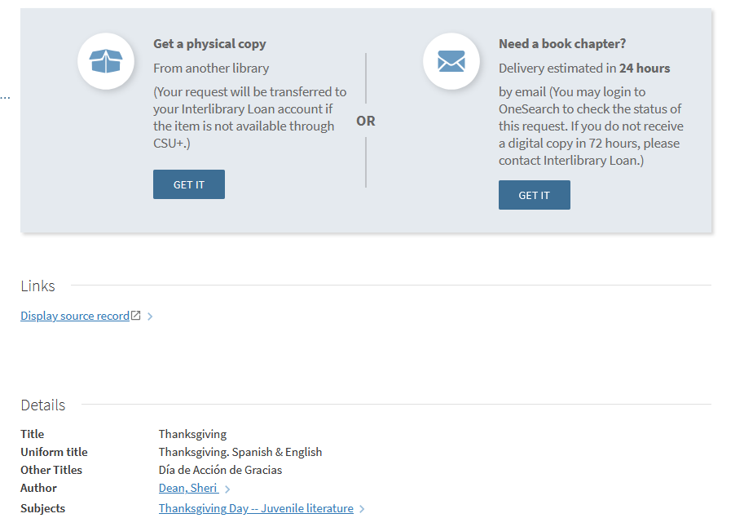
CDI activation –Rapido - OneSearch
Notes:
Next up: Kirstie Genzel of the CO will give an quick introduction and a demo of how CDI activations (or lack thereof) may impact Rapido requesting via OneSearch
Take it away, Kirstie

Slide 5
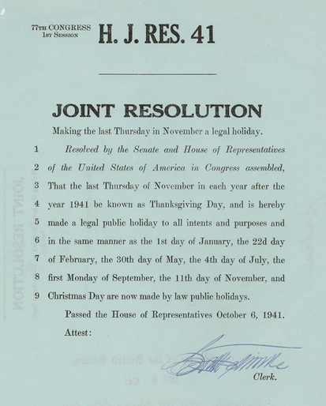
CRDP -> Collection Manager update
Notes:
Next up: Luiz Mendes of Northridge and the Network Zone Management Group & Marcus Jun of SFSU will present the plans and share a F.A.Q. on moving from CRDP->Collection Manager for federal gov docs.
Take it away, Luiz and Marcus.

Slide 6
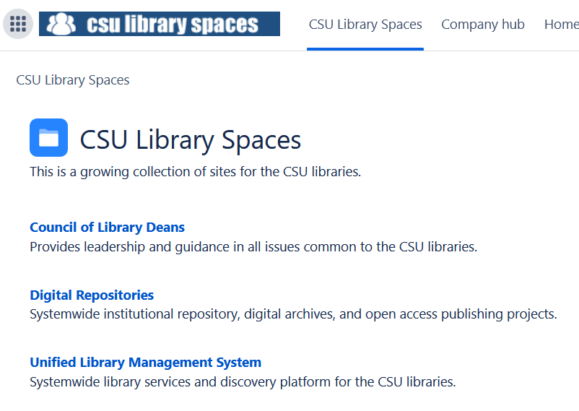
CSU Libraries wiki plans
Notes:
Next up: David Walker of the CO has a presentation about the upcoming plans for the CSU Libraries wiki and then there will be some time for questions.
Please go ahead, David.

Slide 7
CSUBuy, Alma, and CSU Libraries
Notes:
Our final topic of today will be more of an open discussion. We’ve seen some discussion on some of the library listservs, not just the ULMS ones, about the adoption of CSUBuy on CSU campuses and libraries.
A few libraries asked me to host an informal discussion of how the libraries are handling CSUBuy.
I do want to add the caveat that I am not the official voice of CSUBuy for the CO, neither are my colleagues in SDLC or SDLS. I’m just hosting this discussion area so we can share what we all know so far. Thank you to the ULMS Acquisitions Task Force with your help in guiding this discussion and for all the libraries that sent me input for today.
The very, very short explanation of CSUBuy, if you are not familiar with the term or project is:
A streamlined procurement and payment process
Leading to improved data for decision-making, enabling the CSU to better identify shared suppliers and leverage negotiating power to drive cost savings. Much like what we do with many of our library resources when we work together.
You may have also heard this referred to as P2P or procure-2-pay.
I have not actually been able to get official numbers on how many libraries and/or campuses have adopted CSUBuy. I have seen numbers somewhere between 4 and 8 libraries. I believe the plan is to officially move all CSU campuses to this process. One thing we hope to be able to track is what campuses have moved, others that are moving, and what common issues you have and workarounds. We have a lot of the same vendors, which would be a burden on the first campuses to move but should be easier (we hope) for those to come later in the process.
I reached out for some input for this session a week or two ago in email to several people, and here’s a little bit about what I heard. I am sure I am missing some data on this so I appreciate any information you can add.

Slide 8
Next regular meeting!
Thursday, December 19,11am-noon
A few days before holiday break!
Topics:
More wiki updates
California shared gov docs
Best practices for SalesForce
Notes:
This is a reminder that our next meeting, for now, will be December 19, 11am-noon. Some of you will have already left for the holidays but we will record as always.
I’m still looking for topics for December 19 –
Topics that might be in the works:
More updates on the Confluence to SharePoint and Drupal migration for the CSU Libraries wiki pages
An update from Jill @ SJSU on her California shared gov docs collection work, she has been working with other libraries in the state to try to make this happen, continuing her work talked about at eCAUG
Perhaps a best practices in SalesForce refresher, we want to continue to empower campuses to open their own cases and not necessarily have to wait for the CO to do it, so we might talk about that
That’s not enough for an hour, please contact me anytime with ideas, like people did with the CSUBuy conversation, this meeting is here for you and hopefully saves you the trouble of organizing a meeting yourself.

Slide 9
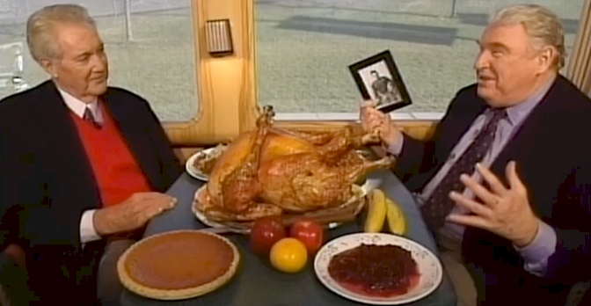
Thanks for attending!
Recording will be available & posted later this week
You are welcome to hang out until 1pm (recording off)
Notes:
Thanks for attending
* Recording for this meeting will be available & posted later today or tomorrow.
You are welcome to hang out until 1pm (recording off), we can talk like Pat Summerall and John Madden over a turducken.

