Slide 1
Empowering Staff: Taking control of Your Rapido Instance
Christopher Lee
Notes:
Hello I-SPIE! I would also like to welcome everyone to the 2023 I-SPIE conference! It has been years since we have been able to get together in person and I hope you are all having a good time so far. For the first traditional presentation of the day, I want to start things out on a hopeful and positive note to get us all energized. I want to talk about how staff can get the necessary roles to take control of your Rapido instance to customize the system to your specific needs.

Slide 2
Rapido or ILLiad?
Things I have heard from multiple staff:
There is so much ILLiad can do
ILLiad is very complicated
Rapido is very complicated
ILLiad is easier to use
Rapido is easier to use
I just want everything in one system
Notes:
I have had many conversations with staff both on Zoom and in person over the last year and there are some consistent but competing comments I often hear from staff.
Some staff will say there are so many things ILLiad can do, that Rapido can’t.
I’ve heard staff say ILLiad is too complicated, and they prefer Rapido.
Other staff will say Rapido is too complicated, and they miss ILLiad.
Some will say ILLiad is easier to use.
While others will say Rapido is
But people in both camps have remarked that they ultimately want to just use one system.
Now I have noticed a trend with these comments. Staff who prefer ILLiad and see it as easier to use are people who were masters of their ILLiad instances and know it inside and out.
Newer staff who are learning both systems tend to prefer to use Rapido and see it as easier and more intuitive to use.
Now I can see both sides to this because…

Slide 3
Rapido Can feel…
Complicated
Notes:
Rapido can feel
Click
Complicated

Slide 4
How so?
Borrowing Workflows
Processing mediated requests
Processing Copyright
Receiving items
Printing
Returning
Lending Workflows
Printing
Pulling
Shipping
Fixing locate fails
Configuration
Sets
Borrowing Mediation Rules
Borrowing Copyright Rules
Labels (in Rapido)
Labels (Discovery in Primo)
Letters (Printed)
Letters (emailed)
Pods
Physical Items Lending Policies
Cloud Apps
High Level Configuration
Locate Settings
Lending Temporarily Off
Borrowing Temporarily Off
Contact Information
TOU
Notes:
In Rapido you have all your Borrowing and Lending workflows
Stuff like printing slips, processing requests, and processing copyright
Click
But you also have configurations such as Sets, Mediation rules, copyright rules, two different things called labels, letters, pods policies and cloud apps
Finally there are configurations for the Resource Sharing library such as locate settings and going non-lending while on vacation.
It is a lot of work

Slide 5
Thankfully…
Configurations do not need to be made daily
Most aren’t any more complicated than their equivalent in other systems.
Notes:
But thankfully the configuration part of that list is not a daily workflow
And in my opinion working in both Rapido and ILLiad, its not actually more complicated. What do I mean by that?

Slide 6
But ILLiad can also feel…
Complicated
Notes:
Well ILLiad can also feel
Complicated

Slide 7
How so?
Borrowing Workflows
Processing nearly all requests (unless using IDS and RapidILL)
Processing Copyright
Receiving items
Printing
Returning
Lending Workflows
Printing
Pulling
Shipping
Configuration
Custom Queues
Custom Holdings Paths
Routing Rules
Update printouts
Email Notifications
ILLiad Customization Manager
ILLiad Addons
Going Non-Lending
IFM Management
High Level Configuration
Z39 Integrations
PeopleSoft Integrations
NCIP to Alma
Notes:
You have the same or similar borrowing and lending workflows. Borrowing is likely unmediated so you may need to do more processing here.
And there are numerous complicated configurations that perform similar functions as Rapido. Custom Queues puts items meeting specific criteria in a group, and Rapido sets perform a similar function except that Items can be in multiple Sets simultaneously because Sets are a saved view and not a group of boxes.
Both have complicated ways of generating printouts. Both have third party addons or Cloud Apps.
But ILLiad does have IFM charging, which in my opinion runs counter to the purpose of libraries and can stay in older systems.

Slide 8
Why Does it Feel Less Complicated?
New staff have expressed that ILLiad feels more complicated
All configurations were done many years ago and maybe only need minor tweaks
You are already an expert in ILLiad
Notes:
But you all know this. You have been using ILLiad for a long time and Rapido for over a year.
As mentioned earlier, new staff often see ILLiad as more complicated.
This could be in part because ILLiad configurations were mostly done years ago and so they aren’t fresh in peoples memory. But I think the main reason is
Click
You are all already experts in ILLiad. Its easier because you not only know how to manipulate the system, you have the ability and are empowered to do so.

Slide 9
How Do I become an Expert in Rapido?
Notes:
So how do you become an expert in Rapido if you aren’t already?

Slide 10
Roles
Notes:
First you need to have the roles that give you the power to manipulate Rapido to your will

Slide 11
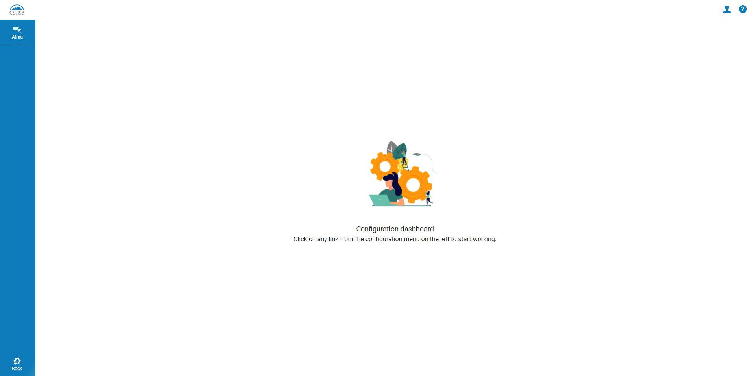
Roles
So EMPTY!
No Power!
Notes:
While working with staff I noticed many people see this screen when they go to Alma configurations. A white void of nothingness where you cannot do anything.
You cannot access the Resource Sharing configurations to create Borrowing mediation rules.
You cannot check or update your copyright rules
No updating letters
No configuring printing.
All the powers you had in ILLiad are nowhere to be seen.

Slide 12
So, Let’s Get some power! (aka Roles)
No Roles
All the Roles!
Notes:
So lets get you the roles needed to configure Rapido as you see fit. Because whosoever has the roles has the power of Rapido!
On a side note I was surprised Ares could lift a metal 45 pound hammer above her head. I need to be sure to stay on her good side.

Slide 13
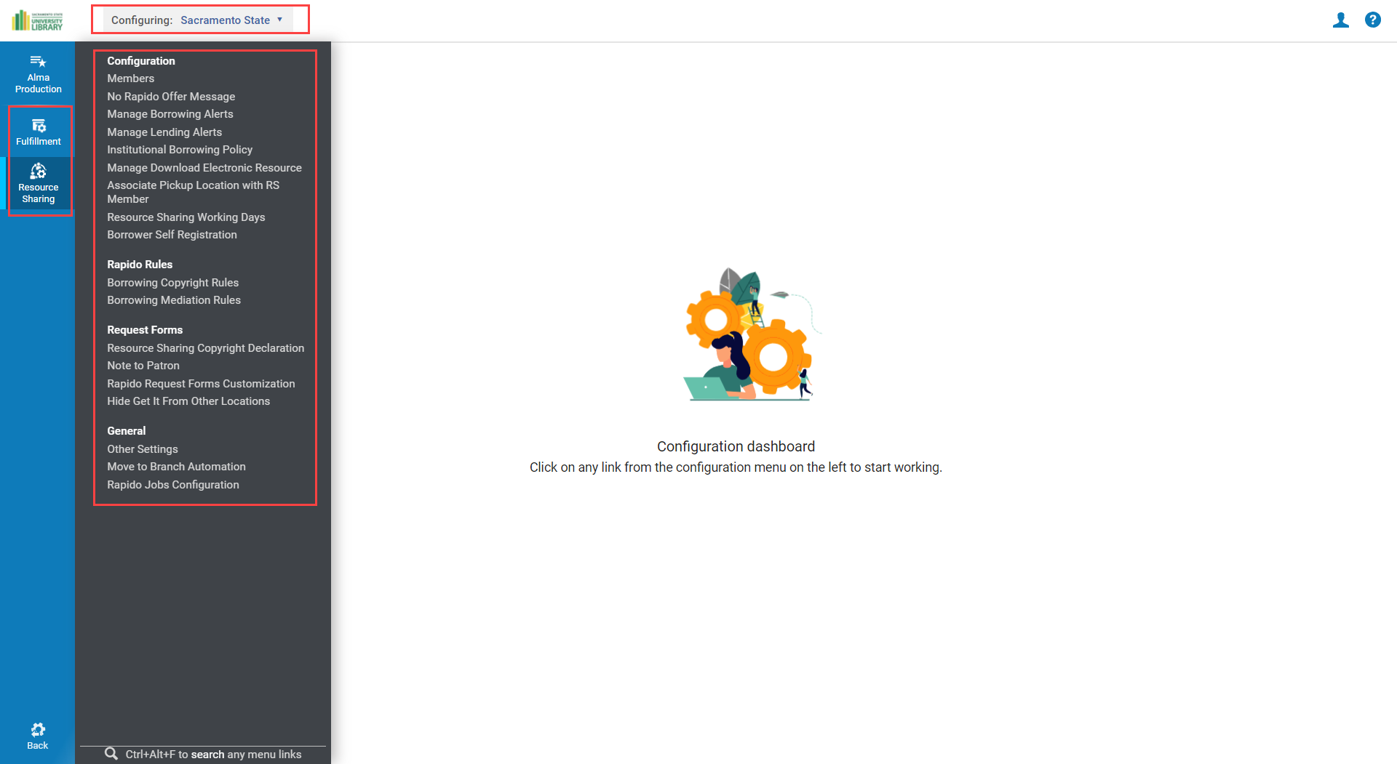
Roles
Can Configure Rapido!
Feel The Power!
Notes:
Once you have the roles you will get more options in configuration. Most importantly, one role will give you the ability to make most of the tweaks to Rapido. For a dummy patron left over from testing the Walk-in patron workflows I added one role and could suddenly tweak Rapido and the general Resource Sharing library settings.

Slide 14
Alma Administration Certification
Instructions available on the Ex Libris Knowledgebase
Many libraries require this certification for the following roles:
Fulfillment Administrator
Letters Administrator
Analytics Administrator
Or Design Analytics Role
Notes:
So, to get these roles you will likely need to go through the Alma Administration Certification course because the roles I want all CSU Resource Sharing staff to have are all administrator roles. I took this course in 2017 and at that time it had a commitment of a couple hours a week for 4 weeks followed by a test. Looking at the website for the course, it looks like it is now able to be completed at your own pace, so hopefully you can knock it out faster.
The roles I think Resource Sharing staff should get are the Fulfillment Administrator Role, Letters Administrator Role, and Analytics Administrator Role. If you cannot get approval for the Analytics Administrator Role, then I suggest asking for the Design Analytics Role which can do most of the same things.
Ultimately, you will need approval from supervisors and administrators for these roles. Feel free to share the recording of this presentation and I am also happy to answer questions about these roles outside of I-SPIE as well.

Slide 15
Fulfillment Administrators Can…
Access Resource Sharing Library Configurations
Go Non-Lending
Go Non-Borrowing
Tweak Locate settings for Resource Sharing
Change the Resource Sharing Contact information
Access Fulfillment Configurations
Settings for Display Logic Rules
Ignore Lender Due Date setting
Access Resource Sharing Configurations
Manage pods
Create Borrowing Mediation Rules
Create Borrowing Copyright Rules
And Much, Much, More!
Notes:
So the first role I want to discuss is the Fulfillment Administrator Role. If you only get permission for one role get this one. It will let you update your Resource Sharing Library configurations in Alma so you can do stuff like set your department to non-lending during holidays, update the contact information, and tweak your locate settings to get less locate failed messages.
This will also give you access to Fulfillment Configurations. Most of these configurations will not apply to Resource Sharing and shouldn’t be messed with. But there are specific settings like the Ignore Lender Due Date setting that will let ILLiad as Last resort due dates match ILLiad.
The most important thing this role will give you access to is the Resource Sharing configurations. These are Rapido specific configurations that let you update pod settings, create mediation rules to streamline workflows, and update copyright rules.

Slide 16
Letters Administrators Can…
Create and edit Letters
The following Letters are commonly used by Rapido:
Printing
Ful Incoming Slip Letter (Pull Slips)
Resource Sharing Receive Slip Letter (Borrowing Receives)
Resource Sharing Return Slip Letter (Return Labels)
Email
Document Delivery Notification Letter
Change Rapido Request Terms Letter
Query To Patron Letter
Ful Lost Email Letter
Borrower Overdue Email Letter
Send Rapido Request Letter
Notes:
The other two Roles aren’t specific to Resource Sharing, but there are a lot of Resource Sharing settings in these areas of configuration.
The Letters Administrator role will let you configure your Rapido Letters, both for printing and sending through email.
Letters can be complicated with a steep earning curve, but once you understand how to use them they can be very customizable to meet your needs. I would be happy to help anyone learn how to edit these letters if they feel they could use some assistance.
Tomorrow, Christina Hennessey will give a much deeper look at letters. Christina is very knowledgeable in this area and is one of the people I contact when I am stuck. She is also a good person to ask if you need help with letters.

Slide 17
Analytics Administrators Can…
Design Analytics
Reports
Dashboards
Share analytics
Through the shared Cal State folder
Create Analytics Objects
Widgets
Reports
Dashboards
The Design Analytics Role can do everything except create Analytics Objects
Notes:
The Analytics Administrator role gives you access to Alma Analytics. In Alma Analytics you can create custom reports and Dashboards, Share those reports so others can use them, and copy reports shared by others.
This role can also create Analytics Objects to be use in Alma outside of the Analytics module. These include the Rapido and copyright analytics available in your Institution Zones and the copyright tracking widgets available for your dashboards.
If you cannot get the Analytics Administrator role I would ask for the Design Analytics Role. With this role you can create and share analytics, you just cant create Analytics Objects.
For a deeper look int Alma Analytics pay attention to Natalya Magazino’s presentation tomorrow.

Slide 18
Resource Sharing Configurations
Notes:
So lets take a quick look at some of the things I said you can do with those roles starting with the Resource Sharing configurations.

Slide 19
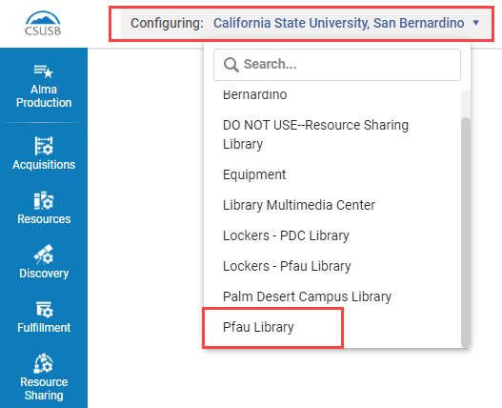
Resource Sharing Library Settings
Set you Library to the Resource Sharing Library
Go to Fulfillment > Library Management > Library Details
Notes:
You can access the Resource Sharing Library settings by changing the library you are configuring to the one designated as your Resource Sharing library. From there you can scroll down and set yourself to temporarily Inactive for Lending. You can also go to the contacts tab and update the department contact information seen by partner libraries in Rapido. The email, phone, and address designated as “Shipping” are used for Resource Sharing.

Slide 20
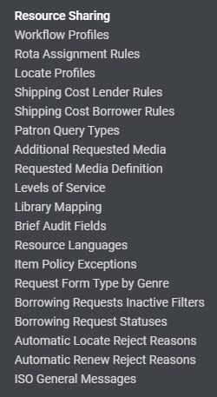
Fulfillment Settings
Go to Fulfillment > Resource Sharing
Resource Sharing Section configures Rotas
Still used for RapidILL settings
Go to Fulfillment > General > Other Settings
Turn off Ignore Lender Due Date
Turn on Check Patron Duplicates
Etc.
Notes:
The Fulfillment configuration settings will be less important for you to access, but there are some settings you may want to access. There is a whole Resource Sharing section under the fulfillment configurations that configures the Rota features. While Rapido pods do not use the rota, RapidILL still uses the rota. The newly created RapidR pod also uses the rota system, as does the find partner feature in Rapido.
There are also some settings under the general fulfillment settings you may want to access. These include the ignore Lender due date with should now be set to false. This setting was originally set to true with CSU+ because we wanted the due date determined at checkout. Due dates do not work like that in Rapido and this setting is no longer necessary. A side effect of this setting is that requests pushed into Alma from ILLiad will have their due date ignored and replaced with a different checkout period. By changing this to false, your ILLiad requests will start to display the same due date in Alma that they had in ILLiad.
Another setting you may be interested in is the Check Patron duplicates setting. This setting is designed to prevent patrons from requesting materials when there is an active request for the same item. If that is a workflow that interests you, set this field to true.

Slide 21
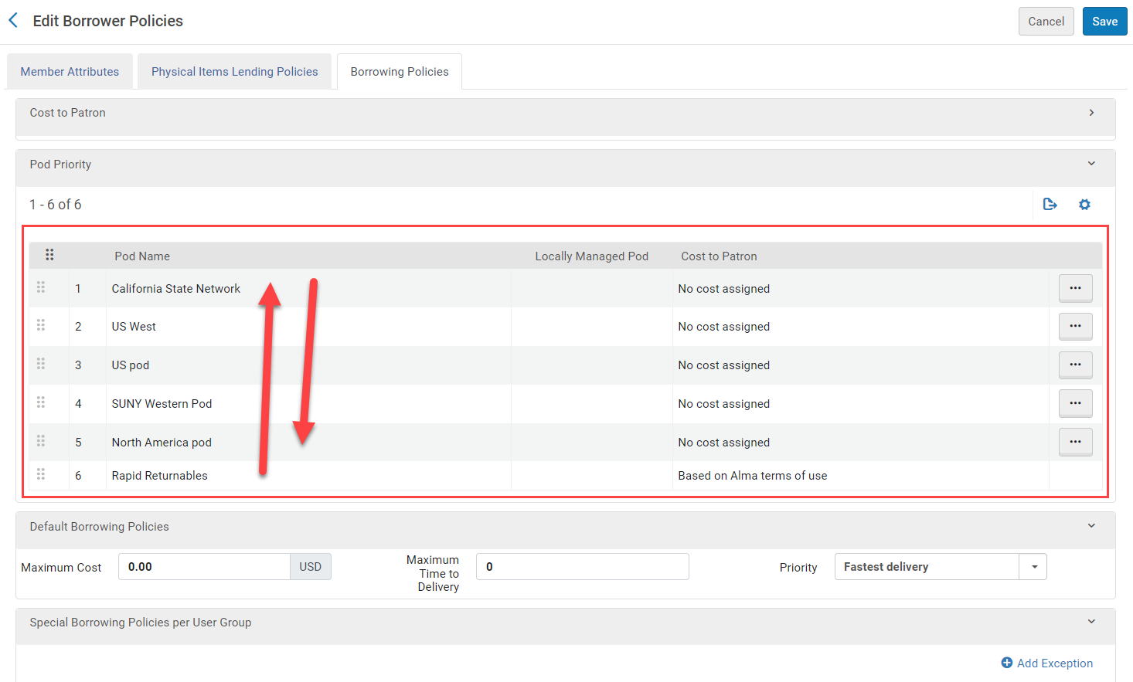
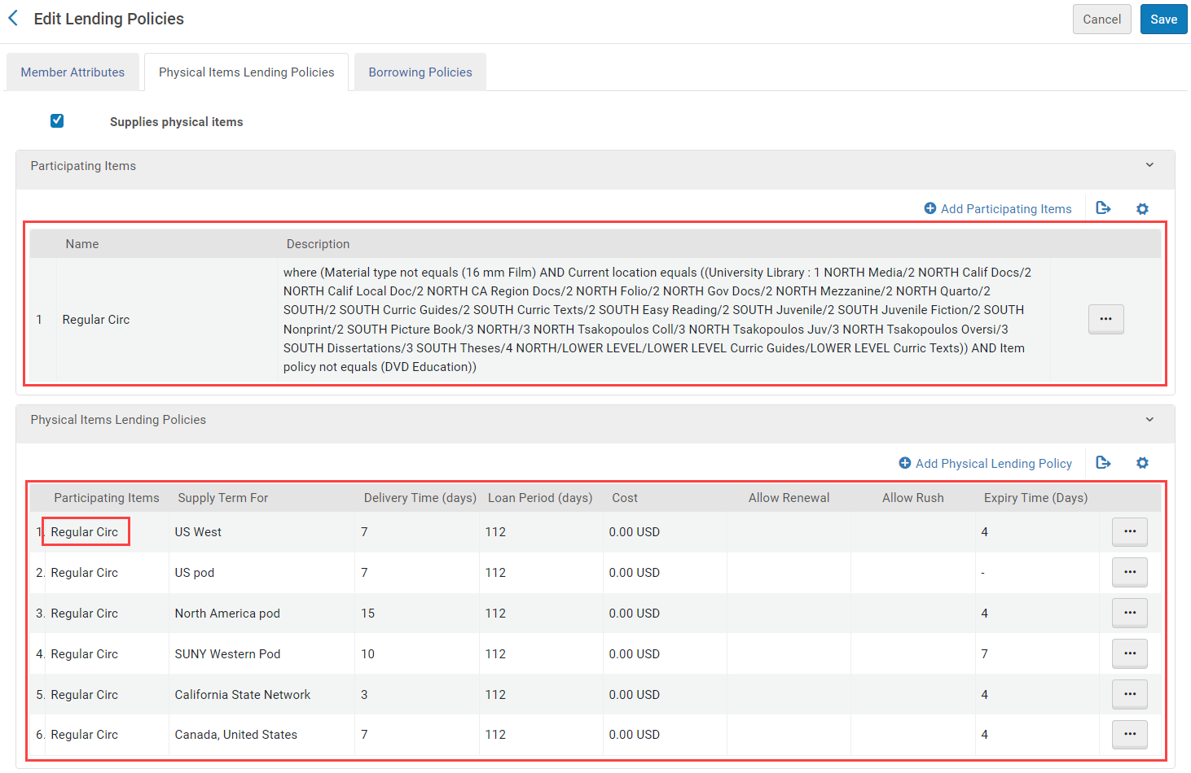
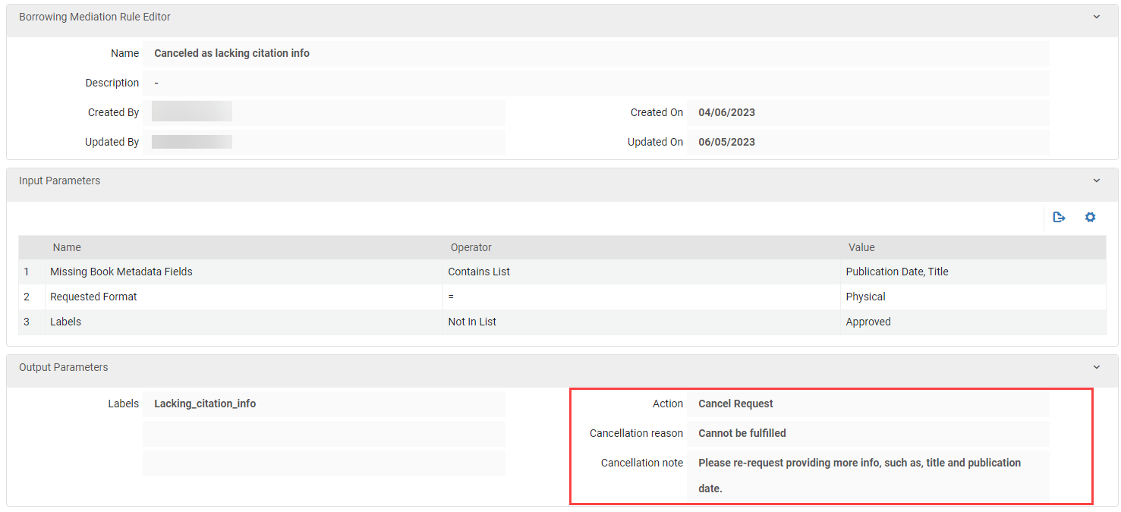
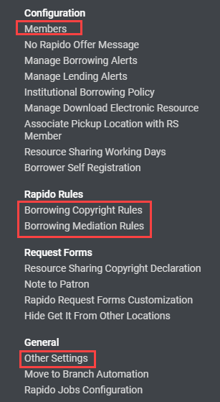
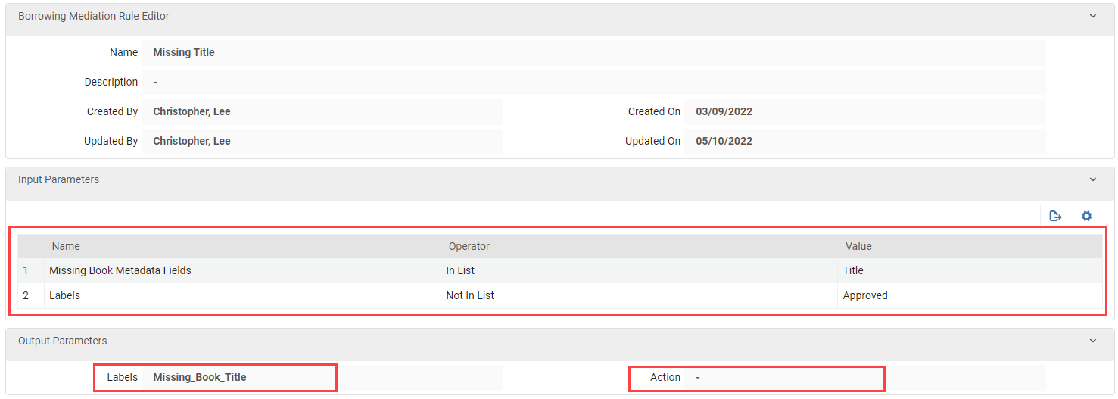
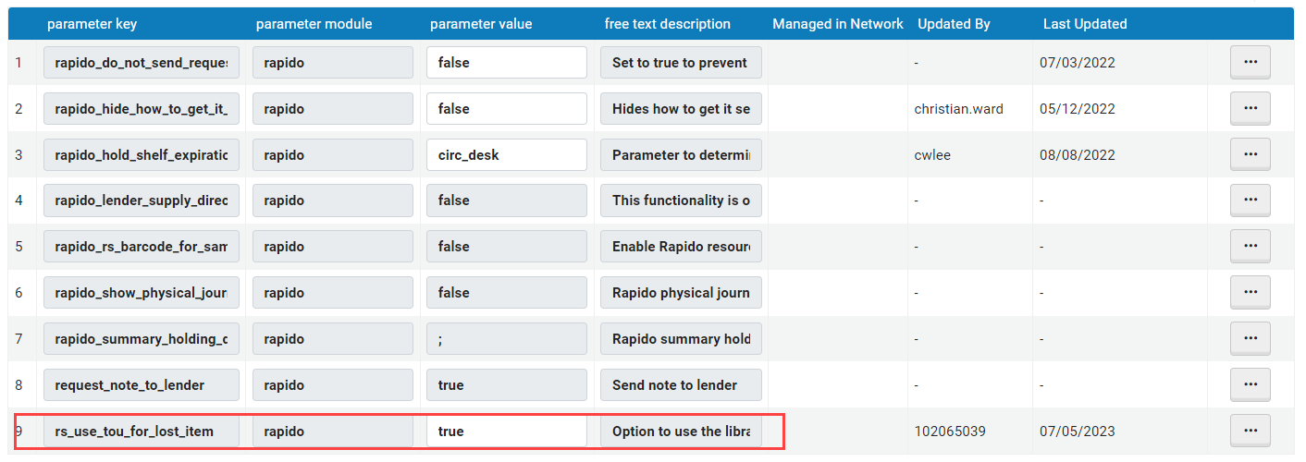
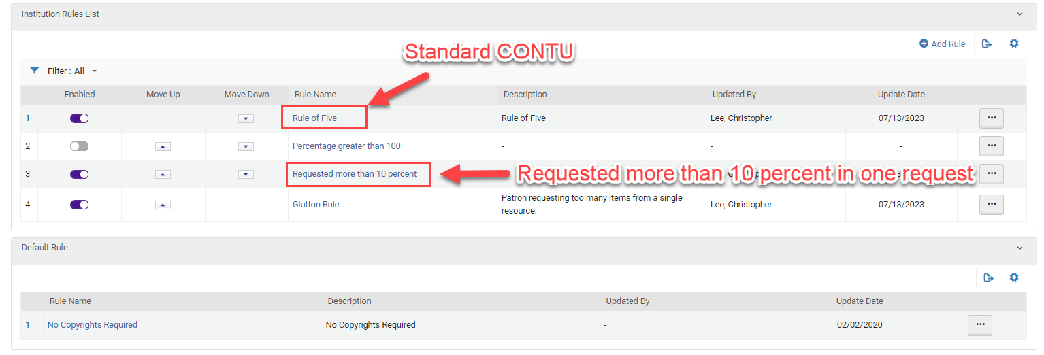
Resource Sharing Settings
Go to Resource Sharing
The Rapido specific settings
Resource Sharing > Configuration > Members
Pod settings. Select what items can be shared as the Lender and reorder the Borrowing pods
Resource Sharing > Borrowing Copyright Rules
Rule of 5, Create rule for mediating requests for more than 10% of the work
Resource Sharing > Borrowing Mediation Rules
Rules to mediate requests for missing info, owned locally, or auto cancel
Resource Sharing > General > Other Settings
Turn on TOU for Lost Items.
Notes:
Finally the Resource Sharing settings that control Rapido are under configuration then Resource Sharing.
The most useful sections in my opinion are the members area, Borrowing Copyright Rules, Borrowing Mediation Rules, and Other Settings.
The Members section is where you have your pod settings. On the Physical Items Lending Policies tab
Click
You can select what items you want to share through Rapido by creating a Participating Items Rule. You can create different participating items rules for different pods. So If you only want to share BluRays with the CSU pod and not the US West pod you can.
You do this in this lower section. You click the ellipses and add the participating items rule you want that pod to use. If no rule is selected then you shouldn’t get any Lending requests from that pod. If All items is selected then you are essentially saying “everything in the library is lendable.” So it is a good idea to attach a well thought out rule.
click
The next tab in the members section is where you can order your pods. It’s a good idea to keep the Cal State Network at the top and have the pods get geographically bigger and bigger the lower you move down the list.
click
The Borrowing Copyright Rules section has the Rule of 5 configured out of the box, but you may want to add additional rules, such as a rule that flags requests for a scan of more than 10 percent of the book.
Click
This is what the borrowing copyright rules page looks like. As you can see, at this library, additional rules were added. For example, the “Requested more than 10 percent” rule flags requests for mediation if the patron requests a page range that is longer than 10 percent of the total pages of the book.
click
The borrowing mediation rules is where you make rules that streamline the process of scanning for your own patron, add a label when certain information is missing, or automatically cancel requests for items meeting certain criteria, like missing too much citation information.
The rules look like this when opened
Click
The input parameters are where you add the settings determining when the rule is and is not applied.
The output parameters are the label that will be added to the request to tell staff why the request needs mediation and the action is the automatic response to the rule. The blank action stops the request for mediation.
Click
The cancel request action automatically cancels the request and send the message you write below.
click
Lastly the Other Settings area has a bunch of random settings you can turn on.
click
One of these settings lets you turn on the ability for TOUs for Lost Items to apply to Rapido.

Slide 22
Letters
Notes:
Now on to some brief information on Letters.

Slide 23
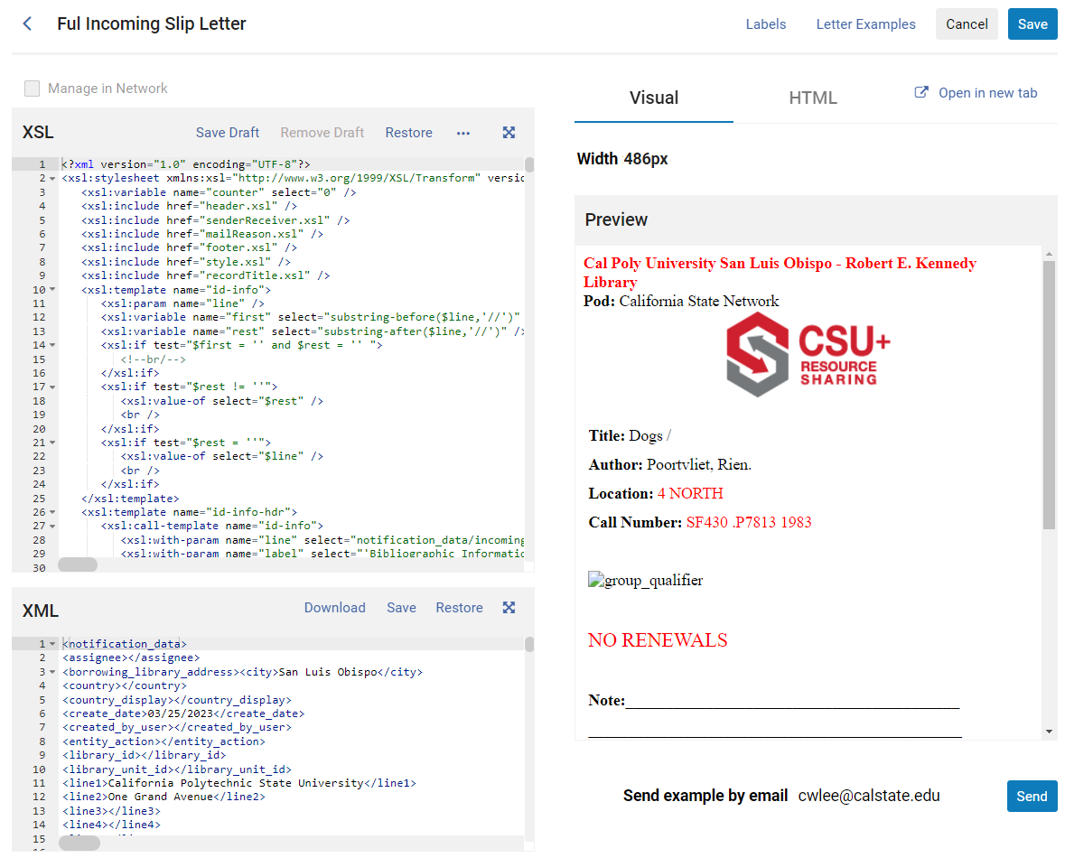
Letters
Go to General > Letters > Letter Configuration
Only edit letters used by your department
Always back up the code before editing
Letters Sections
Main page
New this week
See and edit the XSL and XML code simultaneously
See an active preview at all times
Labels
Change the words used with specific lines of code
Letter Examples
Download the most recently generated examples
Upload manipulated examples
For more information see Christina Hennessey’s Presentation: Empowering Library Staff and Pleasing Library Patrons Through Alma Letters
Notes:
The letters are configured under Configuration, general, letters, letter configuration. Here you can enable, disable, or edit letters used in Alma. Since this has the letters used in every area of Alma it is best to stick to letters specific to Resource Sharing. When editing Letters it is always a good idea to back up the original XSL code by copying it into a text file.
Last weekend the letters view was updated. Letters are mostly edit the same as before, but you can now easily see the example XML and an active preview at all times. I look forward to working in this new environment.
While the main page replaces the Template tab, the Labels section and Letter Examples sections are still present. The labels section lets you change the wording of available labels pull into the letter and the Letters Examples lets you generate, download, and manipulate example XML code to see what the letter will look like.
There will be more information on letters tomorrow in Christina Hennessey’s presentation.

Slide 24
Analytics
Notes:
And now onto some examples of what you can do with Analytics roles.

Slide 25
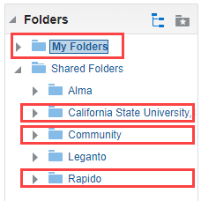
Analytics
Go to Analytics > Analytics > Design Analytics
Can create private analytics in My Folders
Can create IZ analytics in your University folder
Can share analytics through the CalState folder at: Shared Folders/Community/Reports/Institutions/CalState/Resource Sharing
Access out of the box Rapido analytics under the Rapido folder
For more on Letters see Natalya Magazino’s presentation: Resource Sharing Statistics in Alma Analytics at the CSU
Notes:
Analytics are not accessed through configuration, but through the main Alma homepage. Go to Analytics and Design Analytics to get to work making reports and dashboards.
Inside the design Analytics area you can create and access analytics reports. You can save them in your personal folder accessible only to you, in your institutions folder where it is shared just at your library, or through the CalState folder accessible under Shared Folders/Community/Reports/Institutions/CalState/Resource Sharing. This is where the systemwide analytics, like the Rapido dashboards, live.
Ex Libris has also been hard at work adding many new out of the box Rapido reports you can use to view you fill rates, pod usage, and more.

Slide 26
Keeping Up with Rapido
Notes:
Since Rapido is still a fairly new product, it gets regular updates and so it is important to keep up with what is happening behind the scenes. Now, we are all overwhelmed with information overload, so here are a few places to focus on for getting information.

Slide 27
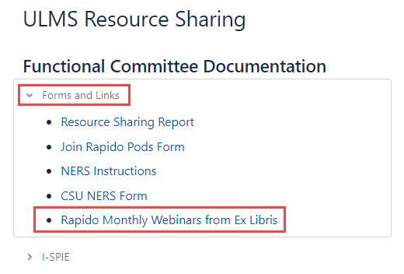
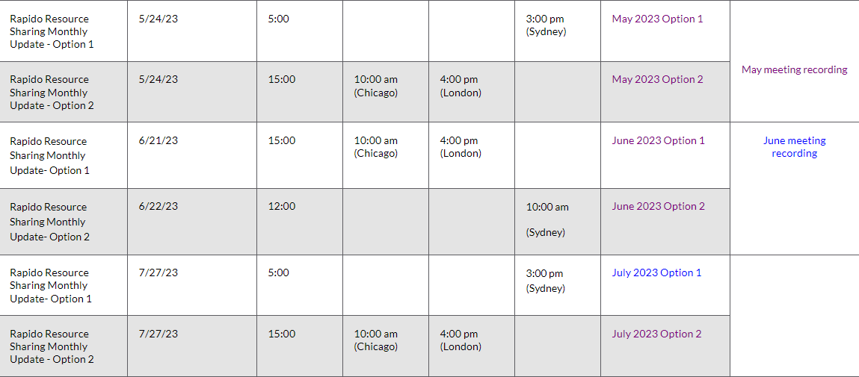
Rapido Monthly Webinars
An hour long (or less) webinar once a month
Ex Libris Development shows what updates will drop
Webinars are recorded for later viewing
Registration for all the 2023 webinars is open
Notes:
The Rapido Monthly webinars are the first place to go for new Rapido information. In these webinars, Judith or Meghann from Ex Libris will take a look at the updates that will go live in a few weeks time.
The webinars are also recorded and uploaded to YouTube. Links to the recordings are added to the same page where you register to watch them live.
I added a link to the registration page to the CSU resource sharing wiki at the top of the page in the Forms and Links section to make it easy to find.
I encourage everyone to attend the monthly webinar.

Slide 28
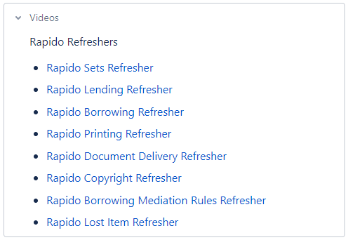
Rapido Refreshers
Rapido Deep Dives with the CSU Resource Sharing Functional Committee (RSFC)
Covers workflows, updates, and configurations
Bi-Weekly in the Academic Year
Recordings added to the wiki under videos
Notes:
The next way to keep up with Rapido, at least in the CSU, is our Rapido Refreshers.
These bi-weekly trainings are put on by the Resource Sharing Functional Committee and they go in depth on workflows, updates, and complicated configurations.
All of the refreshers are uploaded to YouTube and linked on the CSU Resource Sharing Wiki.

Slide 29
I-SPIE TV
Like the conference but smaller
Every third Thursday of the month (excluding holidays)
Informative and fun
Notes:
And lets not forget I-SPIE TV
I-SPIE TV was developed during the pandemic as a way to continue sharing information and keep us connected
While the show is informative, it can also be fun. We usually have a holiday trivia game when the episode falls near a major holiday
It is also a great place to volunteer to get presentation and committee experience if you are new to the library world.

Slide 30
Experimentation
Notes:
So those roles will help give you the tools to master Rapido and tweak it to your needs, but mastery of the system will come through time and experimentation. I have done a lot of experimenting in Rapido and continue to do so to learn all the ins and outs of the software.

Slide 31
Try new things
Duplicate stuck requests and set yourself as the requesting patron
Try crazy things you think MIGHT work on the duplicate request
Contact me to test!
Notes:
I encourage you to try solutions to issues through experimentation. I often duplicate problem requests and try a bunch of potential solutions to the copy with me as the patron until I find out how to make the request do what I want.
Sometimes off the wall solutions work, and sometimes they don’t, which is why it’s a good idea to test on a duplicate.
And when all else fails you can always contact me. If I am available I will be happy to help you solve your issue.

Slide 32
Conclusion
Notes:
That concludes the first presentation of this years I-SPIE Conference! Do you have any questions!

