Slide 1
WEST COAST WISHES
BUILDING PARTNERSHIPS BETWEEN SCELC, ORBIS CASCADE, THE CSU, AND MORE
Notes:
Chris:
Hello Again! This next presentation is about a joint courier route proposed by Linda Wobbe at SCELC which has grown and now includes Orbis Cascade. Parts of this plan are already in place, while other parts are still in the discussion and planning stages. The goal of this presentation is to keep everyone informed on what we are working on. If anyone here today who is not from the CSU, SCELC, or Orbis Cascade we would love you to join in on this project to create a western courier route and library partnership.

Slide 2
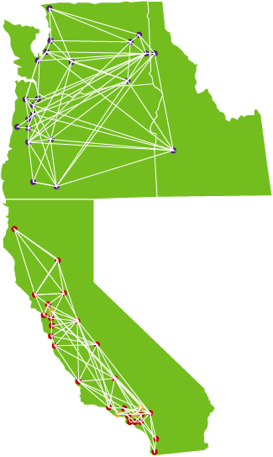
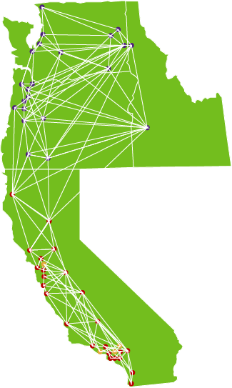
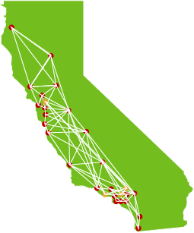
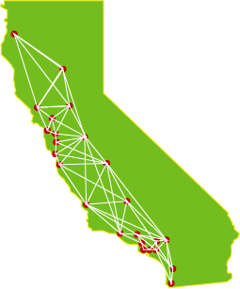
COURIER ROUTE PLAN
Connect CSU
Connect SCELC
Connect Orbis Cascade
Notes:
Chris:
· So here is what the CSU courier route and Rapido pod more or less looks like. All the CSU’s are connected through a Rapido pod and ship materials on a Unity Courier route to save time and money. This has worked very well over the years and was the basis of CSU+.
· Things got a little more complicated when we joined Rapido and have unmediated requests going to libraries outside the courier. We do have some friends on the courier route who are not in a Rapido pod, and it is a shame for them to get skipped.
· Linda here proposed adding some SCELC libraries to our route
· Click
· and we agreed that would be great, especially if they could be in a Rapido pod. Saint Mary’s joined and a few more SCELC libraries are in the process of joining the route. These libraries are all either on Rapido or willing to connect with us using ISO connections and Hybrid pods.
· But we have some longtime friends to the North on their own courier system
· Click
· Orbis Cascade is a network of libraries in Oregon, Washington, and Idaho. We have long worked with Orbis as informal friends in the Resource Sharing community and we already borrow and lend with them through ILLiad. Lori Hilterbrand from Orbis would like to make this informal friendship into a formal partnership.
· Click
· We would like to connect to create a single Western Resource Sharing courier route and hybrid pod.
· Now on to our friends from SCELC.

Slide 3
SCELC
Statewide California Electronic Library Consortium
Serving 300 libraries including all CSUs
Negotiating discounted rates for e-resources
Member benefits open to CSUs include
Shared Print Program SCELC retention commitments #3 in North America
Reciprocal ILL - for CSU Shared Print participants
SCELC Libraries joining the expanded CSU Courier
Pepperdine (ongoing)
Saint Mary’s College of CA - Alma/Rapido
Azusa Pacific University (coming soon)
University of Nevada, Reno (in process) - Alma/Rapido

Slide 4
SCELC
LINK+ Our libraries miss having academic partners
Academic libraries in LINK+ now (70 libraries, 11 academic - 16% - all but one are SCELC libraries)
Academic libraries in LINK+ 2015 (48 libraries, 32 academic - 67% - all but two are SCELC libraries)
Many SCELC libraries are also using Alma and Rapido
SCELC libraries have unique circulating materials
Shared Print Program overlap shows all 50 participating libraries retaining unique content
Integration - want and need to be fully integrated borrowing/lending
Alma
RapidR (An add-on to Rapid)
ISO

Slide 5
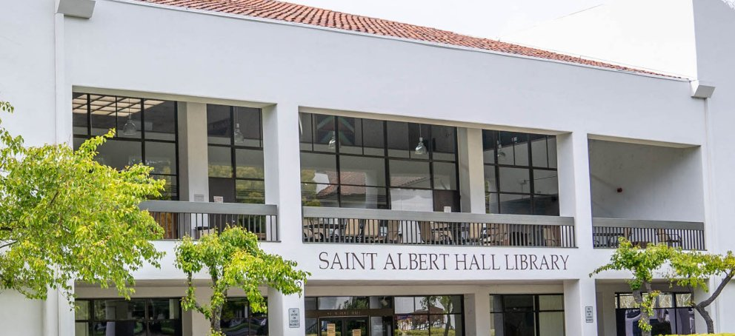
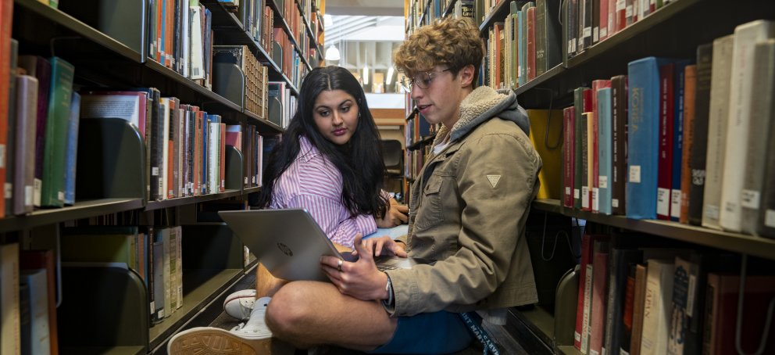
SCELC - Saint Mary’s College of California
SMC
Located in Moraga California east of San Francisco
We are a liberal arts college with a Lasallian tradition to broaden the reach of education, promote social justice, and pursue scholarship in a community of equals
Population: 2,003 Undergraduate and 762 Graduate students. We serve a community of 17 Christian brothers, 367 Staff, and 453 Faculty
SMC Library
Our library has unique collections., reflecting our College's three great traditions: Liberal Arts, Catholic, and Lasallian pillars
ALMA/ RAPIDO
Live on ALMA/ PRIMO VE August 2022
Left Link+ / Courier August 10,2022
Live on Rapido August 29, 2022
Rejoined Unity Courier May 2023
Notes:
Shannon Slide

Slide 6
SCELC - Saint Mary’s College of California
Courier
Since May we’ve been receiving CSU resource sharing through the Courier and USPS
Please remember that we’re on the list! Please ship items to us through Unity.
Multi-type networking is the way to go!
We’re interested in getting more non CSU institutions on board.
Notes:
Shannon Slide

Slide 7
SCELC
Dream Big
State Support
Step Up
Notes:
Teri Slide

Slide 8
ORBIS CASCADE ALLIANCE
About the Alliance
Oregon, Washington, and a tiny bit of Idaho
38 member institutions with consortial borrowing and lending
8 have Rapido
23 have RapidILL
Adding rotas for non-Rapido members
A Pacific Northwest rota with non-member libraries on Alma and the courier
A California rota?

Slide 9
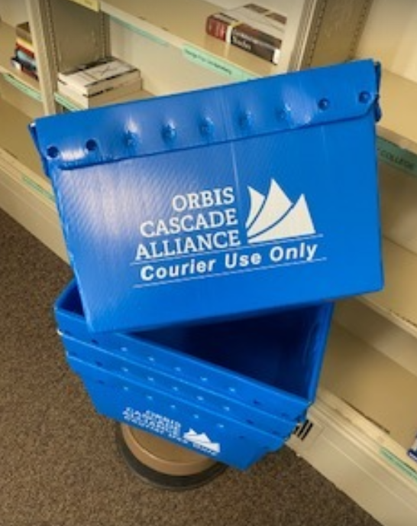
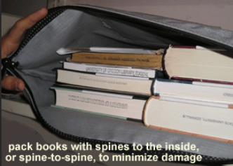
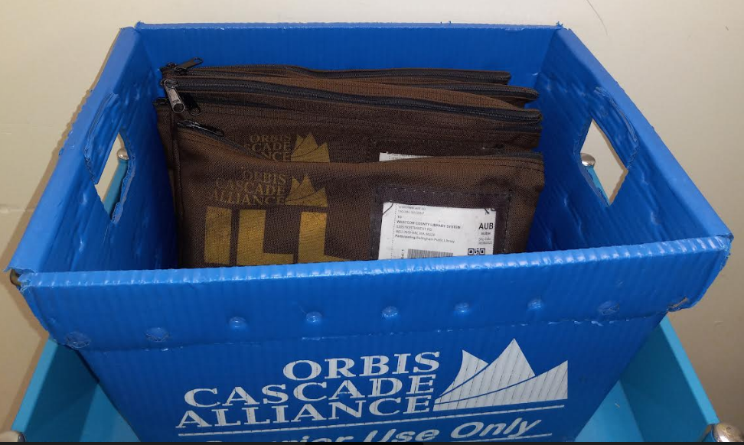
ORBIS CASCADE ALLIANCE
About EXPAK Logistics
In the midst of a 4 year contract with ExPak
California-based company serving all 50 states
88 northwest library dropsites
178 additional libraries through local participation
Participants List
Includes label numbers and limited tracking
Average transit 2-3 days
Expakship interface

Slide 10
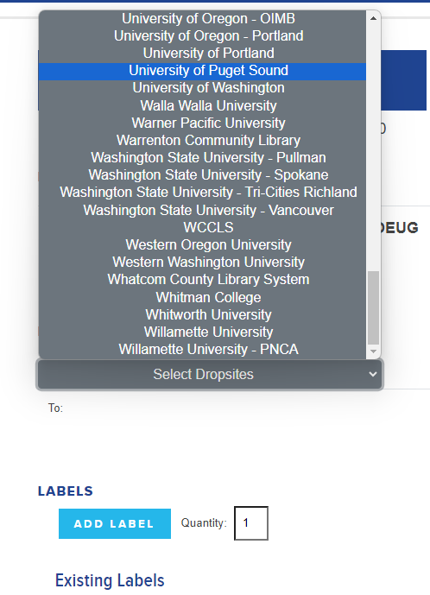
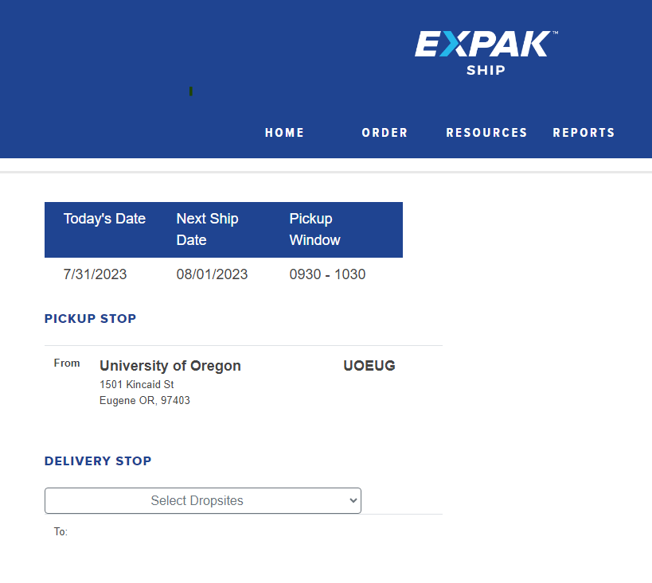
ORBIS CASCADE ALLIANCE
About EXPAK Logistics
Expakship interface

Slide 11
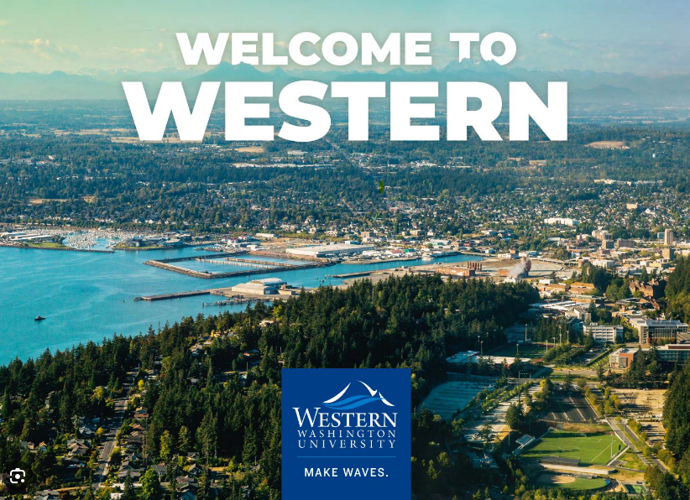
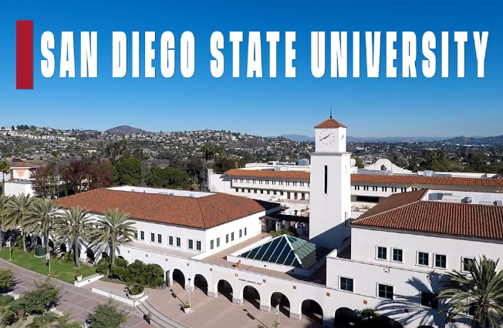
ORBIS CASCADE ALLIANCE
Where We’re Going
California Dreaming!
Shipping costs and delivery times are increasing through all major shipping vendors
Estimated 3500-4500 packages shipping from the Alliance annually
Connecting routes vs. one route
Build a route from Here: to Here:

Slide 12
CSU
Current state of the CSU partnerships:
Rapido Libraries joined (or joining) the CSU Unity contract
Example: Saint Mary’s College
UC’s on the courier route but not connected to the CSU through Alma/Rapido/ISO
Other libraries on the courier route but not connected to the CSU through Alma/Rapido/ISO
Example: Pepperdine University
Notes:
Chris:
· Now that we have heard from our friends in SCELC and Orbis Cascade, what is the current state of the partnerships in the CSU?
· As mentioned before, we already have Saint Mary’s on the courier route and as a partner in Rapido.
· We also have the UC’s on the courier route, but they unfortunately are not currently connected to the CSU through a hybrid pod. I would love to change this and would be happy to set up any type of connection with any interested UC library.
· Pepperdine is also on the courier route but not in a hybrid pod. I would like to make that connection as well.

Slide 13
CSU
Next Steps:
Create Official Rapido Hybrid Pod for this partnership:
Pod will be put immediately after the system pod at libraries with an NZ (after the CSU+ pod)
Initially will only have the libraries in Rapido and Alma Peer-to-Peer Resource Sharing
ISO partners will be added as soon as the connections are released. Ex Libris has asked if the CSU is interested in testing these connections.
Pod terms are:
Delivery Time: 7 Days
Loan Period: 112 Days
Expiry Time: 4 Days
Notes:
Chris:
· While partners are added and the courier is worked on we are going to make the Hybrid pod and put it is place after the CSU pod in Rapido. For libraries on it, or when they join, they will also put it after their organizations pod if applicable.
· We can set up the pod with other Rapido libraries and Alma Peer-to-Peer libraries immediately. This means libraries like Saint Mary’s, and soon Occidental, can be added to the pod ASAP.
· As soon as the ISO connections are tested we can add those to the pod. Ex Libris contacted me the other day asking if the CSU would be interested in testing some new ISO connections, so they will hopefully be able to be added soon.
· The general pod terms are the same as the Western Pod most CSU libraries are already in. While the delivery time is listed as 7 days, the materials will likely come faster through the courier.

Slide 14
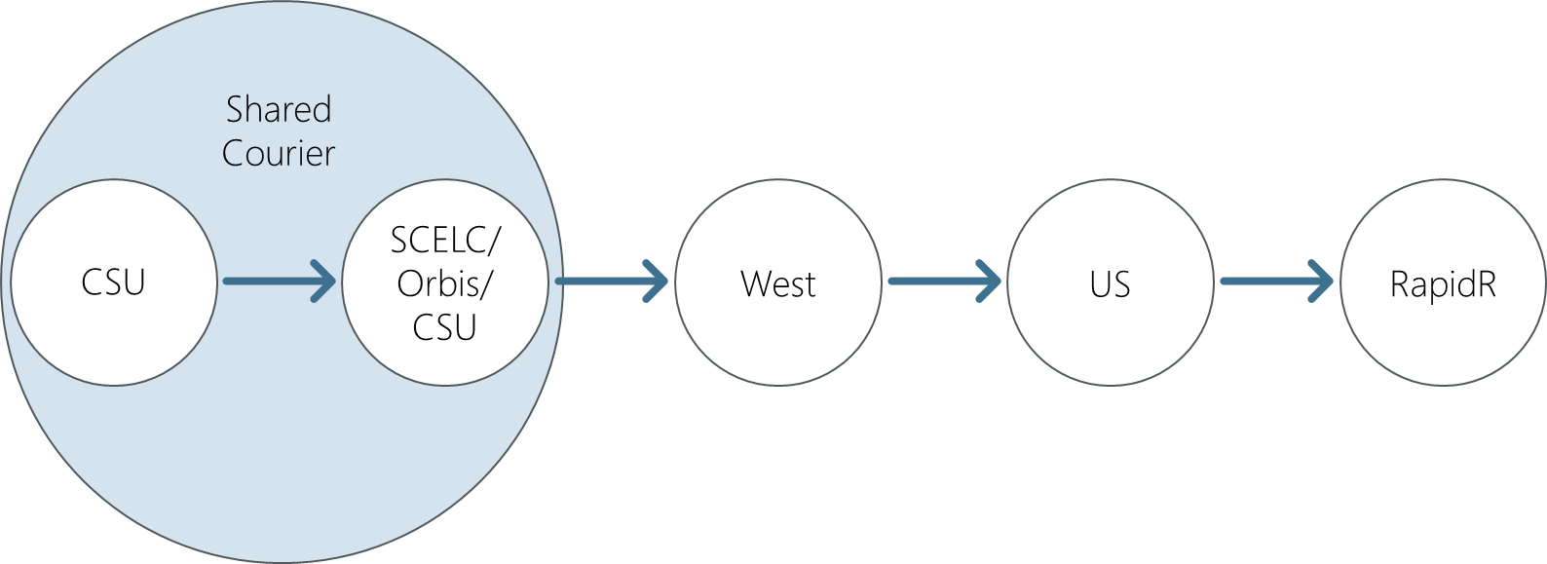
CSU
The Hybrid Pod:
A pod with both Rapido and non-Rapido partners
For Rapido libraries:
Requests are processed like any other Rapido requests
Patrons see the Rapido estimates (at least with Alma Peer-to-Peer partners)
For non-Rapido libraries:
They can partner with Rapido libraries using their own systems
Requests follow the workflows of those systems
Does require some configuration. Contact cwlee@calstate.edu to test the setup.
As with any pod, Ex Libris does much of the setup on their end. Libraries interested in this pod will need to contact Ex Libris. Since this is a closed pod it is not listed in Ex Libris’s pod form.
Notes:
Chris:
· So I said we are making a hybrid pod, but what is a hybrid pod? In short it is a group, or pod, of libraries both in Rapido and outside Rapido.
· For the Rapido libraries this means the requests will appear in Rapido like any other Rapido request. There wont be any change in workflows with these items.
· We will also get the benefits of Rapido such as real time availability information appearing in Primo, at least when its another Rapido or Alma library. As I have not tested the ISO connections to ILLiad and Tipasa I cannot speak to how real time availability will work with them.
· For our non-Rapido partners they will be able to borrow and lend from us using their system of choice with the benefits inherent in that system. It does look like there is some configuration needed to set this up, but I am more than happy to help those libraries with that configuration in any way I can.
· As with any pod, hybrid pods are set up by Ex Libris. I will ask them to make the pod as soon as we have a name for the pod and we can start. When a library is ready to join the pod they will need to contact Ex Libris.

Slide 15
CSU
The Courier:
CSU and SCELC are on Unity (or joining)
Orbis is on EXPAK
Unity will not ship to Oregon, Washington, and Nevada
EXPAK covers the entire Continental USA
Options:
Set a hub in California and hire student workers to change shipping labels from Unity to EXPAK and vice versa
All join the same courier
Notes:
Chris:
· So what about the courier?
· Well, the CSU and SCELC are both currently on Unity, so that part is easy for now.
· Unfortunately Orbis Cascade is on a courier called EXPAK.
· And Unity will not ship outside of California.
· But EXPAK is a nationwide courier for libraries that covers the entire united states.
· So we currently have two options. We can set up a hub in California to transfer Unity Shipments to EXPAK and vice versa. This will work in theory, but it would slow down shipments slightly and leaves plenty of opportunities for human error.
· It would be best to all join the same courier. I sent a message to EXPAK for a fact finding meeting and will likely start the RFP process soon so we can see the pros and cons of both methods. Either way lets connect to Orbis Cascade.

Slide 16
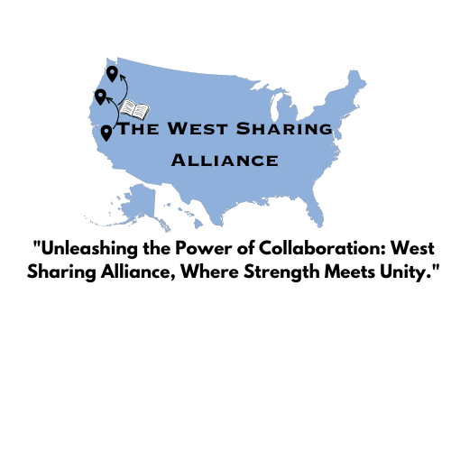
SCELC - Orbis - CSU
Join us at the WorldCafe Breakout
Choose a logo/name for the expansion partners
Learn more about
Develop guidelines / instructions for integration
Join the state lobbying force
Things to think about:
ISO connections with ILLiad are live but appear complicated
Ex Libris mentioned in their August Update work being done on Rapido stand alone
Shipping Labels vs Flip Cards
Best practices for lost books, shipments, etc.
InterLibrary Alliance
Notes:
Chris:
· So that is where we currently stand, but there is some progress we can make at the conference today.
· This partnership is one of the topics in the World Café activity this afternoon. During the world café we would like input on the name and logo for the pod and route.
· We can develop guidelines and workflows
· Join the state lobbying force to get state buy in and support, which is vitally important for our SCELC partners.
· There are also some details to think about during these conversations and when making decisions. Like how will Rapido stand alone, which does not require Alma, play into this? Shipping labels or flip cards? And what about best practices for lost books.

Slide 17
THANK YOU
Presenters
SCELC
Linda Wobbe linda@scelc.org
Shannon Meaney-Ryer smm20@stmarys-ca.edu
Teri Gallaway teri@scelc.org
Orbis Cascade
Lori Hilterbrand lhilterbrand@orbiscascade.org
CSU
Christopher Lee cwlee@calstate.edu
Notes:
· So that’s it from us! Do you have any questions?

