Slide 1
Communications Made Easy ── Patron Query Letters in Alma
Nikki DeMoville
Coordinator - Electronic Resources, Acquisitions, Resource Sharing, and Discovery
Cal Poly, San Luis Obispo

Slide 2
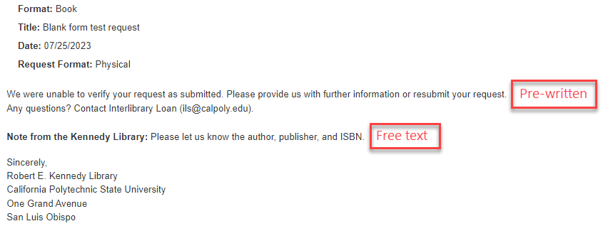
What do Patron Query Letters do?
Just like letter templates in ILLiad
Allow communication directly with the patron from Alma
Linked to a specific ILL request and include the request information
Include up to 3 lines of pre-written text plus a free-text note field; up to 30 different letters

Slide 3
How do you set them up?
Follow the instructions in the CSU wiki or in the Ex Libris Knowledge Center (links listed at end)
General System Administrator or Fulfillment Administrator role required
Recommended customizations in addition to query lines 1, 2, and 3:
Subject line
Can be customized for each query type
Examples:
Regarding your Interlibrary Loan Request %reqId%
Regarding your Off Campus Delivery Interlibrary Loan Request %reqId%
addressFrom
Overrides the default Alma email for patron communications
If you turn this feature on, be sure to remove the Ex Libris email address from this field
Cc or Bcc
Useful if you would like to retain a copy of every query to patron letter in one location
You can also use the “Enabled” toggle to turn off fields so they don’t appear in the letters

Slide 4
Most useful
These will cover the most common use cases:
Regarding your request
(generic)
Incomplete citation
Violates copyright
Whole e-book
Pro Tip: Adapting the text from your ILLiad letters is a good way to begin

Slide 5
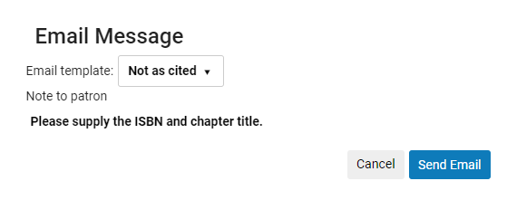
Basic workflow
Identify requests where communication with the patron is necessary
Click on the … menu and choose Send query to patron
Choose a template, add notes if desired and click Send Email

Slide 6
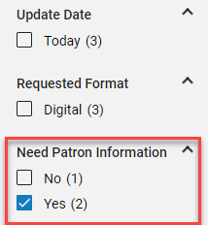
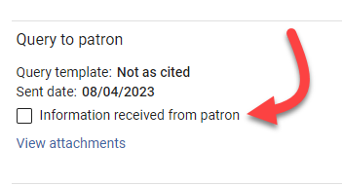
After the letter has been sent
The request will display “Active query to patron”
The template and sent date will display in the request information
The full letter can be viewed from the request’s attachments tab
Need Patron Information is available as a facet in the sidebar and can be used to make a set
If you click the “Information received from patron” box, the query will be closed

Slide 7
Recent and coming changes
May 2023 Rapido Release: addressFrom field in Resource Sharing letters now works as expected
Some configuration required: see https://knowledge.exlibrisgroup.com/Rapido/Release_Notes/2023/Rapido_2023_Release_Notes#Additional_Enhancements
August 2023 Alma Release: new letters configuration interface replaces the XSL Template tab with an enhanced preview plane—editing the look and feel of letters should be much easier
https://knowledge.exlibrisgroup.com/Alma/Release_Notes/2023/Alma_2023_Release_Notes?mon=202308BASE#
2024 H2 Alma Roadmap: "Query to Patron" Responses in Alma
Automatic handling of patrons' responses to resource-sharing request related queries.
Patrons will be able to answer queries sent to them by resource-sharing staff directly in Alma.
https://knowledge.exlibrisgroup.com/Alma/Product_Materials/010Roadmap/Alma_Roadmap_Highlights_(2023-2024)/Fulfillment_and_Resource_Sharing#.22Query_to_Patron.22_Responses_in_Alma

Slide 8
Additional resources
CSU ULMS configuration instructions (shout out to Chris Lee)
https://calstate.atlassian.net/wiki/spaces/URS/pages/2644934664/Send+Query+to+Patron
Ex Libris Knowledge Center Query to Patron Letter customization
https://knowledge.exlibrisgroup.com/Alma/Product_Documentation/010Alma_Online_Help_(English)/050Administration/050Configuring_General_Alma_Functions/070Configuring_Alma_Letters#Example_of_Query_to_Patron_Letter_Customization
Ex Libris Knowledge Center Rapido documentation
https://knowledge.exlibrisgroup.com/Rapido/Product_Documentation/02_Configuration#Configuring_Patron_Queries
Ex Libris YouTube channel: Yoel Kortick demonstrates the new letter configuration features in the August 2023 release
https://www.youtube.com/watch?v=QLq-yU5d7Ro

Slide 9
Thank you! Any questions?
ndemovil@calpoly.edu

