Slide 1
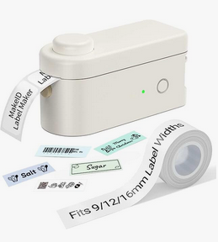
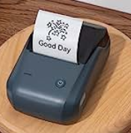
Lightning Talk: Labels!
Christina L. Hennessey
Christina.Hennessey@csun.edu
California State University, Northridge (CSUN)
I-SPIE ANNUAL CONFERENCE – CSU CO (LONG BEACH)
August 10, 2023
Notes:
Hello, I am Christina Hennessey, the Systems Librarian at California State University, Northridge or CSUN.
Welcome to my Lightning Talk about Labels!
So I have worked in the Ex Libris world of Alma and Primo for a little over 5 years, and in the Rapido world for about a year and a half. And one of my favorite things in the Ex Libris world, is usually I can find some way to update text or a label if I don’t like it, or we find it confusing, or we want to add more information to help our patrons.
I’m going to cover a few quick ideas in this talk, but I’ll be speaking tomorrow in a longer presentation about Alma Letters and the labels in there but this is a little overview to give you some ideas of where to find labels that you want to change and how to do it.
So here we go!

Slide 2
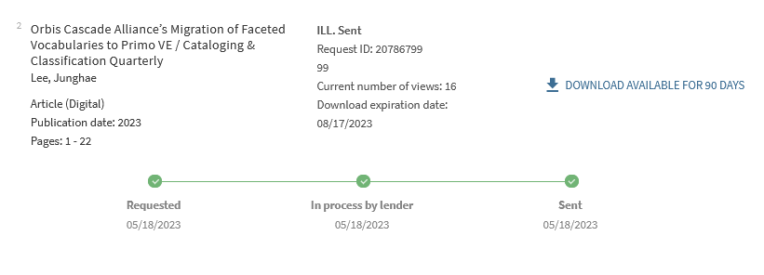
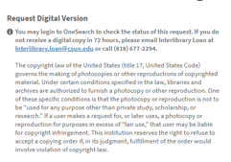
Three places to find labels related to resource sharing
Discovery Labels
Note to Patron
Labels in Alma letters
Notes:
I’m going to cover three places that you might find labels you want to update in relation to resource sharing. There are some other places that you could update text and labels across Ex Libris products, but these are the ones you will see the most for resource sharing changes.
** The first one is Discovery Labels, which is anything that shows to patrons in Primo displays. This includes most Rapido things that show inside Primo, and also includes things like Requests in My Library Account.
** There is also Note to Patron, which is text that shows on your Rapido request forms
** and Labels in Alma letters

Slide 3
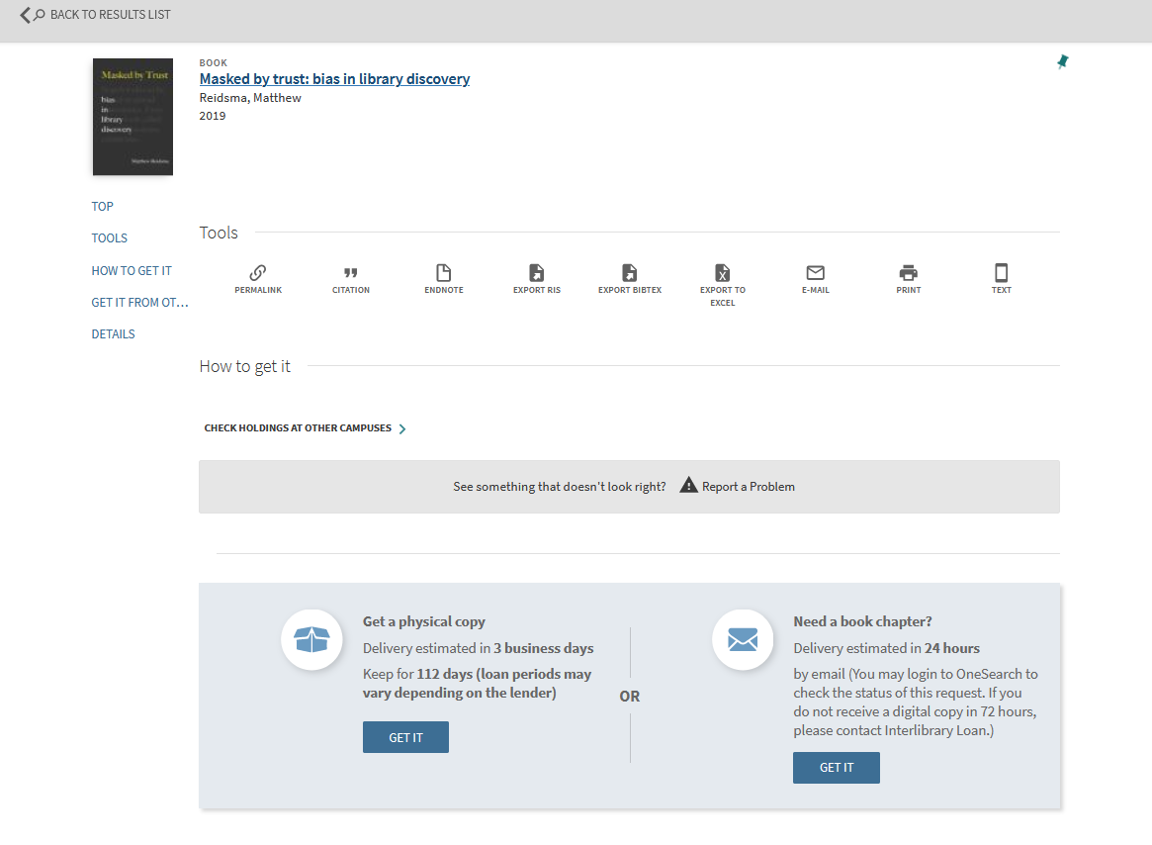
Discovery labels: change ‘Need a book chapter?”
Notes:
So for my first example, let’s say I want to make some changes to the default text and labels that show on the blue Rapido boxes in Primo when a patron can make a request.
You can see here in my screenshot that I have made A LOT of changes already to the Ex Libris default blue boxes but it’s been a while, and I might not remember where to make the changes.
** Let’s say I’m interested in changing that text of ‘Need a book chapter?” to ‘Need a book chapter NOW?”

Slide 4
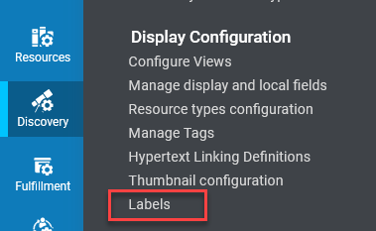
Discovery Labels code tables
Discovery -> Display Configuration -> Labels
89 tables! Search by code or description
Notes:
The place in Alma where you are going to find most of your labels that you want to change is in the Discovery Labels section, which you can find at this path:
Discovery -> Display Configuration -> Labels
** Now when you go to this part of Alma, this can be quite intimidating, there are 89 different code tables in this area with many entries in each table.
** To find the label you want to change, you can search by Code if you know the code for that label, but you probably don’t, but you do know the text you want to change so let’s search for that.
To do that, change Search for Labels: in the drop-down, from Code, to Description, and we’ll search on the next screen.

Slide 5
Discovery Labels: search in the Description of the label field
Search for: Need a book chapter? In the Description field
Notes:
So we search the text: “Need a book chapter” in the Description field across all 89 Discovery code tables to find the label we want to update. The searches are not case-sensitive but you do need to spell everything right and have the same spacing as the text for the search to work.
And then you will get some results for one or more tables. You might have to look through each table to find the exact label you want but we are lucky here in these search results that only one table has this particular text phrase.
** To look closer at this table, click on the ellipsis to Edit the table if you have the Alma roles to do that, you can also just View the table.

Slide 6
Update the label – but which one?
Search for: Need a book chapter again
Notes:
Once you have entered any table that you found in your search results, unfortunately, you have to do the same search again to find the proper label.
In this case, there are two options that match the label that I need to change in this particular table.
I don’t want to recklessly make changes to a label that isn’t the one it actually uses in that blue Rapido box, so in this case, I usually change one label and see if that makes the difference, and if it doesn’t, I change it back and then change the other label instead, and that will help me find the correct one.

Slide 7
Making the Description change for the label
Edit text for rapido.tiles.digital_chapter.best_offer.line_1 and Save
Notes:
So I’m making an educated guess that I want to change the second one here, the one that has the code: rapido.tiles.digital_chapter.best_offer.line_1.
You just edit the text in the Description field and then you Save.

Slide 8
Refresh the webpage to see your label changes
Notes:
I go back to the web page where I had the Rapido boxes with the old text originally and I refresh it
And that immediately updated to my new text in the Rapido boxes with the extra NOW. So it worked!
So knowing these few steps will cover most of your basic changes for Discovery Labels. You can change a word or two there, add some punctuation. But maybe you want to do more!

Slide 9
Some label descriptions allow HTML
Rapido Labels table - nui.ngrs.request.success
Notes:
You may have seen one of the top vote-getters in the recent Primo enhancement voting cycle was to allow HTML in labels. This is available already in some labels so it’s kind of trial and error to find if the label you want to change already supports HTML. You can also open a SalesForce case to ask.
Here’s how it looks in the table when it is complete, you can see a few HTML tags.

Slide 10
Closer look at the HTML in the description
nui.ngrs.request.success = <p>Request has been submitted.</p><p>Please allow time for processing and delivery. You can check the status of your request(s) any time in your <a href="https://csu-un.primo.exlibrisgroup.com/discovery/account?vid=01CALS_UNO:01CALS_UNO&section=requests">library account</a>.</p>
Notes:
Here’s a close-up on that same HTML in that label, we wanted to add a paragraph, add a reminder that processing might take a while, and have a link to the patron’s library account.
** The message ends up looking like this to the patron, which is much more informative and friendly.
HTML can get you formatting, bold, color and links in your labels.

Slide 11
Pro tip: Inspect in the web browser to find the code for the label
Notes:
One more item on Discovery Labels. Here’s a quick pro tip if you end up with multiple results when searching for the label you want to change.
** You can right-click near the text you want to change, on most web browsers there will be a feature like ‘Inspect’. This is a screenshot from Firefox.
** That will open a window on the left bottom of the browser page, where you can search HTML for the exact text you are looking for, and you’ll find a block of code like this.
**In this case, this block tells me that the code I want to update is:
rapido.tiles.digital_chapter.best_offer.line_1
Which matches the code I want to update in the table, as we saw on the previous slides.
So that’s how you update your labels for most of the things you find that relate to displays in Primo & Rapido.

Slide 12
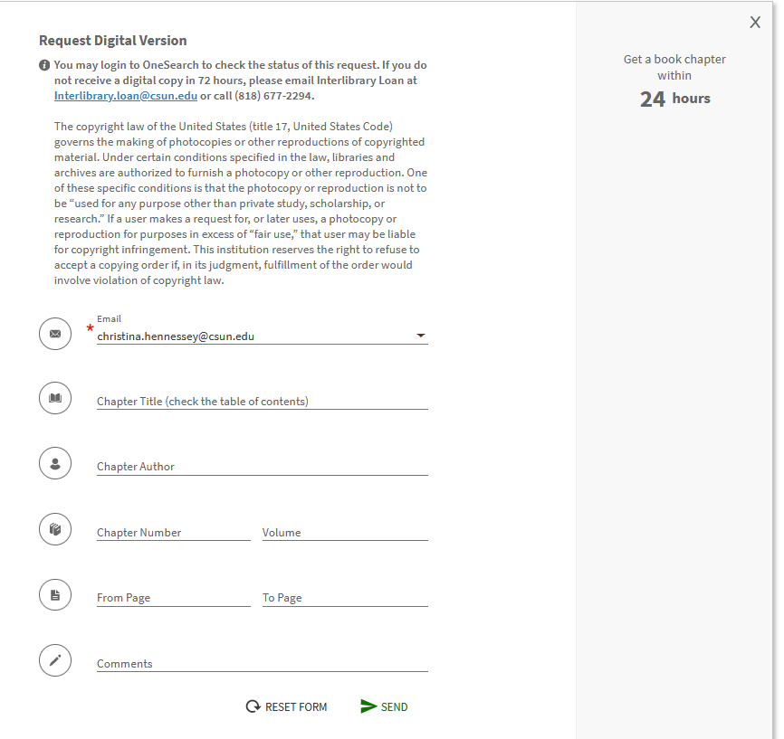
Note to Patron - Digital
Admin -> Resource Sharing -> Note to Patron ->
discoveryDigitalRequestMessage.html
Notes:
However, not all your labels will be in Discovery Labels, here are a few other places to find them.
There is a menu item in the Resource Sharing admin area named Note to Patron that has the text for digital and physical request forms.
** Here’s what the Digital one looks like when it is filled out. You just make changes to the Content field. You can see this one accepts HTML.
** And this is what shows at the top of the digital request form, this is what we see on a book chapter Rapido request at CSUN.

Slide 13
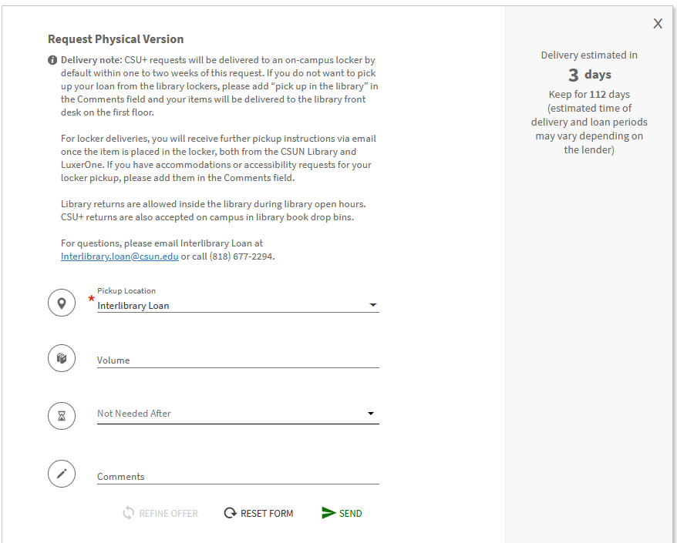
Note to Patron - Physical
Admin -> Resource Sharing -> Note to Patron ->
discoveryPhysicalRequestMessage.html
Notes:
And here’s the physical request one, what shows when I want to request a whole physical book. You just make changes to the Content field, and this one also accepts HTML.
** And this is what shows at the top of the physical book request form at CSUN.

Slide 14
Changing a letter label, part 1
Notes:
The last thing I want to cover quickly is that you can change labels in your Alma letters. I am going to talk about this in great detail tomorrow, but I want to share a little bit in the context of this Lightning Talk.
** There is a unique section in every single Alma letter called Labels, and you can change those without doing anything else to Alma letters.
** Enter any letter, this example is from the Borrowing Activity Letter but most of your letters look like this at the bottom with a closing phrase like ‘Sincerely’, and then the name of a library or department.
When I’m looking in the preview for this letter and I see that the word ‘Sincerely’ is missing a comma and this bothers me, because it looks sloppy in our communication with patrons. So I click on the Labels link
** And I look through the Labels table, and see there is the word Sincerely, with no comma. I can also tell by looking at this that this is still the Ex Libris default text as there is no information about when and who updated it and it is all grey-colored.
** So I click on the ellipsis and see the Customize option

Slide 15
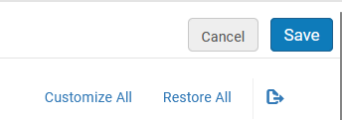
Changing a letter label, part 2
Notes:
Once I choose Customize, the label description turns white and I can edit it anyway I like.
** When I have it the way I want, I Save it at the top
** the panel will close and I immediately see in the letter preview that the Sincerely in my letter has a comma now.
** And when I go back to that same letter Labels table in the future, it will remind me that I was the one that updated this (as that’s my Alma ID), and I updated it on August 6, 2023.
** If you don’t like your changes that day, or a year later, you can always go back to the Ex Libris default setting via the Restore option for that label.
I’ll be talking much more about Letter labels tomorrow but I wanted to show you how to quickly edit one.

Slide 16
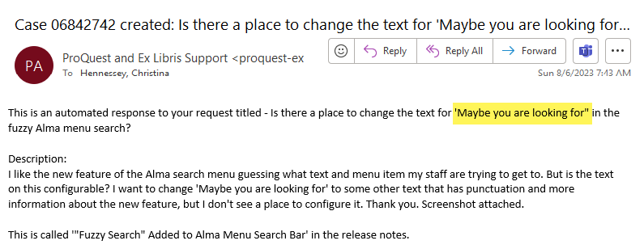
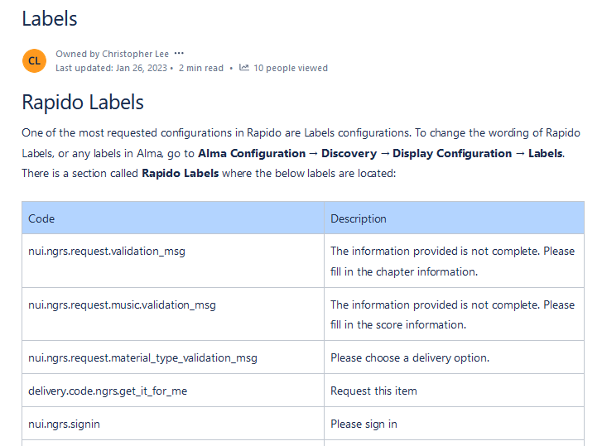
If you are still stumped?
Ask your colleagues!
On Slack
On the listservs (CSU or ELUNA)
Open a Salesforce case
Chris Lee has some pages on Labels on the ULMS wiki:
https://calstate.atlassian.net/wiki/spaces/URS/pages/2587754511/Labels
https://calstate.atlassian.net/wiki/spaces/URS/pages/2409431041/Rapido+Configuration+Labels
Notes:
If you are still stumped with how to update some text or a label!
** Ask your colleagues
** On Slack or Teams or whatever you use to communicate in your organization
** On the Cal State ULMS listservs, or the ELUNA Alma or Primo listservs
** You can also open a Salesforce case, here’s one I opened earlier this week when I couldn’t find how to update some new text in the August 2023 release that I wanted to improve. Sometimes you get a note back that says, yeah, that’s hardcoded, we can’t change it. Sometimes they offer to change it for you! And sometimes they add a new field that all customers can edit based on your suggestion!
** Finally, you can find some more examples of labels other CSU folks have changed in their systems on these pages from CSU’s Chris Lee.

Slide 17
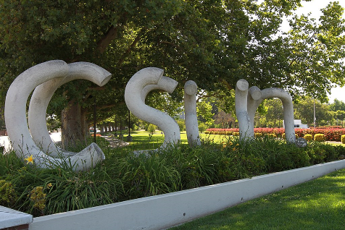
Questions? Christina L. Hennessey christina.hennessey@csun.edu
Notes:
Thank you for your time & attention and for your interest in labels.
I encourage you to reach out if you have label questions or ideas, I would love to hear from you.

