Slide 1
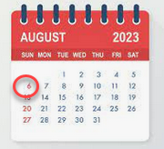
Empowering library staff and pleasing library patrons through Alma letters
Christina L. Hennessey
Christina.Hennessey@csun.edu
California State University, Northridge (CSUN)
I-SPIE ANNUAL CONFERENCE – CSU CO (LONG BEACH)
August 11, 2023 9:00am-9:45am
Notes:
Good morning and welcome to my session on Alma letters.
** You may have seen a version of this presentation at the ELUNA conference this year, if you did, I wanted to let you know that this is a much revised version, this one has a lot more about resource sharing and lots of information about the new letter interface, which debuted in the August 2023 Alma release, 5 days ago on Sunday, August 6.
In this presentation, I will quickly go over the basics of Alma letter structure but I want to give you suggestions & tools to use in your own letter improvement, to make letters easier for you and your staff to use, and to have them make more sense to your patrons.
This presentation has a lot of detail but the slides will available shortly after the conference on the conference wiki, along with a Zoom recording you can refer to later.
I’ll be speaking for about the next 35 minutes…then we’ll have some time for Q&A.

Slide 2
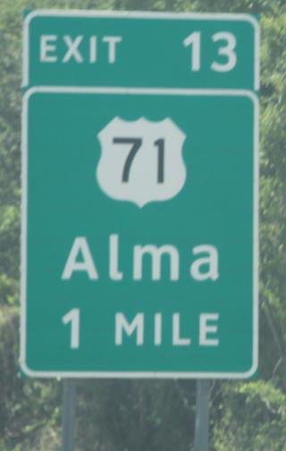
Context of my Alma letter experience
Systems Librarian at California State University, Northridge (CSUN)
5 years in Alma/Primo/Primo VE; 1.5 years in Rapido
Have updated Alma letters for my own institution but for two others and have consulted with a few other libraries as well
CSU letters are not managed centrally
CSU Rapido letters are mostly managed by Chris Lee
Notes:
So I want to give you some context of my own Alma letter experience:
** I am the systems librarian at California State University, Northridge, better known locally as CSUN. I tell you this as I am NOT someone that currently works in circulation or access services or interlibrary loan, which almost all of you do, but I do work very closely with those areas.
** I’ve personally been working in Alma, and Primo, and then Primo VE for five years, and about 1.5 years in Rapido.
** I’ve not only done work on letters for CSUN, but two other Cal State Libraries and have consulted with other libraries inside and outside the CSU on their own letter improvement projects and questions. I would also be glad to help you with your letter projects after today. I really like working on letters!
** Our Cal State letters overall are NOT managed centrally in our consortium and all libraries update ours individually. I do recognize many consortia do manage their letters centrally.
** However, in relation to Rapido letters, in the CSU, those are mostly managed and updated by Chris Lee in the Chancellors Office. But maybe you have some local changes you would like to make to the letters Chris has created, or you’d like to know more about what is possible so you can make suggestions to Chris, or you want to try your own local changes without bothering Chris!
[exit sign is from Alma, Arkansas, USA]

Slide 3
Why you should you know more about Alma letters?
The only communication you have with some of your patrons
You and/or your staff may have never seen your letters
Get your pandemic or quarantine instructions out of there
Possibly strong language in letters that can upset patrons
Maybe your Alma letter guru left
You cleaned up letters a few years ago – letters have changed a lot and there are many new ones; also new features
Learning a little code
Notes:
So why should you learn more about Alma letters?
** The first point I want to emphasize more than anything is this is really the only communication you have with so many of your patrons. So you definitely want that interaction, and the opinion they have of you and your library, to be a good one.
** Perhaps you’ve been in Alma for a while but you are not actually a patron of your own library – meaning you don’t actually check out items from your own library to yourself, and that is okay! Also, your staff might not see the letters that come from their desk, again, they support the desks but maybe are not a patron of their own desk. And you might have text in there that doesn’t make sense or is no longer true.
** Most all libraries physically closed in 2020 and then had limited services from 2020 to as late as 2022. It was a scary time and we all had to make changes and update words and messaging everywhere very fast, including in Alma letters. As we came back to our libraries in person, bit by bit, we removed some of this language but maybe forgot where else we put it in the crisis. So this is a good time to review your letters again, in 2023, to make sure you put all those changes back to “normal” as it were.
** We are all trying to be more sensitive to our patrons that may be upset by some strong wording in our letters, this is a good time to review that language.
** Lots of library staff are changing jobs since the pandemic. Maybe you used to have someone in your library that loved to do Alma letters and they left. And no one has touched the letters since. Maybe the new letter guru can be you!
** Maybe you already worked on your letters a few years ago. New letters are added from time to time and this is usually announced in Ex Libris release notes. If you enable a new feature or add a new Ex Libris product, you might get some new letters that you need to configure. So it is good to check back every year or so.
** As we think lots about empowering ourselves, maybe you want to learn a little code for your professional development. You actually don’t have to know any code to update Alma letters but it’s an easy and quick place to start. Then you can put “I know something about XSL and XML” on your resume and c.v. and put this in your annual review.

Slide 4
What do we mean by “letters”?
Letters = communications from Alma
Some libraries still print these out and “snail mail” them to patrons, but mostly emails
Resource Sharing: print for labels or to use to look in stacks
Some are automatic jobs: every day, once a week, once a month
Some are caused by a manually run Alma job
Many are in relation to some action by a library staff member in Alma
Many are in relation to some action by a patron
Notes:
So maybe you are not familiar with Alma letters at all. That is okay!
** Letters are just any communication from Alma.
** Some libraries still print these out and mail the letters to patrons, especially when they owe money. But it is mostly about emails
** However, in the case of resource sharing, there are some of the letters you can use as printed labels to wrap around a book, or to share information for staff and students to look for things in the stacks.
** Some Alma letters are sent by automatic Alma jobs – for example, overdue notices go out every day at a particular time.
** Some letters are caused by Alma jobs that you manually ran.
** Then many letters are in relation to some action by a staff member in Alma, things checked in and out, items are received, items are scanned at the hold shelf, and so on.
** Or, sometimes a patron has made a Rapido request or done something in Primo, these actions could also send a letter to the patron.

Slide 5
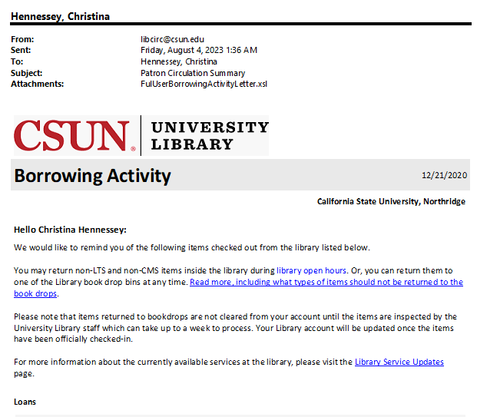
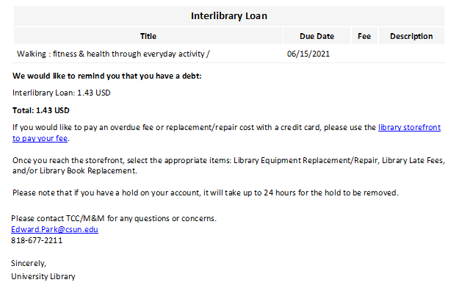
Letter example: Borrowing Activity Letter
Notes:
I wanted to include a few examples of Alma letters if you’ve never seen one before.
Here’s the Borrowing Activity Letter, that is either sent once a month by a scheduled job, or manually when you click ‘Send Activity Report’ in a patron’s record.
It tells the patron what they have currently checked out, what is overdue, and if they owe money.
In relation to resource sharing, depending on how you have set up your Interlibrary Loan checkouts, your patrons might see your check outs for CSU+ or your local lending system here, and you might see your ILLiad checkouts here as well.
You can see in my example here that I had an Interlibrary Loan checkout, and owed the Interlibrary Loan department some money too.

Slide 6
Letter example: Return Receipt Letter
Notes:
Here’s an example of the ‘Return Receipt Letter’ which is sent when something was returned to the library and checked back in, if this letter is turned on for that desk.
It says what desk it was returned to, and when it was checked back in by staff.
You might send these as part of your ILL workflow, you might not! It is optional.

Slide 7
Letter example: Document Delivery Letter
Notes:
But not all letters are about physical item checkout or general circulation.
In Rapido, you’ve gotten a whole new set of Alma letters to configure.
Here is a version of our Document Delivery Letter, the one that sends a link to an electronically delivered item that came through Rapido.
You can probably tell that this is not how this one looks out of the box, we made a lot of changes to this one at Northridge, and I would be glad to share our copy with you later.

Slide 8
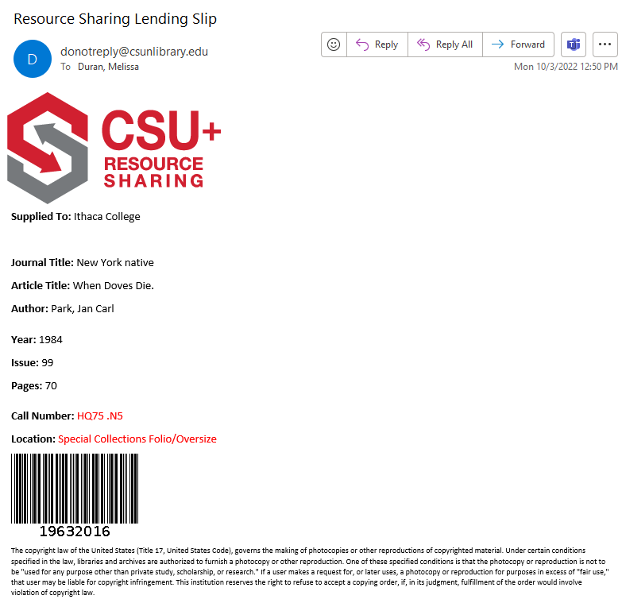
Letter example: Ful Incoming Slip Letter
Alma name: Ful Incoming Slip Letter
Letter subject: Resource Sharing Lending Slip
Notes:
Also, not all Alma letters go to patrons.
There are a few Alma letters that are just for library employees to do their work.
Although this is an internal letter, you can still configure it as you like to make your staff happy as well, so it is easier for them to do their jobs.
This is the letter for a slip that is printed out by library staff when they need to retrieve an item from the shelf to be scanned or mailed to a borrower.
One thing that can be really confusing about letters is that the name of the letter inside of Alma, might not be the same as the name of the subject of the email, and also might not be the name of the letter inside the email! So you’ll want to keep that straight when you are editing your letters or sharing changes you want to make to a letter with your systems librarian.
** In this case, the letter in Alma is named: Ful Incoming Slip Letter
** But the subject of the letter or email is ‘Resource Sharing Lending Slip’.

Slide 9
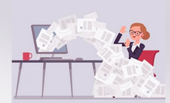
Where can letters already sent to a patron be found in Alma?
User record – Attachments tab
Either all the letters for all time or for a set retention period (last 365 days)
Saves it in the formatting it had when Alma sent it
Useful for showing patrons that you really did send it
Not found in Analytics
Notes:
So maybe you are really new to Alma and you aren’t even sure if you are sending Alma letters or what letters you sent in the past.
** One of my favorite, favorite parts of Alma is that by looking in the Attachments tab for user records you can see recent letters sent to that user.
** Depending on how you set up letter retention, you can refer back to all the letters sent to a user for all time, or for the last year, or whatever retention setting you want to use.
** The letter is saved in the Attachments area in the format as it was originally sent. So you can make some changes in your letter configurations, but the letter is still saved in the user record in the exact way you sent it, whenever you sent it.
** This history helps - the days of ‘I never got that bill” or “I didn’t know when that was due” have a little bit of evidence to them now. Of course, patrons can always claim a spam filter or they never check that email address, but this still helps.
** Some sad news to share is that you cannot use Alma Analytics, which Natalya will be presenting about in our next session, to find out how many letters were sent or when or by whom.

Slide 10
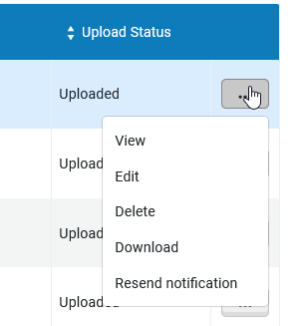
User record – Attachments tab
Notes:
So here’s an example of one of my test patrons in the Attachments tab.
The list of all the letters ever sent to the patron is here, we decided to retain all our letters for all time at CSUN. This list tells you the name of the letter, and the time & date it was sent
You can also click on the ellipsis next to each letter to take action on it.
** I can view the letter from here.

Slide 11
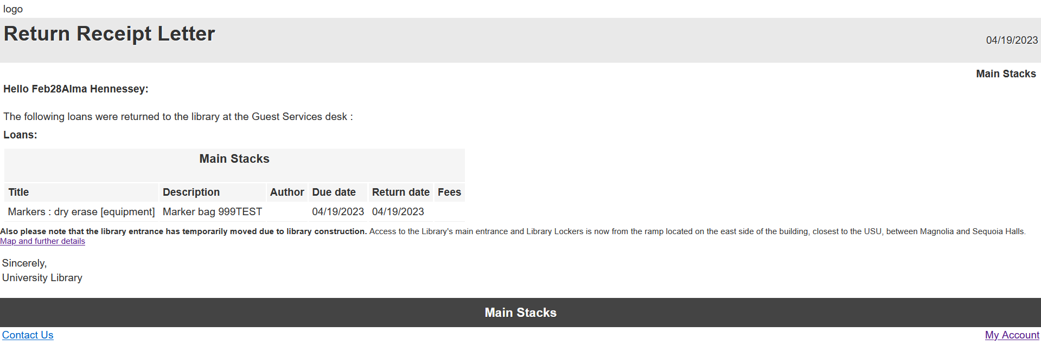
View a previously sent letter
Notes:
So if you clicked View on the previous screen on a particular letter, you would see this for your Preview.
I will note that the letter doesn’t look exactly like it did when you sent it
e.g. the logo is missing, it’s not the right colors. But you get the idea

Slide 12
Alma roles & menu for configuring letters
Path: Alma Configuration -> General -> Letters -> Letters Configuration
Notes:
So that was how you can see the history of Alma letters sent to a particular user in a user record. But where do we actually configure the letters?
** Here’s the path you use to get to Letter Configuration inside of Alma – Alma Configuration -> General -> Letters -> Letters Configuration
** However, not everyone can configure Alma letters and you need some fairly powerful Alma roles to do that. Chris Lee addressed some of this in his presentation yesterday.
If you have either the Letter Administrator role or the General Systems Administrator roles, you are good to go and will be able to configure Alma letters.
If you don’t have either of these, you can at least ask your systems librarian if you can have access to Letter Administrator, that is the lesser of two powerful roles. But it is still powerful.
These two particular Alma roles do not have scopes; they are institution-wide.
And there is no granularity on these, you can’t say that someone can edit one letter but not another. That is really a shame for resource sharing and Rapido letters because we would like to be able to give resource sharing folks access to those particular letters and not the others.

Slide 13
All the letters in one place in Alma
Notes:
When you go to Letters Configuration, here’s what you see.
And this is one place that many people run for the hills.
There are 137 different Alma letters in my system as of August 2023! And it might be more soon. And your system might have more or fewer letters, but 137 is probably close to what you should see in your own system.
But you don’t need to worry about all of these letters, just some of them.

Slide 14
Settings for individual letters
Retention. Per letter so these can be different
Channel: All you care about is EMAIL
Enable vs. disable
Patron-facing
Customized, by who and when
Notes:
So let’s take a closer look at a few examples of the letters and their configuration.
** I mentioned ‘retention’ a bit ago, which is how long you want to keep the letters in the patron record on the Attachments tab. You can leave this blank to keep letters in this tab forever, or you could set it to something like ‘365’ to hold letters for 365 days. You can set different retention schedules for different letters; you may want to keep billing notices forever but Loan Receipt Letters only one year.
** You can also see a column here named ‘Channel’ which can be confusing. You will almost always only care about Channel equals EMAIL. SMS is what you would use to send a text to a patron. And WEBHOOK is a special thing where when an action happens in your system, some special code runs outside of Alma and Primo. You just need to know that EMAIL is the channel you care about.
** Letters can be enabled and disabled I find it useful to disable letters that I know we don’t use in our system, just so I don’t think I have to update them or test them whenever I am making big changes or doing a letter review. It is a good visual helper. When we had to close very fast in Spring 2020, also when we changed the name of our library very fast, it was very helpful to have good visual information on letters that I could ignore.
** Patron-facing letters are letters that go to patrons, that makes sense.
** We’ll be talking about letter customization today; this column will let you know if anyone at your site has ever customized that letter
** and you can see their Alma ID if you aren’t sure who it was (and maybe they can tell you why they updated it, if they remember).

Slide 15
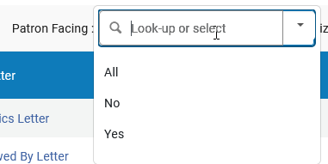
Letter filters to calm you
Notes:
So 137 letters can be very intimidating, but let’s already use some filters to calm you so you can see that it isn’t actually that much.
** At the top of the Letters Configuration page, you’ll see you have a few filters to choose from. You can filter by enabled or not; patron-facing or not; what channel, and if that letter has been customized at your site.
** It would be nice to check all the letters but if you want to do something with immediate impact, limit to patron-facing letters
** That already gets us down to 83 letters, that’s 54 fewer than we started with.
** Limit to those that are enabled (on your system), and limit to channel = email, and it is a manageable 49 letters instead of 137.

Slide 16
Some of the letters related to Rapido and resource sharing
Ful Resource Request Slip Letter
Resource Sharing Shipping Slip Letter
Resource Sharing Return Slip Letter
Resource Sharing Receive Slip Letter
Resource Sharing Request Confirmation Letter
Rapido member letter
Change Rapido Request Terms Letter
Document Delivery Notification Letter
Ful Incoming Slip Letter
Query to Patron Letter
Ful Borrowing Info Letter
Lending Requests Report Slip Letter
Ful Lost Email Letter
ALSO: loan, return, and overdue letters
https://knowledge.exlibrisgroup.com/Rapido/Product_Documentation/02_Configuration#Configuring_Rapido_Letters
Look at Ex Libris documentation to see the full list of all Alma Letters: https://knowledge.exlibrisgroup.com/Alma/Product_Documentation/010Alma_Online_Help_(English)/050Administration/050Configuring_General_Alma_Functions/070Configuring_Alma_Letters#Letter_List
Notes:
** Here is a list of some of the letters that relate to Rapido and/or Resource Sharing. You can see that some of them have ‘resource’ or even ‘resource sharing’ or ‘slip’ in the title, but sometimes it is ‘Document Delivery’, or Rapido. And then there is the one named ‘Ful Incoming Slip Letter’ and ‘Query to Patron Letter’ that doesn’t have any of those terms in it.
** I was just making a list of these for my presentation and noted there were some we don’t use at Northridge, but you might, so I’m listing those here
** But also, the regular loan, return, and overdue letters for your whole Alma system might have some resource sharing and ILL information in it as well.
** It does seem to be a moving target, here is supposedly the latest link and list of all the Rapido letters but you can always ask your fellow resource sharing friends if you are not sure.
** And here is a link to the entire list of the 137 Alma letters

Slide 17
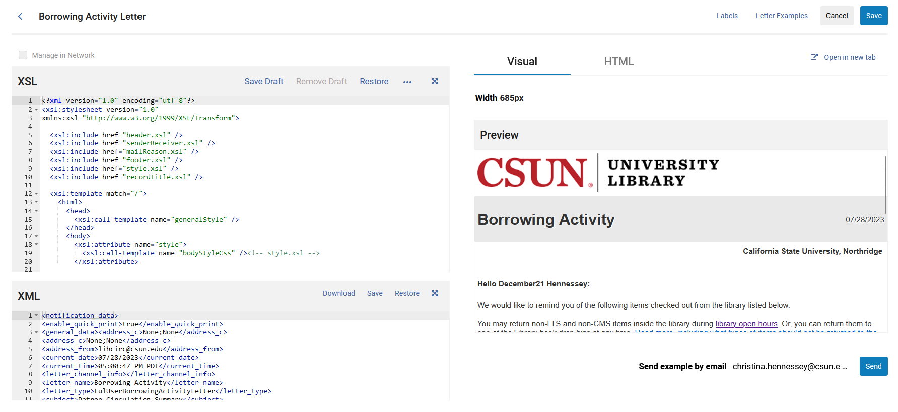
New letter editing interface!
Notes:
So as I mentioned, there is a new letter editing interface as of this past Sunday, August 6. If you haven’t seen it, here it is!
When you click on the name of any letter in the Letters Configuration screen, or if you choose Edit, this is the new screen you will see.
We’ll go into a lot of detail here in a minute, but you can see a few elements:
** XSL panel, left top side: That is the code behind the way the letter looks and behaves.
** XML pane, left bottom side: This is the XML or metadata that tells the letter what is available and what to show. It has things like patron name, item information, money owed, name of the letter. All your ‘sample letters examples’ will be files of XML.
** Then on the right, there is a new Visual panel, and an HTML panel. This will be created from a combination of your XSLs and XML and Labels. You can edit the width of your preview, and email it to yourself.
**If you are looking for the old Labels and Letter Examples tabs, they are now links at the top of the same screen.

Slide 18
Format of letters: Labels
Notes:
** First up is the Labels, which is a place you can make an easy, quick impact in your Letters
You might have set up a lot of these at migration or go live time…but they probably need updating.
I will be talking a little bit about Labels today in relation to letters, I mentioned them yesterday in my Lightning Talk as well and how to edit them.
** In this table, the Code is what will be used in the XSL code, which I will show in the next slide, to show whatever text is in Description in the Letter
**You can see in this example here that inside the XSL
** I have whatever is in the code for Sincerely;
** and whatever is in the code for Department. Anything in your XSL file led by two at-signs and closed by two at-signs - is something that is a label converted from the code to the description. You don’t really need to know that, but if you are troubleshooting a letter later and want to know what to look for in the XSL file, this is how you find it – look for the code that goes with that description.
** Here’s what that looks like in my letter.
Every letter has different labels.

Slide 19
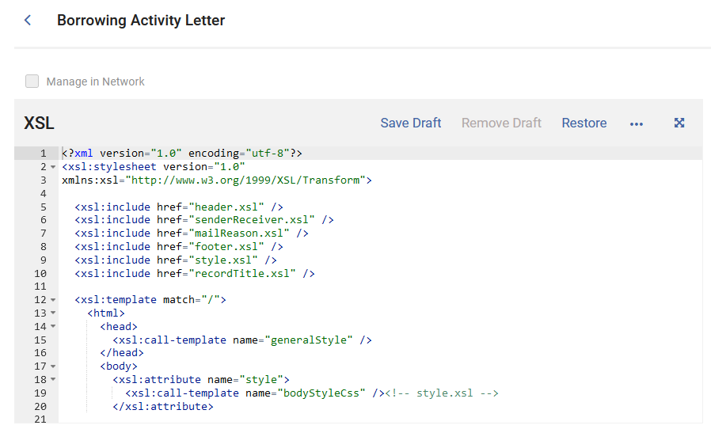
Format of letters: XSL (was: Templates)
You don’t have to touch this
Notes:
Next up is the XSL section, which was formerly known as Templates
This is another part of letter work that usually has library staff members running for the hills!
** I’m going to talk a little bit about coding changes you can make to your XSL later on but I mainly wanted to make you aware of this area, and that you never have to do anything with this area if you don’t want
You can see in this example that this XSL calls other XSL files – other components that are shared by many letters and control your headers and your footers and the style of your letters.
You can edit XSL right in this editor right here, you can see in the new letter editing interface that it is much improved and the colors help you figure out elements and where you might have mistakes.
** But most folks prefer to copy off sections of the XSL and work on them in a text editor like Notepad++

Slide 20
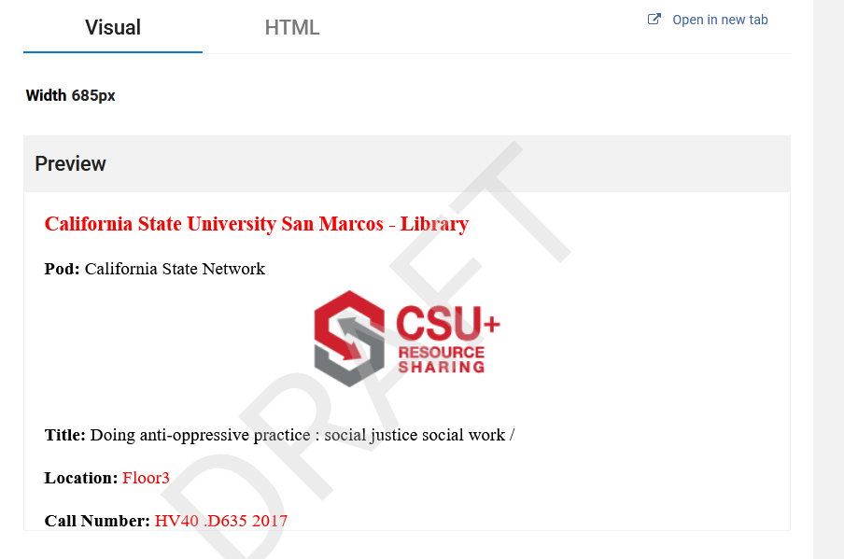
Sharing and testing XSLs
Can get a shared one from the community
Chris Lee has uploaded some
You can also contribute
New options to Save and Remove drafts and see those in the preview
Notes:
If you do find other letter layouts that you like from other sites, you don’t have to do it all yourself! When you are in the XSL panel, if you look under the ellipsis, you see that there are shared XSLs from other sites for that letter. You can also just copy and paste from a text file into that panel to overwrite the XSL that you currently are using.
** You can see here that Chris uploaded some for the Ful Incoming Slip Letter.
** You can also contribute your own with the Contribute option.
** The August 6 release has a new save draft option so you can do more tests to an XSL file without making anything so FINAL, I haven’t gotten to play with it much yet but I see that when I make a save draft version, my preview panel shows a DRAFT watermark, so that’s a nice visual when you are doing testing.

Slide 21
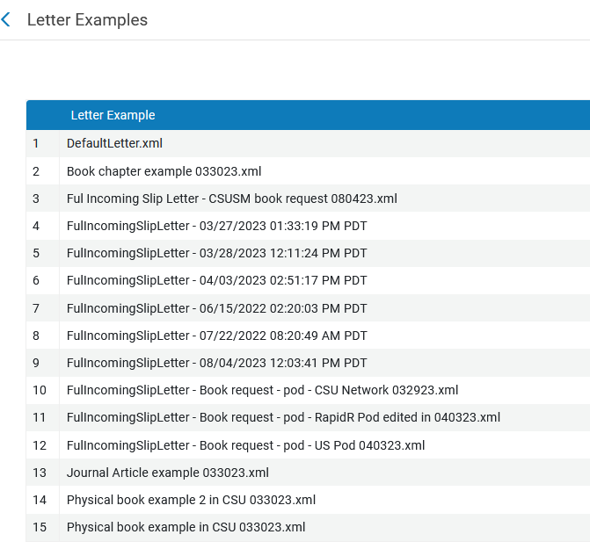
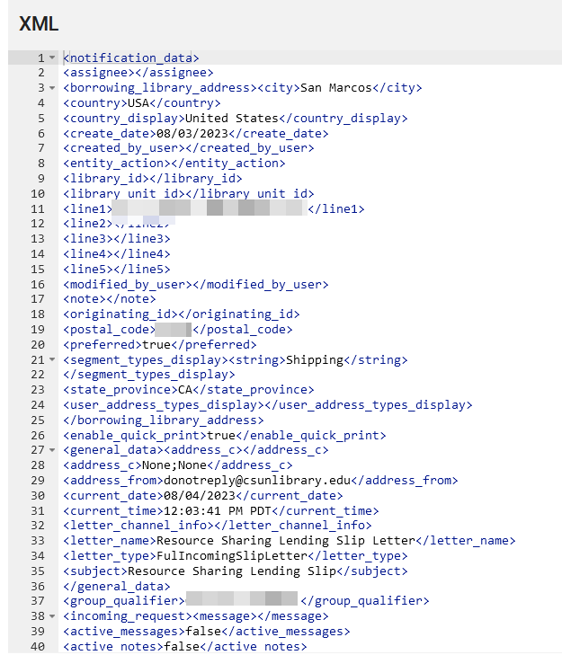
Format of letters: Letter Examples
Letter Templates in XSL
Letter Examples in XML
Save for later testing
Notes:
The last area of letters is optional as well, but this is where you really make an impact in your letter improvement projects.
Letter Examples are where you can save copies of letter XML for current or later testing.
** Without getting too much in the weeds, your letter template is in XSL, which we looked at on an earlier slide.
** but each specific instance of a letter is in XML format, and these are not the same thing.
So when a patron makes a request from my library, Alma generates an XML of metadata about the patron, about that book they want, when the book is due, and so on. Here’s just a few lines of the XML from a recent real request. The entire file is over 500 lines long! But please note that if the data isn’t in the XML, it can’t be in the letter. But Ex Libris is very open to adding items to the XML for a particular letter so open a Salesforce case and ask! We have seen this happen in Rapido development.
So why would I want to save copies of XML or letters for particular instances?
Let’s say I’m making a change to some of my print slips.
** If I have several different scenarios and libraries and books vs. book chapters vs. articles, I may want to test that my formatting change is going to look okay in all those cases.
It is great to have examples of different cases ready for testing, instead of waiting for letters with that condition to happen.

Slide 22
Loading recent Letter Examples
Notes:
So now I’m going to go through how to save some recent letters for your examples and testing.
Go to Letter Configuration and click on any letter name, and go to the Letter Examples link for that letter.
Maybe you already have several examples for letters in this section.
** But if it is a letter that you don’t use in your system, or if no one has ever saved a letter there, you will only see this: Default Letter.xml. That is a sample letter put in there by Ex Libris.
In my example, this is the Ful Lost Email Letter, which we don’t use at Northridge.
You can see in the settings here that this is the Default Preview letter, so the one that will show in the new preview window back on the other screen.

Slide 23
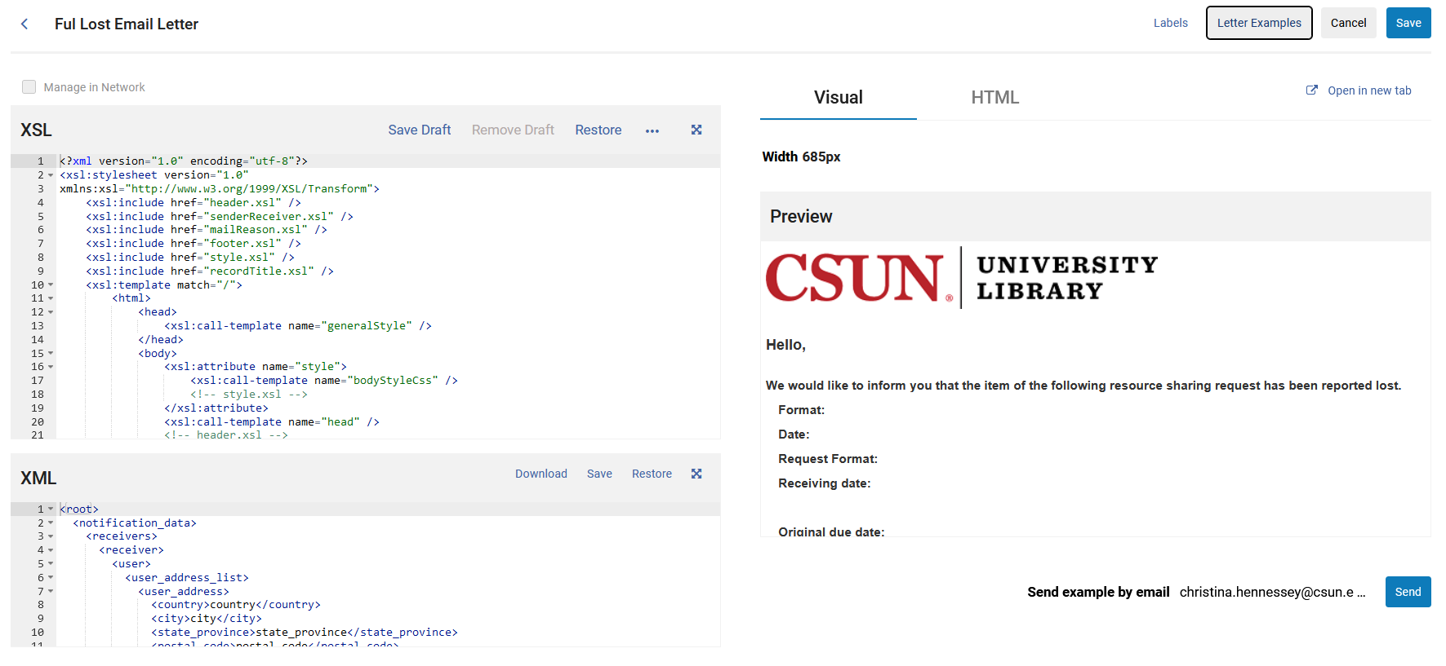
Letter example preview: in small window
Notes:
Here’s what that preview looks like for a default letter.
This can help give you an idea of what this letter would look like if you did have a local example in your system.
Usually there is text to tell you something of context, in this case, the text:
“We would like to inform you that the item of the following resource sharing request has been reported lost.”
That clears up for me what this letter is for, something happened in Alma by a staff action or an Alma job, that set that item to lost status and let the patron know.
However, this sample letter is not using metadata from your system (although it did pull in some local components, like our library logo) so it would be nice to have examples from your own system.

Slide 24
Letter example preview: open in new tab
Notes:
You could see in my example on the previous slide that you can’t see the whole letter in that preview.
You can scroll down to see the whole thing,
** or you can see the whole letter by clicking on Open in new tab at the top of the preview window.
It looks like this. It doesn’t have everything, subjects, barcodes, etc. but it gives you an idea of the whole letter.
So this is what you might see if you have a letter where you have not saved any examples.

Slide 25
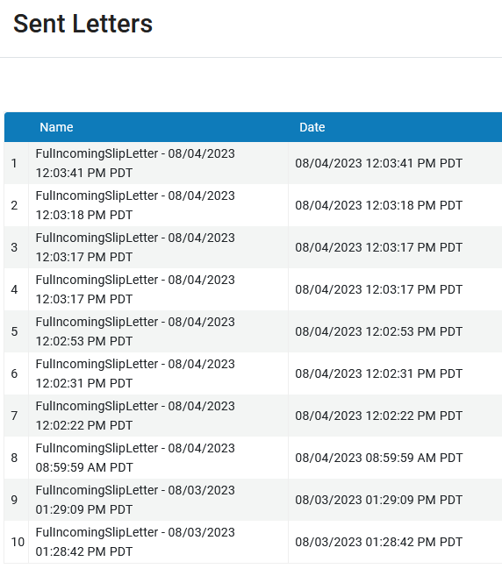
A letter that has lots of examples: Ful Incoming Slip Letter
Only last TEN sent
In the last SEVEN days
Notes:
So next we are going to look at Ful Incoming Slip Letter examples. You should have a lot of these to work with in your system.
** So again, you’ll click on a letter name, in this case, Ful Incoming Slip Letter
** Go to the Letter Examples link at the top right
** and click on Add from system letters
** and you would see a list like this.
** Please note! What you will see here are only the last TEN letters of this type that were sent in your system, but only if they were sent in the last SEVEN days

Slide 26
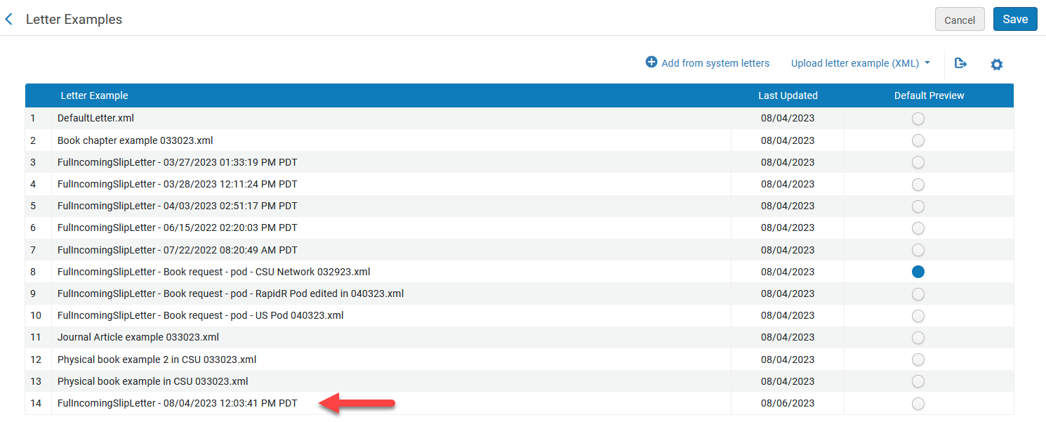
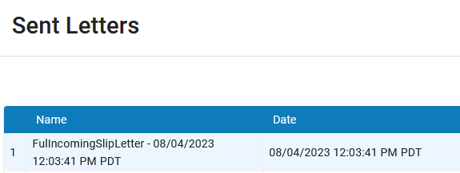
How to save an example letter
Notes:
So going back to our Ful Incoming Slip Letter examples, we click on one from the Sent Letters area, and that will put it in your Letter Examples area
** It will be saved in the Letter Examples list by default with the same date/time that it was sent
Before we do anything else, if you don’t save from here, you didn’t save that letter
** So save at the top of the page, and then come back in to the Letter Examples area

Slide 27
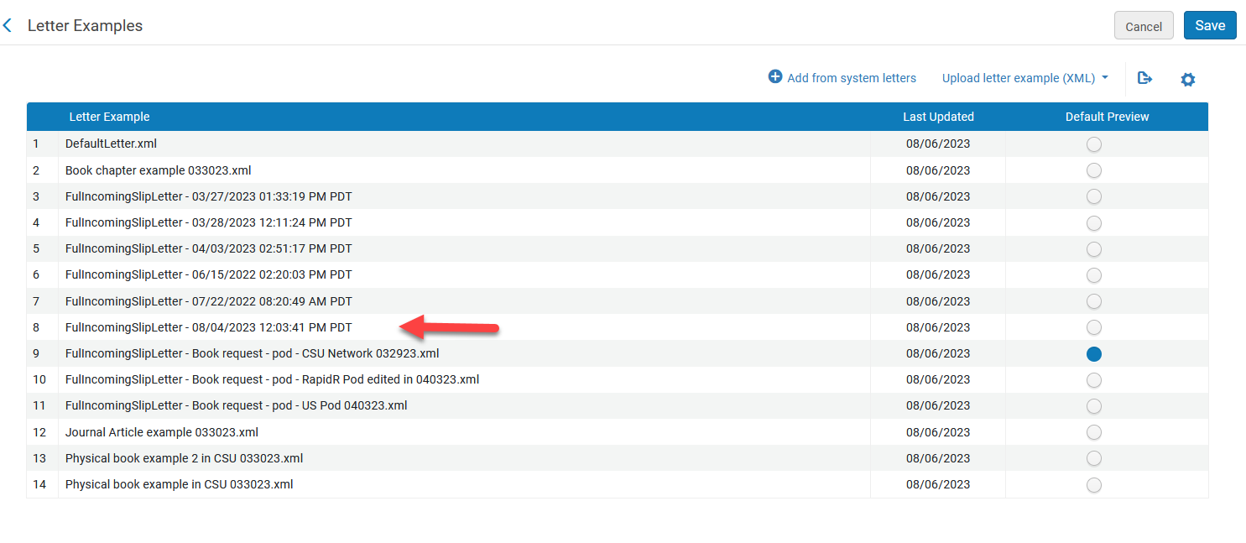
Re-enter the Letter Examples
The letter you just saved may have moved locations
Now all your ‘Last Updated’ will have today’s date
Notes:
After you have saved it, click the Letter Examples link again, enter the Letter Examples area, and please note that your letter may have moved places in the list order
** Also, the Last Updated column for all your letters in this area will now have today’s date even though you just added that one new letter today.

Slide 28
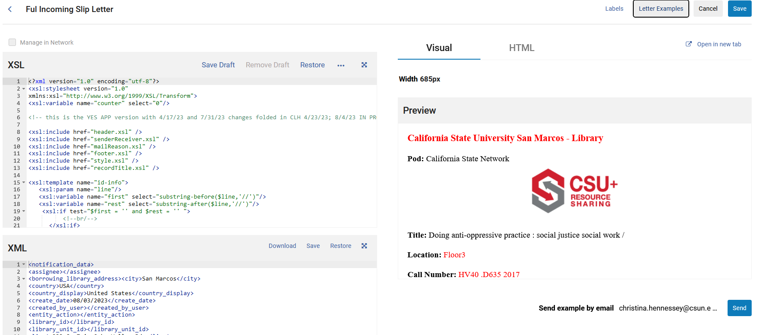
Let’s preview what we saved
Notes:
So after all that, let’s look at what we got for this letter example.
** Change default preview to the letter you just added, and Save
** You’ll see a message saying, XML was replaced
** and then the preview window will appear with the new letter example
I can see this was an example of a real request, let’s look at it in a bigger version by clicking on Open in New Tab at the top of the preview section.

Slide 29
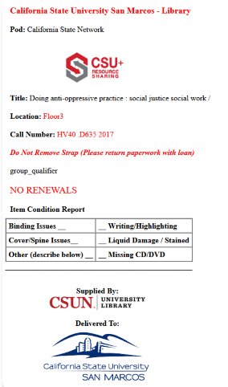
Bigger version of the saved letter
Notes:
This was a request for a physical book, here’s information about the location in the building, and the call number, condition report, and some nice logos of CSU+, CSUN, and CSU San Marcos.
As I keep mentioning in these previews, sometimes not everything shows up in the preview, an image is there in the real letter instead of that text ‘group_qualifier’.

Slide 30
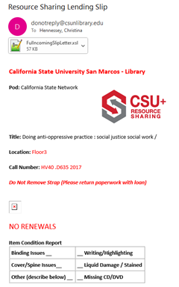
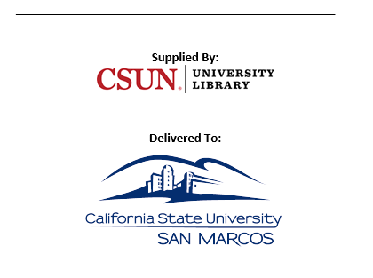
Email letter to yourself
Notes:
When I’m back in the preview, I can do a few things with the letter,
** Email it to yourself. I like to save copies of letters in my email for later work, or because an administrator or a staff member wants a copy of the letter to review for wording, layout and accessibility. Put in your email address and press the Send button.
** The letter arrives in your email in a few minutes after you do this.
** When you open it up, it looks like this. Much like in the other examples, maybe you see all the images and maybe you don’t. But this gives you a copy you can use later for testing.

Slide 31
Rename the letter so it means something
Notes:
The next thing I want to do is rename that letter to something that makes sense to me and load it back into the Letter Examples area.
In order to rename that letter, you have to export the XML file to your computer, rename the file, and then load the file back into Letter Examples. So here’s how you do that.
** Go to the XML panel on the preview screen and press Download
** Depending on how your browser is set up, this file might be saved to your Downloads folder on your computer or somewhere else.
** Find it wherever it is on your computer and save it with some name that makes sense to you
In this case, I call it CSUSM book request as I was testing something with that workflow.
I also add the date to the filename. This is important, as a letter example that worked in 2021 might not work in 2023 – maybe you changed the name of a library or the letter XML changed, so it’s good to know when the letter is from

Slide 32
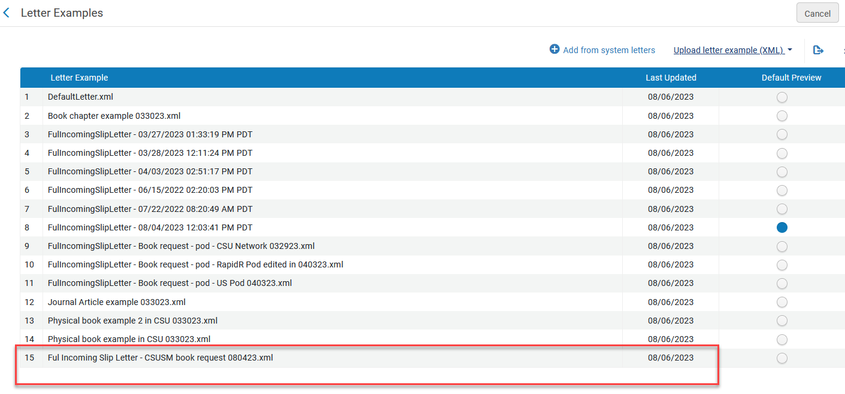
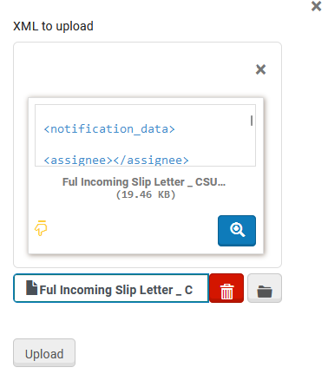
Upload the renamed version of that same XML file
Notes:
So now you want to load that same file back into your Letter Examples.
** Letter Examples button
** Upload letter example (XML) link
** That brings up this window.
** Find the file you just saved on your computer, and click Upload
** And now there it is in your Letter Examples for that letter with its informative new name.
And don’t forget to Save! It will forget what you just did otherwise.

Slide 33
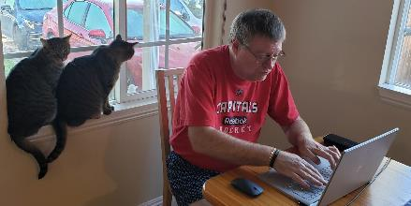
Download letter examples for everything you can
Getting letter examples is a great place to start and might take you a while
Work through each of the letters
That will give you a sense of what letters are used a lot so you know where to spend your time
Sometimes you only need one example but it is nice to have a few and definitely nice to have at least one local to your system
Notes:
So getting letter examples and saving them off is a GREAT place to start and it might take you a while.
** I recommend working through each of the letters one by one, especially the patron-facing ones that you care about
** This will also make it clearer to you when letters happen, not only the automatic and scheduled ones, but the ones that are tied to someone’s work schedule.
** It’s good to have at least one example of something in your system but you might find you want several

Slide 34
Bcc: for those letters you don’t know
Most letters have a bcc: option in the Labels
Your institutional email or maybe a special email account (you don’t want to be overwhelmed)
Maybe not all at once but ones you are stumped by (maybe if some only happen once a month – include those)
I have ones that I marked to bcc: me August 2020 that I still have never seen
Notes:
So after all that, you’re still going to end up with letters you don’t have any examples for, letters you don’t understand, and letters that you want specific examples for
The good news is that most letters have a Blind Copy or bcc option in the Labels
** You can choose to add your own email, or maybe a special email account for your department.
** Then put that email in the bcc label for many letters, maybe not all at once, but especially those that you have no idea what causes them to happen. Maybe they only happen once a month or once a year and you’d like to see them whenever do they happen. Just set this bcc label and forget about it.
** I did my original letter cleanup project in the Summer of 2020 and put a bcc: on several letters at that time. I still have never seen quite a few of those, three years later, and never figured out a workflow or job to cause them either.

Slide 35
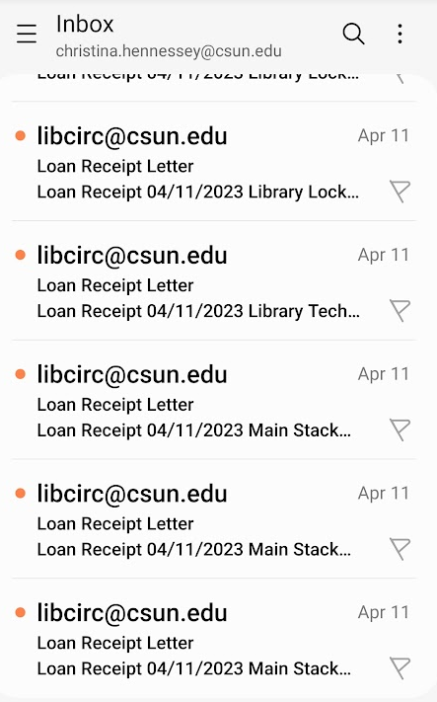
More bcc: notes
Be careful with the bcc: If you accidentally have it on a letter that goes out to a lot of patrons
Once you get a bcc: that you have been waiting for, you need to get in the Letter Examples – Add from system letters as soon as you can to save it
Also, you might need to reach out to staff what they did to make it happen? Might be a new workflow or a new staff/student that did something unexpected in Alma. But be nice
Notes:
A few more things about the bcc.
** Be careful with it! If you put a bcc: on a letter type that only goes out at a particular time of day and all at once, like the daily overdue letters, whatever email you bcc’d on MIGHT get blocked temporarily. I did do this once before sending out a Borrowing Activity Letter to all patrons and I got bcc’d on all 2,000+ emails and then I couldn’t use my email for an hour. So don’t do that.
** Once you do get a bcc: on a letter example you’ve been waiting for, be sure you go to Letter Examples and save it off in the next 7 days, and before 10 more letters of that type come in, or you will lose that example.
** Especially for those letters you didn’t expect, you might have to reach out to staff or one of your student workers and ask them what they did to make it happen? Sometimes it is a new workflow, or a new staff member that didn’t follow the workflow, so it is good for them and you to know what causes the letter. But be nice about it.

Slide 36
Improve some labels
Notes:
So you have your saved examples, and your bcc’s are set, what can you do next?
One of the easiest things to do to improve your letters is to check some labels that are across many of the letters.
I covered how to edit these in my Lightning Talk yesterday…so here are a few to check.
** Department description – might have something like ‘Circulation Department’ by default. Maybe you want that text but you might want the name of your library instead. Or if it is an ILL or resource sharing-specific letter, you can add ‘Interlibrary Loan Department’ or ‘Awesome Resource Sharing Folks’ or whatever you want to call your area, instead of Circulation Department.
** We looked at the label for Sincerely in the Lightning Talk and earlier in this presentation, and added a comma. But maybe you don’t like the word ‘sincerely’, maybe your library is not sincere, perhaps you’d like to say ‘Cheers’ or ‘See you soon at the library’ instead!
** Addressfrom label – this is the address Alma acts like it is sending the email from.
You may have a specific one for some of the letters (something like libcirc@csun.edu is a real email with staff that can answer it)
** Maybe this is an ILL-specific letter so you want it to come from your ILL-specific address, you can do that here.
** Some letters you don’t want a reply on, you can put a fake email here. You do have to put something here, however.
** Just make sure it doesn’t still have Your,department@organization.com which is the default, I think some new letters have a Clarivate address in there instead.

Slide 37
Improve more labels
Notes:
More label change ideas -
** There are quite a few of the letters that use ‘Dear’ as the salutation. Maybe you like ‘dear’ but I find ‘Hello’ to be a bit more friendly.
** There are also some that have Dear Sir/Madam. Which I think it supposed to be polite but is very impersonal, can be offensive, and looks spammy.

Slide 38
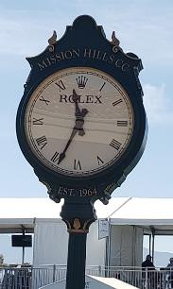
Review letters for outdated text
Did you change the name of your library (overall or departments)?
Did you have messages about quarantining of items?
Do you have messages about wearing masks?
Did you have instructions for how to return items when you were closed?
Do you have an old logo on your letters?
Does your Payment letter say ‘Cash Payment’ when you now allow credit cards?
Did a department move or change phone numbers or email addresses?
Notes:
Some other general themes that you can look for to improve your letters.
** We often have to change names of departments, or libraries, or services. You may have this information hard-coded in your messaging or labels somewhere.
** Did you have messages about quarantining of library returns in 2020 that are still in your letters?
** Or about wearing of masks, social distancing? You will want to get those out of there.
** Also not directly using COVID-time language, but you may have had special processes during the pandemic. Example here – ‘wait at the library’s front entrance to return your kit’ was from a time that students were graduating and needed to return laptops but they were not allowed to enter the library building and we didn’t want them to put the laptops in the book drops!
** I mentioned changing the name of your library, maybe you have old logos in your letters that refer to the old name, so you want to update those.
** Maybe you used to only accept cash or check for fee payments, and now you allow credit cards. I found the subject of our letter was ‘Cash Receipt’ since that was the only form of payment we used to accept. That also looked spammy. So I changed that subject to CSUN Library Payment Receipt.
** And if you have contact information in your letters, is it up-to-date? We merged some departments a few years ago, and so the contact number and email address was wrong for some areas.

Slide 39
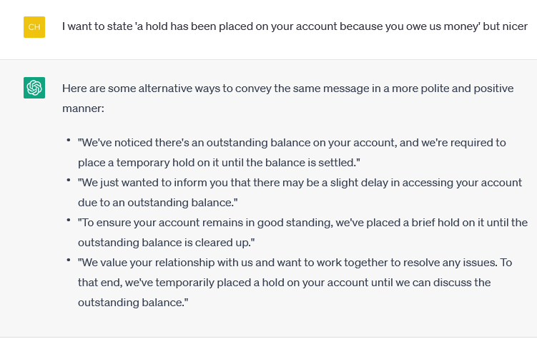
Review letters for strong text: use AI
Do you have text like ‘you will not be able to get your diploma if you don’t return this’?
Try generative AI like ChatGPT if you are stuck on wording
Notes:
Another thing you can do is review your letters for strong or potentially upsetting text.
** Do you have really strong text like ‘you will not be able to get your diploma if you don’t return this library item’? We used to at Northridge. And keeping in mind that students are stressed, and we want retention of students and we want to keep them on track to graduate, and getting an email like this can be quite upsetting.
** You can play with ChatGPT or some sort of Generative AI to improve your letter wording. I put this text in ChatGPT:
I want to state 'a hold has been placed on your account because you owe us money' but nicer
Here’s what it gave me. It isn’t quite library-context-specific but I like that last option and this helps me think about how I can improve my letter language.
I will note that any generative AI has its own biases, including the ones it learns from you in context. But it is still a nice way to improve letter language.
I also realize that anyone looking at this presentation or listening to the recording, in a year or even a month, this ChatGPT reference might be very antiquated…mainly this is a tip for you right now in August 2023.

Slide 40
Review letters for strong text: “fines”
Fines vs. fees
Notes:
More things to look at for strong text.
A few years ago, it was really important to our library and our university that we didn’t refer to any money owed to us as ‘fines’, that was a lot more negative of a word than ‘fees’. Well, the word ‘fines’ is used A LOT in letters and in our Primo displays. But you can replace ‘fines’ with ‘fees’, usually through changing labels in letters.

Slide 41
Review letters for library jargon
Look at letter subjects
Find these in Labels – subject & letter name
What is going to let the patron know that this is a letter from the library and not some spam?
Notes:
** Another thing you can do is step outside the library world for a bit and consider if the instructions in your letters make sense to non-library folks, especially the subject lines
** You can find these in your letter labels – subject & letter name fields.
** For example, the letter that sends a link to an electronically-requested item is called ‘Notification Item Letter’ by default
** Now if I got an email with that subject, I would think that is spam and delete it instead of opening it to find the interlibrary loan item I have been waiting for to do my research.
** We changed that subject to ‘Requested Item Delivered Electronically’. This is very specific of what is in this email, a link to the requested item

Slide 42
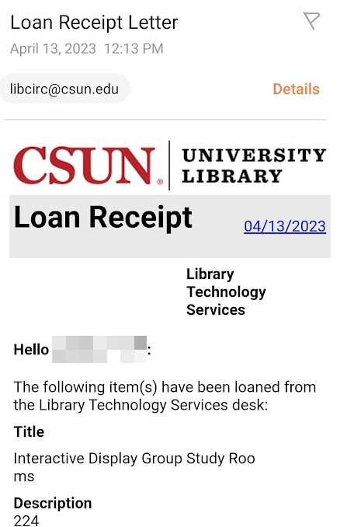
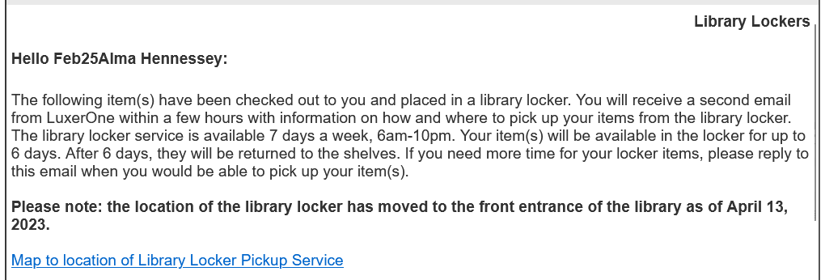
Review letters for accessibility and formatting
Do you have text like this?
For directions to the library, click here
Better: Directions to the library
Look at your letters on tablets and phones
Check colors and contrast
Notes:
Finally, look through the text in your letters for accessibility and formatting issues. I give a hat tip to Darnesa on this one, she and her department review all our ILL letters and she reminded me about this one.
** One of the big rules in accessibility text is to not have text like ‘click here’ since a screen reader might be reading that to your patron. It is better to make the whole link from the name of what it is. Ex Libris uses ‘click here’ a lot by default, I have noticed.
** So look through your text for ‘click here’ and things like that so it looks more like this example. Consider that a screenreader would be reading this text, ‘click here’ is not informative but ‘Map to location of Library Locker Pickup Service’ sure is. Also do the URL as a clickable link of text, not as something written out…again, a screenreader would try to read the whole URL out and that’s rough on someone reading via a screenreader.
** Take a look at your letters on a tablet or phone. Does it format and resize okay? Here’s an example of a letter I was copied on back in April. I see that the title of the item cut off in the middle of the title and it looked weird so I went back and fixed that later.
** And check the colors and contrast on your letters. You can go crazy with colors and then it makes it so the text can’t be read so you’ll want to watch out for that.

Slide 43
Borrowing Activity Letter ideas: marketing & informational messages
Notes:
I wanted to specifically address the particular Letter named: Borrowing Activity Letter. I showed you an example of that letter earlier – it is sent to all patrons that have items checked out, overdues, and/or owe us money.
Many libraries might have this one turned off by default but it is worth looking into
We use ours every month for library marketing & informational messages.
** You could include special instructions about renewals or returning items near the end of the semester;
** New names for departments;
** Planned library closures;
** And department closures
You can do this in any letter, particularly resource sharing ones as you often have holiday closures longer than the full library closures.

Slide 44
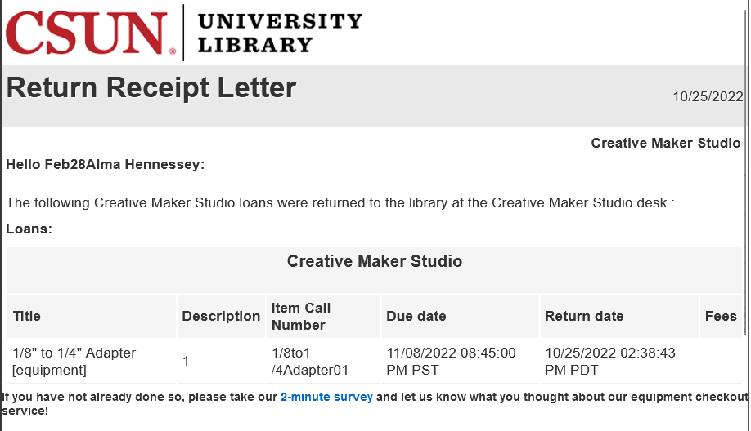
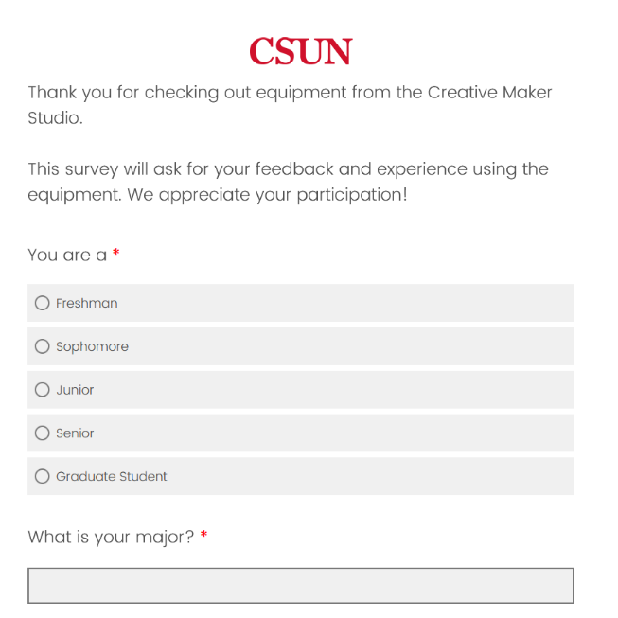
Survey links
Notes:
Another thing you can put in particular letters is a link to a survey, libraries love their surveys!
In this example, we get a particular amount of funds from the Campus Quality Fees, or CQFs, that all students vote on and pay as part of their tuition, but we need to justify it at the end of each fiscal year.
** Part of that is we want to survey students on their experience using these materials from our library.
** So we include a link to a survey in the letter they see when they return the item, the Return Receipt Letter. And only students returning an item from that particular library will see this survey.
We do see in our stats that students do click on these and fill them out.
You could do something similar for ILL checkouts or returns, linking to a survey about what works and what could be improved about the service.

Slide 45
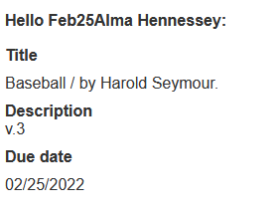
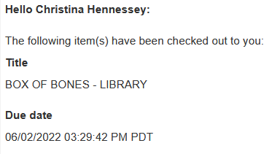
Conditionals in templates: Due date/time
New_due_date_str has time
Due_date just has date
Notes:
I’m not going to get into too much detail on conditionals in XSL code due to time constraints, but I wanted to give you some ideas of what to do there and some code samples so you can look at them later.
** First, you might have some checkouts that are due at the end of the day
** and some that aren’t due for a year. For the shorter checkout, the return time in the letter is really important. There is a different XML field you can use to show time or not show time so you can do that with conditionals.
** Here’s a code example from the Loan Receipt Letter where I want to show the due time for particular items and libraries and just the due date for others.

Slide 46
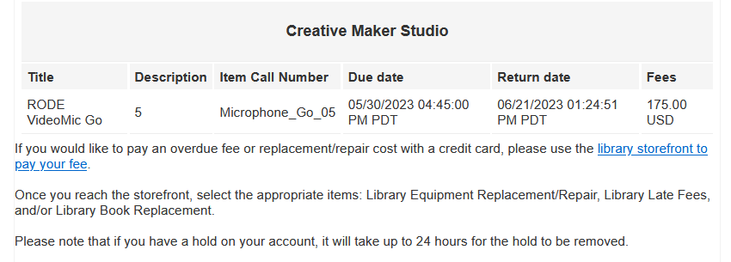
Conditionals in templates: Do you owe money?
Check total_fines_amount > 0
Notes:
You may have some text about how to pay for fees or replacement costs, but you don’t want to show that message if that patron doesn’t owe money because they might think they do! So you can do a conditional to not show the text if they don’t owe money.
** You check the total fines value
** Here’s the XSL code
** and the result looks like this in the letter.

Slide 47
Conditionals in templates: terminating a letter
xsl:message terminate = “yes”
Notes:
There might be some cases where you don’t want to send the letter at all. Something like the Ful Resource Request Slip Letter is used in different ways between our Rapido workflow and our other service desks, and in some cases, we just don’t want to print/send the letter at all. So you can add code to terminate the letter, which means – don’t send it in these conditions.
You can see in this example that I have code that if the destination of this request is one of our libraries where we lend technology, I don’t want to print this letter at all. This function terminates the letter and the patron, or in this case, staff, gets nothing.
** If you check letters with these conditions in the letter preview, you will see something like this error in the preview (which is not really an error, it’s just what you want!)

Slide 48
Conditionals in templates: notes for a special library
Locker messages or notes for a special library
Notes:
Finally, you may have special notes that you only want to show for a particular library. We have a special locker library for our LuxerOne locker checkouts, the code determines that something was checked out to the locker library, so those patrons get a lot of extra information inside their copy of the letter - about how to do their pickup and where the locker is located.

Slide 49
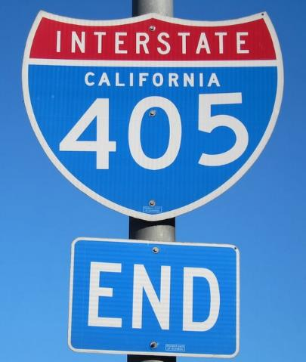
In summary
You don’t have to do it all at once
Every little change helps
Get some letter examples
Update labels
Update letter subjects
Look out for new letters
Save & back-up often
Notes:
In summary!
** You don’t have to do it all at once. There are some tips I shared in here that you can do in the airport later today or in your Uber or Lyft, maybe you already changed something during this session while I was talking! But you can parse this work out over months as well.
** Really, every little change helps
** Try to get some letter examples if you can. It makes changing letters later on so much easier
** Update labels – fix punctuation, make words nicer and clearer.
** Update letter subjects – make them make sense, brand with your library, get rid of library jargon
** Keep an eye out in release notes for new letters that you might need to be ready for
** And save & back-up your work often

Slide 50
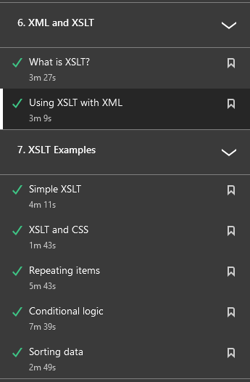
Recommended resources
Ex Libris’ Configuring Alma Letters
Ex Libris’ Letter List
Ex Libris’ video on New Letter Configuration (6 min., August 2023)
New August 9, 2023 webinar on new letter interface
Ex Libris collection of presentations & tips on letters
XSL/XSLT: Linked In Learning: XML Essential Training Chapters 6 & 7
Chris Lee’s Letters Codes and Tips (scannable barcodes!)
Notes:
I did not learn about letters alone and I did not cover everything about letters here so here are some other excellent resources!
** First, the Ex Libris documentation on Configuring Alma Letters has lots more information within. But this is a very long page, it would be 58 pages if you printed it out, so it is probably too much to read. But you will refer to it again and again.
** On that same page, this link goes directly to the Letter List of all the existing letters. That is always updated so you can see the latest description of a particular letter.
** Here’s a 6 minute video from Ex Libris on the new letter editing interface
** And I had to finish this presentation before this webinar happened, but I’ll add the link to the new August 9 webinar in my final slides for upload.
** Finally, Ex Libris has gathered all the documentation and presentations they have done on Letters on this one page. It might not be up-to-date with the new interface yet but will be soon!
** If you have access to LinkedIn Learning, there is a session named ‘XML Essential Training’, it has two chapters (6 and 7) on XSL & XSLT, it’s only about 30 minutes of videos, I found that as a great start to working with XSL to improve your letters.
** And Chris Lee of the Cal State Office the Chancellor has a great page on Alma Letters Code and Tips on the CSU wiki. An important thing you will find there is the particular XSL code to show scannable barcodes and internal and external request IDs on your print slips.

Slide 51
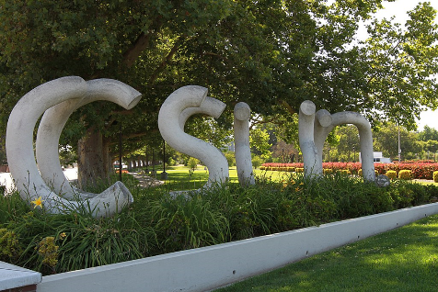
Questions? Christina L. Hennessey christina.hennessey@csun.edu
Notes:
Thank you for your time & attention and for your interest in Alma letters.
I encourage you to reach out if you have letter questions or ideas, I would love to hear from you.
We do have a few minutes for questions. What questions do you have today?

