Slide 1

CSU+
Expanding the available resources through Consortia-to-Consortia Resource Sharing

Slide 2

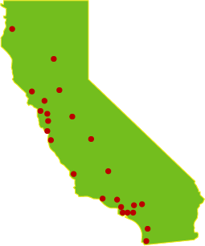
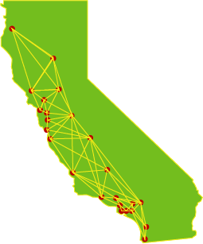
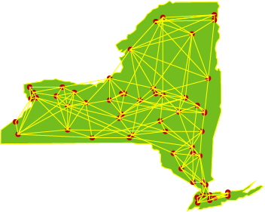
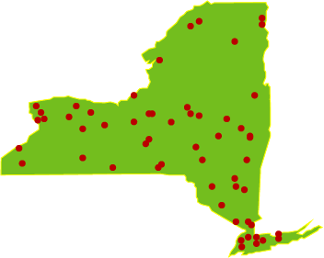
Put The “Plus” In CSU+
*States not to scale geographically
Notes:
Prior to 2017 the CSU libraries were friendly and loosely connected, but when CSU+ launched (click) we improved our services with unmediated workflows, shared policies, and by putting resource sharing front and center in our discovery system.
(click) Across the country other consortia have networked their systems together (click) in a similar way to improve resource sharing within their specific groups. We propose taking the next step and put the plus in CSU+ by adding a secondary Rota in Alma to share between consortia.

Slide 3
Who Wants To Share?
SUNY Library Consortium
63 libraries
  13 Colleges of Arts and Sciences
  6 Colleges of Technology/Agriculture and Technology
  30 Community Colleges
  10 Health Science Centers & Specialized and Statutory Colleges
  4 University Centers
  The 4 University Centers will share to start (University at Albany, the University at Buffalo, Binghamton University, and Stony Brook University). The combined sharable collection is approximately 5.9 million items.
  After launch proves the process works, 25 of the 4-year universities are likely to join.
Notes:
I heard the State University of New York, also known as SUNY, was interested in piloting consortia-to-consortia resource sharing and spoke with Timothy Jackson and Shannon Pritting who manage resource sharing for SUNY and while we would ideally want all 24 of the CSU libraries and all 63 SUNY libraries to share materials, we know we cannot just jump in with all the libraries who have wildly different sizes and priorities. So, we would like to start by piloting the service with 4 to 6 CSU libraries and 4 SUNY libraries to make sure the service works. Their 4 libraries would be their 4 main university centers from the University at Albany, the University at Buffalo, Binghamton University, and Stony Brook University. This would mean about 5.9 million items would be available for resource sharing to start on their end. Our 4 to 6 libraries would be at the discretion of our library deans and their staff. Basically, whoever would like to volunteer can.

Slide 4

What Is The Proposed Agreement?
No charges for loans borrowed from SUNY libraries for a 16-week loan
No charges for articles delivered by SUNY libraries
Loans requested via Alma as a secondary rota
Additional Consortia can be added to this Alma sharing network.
  Orbis Cascade, University of California, etc. can join to borrow from CSU+ and SUNY.
Notes:
So, we all know that saying we will share materials is easier said than done. We need basic shared policies and a way of actually sharing materials. Thankfully we already have nearly identical shared policies for checkout times, lost book fees, etc. Alma also doesn’t currently have a mechanism for charging libraries for Resource Sharing so that makes things simple, we can easily agree to not charge each other for resource sharing. SUNY also wants to make a formal agreement not to charge for resource sharing done through ILLiad as well, so no charging each other for articles and book chapter scans. We can then prioritize sending requests for articles to SUNY to bring down our current expenses.
Now how would the actual sharing go? We would like to configure each other’s libraries as resource sharing partners and create a secondary rota. This means two things I think you should be aware of.
First, we are not combining Network Zones. We aren’t sharing that level of data where we have a shared catalog or the ability to search each other’s patrons. This maintains our security and patron privacy.
Secondly, they would be a second rota for us and vice versa. So, when our patron places a request for a book Alma will automatically search within the CSU first and only bounce the request to SUNY if none of the CSUs can supply it. So, we wont be requesting materials from them that we can get from the CSU.
Another important point is that we can easily expand this service to other interested Alma libraries in the future.

Slide 5
How Does That Benefit Us?
Reducing charges with articles and loans
Additional unmediated lenders will shorten turnaround time, improving service to patrons
Additional unmediated lenders will reduce staff time on processing requests
Is a step towards all resource sharing going through Alma instead of ILLiad
Larger collection will encourage partners closer to the CSU to join (such as the UC system)
Notes:
So, to be clear, this benefits us by reducing charges for articles and loans through a reciprocal agreement not to charge one another.
This service is unmediated and works like CSU+ so there will be shortened turnaround times compared to ILLiad.
More unmediated lenders in Alma makes processing requests easier for staff.
This is a step towards doing all resource sharing in Alma instead of using multiple systems.
Adding SUNY may help us encourage closer libraries to join and connect to us and SUNY.

Slide 6
Room For Growth
Additional Consortia can join after launch:
West
  Orbis Cascade (38 Libraries)
  University of California (10 Libraries)
East
  The City University of New York Libraries (21 Libraries)
  Connecticut State Colleges & Universities Library Consortium (18 Libraries)
  Washington Research Library Consortium (9 Libraries)
Notes:
Speaking of closer libraries. We would like this to be a first step. We are starting with SUNY because they are currently interested, but depending on the success of the pilot we would like to approach Orbis Cascade in Oregon and Washington, and the UC system, to add rotas closer to home to decrease turnaround times and shipping costs. SUNY also is looking at partners closer to them such as The City University of New York Libraries and the Connecticut State Colleges & Universities Library Consortium. Ideally, we would eventually build a network that spans the country for unmediated resource sharing similar to how ILLiad operates.

Slide 7

Potential Costs
No additional subscription costs
No additional software costs
May increase shipping costs as we share more outside California
Notes:
We are all concerned with costs, especially these days. Well I have some good news on this front. This plan uses built in Alma functionality, so there is no new subscription or software costs. The only thing it costs to set up is the time for Timothy and me to configure the partners and periodic testing.
There is one area that may have some increased costs and that is shipping. Unity won’t deliver to New York so we will need to use the same shipping methods campuses already use to ship out of state. While there will probably be an initial increase of costs associated with shipping, we think it may be minimized for several reasons. First is that if an item isn’t available through CSU+ already it would go to ILLiad and come from a library not on Unity, so we might already be paying a similar shipping cost. Also, the reduction in charges caused by a reciprocal agreement may help offset the cost as well. This would be one area we would carefully track during the pilot process to help determine if we want to move forward and add additional libraries.

Slide 8
What About Rapido?
This partnership would be beneficial with Rapido:
  Rapido has benefits not available here:
    Ex Libris configures pods and adds new partners automatically
    More information given to patrons when ordering materials
    Built in article functionality
  Allows us to speed up the move to all Alma ILL by adding non-Rapido libraries
This partnership is still beneficial without Rapido:
  Without Rapido CSU libraries would still expand the number of materials available through CSU+
  Faster turn around times
  Reciprocal agreements for physical and digital resource sharing
Notes:
Now you may be wondering about Rapido. Rapido also lets us use resource sharing in Alma with outside libraries but has some differences besides cost. With Rapido, Ex Libris configures the partners so there is less configuration and upkeep. It gives more information upfront to the patron, which unfortunately isn’t an option in old fashioned Alma, and it has built in article functionality which is something we still haven’t quite worked out without Rapido.
So, if we choose to get Rapido why do this? Well the two systems aren’t mutually exclusive, and the slips and processing can be done simultaneously without adding a bunch of different workflows. What this option does is help speed up the process of moving completely to Alma resource sharing by adding libraries who use Alma but currently do not use Rapido.
Now if we decide not to use Rapido this is still beneficial to us because it essentially expands the amount of materials available through CSU+, should have faster turnaround times than ILLiad, and reciprocal agreements can help reduce our IFM bills for general resource sharing.

Slide 9

Notes:
So, in short we want to pilot with 4 to 6 CSU libraries, track the costs or cost savings, and see if we want to continue with consortia to consortia resource sharing. Do you have any questions?

