Slide 1
Alma Trials
Trials in the NZ

Slide 2
Trials: Introduction
This is for NZ trials but can be used for IZ
  There are a lot of pieces to setting up trials
    Once pieces are in place, the next trial becomes easier to set up
Simplify the SDLC trial process for libraries
  Send out the trial links and survey in one email from Alma
  If subscription purchased, all necessary pieces in the nz
    Resource can be ordered and activated from the nz right away after trial period

Slide 3
Trials: what is needed
Trial Configurations in the Nz:
  Vendor Record
  Negotiated License Record
  Create Set of Trial Participants
    Optional but suggested if there is a large group of participants
  Configure Trial Email Letter
  Configure Trial Management job
  Order Trial Resource

Slide 4
Trials: Vendor Record
Create Vendor record in the NZ for new vendor. If this is a trial for a resource from a current vendor, a new record is not needed.

Slide 5
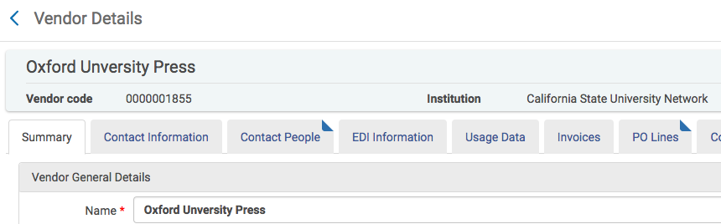
Trials: vendor record

Slide 6
Trials: Negotiated License
Create the NZ Negotiated License using the subscription information from the vendor. Add each library and the cost for the subscription for each library. Similar set up to creating NZ negotiated licenses for Opt-in resources.
This would not be needed if setting up Trials in the iz.

Slide 7
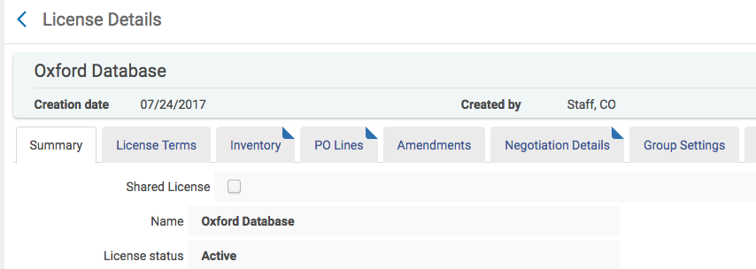
Trials: Negotiated License record

Slide 8
Trials: Participants
There is a How-to document on the Acquisitions and ERM wiki page. The instructions are for creating a User Set in Alma.
You can create a set of Participants or add them one at a time In the trial.
Great if it is the same group of people who will be testing Trials and there a large number of participants

Slide 9
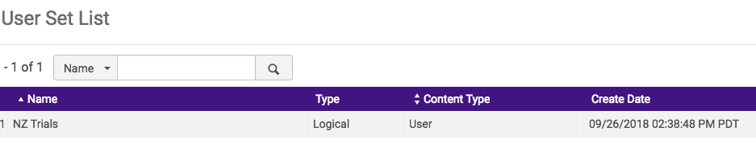
Trials: Participants from a set

Slide 10
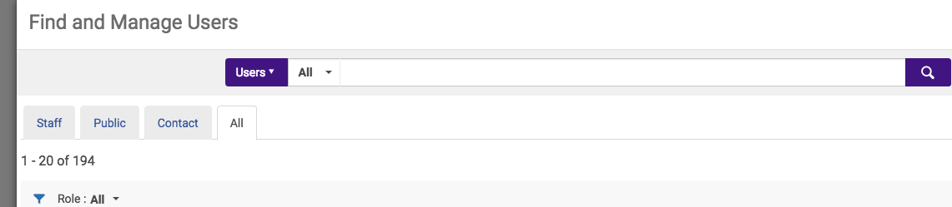
Trials: participants –add individual users

Slide 11
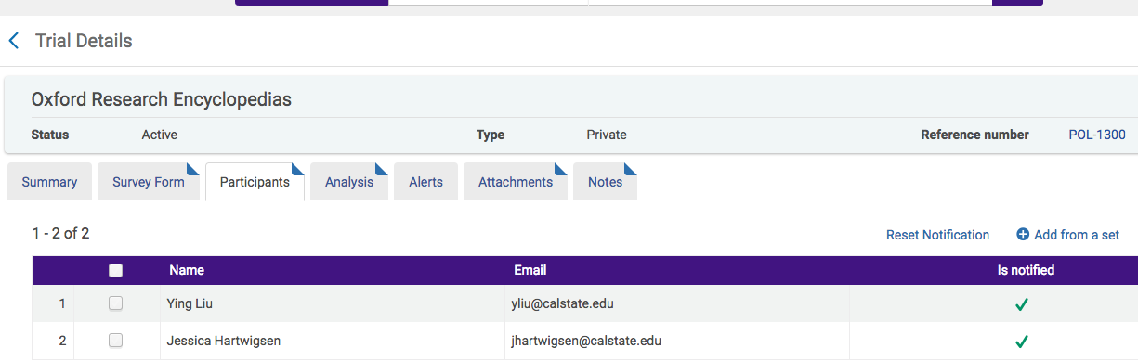
Trials: participants

Slide 12
Trials: letter
This is the letter that is sent out to the participants of the Trial. The email can include information about the Trial, a link to the portfolios, and a link to the collection.
  Links to the portfolios and collection come from the Trial but the email will have links if activated in the trial
Also included is a link to the survey form.
The Trial Letter can be found under: Configuration Menu > General > General Configuration > Letter Emails.

Slide 13
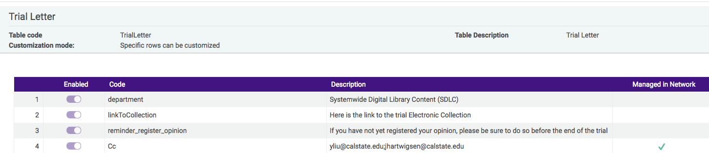
Trials: letter fields

Slide 14
Trials: letter / email message
The Letter that is set up in alma appears in an email to the participants.
Also, the form that is set up in Manage Trials, includes links to the survey, links to the portfolios and links to the collection. Links the portfolios and collection are optional.
The link to the survey included in the email will only work if the trial is active.

Slide 15
Trials: letter/email message
Thank you for agreeing to participate in the trial we are conducting for : Oxford Research Encyclopedias .
link to trial form : Oxford Research Encyclopedias
The trial is scheduled to run from 09/24/2018 - 11/01/2018 .
You are invited to participate in a trial the SDLC is conducting for : PolicyMap .
Please let us know how you like the trial by completing this survey! Thank you! : PolicyMap
Here is the link to the trial Electronic Collection : PolicyMap, The Reinvestment Fund (TRF)
This trial is scheduled to run from 10/05/2018 - 12/31/2018 .
We appreciate your participation on this trial and look forward to receiving your feedback after the trial! For questions regarding the trial or pricing, please contact Eddie Choy: echoy@calstate.edu, (562) 951-4592 or Terri Joiner: tjoiner@calstate.edu, (562) 951-4646.
Systemwide Digital Library Content (SDLC)

Slide 16
Trials: Management job
The job is labeled: Trials - Start and Notify Participants and must be set to Active. The job runs nightly and moves a Trial from Draft to Active.
Also, this triggers the Trial Letter to be sent to participants. The Trial is activate and participants can access the collection and portfolios.
Participants will be able to access and submit the Trial survey.
This job should be set to Active but if it is not, submit a case to SalesForce.

Slide 17
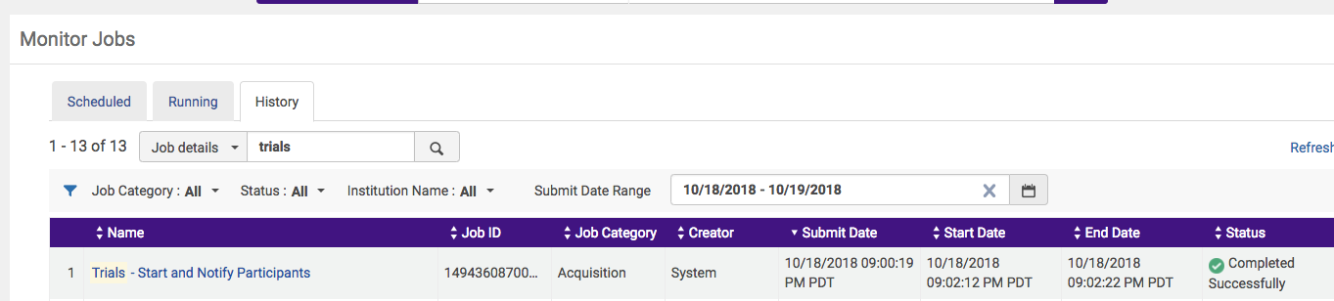
Trials: management job

Slide 18
Trials: ordering e-collection
Locate the e-collection in the CZ and ORDER the resource, do not activate the e-collection.
Once the purchase order record is open, locate the NZ license for the Trial and add it to the POL. (NZ only)
Add the Vendor Record, the cost of the resource, and the fund.
  Use the Opt-in fund since this is where the funds will come from if the library chooses to subscribe after the trial period.
  If setting up the trial in the Iz, use a local fund.
Choose Save and Start Trial
Then Go to Acquisitions> Purchase Order Lines > Manage Trials
Edit the trial –multiple tabs
  Summary, survey form, participants, analysis, alerts, attachments, notes
  Majority of the work is here, in the form

Slide 19
Trials: management
Locate the new e-collection in the list of Trials and click Edit
  Add start and end date of the Trial
  Enter name of main contact person
  Edit the Trial survey form under the Survey Form tab in the Trial.
    Once the form is set up and questions established, can be used for future trials

Slide 20
Trials: survey form
  Choose whether or not to make the trial survey form available to the public.
    Currently the NZ Trials survey will not be made available to the public unless library wants it available in Primo.
    The survey form will only be available to those users included in the Set of Participants.
    Add participants or create a set of participants to be notified of the Trial
      Currently NZ Set of participants is using names from EAR and CD lists maintained by SDLC.
      Can add more names to the list of participants.

Slide 21
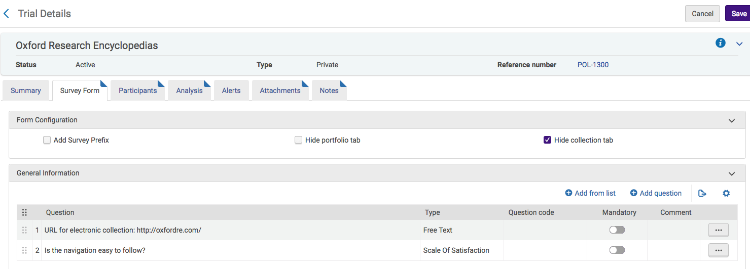
Trials: Survey form

Slide 22
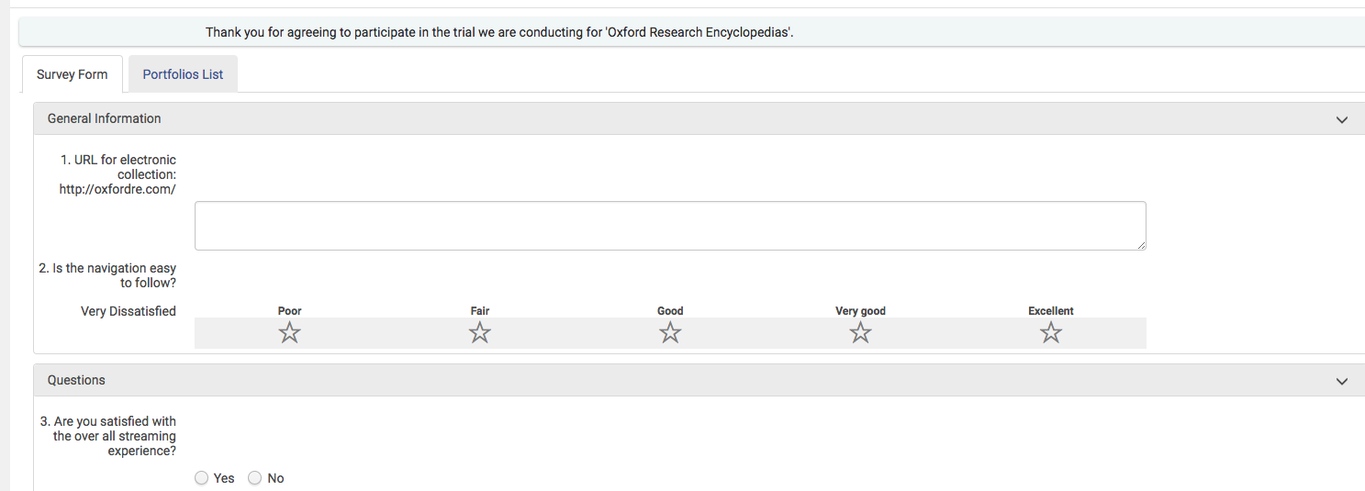
Trials: survey form

Slide 23
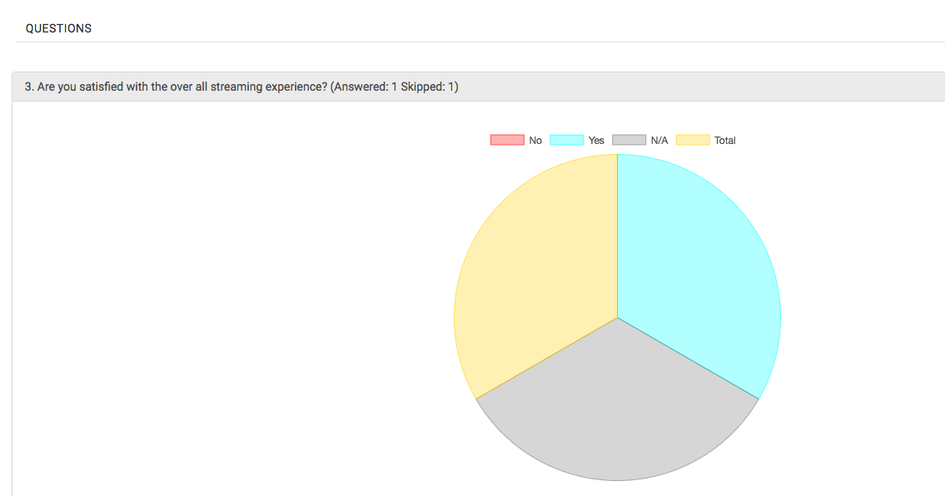
Trials: survey form results

Slide 24
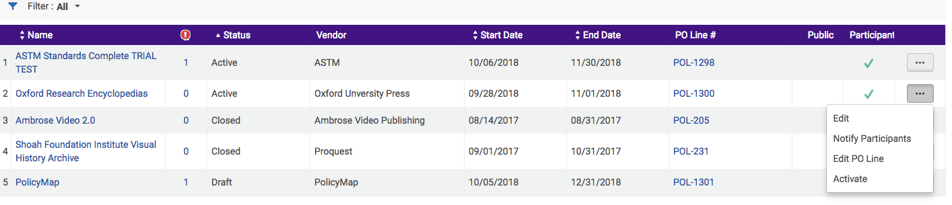
Trials: activate

Slide 25
Trials: activate
Once the trial has been activated, the management job will run overnight.
An email is sent out to participants
The trial is active
The survey form is live
The e-collection can be activated if you would like to see the trial database in primo
The trial ends and then if resource is purchased, the POL can be updated and the resource ordered.

Slide 26
Trials: findings & conclusions
The Survey Form link, in the email notification, will only work if the Trial is set to Active.
Trials only work with full text e-collections. *Can add a portfolio placeholder to make database-only e-collection work with Trials.
Update POL after trial is over.
The Trial Survey can be made available to the public.
The e-collections can be made available in Primo or remain inactive. The e-collection status does not affect the Trial status or access to the survey form.
The Notify button in Edit Trials does not send out notifications. Needs to be reset and this notify button in the trial will work:
  https://knowledge.exlibrisgroup.com/Alma/Product_Documentation/010Alma_Online_Help_(English)/020Acquisitions/060Evaluations_and_Trials/020Managing_Trials#Analyzing_Trial_Results
  (you will need to scroll up just a little bit)
  This section reads, "If a checkmark appears in the Is Notified column, the user has already received a notification. Another notification will not be sent to the user when notifications are sent out. To reset a user so that they will receive another notification, either select Reset Notification on the row action list, or select a group of users and select Reset All Notifications from the view action list."
The NZ Survey Form can be accessed by any participant, users do not need access to the NZ to use the form or access the resource.
Continue to work with SDLC to discuss how best to utilize NZ Trials.
GOOGLE DOC WITH WRITTEN INSTRUCTIONS.
There is a lot of initial set up with Trials but once you have one, all of the pieces are there for the next Trial.
  (Show oxford trial and email notifications)

Slide 27
Trials: questions
Are there any questions about nz trials?

