Slide 1
Licenses and License Terms
Updating NZ and IZ Licenses

Slide 2
License Terms: The issues
Some libraries have started adding and setting up their licenses but terms of use can be an onerous task.
There are a lot of fields that have to be entered in manually.
If your library has a lot of licenses, that can take up quite a bit of time to enter in each field for each license.
Getting terms of use from the vendor is not always the easiest task.

Slide 3
License Terms: Update using script
A script was written by Sarina and David to update license terms.
There is a script is available that can be downloaded and used locally.
Script available on GitHub
There is an Excel Spreadsheet with a list of License Terms to be filled in, available on the wiki.
This spreadsheet along with the script, can be used to update license terms.
*Your library does need existing licenses in the IZ to use the script and spreadsheet option.

Slide 4
License Terms: Updating the NZ
SDLC and I have been working on updating the NZ license terms.
The NZ terms can be viewed in Alma and Primo.
The process: We sent the vendors a spreadsheet filled in with license terms and asked them to confirm they are correct or to edit the terms.
EBSCO has returned terms of use that have been used to update all of the NZ EBSCO licenses.
JSTOR has also been updated.

Slide 5
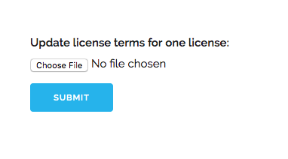
License Terms: Using the script
This is the script I use to
update the NZ Licenses in
the web browser.

Slide 6
License Terms: Spreadsheet
The License Code field
needs to match the code
used in the license.
*There cannot be any
spaces in the code name.

Slide 7
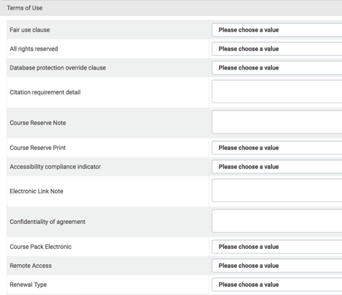
License Terms: Updating the license.
License terms that
needs updating.
Terms of use for license
That have not been
updated.

Slide 8
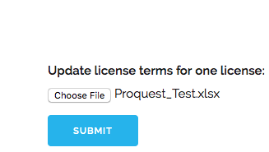
License Terms: Updating
Using a file named ProQuest_Test to update the
ProQuest Test license. I updated the license code in the file
to match the license code of the test license.
Choose the correct file and Submit.

Slide 9
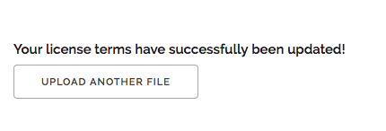
License Terms: The result
A message will come
back that either the
terms were updated
successfully or that it failed.

Slide 10
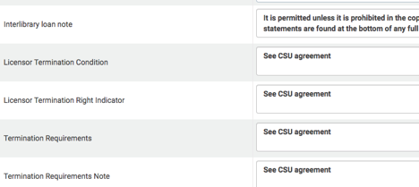
License Terms: License updated
License has been updated.

Slide 11
License Terms: In Primo
Example of the license terms
displayed in SJSU’s OneSearch
for an NZ License.

Slide 12
License Terms: Why is Useful?
In the NZ, there are 72 EBSCO licenses and if the terms had to be manually updated, this would take quite a bit of time. With the script and spreadsheet, the only changes I had to make were to the License Code in the spreadsheet. Then I used the script to update all of the licenses. It took me about 10 minutes to update them all.
As license terms are returned from the vendor, I’ll be updating the NZ licenses.
If your library’s IZ has multiple licenses for the same vendor with similar terms of use, it is faster to update the spreadsheet’s License code and update the license using the script.

Slide 13
Licenses
*To use the script, the license will need to exist in the IZ.
What to do if your library doesn’t have licenses yet?
In the IZ, create a template.
Use the template to create licenses for the same vendor.
Working on option to “push” a license template from NZ to IZ.
The license is editable and has license terms included.

Slide 15
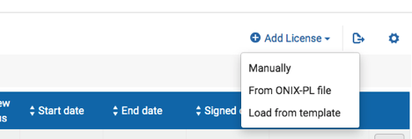
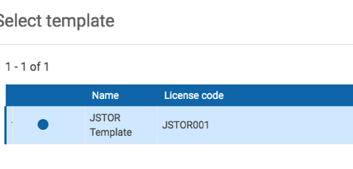
License: Create from template

Slide 16
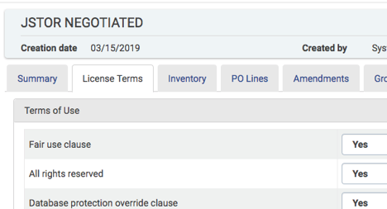
License: NZ to IZ
The green check mark means the license
originated in the NZ.

Slide 17
License and License Terms: Documentation
There is a document on the wiki with information about the script and spreadsheet used to update license terms. The spreadsheet can be downloaded from the wiki.
Also on the wiki page, there is information on how to display terms in Primo and how to link e-collections to licenses.
*IZ E-collections need to be linked to licenses to display terms Primo. NZ e-collections are already linked to licenses.
I’ll send out more information about sharing NZ templates with the IZ once I hear from Ex Libris.
There is more information about creating local license templates in the Alma documentation.

Slide 18
Licenses and License Terms
Questions?

